Slide 1


Let us inherit the true love of God and render glory until the time of our
ascension!
Report on the Present State of Affairs of the Unification Church Korean HQ
Unification Church Korean HQ

Slide 2
Outline
Ⅰ. Innovation
Ⅱ. Growth
(Registered members, worship, and donations)
III. Environmental Restoration of Church Buildings
`

Slide 3
I. Innovation

Slide 4

▣ The Background for Innovation
- Centered on professionals in each field, Chairman Kook Jin Moon checked the HQ’s management efficiency and personally toured 120 churches, 40 of which he visited without any advance notice in 2007
① Feeble Church Environment
② Lack of Professionalism in the Leadership of Pastors
③ Small Number of Members comparable to the Pioneering Days
④ Lack of System
:
∴ Difficult for the Church to grow with the current HQ and church system.
Planned and executed an innovative measure.
1. Introduction of a Sophisticated System
① KPI Performance Management Team
② Church Management System
③ Electronic Payments System
④ Budgeting System
⑤ Innovative System of Management based on the Six Sigma
2. A Reshuffle of the Financial Support Organization at HQ
①Formed the Church
Assistance Dept.
② Formed the Asset Management Dept.
③ Formed True Parents’ Proclamations Executive Committee
3. Reorganization of Regional HQ Churches System
① 20 Regional HQs
→ 12 Regional HQs
② Secure income to renovate the church environment thanks to the integration of churches

Slide 5
II. Growth
(Registered members. Worship ∙Donation)

Slide 6
Members
Analysis of Registered Members (Adults) from 2008 to June2012
2008
2009
2010
2011
2012
Total number of registered members who are over 20 years old
Number of Active Members who are over 20 years old (Maintenance of Minimum Standard)
2008 vs2012
Total Number of Adult Members that Registered
Increased by 52.8%
(Increase of15,857 registrations)
Total Number of Adult Members who Registered
2008 vs2012
Number of Active Members
Increased by 20%
(Increase of 5,203 members)
※ 2012.6.30
Registered members | Toddler |  | Sung-hwa children |  | Sung-hwa students |  | Youths 1 |  | Youths 2 |  |  |  | Older & Above |  |  |  |  |  | Sub-Total
 | 0~4 yrs |  | 5~13 yrs |  | 14~19 yrs |  | 20~23 yrs |  | 24~30 yrs |  | 31~40 yrs |  | 41~50 yrs |  | 51~60 yrs |  | Above 61 yrs
 | M | F | M | F | M | F | M | F | M | F | M | F | M | F | M | F | M | F
Active members | 412 | 404 | 4,238 | 4,163 | 2,907 | 2,858 | 609 | 713 | 810 | 936 | 1,853 | 2,571 | 4,908 | 5,382 | 3,829 | 3,215 | 3,175 | 3,711 | 46,694
 | 816 |  | 8,401 |  | 5,765 |  | 31,712
Non-active members | 211 | 175 | 1,325 | 1,209 | 567 | 455 | 313 | 267 | 426 | 393 | 647 | 733 | 1,043 | 685 | 601 | 340 | 685 | 880 | 10,955
New Members Procedure | 3 | 0 | 5 | 6 | 66 | 57 | 35 | 30 | 115 | 127 | 495 | 255 | 516 | 287 | 413 | 489 | 1,846 | 2,562 | 7,307
Sub-Total | 626 | 579 | 5,568 | 5,378 | 3,540 | 3,370 | 957 | 1,010 | 1,351 | 1,456 | 2,995 | 3,559 | 6,467 | 6,354 | 4,843 | 4,044 | 5,706 | 7,153 | 64,956
 | 1,205 |  | 10,946 |  | 6,910 |  | 1,967 |  | 43,928
 | 12,151 |  |  |  | 6,910 |  | 45,895
Total | 64,956 |  |  |  |  |  |  |  |  |  |  |  |  |  |  |  |  |  | 64,956

Slide 7
Worship
Attendants
Analysis of Adult Worship Attendants from 2008~2012(Jan~June)
2008
2009
2010
2011
2012
Adults Worship Attendants
+2.6%
+6.1%
18,368 Attendants
+30.2%
17,893 Attendants
16,946 Attendants
-0.5%
16,868 Attendants
2008 vs2012
Monthly Average Number of Attendants
Increased by 41.1%
(Increase by
5,352 attendants)
13,016 Attendants
Integration of churches and Church Systems - Introduction of KPI
System
Yearly Average Number of Worship Attendants
2008: 13,016 Attendants
2009: 16,946 Attendants
2010: 16,868 Attendants
2011: 17,839Attendants
2012: 18,368 Attendants (Jan~ June)
Toddlers |  | Sung-Hwa Children |  | Sung-Hwa Students |  | Youth 1 |  | Youths 2 |  |  |  | Prime Age
0~4 yrs |  | 5~13 Yrs |  | 14~19 yrs |  | 20~23 Yrs |  | 24~30 yrs |  | 31~40 yrs |  | 41~50세 |  | 51~60 yrs |  | Over 61 yrs
M | F | M | F | M | F | M | F | M | F | M | F | M | F | M | F | M | F
215 | 211 | 2,591 | 2,591 | 1,806 | 1,807 | 258 | 337 | 363 | 435 | 928 | 1,564 | 2,139 | 4,015 | 1,745 | 2,340 | 1,812 | 2,432
426 |  | 5,183 |  | 3,613 |  | 595 |  | 17,772
5,608 |  |  |  | 3,613 |  | 18,368
27,588
Jan~ June 2012
Average Number of Attendants by Age Group
※ Number of Attendants (20yrs) working with Sung-Hwa: 198 attendants

Slide 8

Donations
Analysis of Donations from 2008~ June 2012
2008
2009
2010
2011
2012
Donations
2.9 Billion
2.06 Billion
1.78 Billion
1.55 Billion
2008 vs2012
Monthly Average amount of Donations
Increased by 109%
(Increased by 1.09 billion)
1 Billion
2008
6.4 Billion
2009
2.7 Billion
2010
3$4$억
2011
+1 Billion?
2012
2008년 대비 2011년 총 헌금 증가액 $≒$125억(101.5%)
※ 헌금은 십일조, 주일헌금, 감사헌금 소계로 (명절헌금,천복궁 헌금, 특별헌금은 별도)
※ 기타, 건축, 명절 천복궁헌금추가시 헌금총액 $≒$ 272.4억

Slide 9
Analysis of the Korean HQ Cheon Bok Gung Church Donation (Accumulation)
Cheon Bok Gung donation
Members Donations (HQ Included)≒ 23.94 Billion
Foreign Members Donations (Businesses included) ≒ 37.87 Billion
2009
2010
2011
2012
Regional HQs Accounts | Results
Seoul, Gangbuk | ₩ 1,992,174,301
Seoul, Gangnam | ₩ 1,513,442,387
Incheon, Gyeonggi, Bukbu | ₩ 2,246,341,706
Gyeonggi, Nambu | ₩ 2,082,923,888
Gangwon | ₩ 792,878,660
Chungbuk | ₩ 642,814,525
Dajeon,Chungnam | ₩ 1,392,127,897
Jeonbuk | ₩ 1,537,551,072
Gwangju, Jeonnam | ₩ 1,632,705,950
Daegu, Gyeongnam | ₩ 1,354,421,688
Gyeongnam | ₩ 1,533,003,152
Busan, Ulsan | ₩ 982,434,572
Jeju City | ₩ 65,295,000
Total | ₩ 17,768,114,798
Total Amount of Donations Collected in CheonBokGung and HQ
17.76 Billion
<주> 1) Financial State by Each Regional HQ: Total Number of Donations Deposited within the HQs account + Amount Deposited within the Unification Foundation Account for that Church
2) Cheon Bok Gung(World HQs) Amount Collected ≒ 20 Billion (Donations of Members Registered within HQ Church- 6 Billion)

Slide 10
III. Environmental Restorations of Church Buildings

Slide 11
1. Overall Analysis of Environmental Restorations of Church Buildings (Jan 2009 ~ June 2012)
Category | Completed | In Progress | Others
New Construction, Extension or Purchase | 19 | 12
Remodeling, Renting, etc | 39 | 11
Subtotal | 58 | 23
Total | 81

Slide 12
2. Details on the Present State of Church Buildings Restorations
1) Church Buildings with Completed Restorations
No | Regional HQ | Church | Category | Period (Solar Calendar)
1 | Jeon Buk | Muju | Remodeling | 2009.05/2012.06
2 | Gangnam, Seoul | Yangcheon | Remodeling | 2009.06/2011.01
3 | Gwangju, Jeonnam | Gwangyang | New Church Construction | 2009.06
4 | Ulsan, Busan | East Ulsan | Remodeling | 2009.08
5 | Gangnam, Seoul | Gangseo | Remodeling | 2009.09
6 | Gyeonggi, Nambu | Icheon | Remodeling | 2009.09
7 | Gangman, Seoul | Gangdong | Remodeling | 2009.09/ 2011.11
8 | Gangbuk, Seoul | Nowon | New Church Construction | 2009.10
9 | Chungbuk | Bo-un | Remodeling | 2009.10
10 | Gangnam, Seoul | Gangnam | New Church Construction | 2009.12
11 | Gangnam, Seoul | Guro | Renting an Educational Center | 2009.12
12 | Incheon, Gyeongi, Bukbu | Paju | Remodeling | 2009.12
13 | Gyeongi, Nambu | Osan | Remodeling | 2009.12
14 | Gangbuk, Seoul | SeongBuk | Remodeling | 2009.12
15 | Gangweon | HeongCheon | Remodeling | 2009.12

Slide 13
2. Details on the Present State of Church Buildings Restorations
1) Church Buildings with Completed Restorations
No | Regional HQ | Church | Category | Period (Solar Calendar)
16 | Gangbuk, Seoul | Gwangjin | Renting of Education Center / Remodeling | 2009.12/ 2011.04
17 | Gyeongnam | Hapcheon | New Construction/ Extension of Educational Center | 2010.01/ 2011.11
18 | Gangnam, Seoul | Songpa | Renting of Educational Center / Remodeling | 2010.01/ 2011.10
19 | Daejon, Chungnam | Nonsan | Remodeling | 2010.01/ 2010.6
20 | Gangnam, Seoul | Gwanak | Remodeling | 2010.03
21 | Incheon, Gyeongil, Bukbu | Guri | Renting of Educational Center | 2010.03
22 | Daejon, Chungnam | Daedeok | Remodeling | 2010.04
23 | Gangnam, Seoul | Gumcheon | Renting of Educational Center / Remodeling | 2010.05
24 | Gyeonggi, Nambu | Gwacheon | Remodeling | 2010.06
25 | Gangbuk, Seoul | Gangbuk | Purchase of Building | 2010.08
26 | Chungbuk | Cheongju | Remodeling | 2010.09
27 | Gyeonggi, Nambu | Bucheon | Remodeling | 2010.10
28 | Daejon, Chungnam | Seosan | Remodeling | 2010.12/ 2011.05
29 | Gyeonggi, Nambu | Pyeongtaek | Purchase of Land / Renting of Educational Center | 2011.01/ 2011.05
30 | Gwangju, Jeonnam | Gwangju | Remodeling | 2011.02

Slide 14
2. Details on the Present State of Church Buildings Restorations
1) Church Buildings with Completed Restorations
No | Regional HQ | Church | Category | Period (Solar Calendar)
31 | Gwangju, Jeonnam | Nampyeong | Remodeling | 2011.02
32 | Gangwon | Samcheok | Remodeling | 2011.03
33 | Daejon, Chungnam | Yeongi | Remodeling | 2011.03
34 | Gyeongnam | Yangsan | Remodeling | 2011.03
35 | Gyeonggi, Nambu | Yamok | New Construction | 2011.03
36 | Daegu, Gyeongbuk | Kimcheon | Remodeling | 2011.04
37 | Daegu, Gyeongbuk | Yeongju | Remodeling | 2011.06
38 | Gangbuk, Seoul | Dongdaemun | Remodeling | 2011.07
39 | Gwangju, Jeon-nam | Yeong-gwang | Renovation | 2011.08
40 | Gangnam, Seoul | Yeongdungpo | Remodeling | 2011.08
41 | Daejon, Chungnam | Seocheon | Remodeling | 2011.09
42 | Jeonbuk | Jeonju | Extension of Building | 2011.10
43 | Daejon, Chungnam | Te-an | Remodeling | 2011.11
44 | Gyeongnam | Hamyang | Extension of Building | 2011.11
45 | Gangbuk, Seoul | Unpyeong | Extension of Building | 2011.12

Slide 15
2. Details on the Present State of Church Buildings Restorations
1) Church Buildings with Completed Restorations
No | Regional HQ | Church | Category | Period (Solar Calendar)
46 | Gangbuk, Seoul | Jungrang | Purchase of Educational Center | 2011.12
47 | Incheon, Gyeonggi, Bukbu | Dongducheon | Extension of Educational Center | 2011.12
48 | Jeongbuk | Namwon | Purchase of Educational Center | 2011.12
49 | Daegu, Gyeongbuk | Yeongcheon | Remodeling | 2011.12
50 | Gangbuk, Seoul | Dobong | Purchase of Building | 2012.01
51 | Gangwondo | Yang-gu | New Construction | 2012.02
52 | Gyeongnam | Kimhe | Remodeling | 2012.03
53 | Jeonbuk | Kimje | Purchase of Building | 2012.04
54 | Daejeon, Chungnam | Hongseong | Renting an Educational Center | 2012.05
55 | Incheon, Gyeonggi, Bukbu | Cheongshim | New Building | 2012.05
56 | Daegu, Gyeongbuk | Andong | Extension of Building | 2012.06
57 | Chunbuk | Jecheon | Purchase of Building | 2012.06
58 | Chungnam | Gumsan | Remodeling | 2012.06
Total 58 regions |  | No of New Constructions. Extension of Buildings· Purchases of Building 19/ No of Remodeling· Renting39

Slide 16
2. Details on the Present State of Church Buildings Restorations
2) Church Buildings with Ongoing Restoration
No | Regional HQ | Church | Category | Period
1 | Jeongbuk | Gunsan | Extension of Building | Under Construction
2 | Incheon, Gyeonggi, Bukbu | Ganghwa | New Construction | Under Construction
3 | Gyeonggi, Nambu | Pyeongtek | New Construction | Under Construction
4 | Gyeongnam | Changwon | New Construction | Under Construction
5 | Chungnam | Gongju | Remodeling | Under Construction
6 | Chungnam | Buyeo | Remodeling | Under Preparation
7 | Gyeonggi, Nambu | Anseong | Purchase of Building | Under Preparation
8 | Gangwon | Yeongwol | Remodeling | Under Preparation
9 | Gyeongbuk | Bonghw | Remodeling | Under Preparation
10 | Chungnam | Cheonan | New Construction | Under Preparation
11 | Chungnam | Yesan | New Construction | Under Preparation
12 | Daegu, Gyeongbuk | Daegu | Remodeling | Under Preparation
13 | Gangwon | Wonju | New Construction | Under Preparation
14 | Jeonnam | Jeong-up | Extension of Building | Under Preparation
15 | Ulsan, Busan | West Busan | Remodeling | Under Preparation

Slide 17
2. Details on the Present State of Church Buildings Restorations
2) Church Buildings with Ongoing Restoration
No | Regional HQ | Church | Category | Period
15 | Busan, Ulsan | West Busan | Remodeling | Under Preparation
16 | Busan, Ulsan | North Busan | Purchase of Building | Under Preparation
17 | Jeon-nam | Geomundo | Remodeling | Under Preparation
18 | Daegu, Gyeongbuk | Ullungdo | Remodeling | Under Preparation
19 | Jeju | Jeju | Remodeling | Under Preparation
20 | Jeon-nam | Yeonggwang | Remodeling | Under Construction
21 | Gyeonggi, Nambu | Gunpo | Purchase of Building | Under Preparation
22 | Gangwon | Jeongseon | Remodeling | Under Preparation
23 | Gangnam, Seoul | Guro | Purchase of Building | Under Preparation
Total 22 regions |  | Total No of New Construction. Extension of Building· Purchase of Building - 12 /No of Remodeling cases - 11

Slide 18
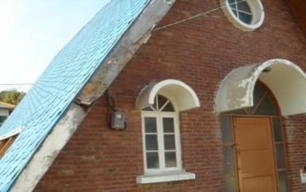
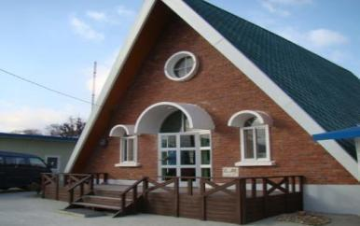
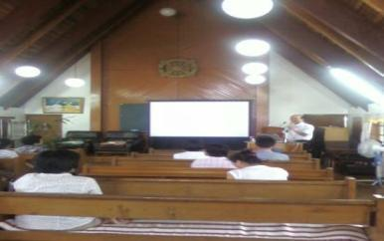
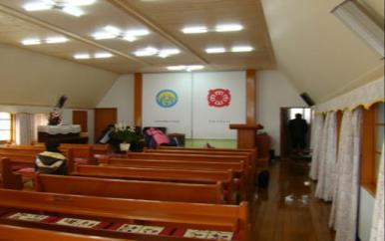
Muju Church, Jeonbuk : May 2009 Remodeling - 1
Before Renovations
After Renovations

Slide 19
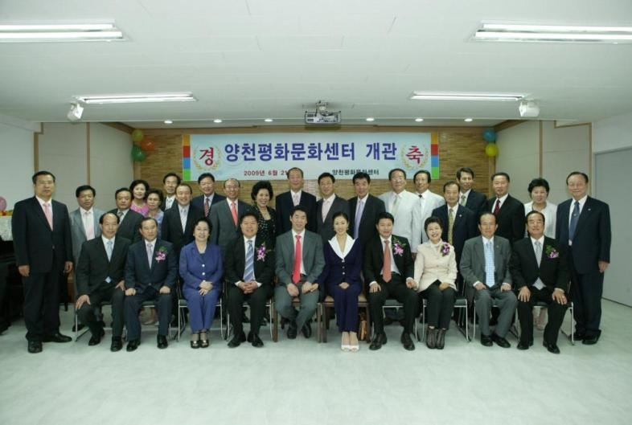
Yangcheon Church, Seoul : Remodeling from June 2009 to Jan 2011

Slide 20
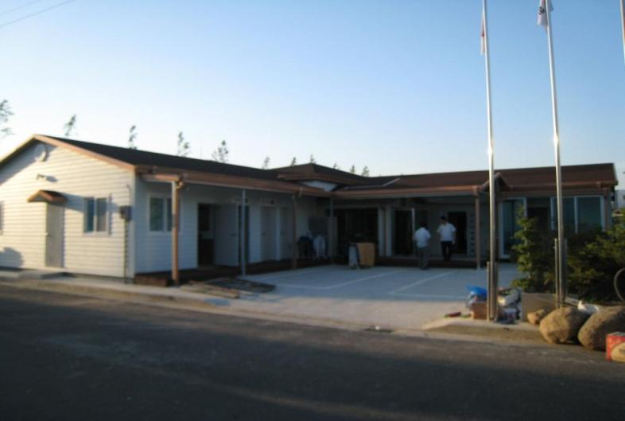
Gwangyang Church, Jeonnam :
Construction of New Church (June 2009)

Slide 21
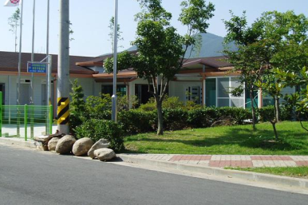
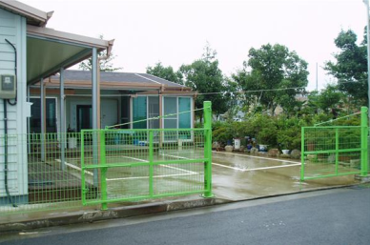
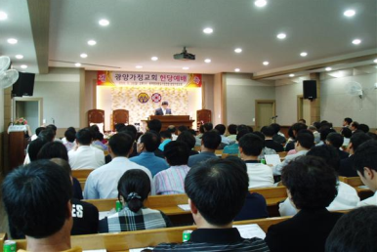
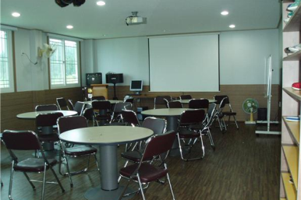
Gwangyang Church, Jeonnam : New Church (June 2009)

Slide 22
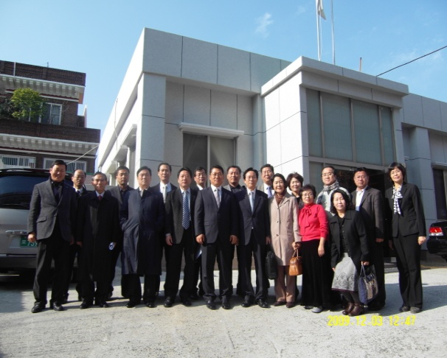
East Ulsan Church : Remodeling (Aug 2009)

Slide 23
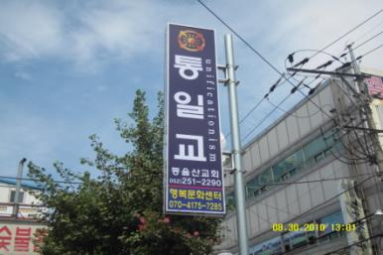
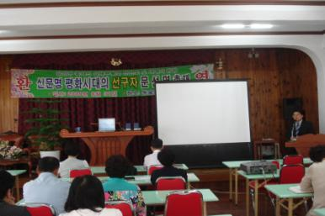
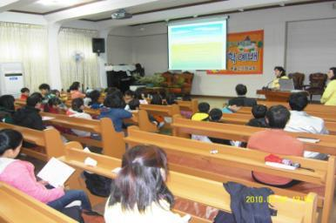
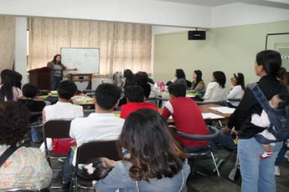
East Ulsan Church: Newly Renovated Church (Aug 2009)

Slide 24
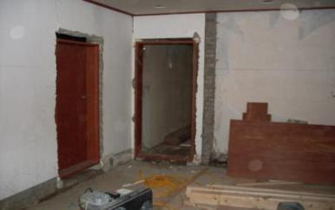
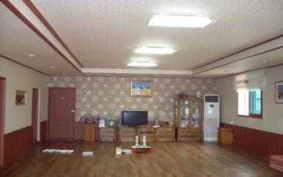
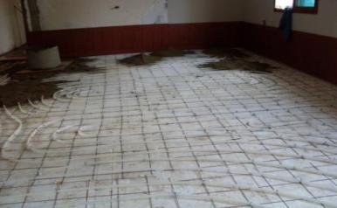
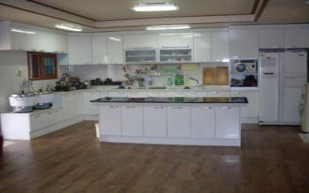
Icheon Church, Gyeongi : Remodeling (Sep. 2009)
Before
After

Slide 25
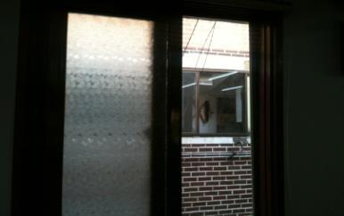
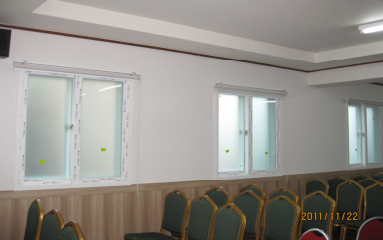
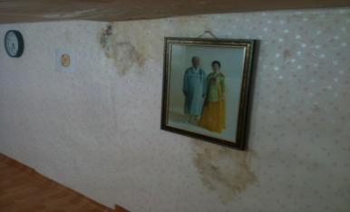
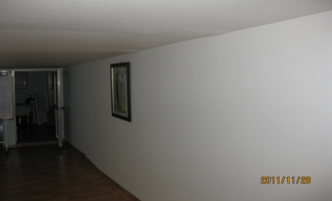
Gangdong Church, Seoul : Remodeling (June 2009/ Dec 2011)
Before
After

Slide 26
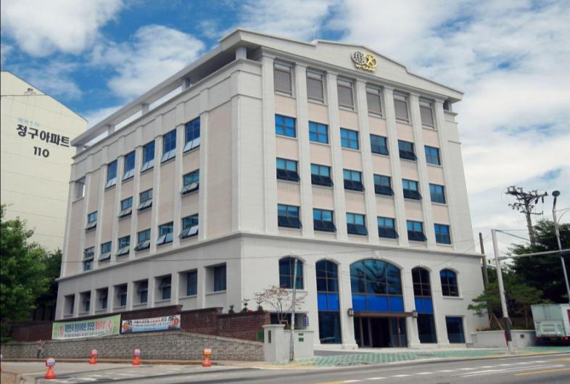
Nowon Church, Seoul : Construction of New Church (Oct. 2009)

Slide 27
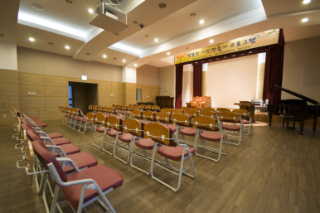
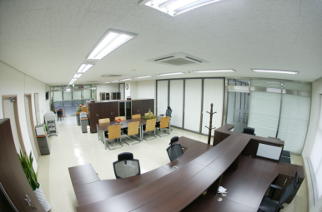
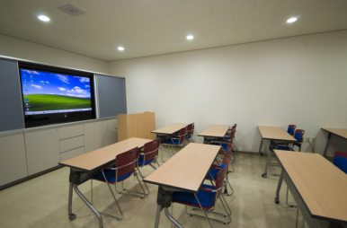
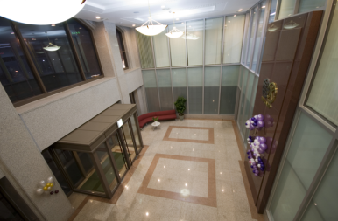
Nowon Church, Seoul : Newly Constructed Church (Oct. 2009)

Slide 28
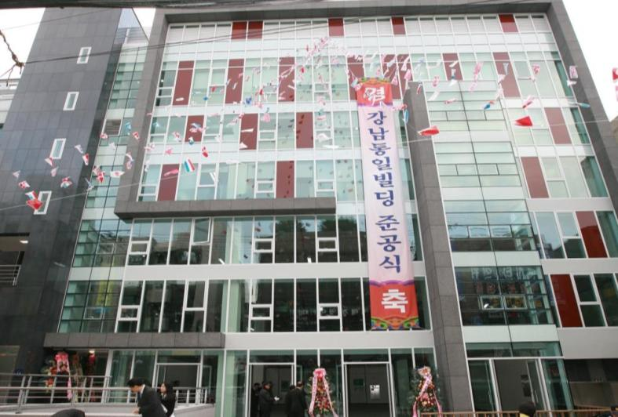
Gangnam Church, Seoul : Construction of New Church (Dec. 2009)

Slide 29
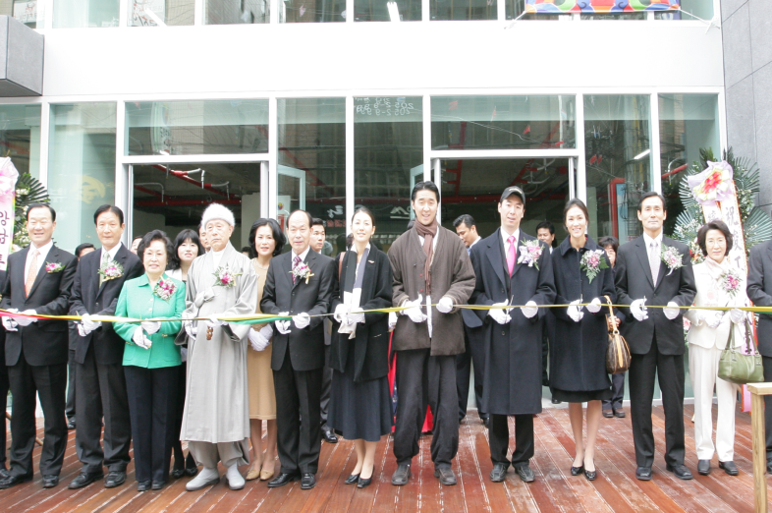
Gangnam Church, Seoul : Newly Constructed Church (Dec. 2009)

Slide 30
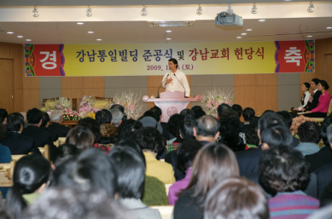
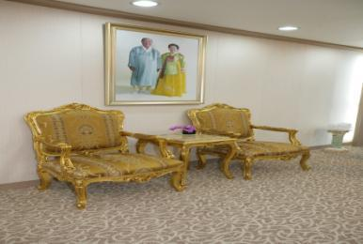
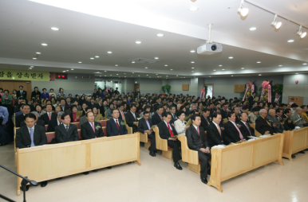
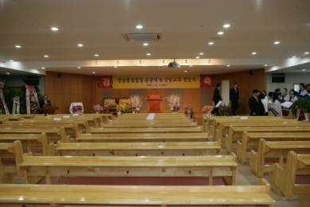
Gangnam Church, Seoul : New Church Building (Dec. 2009)

Slide 31
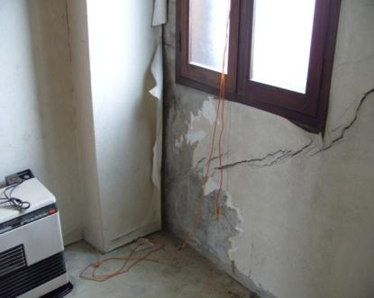
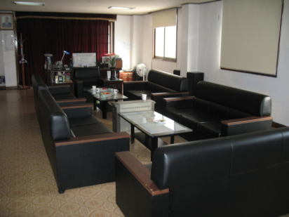
Paju Church, Gyeonggi : Church Remodeling (Dec. 2009)
Before
After

Slide 32
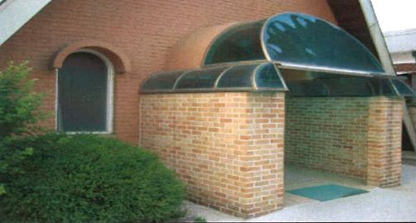
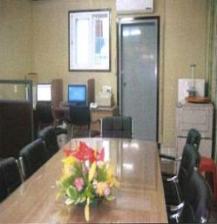
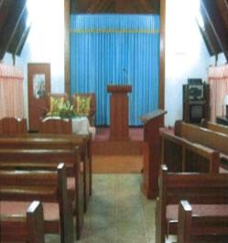
Osan Church, Gyeonggi: Church Remodeling (Dec. 2009)

Slide 33
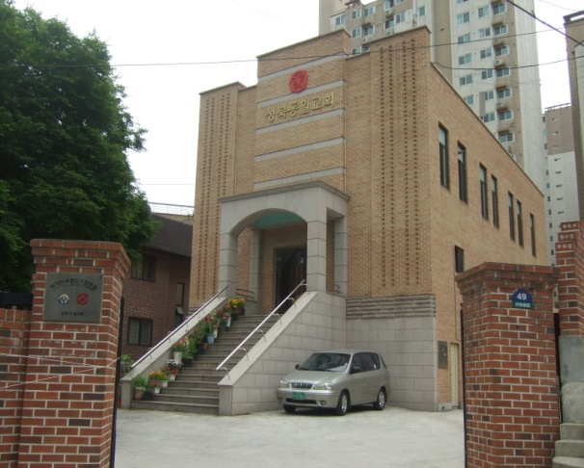
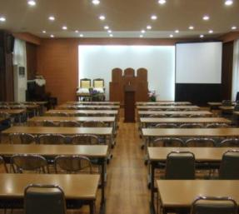
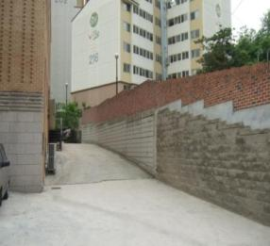
Seongbuk Church, Seoul : Church Remodeling (Dec. 2009)

Slide 34
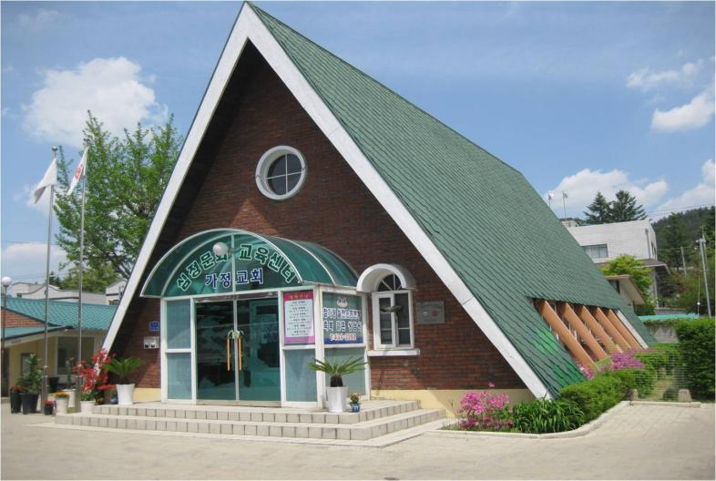
Hongcheon Church, Gangwon : Church Remodeling (Dec. 2009)

Slide 35
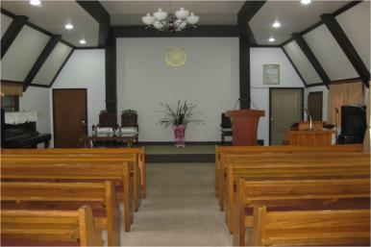
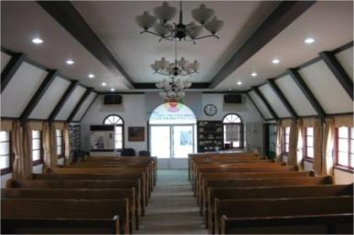
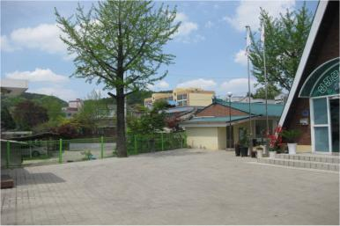
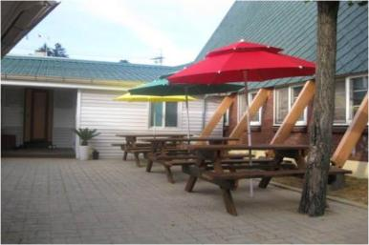
Hongcheon Church, Gangwon : Church Remodeling (Dec. 2009)

Slide 36
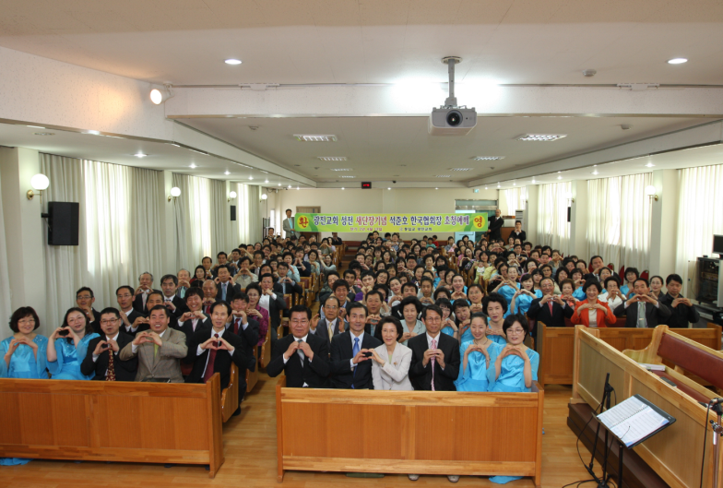
Gwangjin Church, Seoul : Remodeling (Dec 2009/April 2011 )

Slide 37
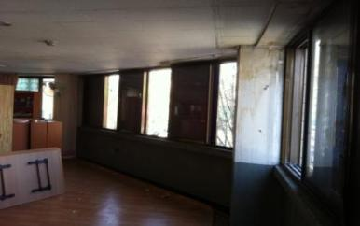
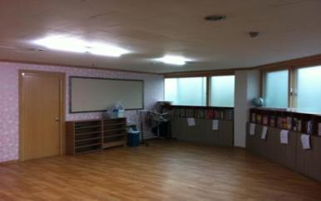


Gwangjin Church, Seoul : Remodeling (Dec 2009/April 2011)
Before
After

Slide 38

Hapcheon Church, Gyeongnam : Construction of New Church (Jan. 2010~Nov. 2011)

Slide 39




Hapcheon Church, Gyeongnam : Construction of New Church (Jan. 2010~Nov. 2011)

Slide 40

Songpa Church, Seoul : Remodeling (Jan. 2010~ Nov. 2011)

Slide 41


Songpa Church, Seoul : Remodeling (Jan. 2010~ Nov. 2011)

Slide 42




Nonsan Church, Chungnam: Remodeling (Jan. 2010)
Before
After

Slide 43

Gwanak Church, Seoul : Remodeling (March 2010)

Slide 44


Gwanak Church, Seoul : Remodeling (March 2010)

Slide 45



Guri Church, Gyeonggi :Remodeling of Educational Center (March 2010)

Slide 46




Daedeok Church, Chungnam: Church Remodeling (April 2010)
Before
After

Slide 47


Gwacheon Church, Gyeonggi : Remodeling (June 2010)
Before
After

Slide 48

Gangbuk Church, Seoul :
Purchased Church Building (Aug 2010)

Slide 49

Gangbuk Church, Seoul :
Purchased Church Building (Aug 2010)

Slide 50

Cheongju Church, Chungbuk : Church Remodeling (Sep 2010)
개 선 후

Slide 51




Bucheon Church, Gyeonggi : Church Remodeling (Oct.2010)
Before
After

Slide 52

Seosan Church, Chungnam : Remodeling (Dec 2010/ July 2011)

Slide 53


Samcheok Church, Gangwon: Church Remodeling (May 2011)
Before
After

Slide 54




Yangsan Church, Gyeongnam : Church Remodeling (March 2011)
Before
After

Slide 55

Yamok Church, Gyeonggi :
Construction of New Church Building (March 2011)

Slide 56




Yamok Church, Gyeonggi :
Construction of New Church Building (March 2011)

Slide 57




Kimcheon Church, Gyeongbuk : Church Remodeling (April 2011)
Before
After

Slide 58




Yeongju Church, Gyeongbuk : Church Remodeling (June 2011)
Before
After

Slide 59


Dongdaemun Church, Seoul : Church Remodeling (July 2011)
Before
After

Slide 60




Yeonggwang Church, Jeon-nam : Remodeling (Aug 2011)
Before
After

Slide 61

Yeongdungpo Church, Seoul : Remodeling (Aug 2011)

Slide 62




Yeongdungpo Church, Seoul : Remodeling (Aug 2011)

Slide 63

Sacheon Church, Chungnam : Remodeling of Church (Sep 2011)

Slide 64




Sacheon Church, Chungnam : Remodeling of Church (Sep 2011)

Slide 65

Jeonju Church, Jeonbuk : Extension of Church (Oct 2011)

Slide 66

Jeonju Church, Jeonbuk : Extension of Church (Oct 2011)

Slide 67




Jeonju Church, Jeonbuk : Extension of Church (Oct 2011)

Slide 68

Hamyang Church, Gyeongnam : Extension of Church (Nov 2011)

Slide 69




Hamyang Church, Gyeongnam : Extension of Church (Nov 2011)
Before
After

Slide 70

Unpyeong Church, Seoul : Extension of Church (Dec 2011)

Slide 71




Unpyeong Church, Seoul : Extension of Church (Dec 2011)

Slide 72

Jungrang Church, Seoul :
Purchase of Educational Center (Dec. 2011)

Slide 73




Jungrang Church, Seoul :
Purchase of Educational Center (Dec. 2011)

Slide 74

Dongducheon Church, Gyeonggi :
Extension of Educational Center (Dec. 2011)

Slide 75




Dongducheon Church, Gyeonggi :
Extension of Educational Center (Dec. 2011)

Slide 76

Yeongcheon Church, Gyeongbuk :
Remodeling of Church (Dec 2011)

Slide 77




Yeongcheon Church, Gyeongbuk :
Remodeling of Church (Dec 2011)
Before
After

Slide 78

Yanggu Church, Gangwon :
Construction of New Church Building (Feb 2012)

Slide 79




Yanggu Church, Gangwon :
Construction of New Church Building (Feb 2012)

Slide 80

Gimhe Church, Gyeongnam :
Remodeling of Church (March 2012)

Slide 81




Gimhe Church, Gyeongnam :
Remodeling of Church (March 2012)

Slide 82




Gimje Church, Jeonbuk :
Purchase of Educational Center (April 2012)

Slide 83

Cheongshim Church, Incheon Gyeonggi Bukbu :
Construction of New Church Building (May 2012)

Slide 84




Cheongshim Church, Incheon Gyeonggi Bukbu :
Construction of New Church Building (May 2012)

Slide 85




Muju Church, Jeonbuk :
Extension of Educational Center (June 2012)

Slide 86




Andong Church, Daegu Gyeongbuk :
Extension of Educational Center (June 2012)

Slide 87




Jecheon Church, Chungbuk :
Purchase of Church Entry Area (June 2012)
개 선 전
개 선 후

Slide 88
Overall Analysis
Registered Members (Adults)
+52.8% Increase of members by 15,857
in contrast with Dec. 2008
Worship Attendants
(Adults)
+41.1% Increase of members by 5,352
in contrast with the average number in 2008
Donations
+109% Increase of average monthly donations by
one billion 90 million won in contrast with 2008
Church Environmental Reforms
From 2009 ~ today
Completed Renovations with 58 Churches/
On going Renovations with 23 Churches
*Registered m. & Worship is about over 20 years old members

