Slide 1

Hoon Dok Culture
in Asia 2011

Slide 2
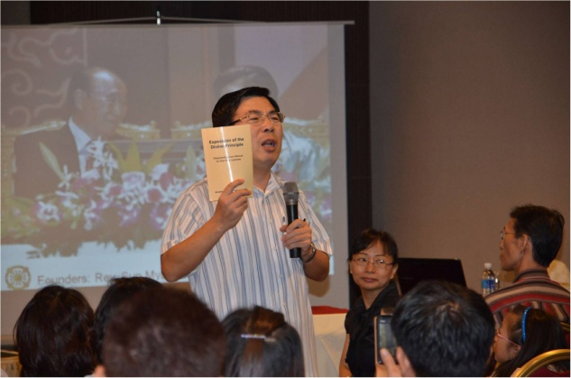

Regional Chairman Asia,
Dr. Chung Sik Yong who initiated the Hoon Dok revolution in Asia in 2011
MALAYSIA

Slide 3
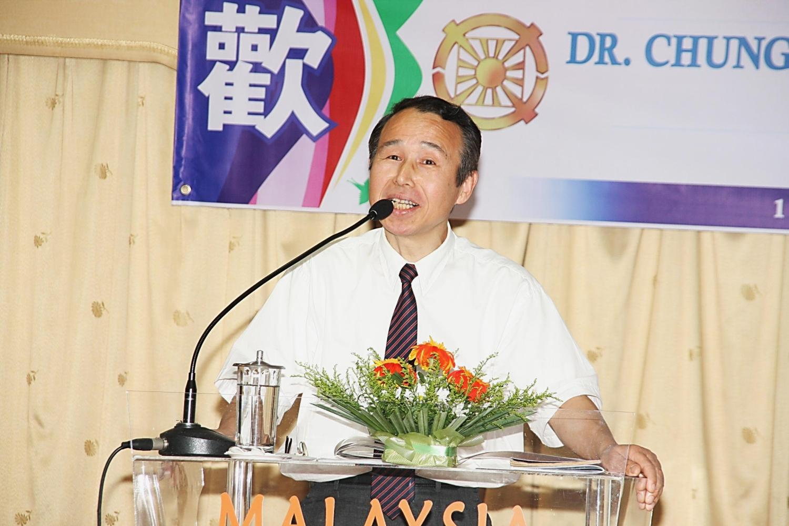
Rev. Masaaki Chaen, the Hoon Dok Champion brought
the Hoon Dok Virus to Asia beginning from Taiwan, Nepal, Thailand, Malaysia

Slide 4
HOON DOK CULTURE IN TAIWAN
The strategy to promote Hoon Dok culture is as follows:
a) Promote EDP Reading among the Blessed Central
Families
b) Giving monetary awards for 2nd generations who
accomplish the 100-time EDP reading conditions (NT 1000 or 35 USD)
c) Include 1-hour EDP session in 2nd generation
workshops
d) Include Hoon Dok content in the Sunday school
programs
e) Encourage members to write good testimonies
pertaining to the grace of EDP reading and spread
them nationwide.

Slide 5
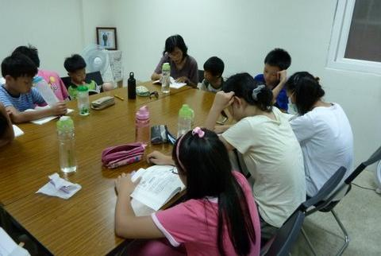
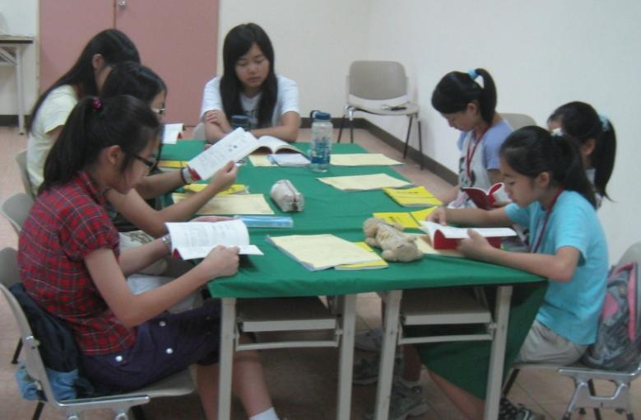
Strategies to Promote Hoon Dok in Taiwan
2nd Gen. reading 1-hour EDP during Sunday School & Workshops

Slide 6
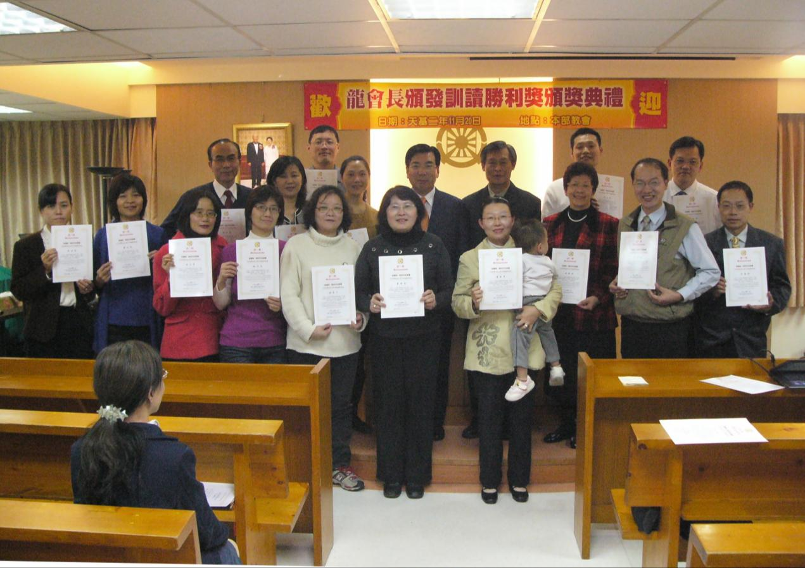
Certification of Recognition by Regional President
Certificate of Recognition for those who completed 100- time reading

Slide 7
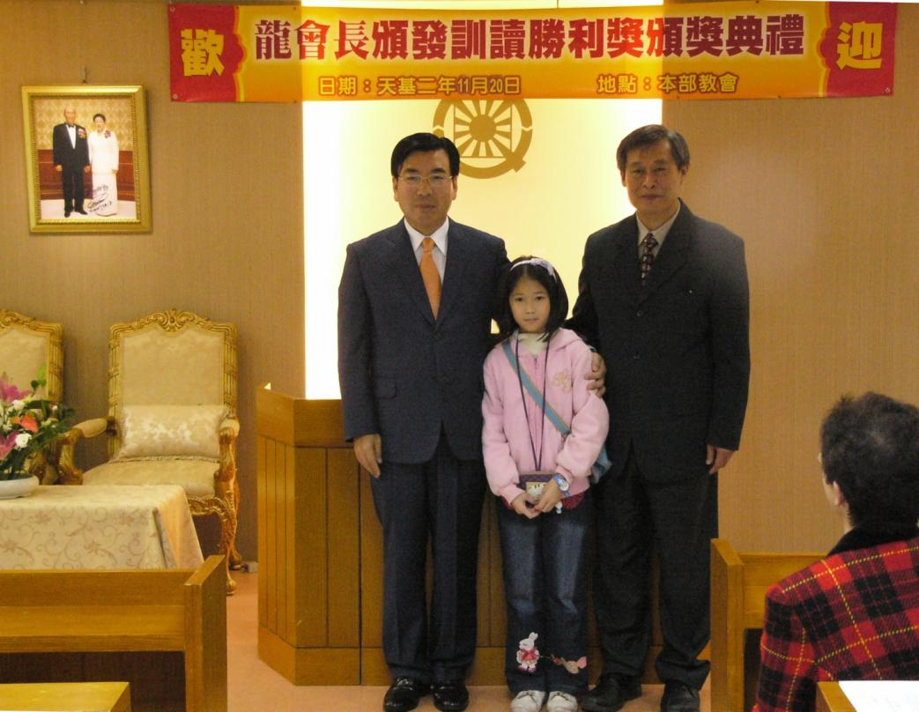
Certification of Recognition by Regional President
One second Gen. who has completed the 100-time reading of 3-hour EDP

Slide 8
Results & Testimonies
Testimonies from Hoon Dok Members:
1. More stable emotionally ; Not easily provoked or get
angry ; more joyful in heart
2. Career fortune improved; human relationships improved
i.e. husband & wife, parents & children,
with colleagues at work
3. DP content becomes real & dreams about True Parents
Physical illness recovered.
Overflowing blessing of all things

Slide 9
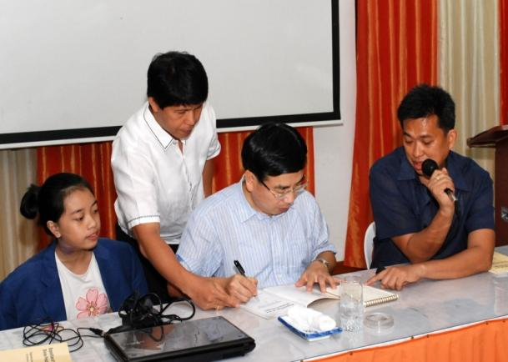
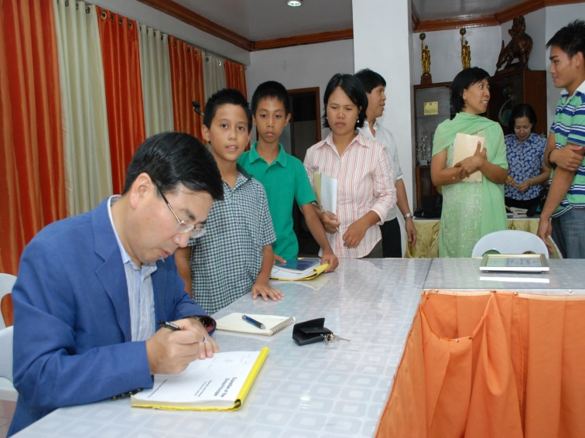
HOON DOK CULTURE IN PHILIPPINES
Dr Yong signing the EDP Book as encouragement for members to dedicate themselves to reading

Slide 10
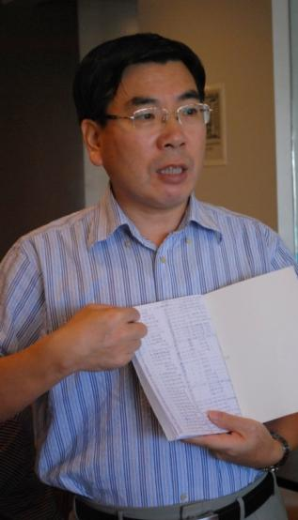
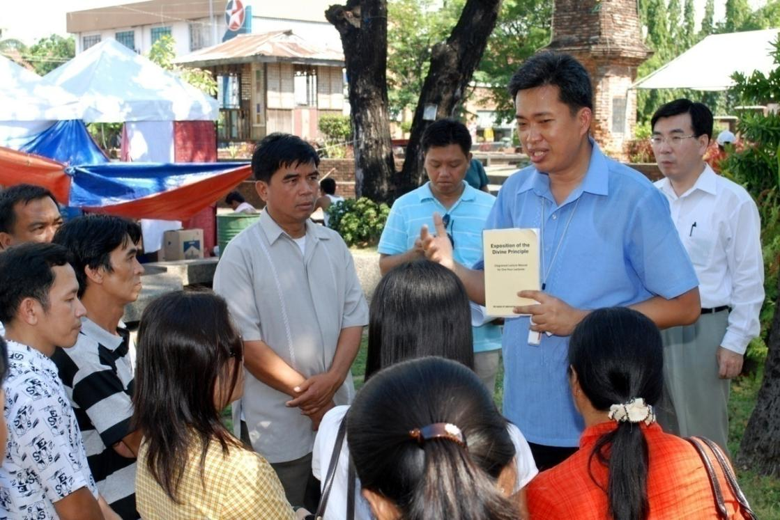
Promote EDP Reading in the Philippines
Leader explaining to members about the importance of Hoon Dok reading & encouraging members to dedicate themselves to complete EDP reading 100 times.

Slide 11
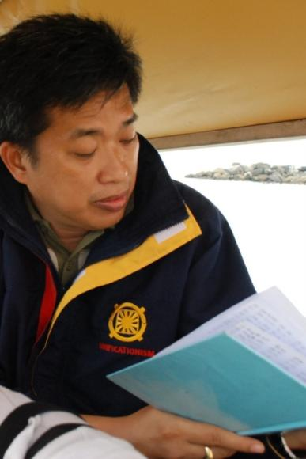
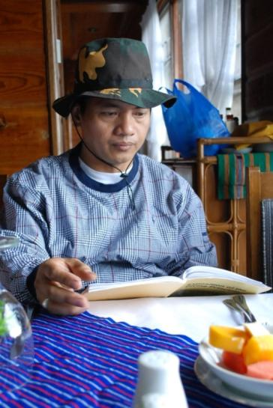
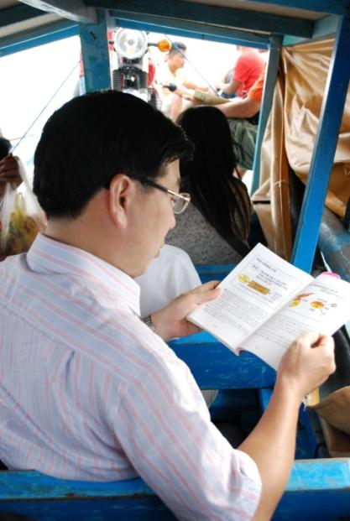
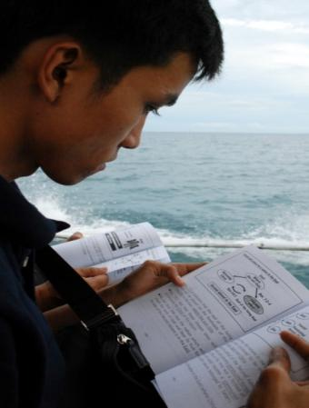
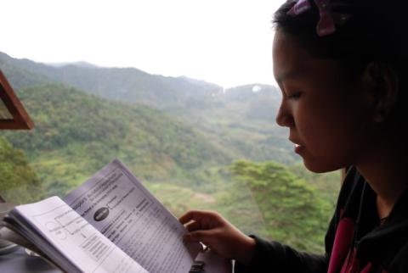
Hoon Dok virus spreading all over Philippines
Leaders lead by example, members compete with one another to complete reading the EDP

Slide 12
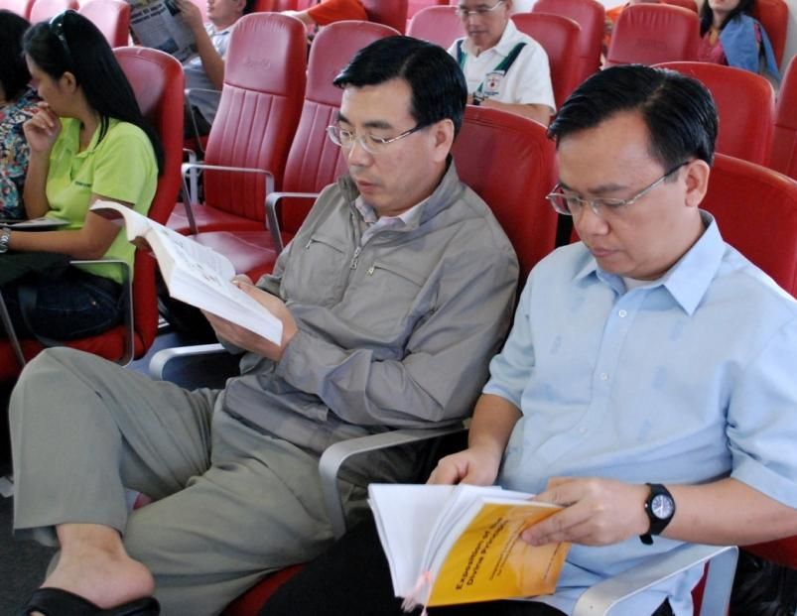
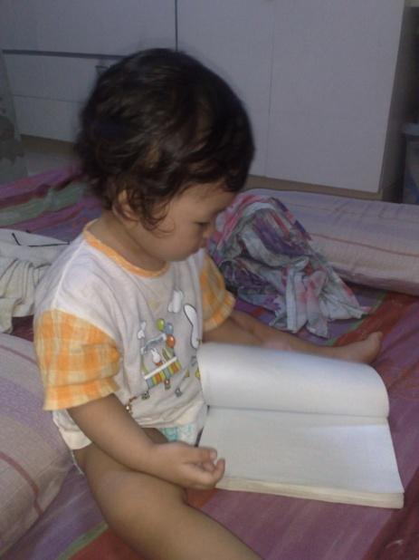
Hoon Dok virus spreading all over Philippines
Leaders led by example, 2nd Gens. were also excited and following the EDP reading culture

Slide 13
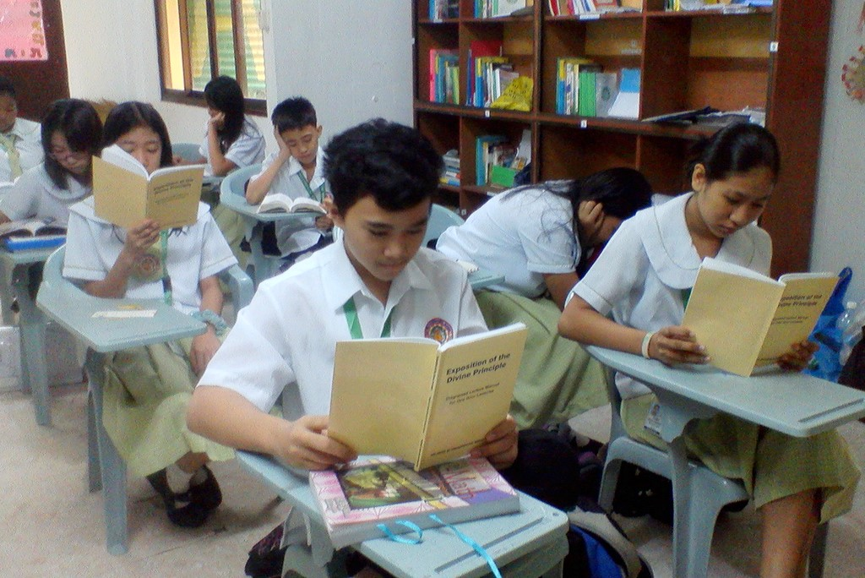
Hoon Dok virus spreading all over Philippines
Second Generation Children in Sun Hwa reading EDP during break time

Slide 14
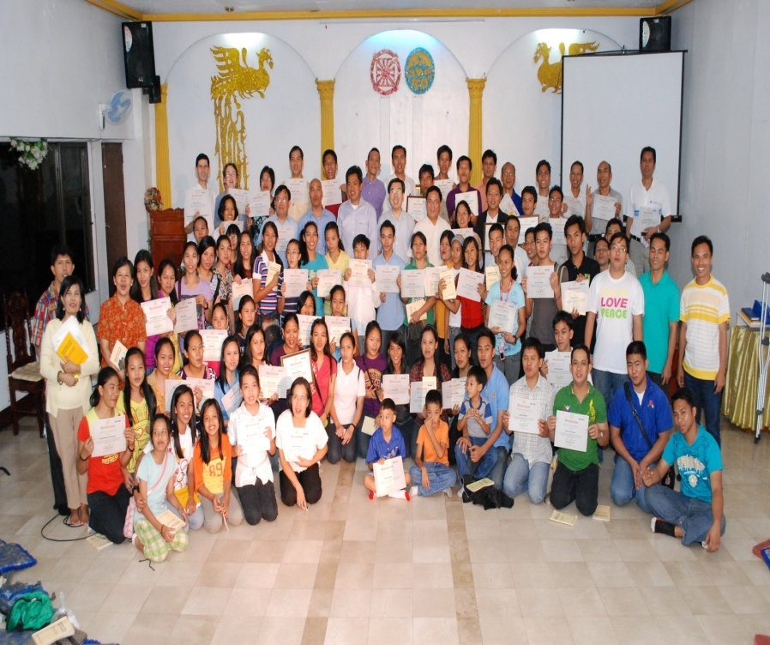
Certificate of Recognition by Regional President
Group photo among those who completed reading 100 times 1-hour & 3 hour EDP

Slide 15
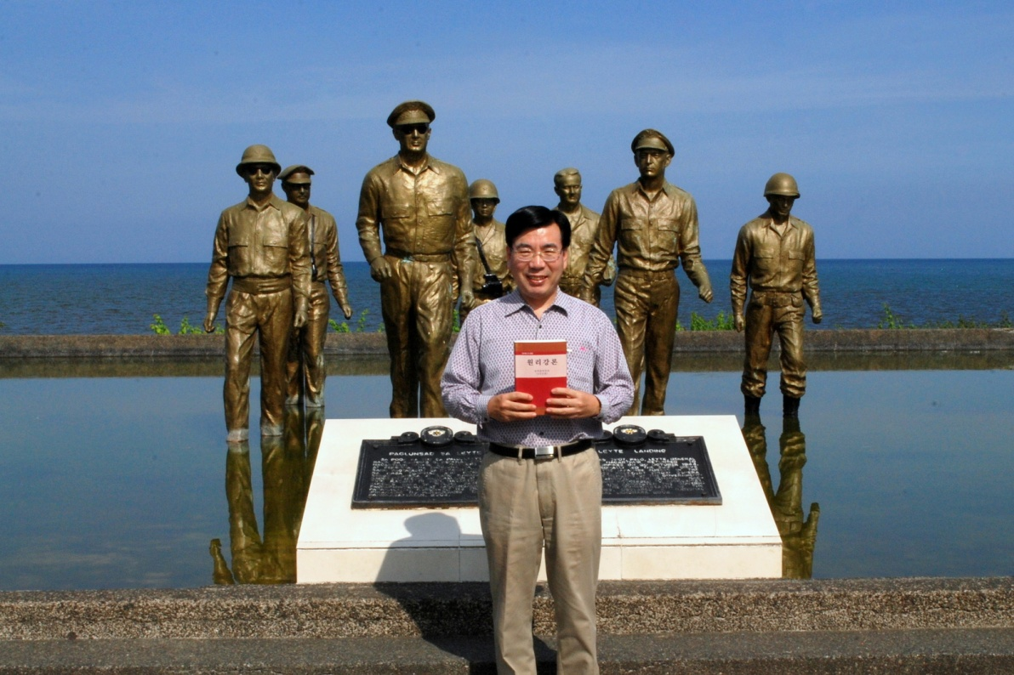
First 100 times 3-hour EDP reader in Asia
Completed the Reading of 100x 3-hour EDP at Gen. Mac Arthur’s Historic Landing Site in Leyte, Philippines

Slide 16
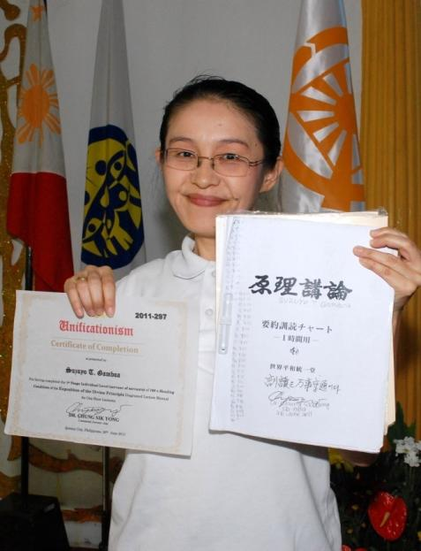
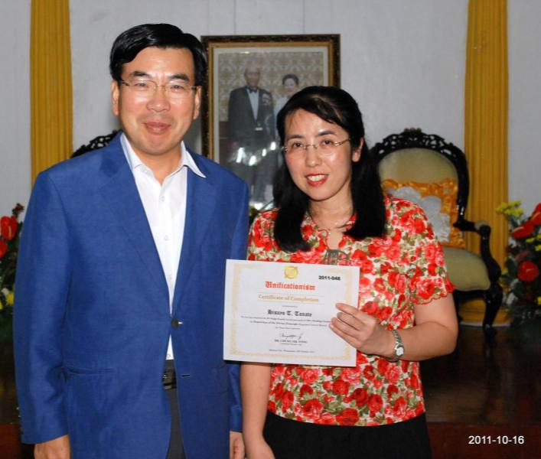
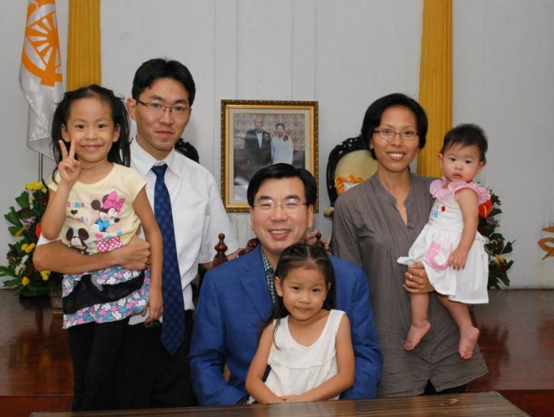
Leadership By Example
Japanese Missionaries in Philippines received certificate of recognition from Dr Yong

Slide 17
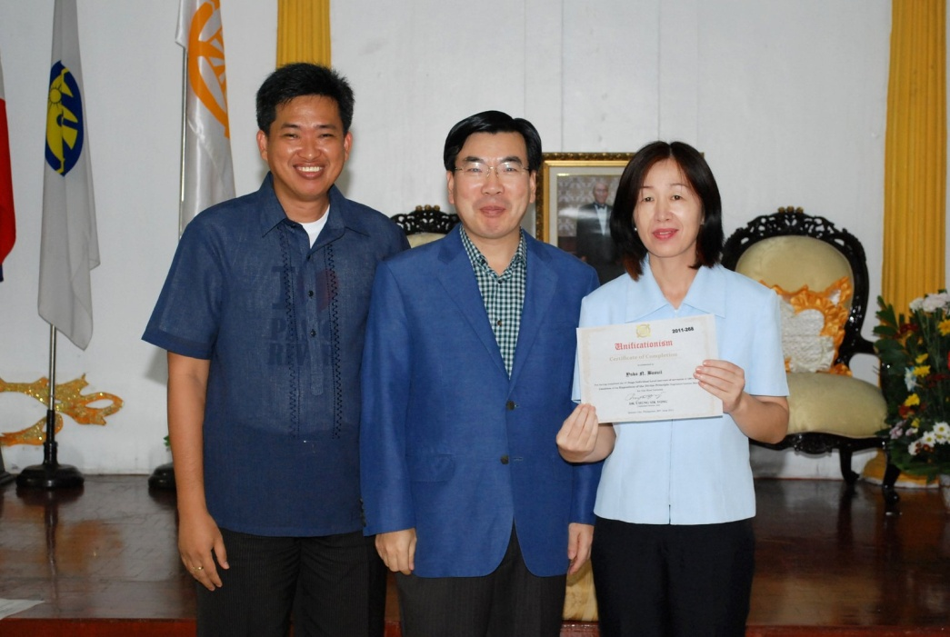
Leadership By Example
Former National Leader, Rev Jun Basuil received certificate of recognition from Dr Yong

Slide 18
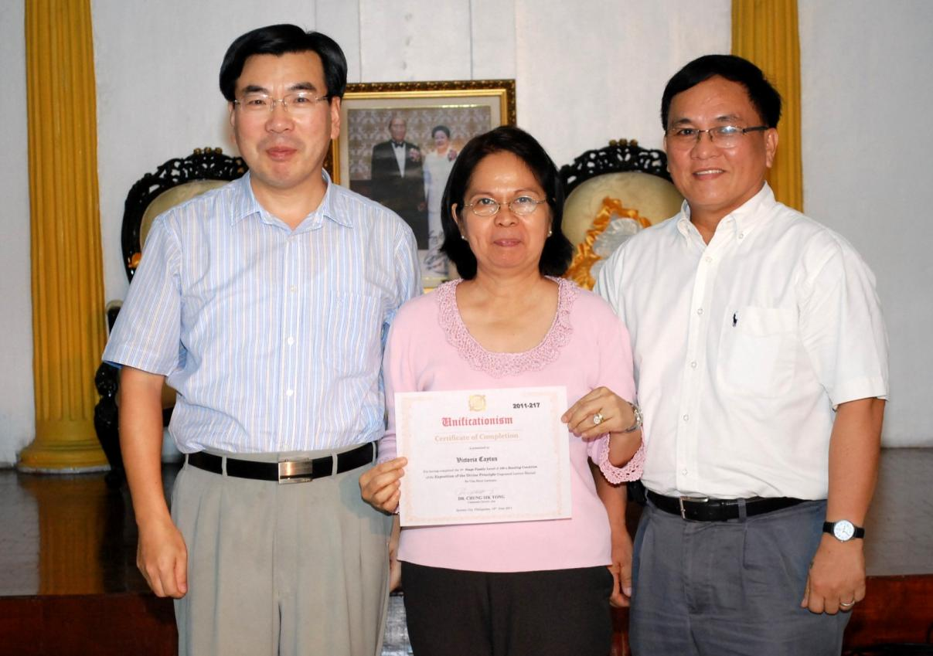
Leadership By Example
VIP who completed the 100 times 1-hour EDP reading, General & Mrs Alfredo S. Cayton, Jr.

Slide 19
Achievers of 100 times edp reading
IN PHILIPPINES
Exposition Divine Principle | Number of Members who Finished
1- Hour EDP | 1090
3- Hour EDP | 72
10-Hour EDP | 10

Slide 20
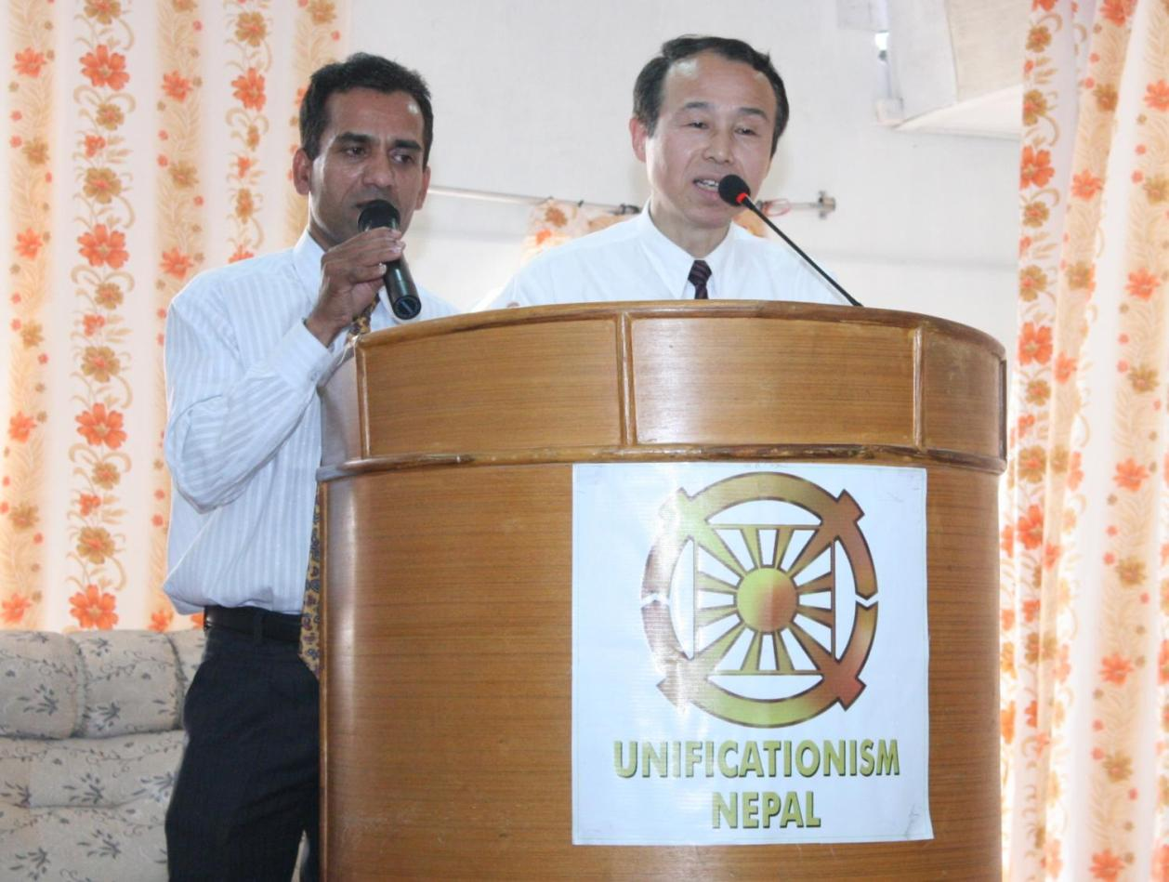
HOON DOK CULTURE IN MALAYSIA
On April 28-30, 2011, Rev. Masaaki Chaen, the Hoon Dok Champion visited Nepal HQ in Kathmandu & shared his testimony to ignite the Hoon Dok passion.

Slide 21
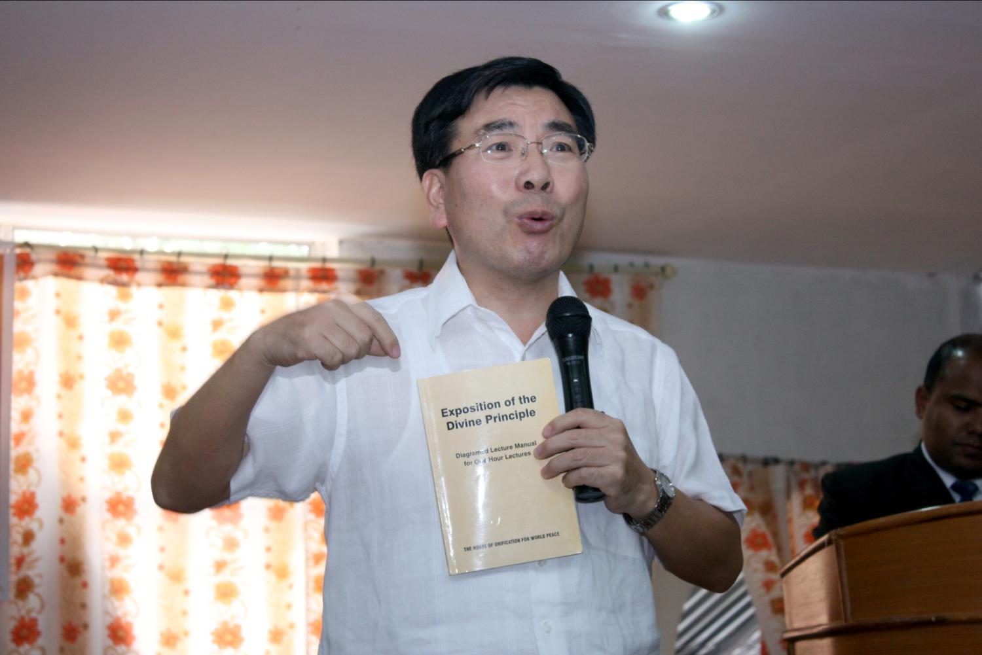
Asia Regional President Dr. Chung Sik Yong launching
the Hoon Dok culture in Nepal

Slide 22
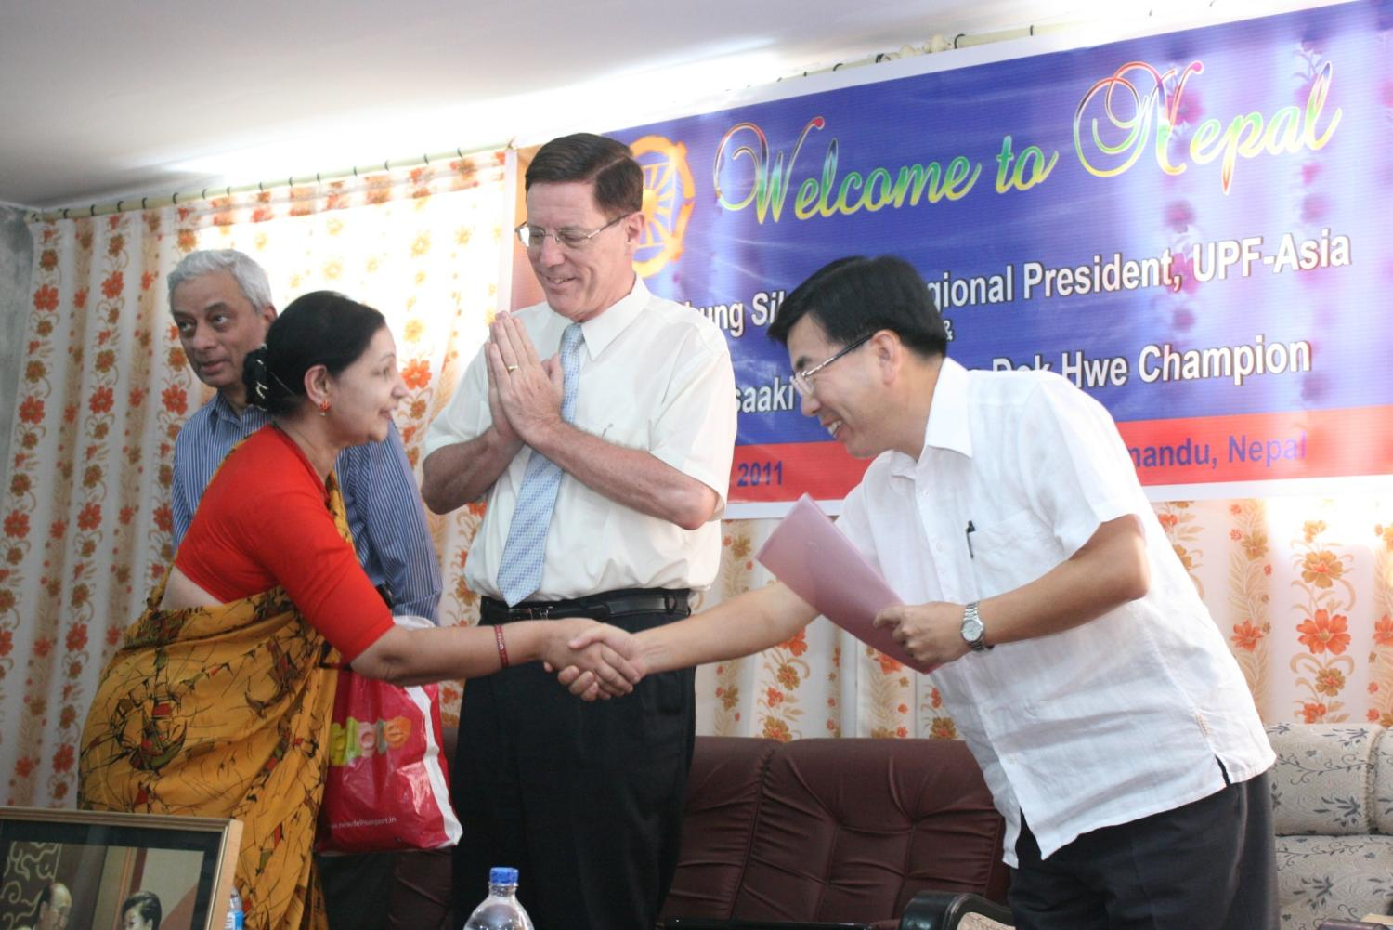
Encouragement for VIPs - Amb. & Mrs. Rajan to do EDP
Hoon Dok reading .

Slide 23
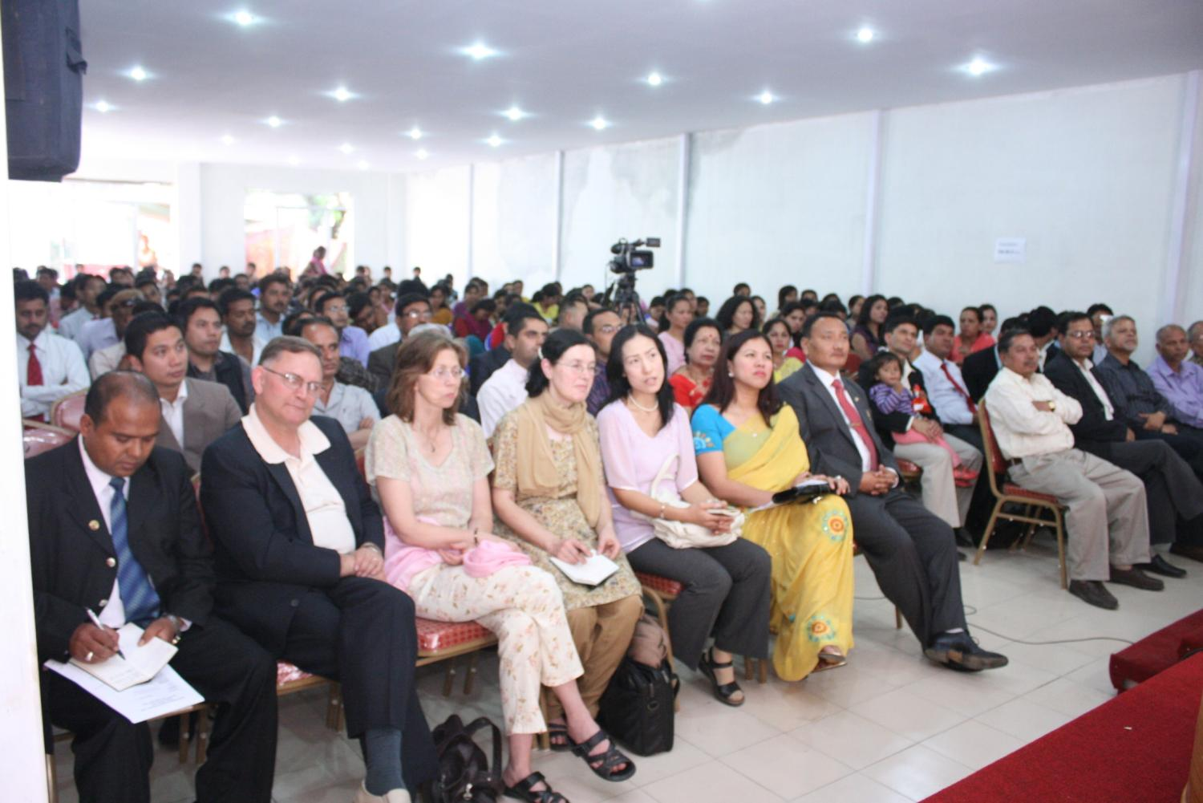
Participants listening to Mr. Masaaki Chaen & Dr Yong’s sharing at the Hoon Dok culture seminar in Kathmandu

Slide 24
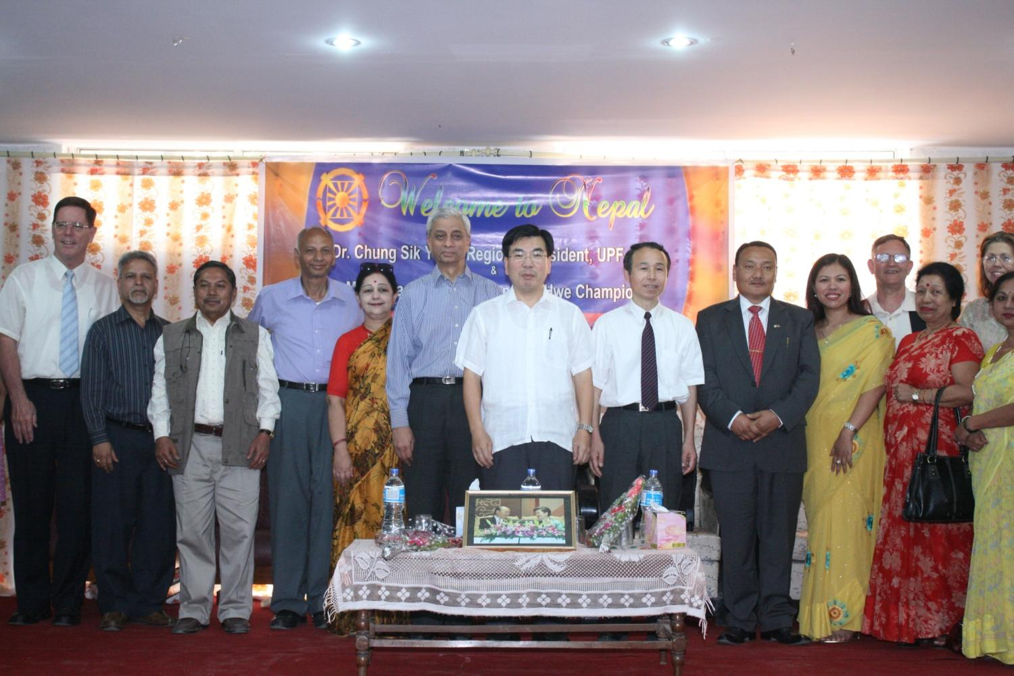
Ambassadors for Peace who attended HDH culture seminar.

Slide 25
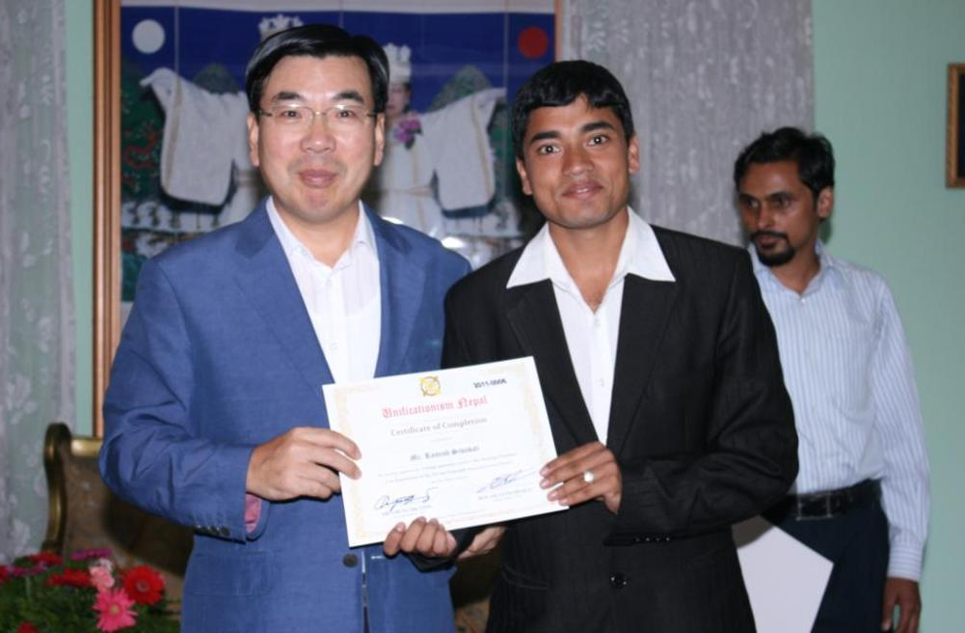
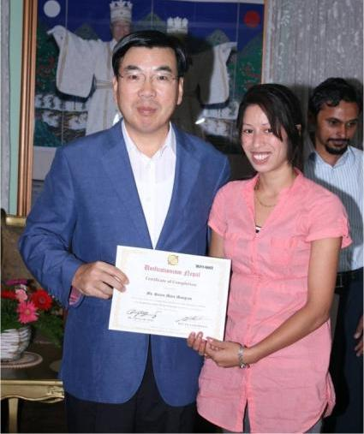
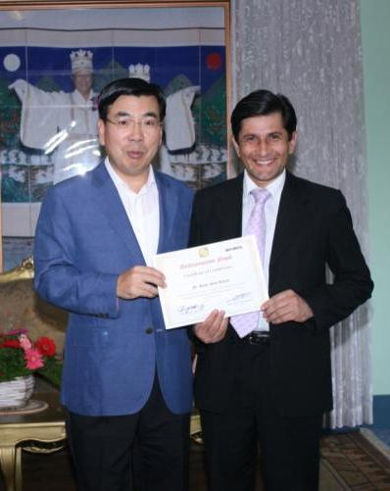
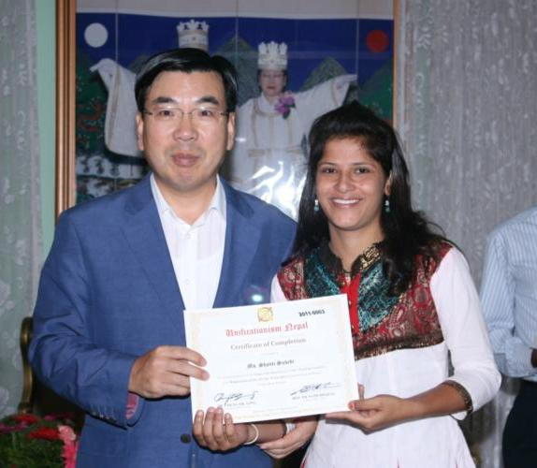
Asia Regional President Dr. Chung Sik Yong presents Certificate of Recognition to members who completed 100 times EDP reading in Nepal.

Slide 26
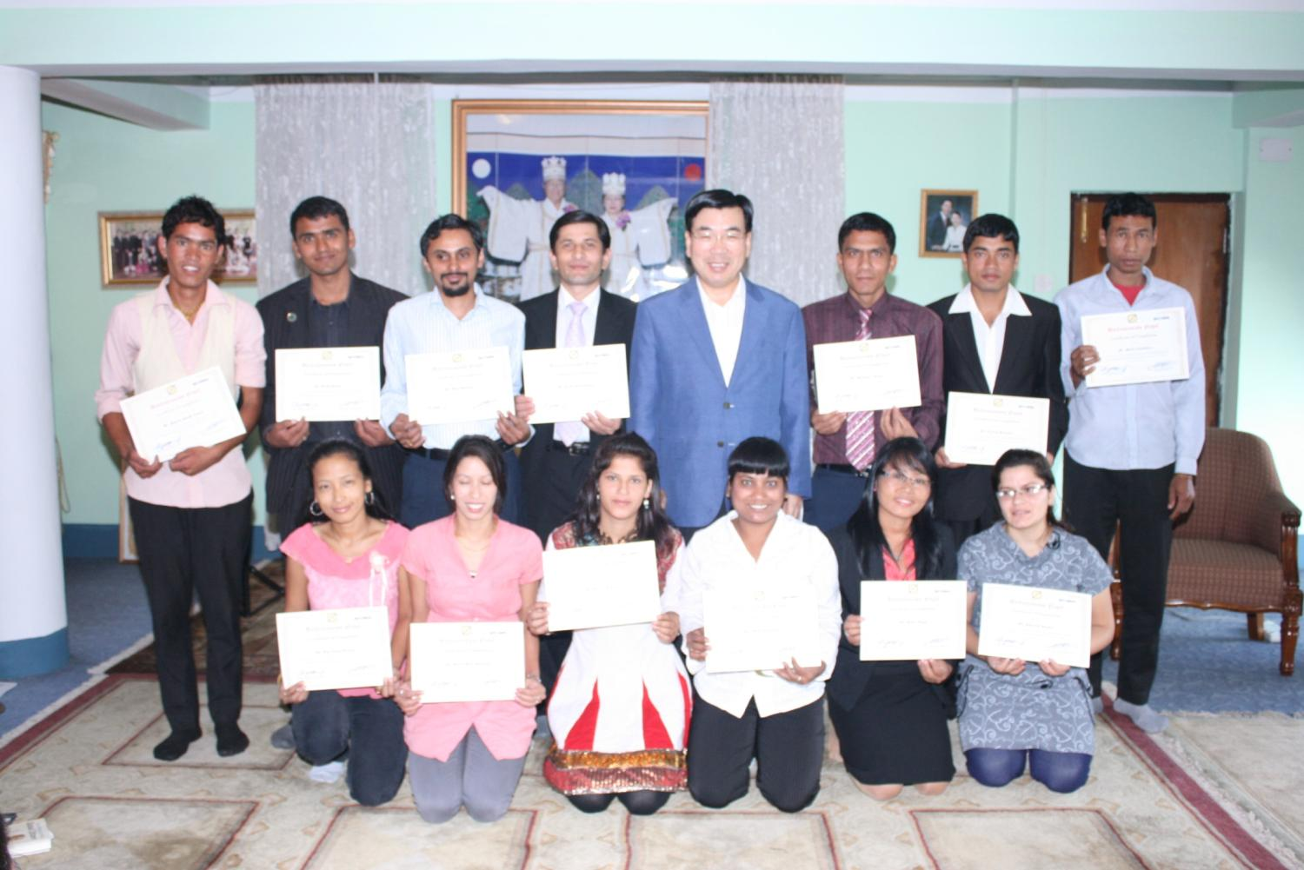
Asia Regional President Dr. Chung Sik Yong presents Certificate of Recognition to members who completed 100 times EDP reading in Nepal.

Slide 27
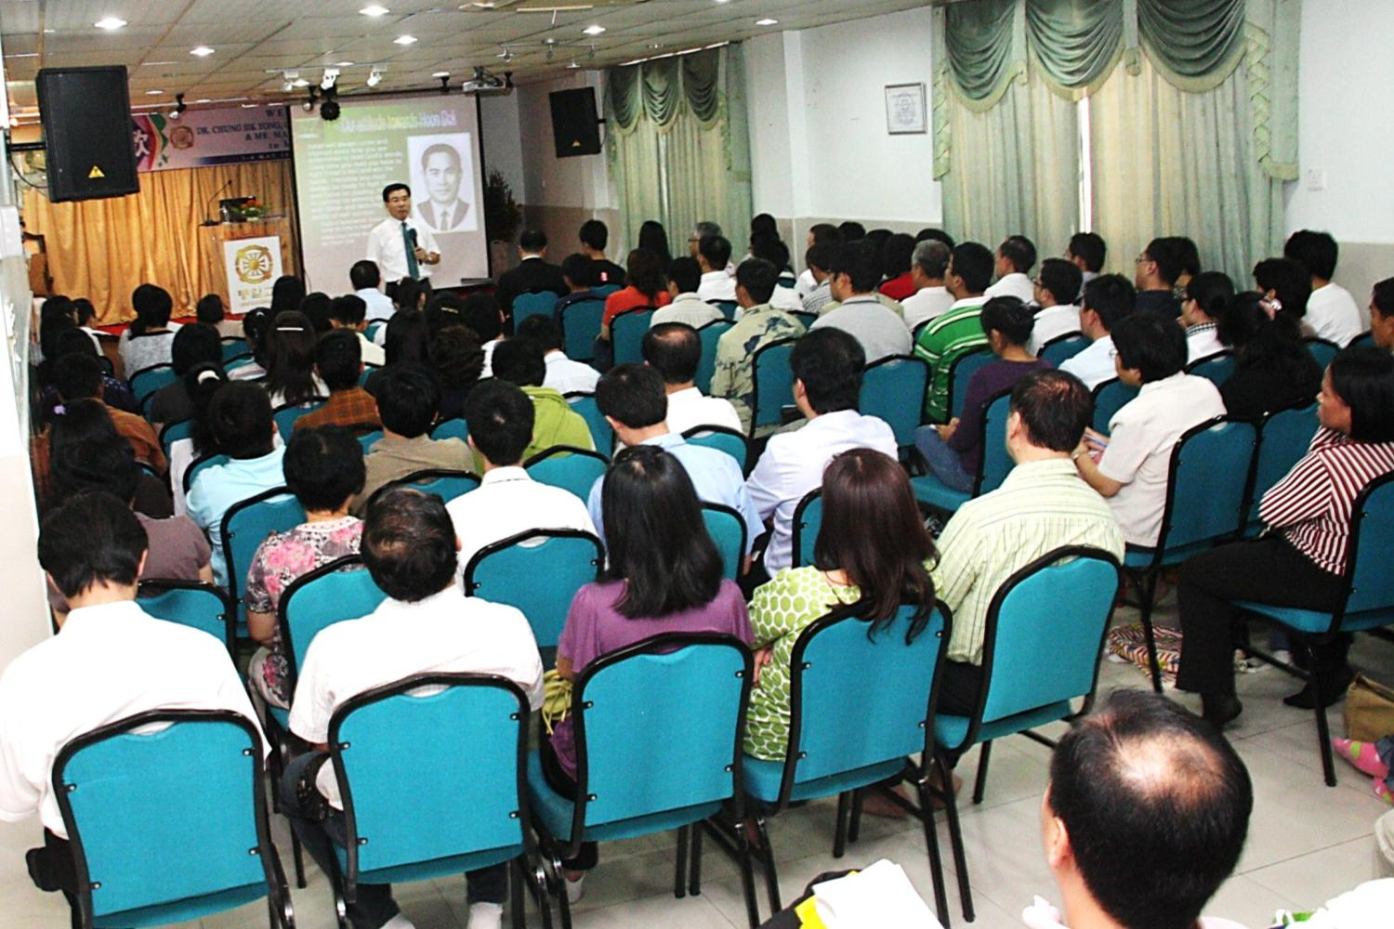
HOON DOK CULTURE IN MALAYSIA
Dr. Yong & Rev Masaaki visited Central Church in Kuala Lumpur, Johor to share his testimony to Malaysian and Singapore members 1-4 May 2011
MALAYSIA

Slide 28
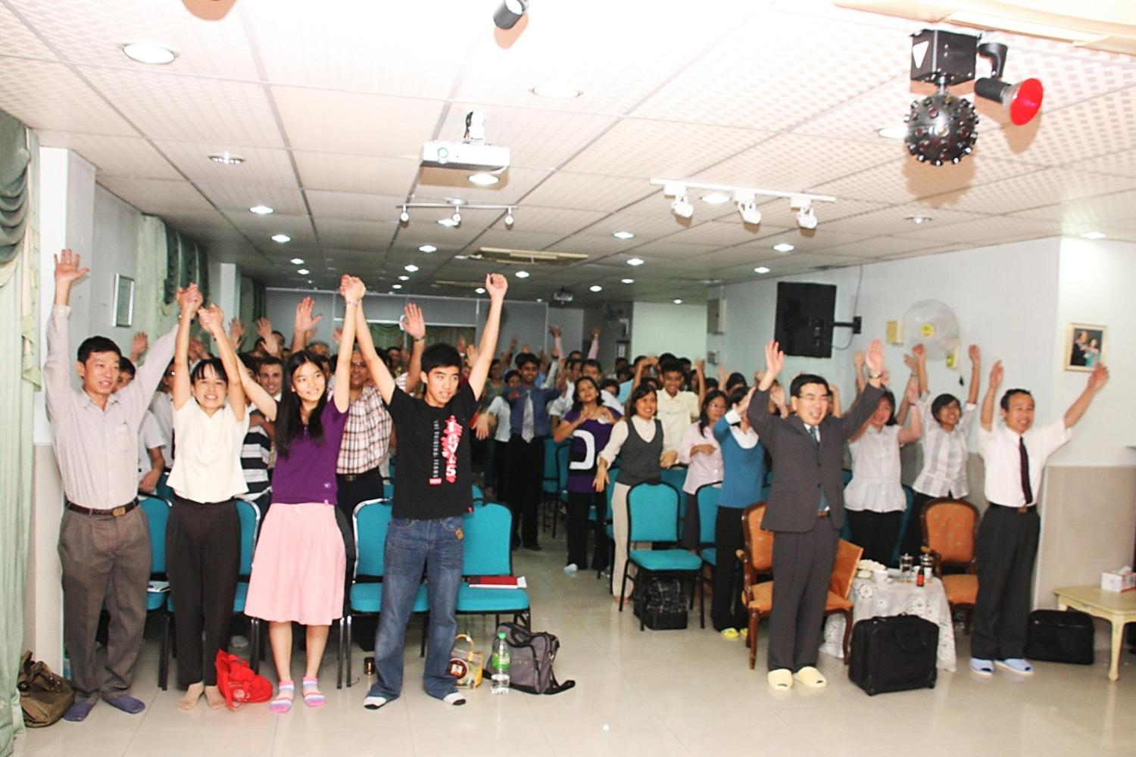
3 Cheers of og-mansei in determination to fulfill 100 times EDP reading

Slide 29
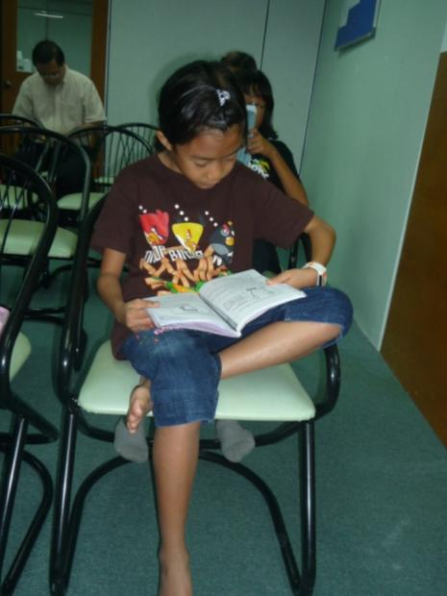
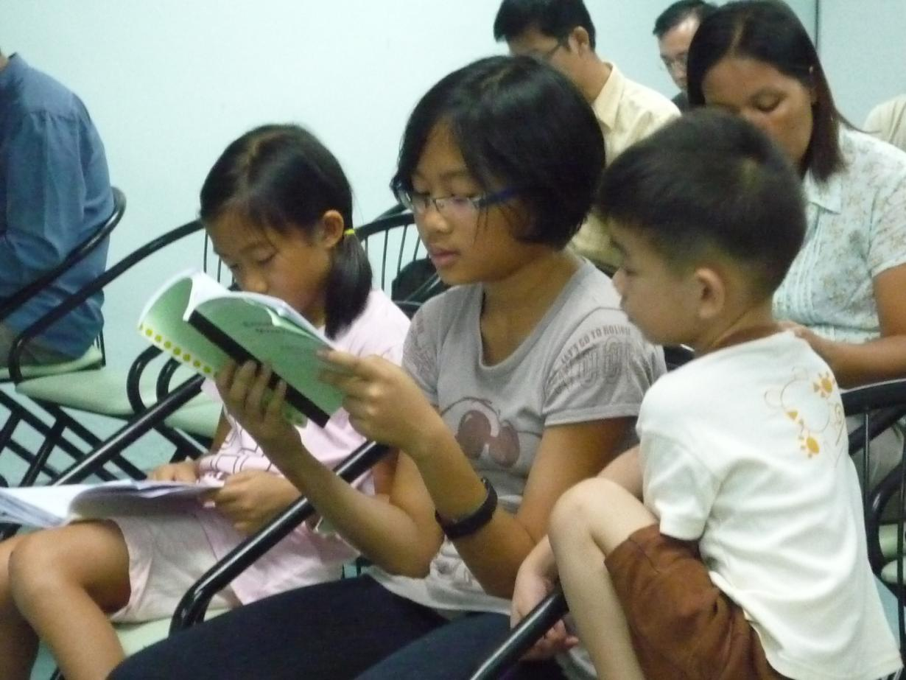
Malaysian 2nd Gen. reading 1 hour EDP
ASIA

Slide 30
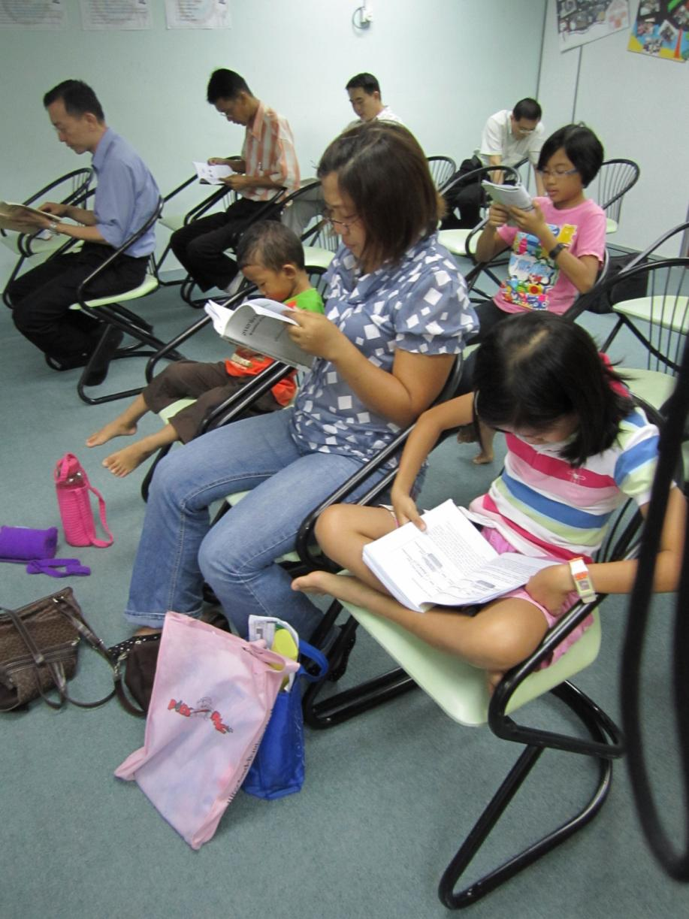
Members & 2nd Gen. set aside time to read
EDP at the Church

Slide 31
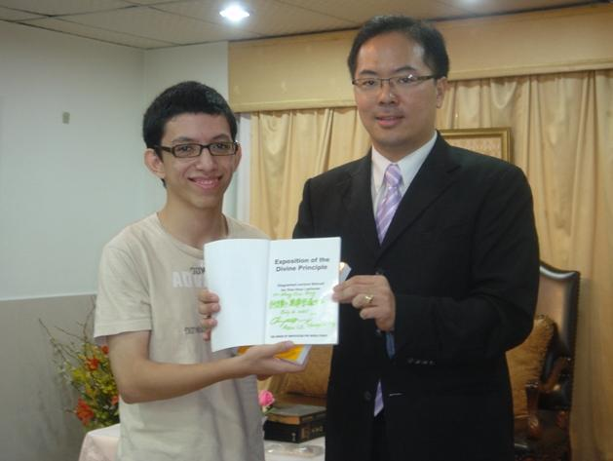
Book signed by Dr. Yong in recognition of fulfilling 100 time reading of 1 hour EDP

Slide 32
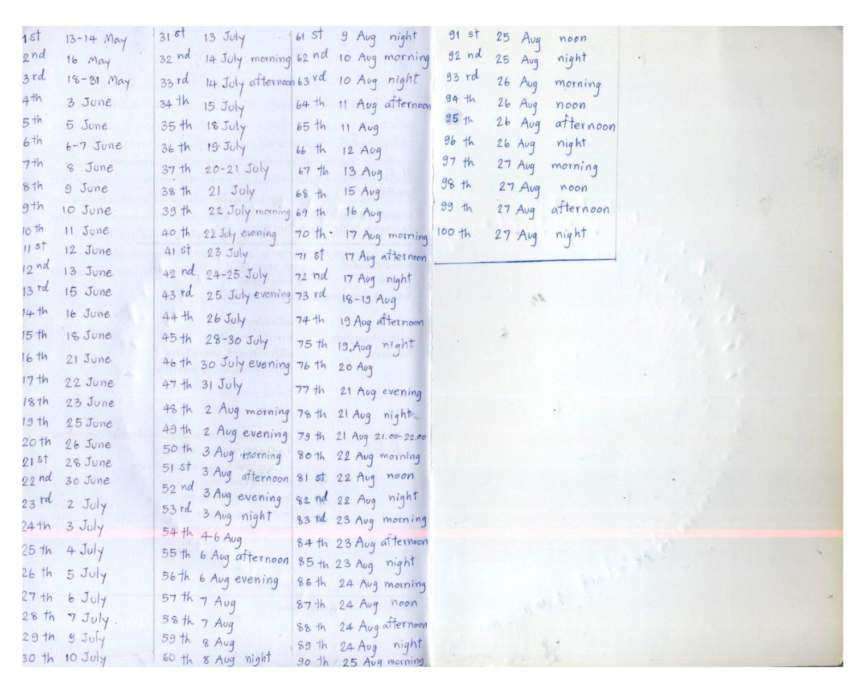
A recorded progress of the 1 hour EDP reading from 1st to 100th time by date

Slide 33
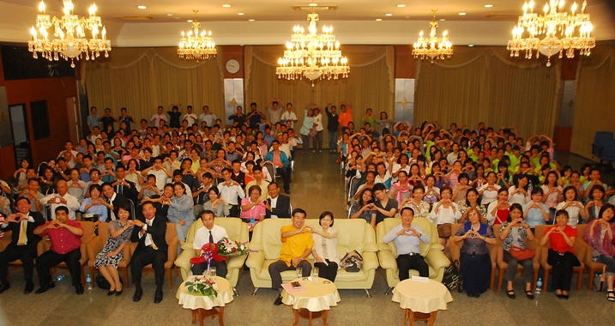
HOON DOK CULTURE IN THAILAND
Dr Yong and Mr. Masaaki visited Thailand HQ Church in Bangkok to share his testimony to Thai members 26 April 2011

Slide 34
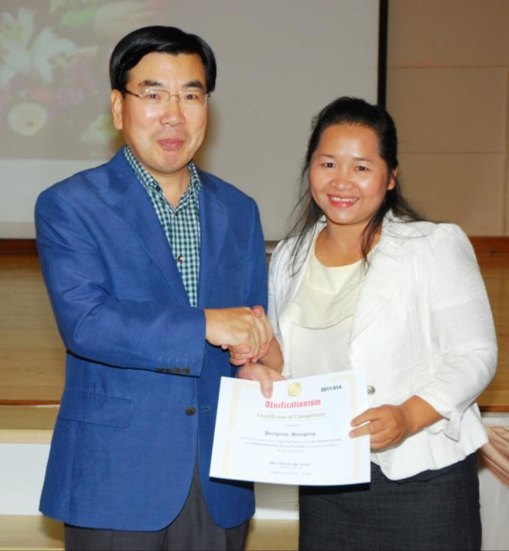
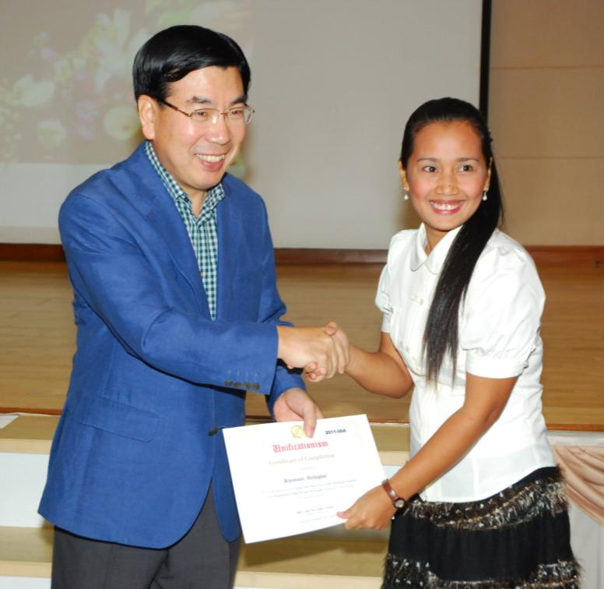
Certificate of Recognition by Regional President
14 Thailand members received certificate of recognition from Dr Yong for completing 100 times 1hour EDP reading July 24, 2011

Slide 35
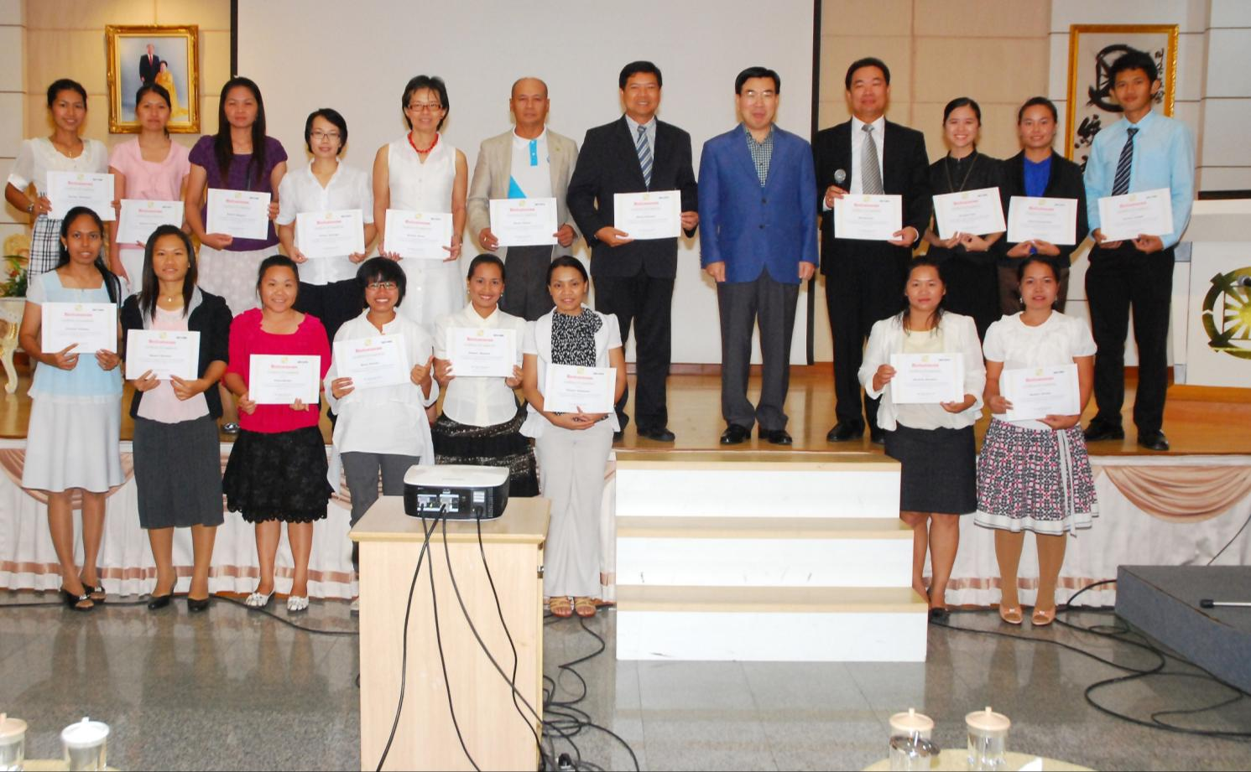
Certificate of Recognition by Regional President
Thailand members received certificate of recogniotion from Dr Yong for completing 100 times 1hour EDP reading July 24, 2011

Slide 36
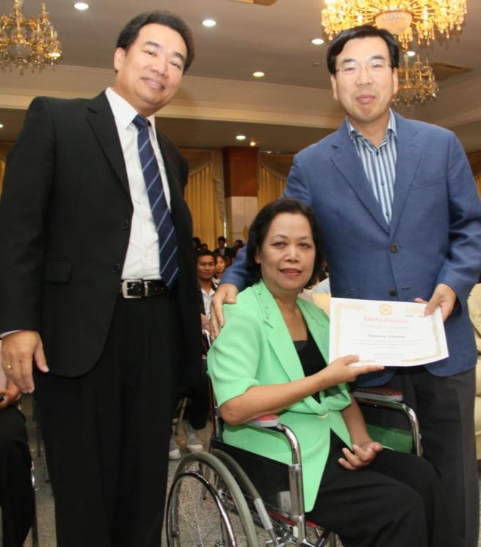
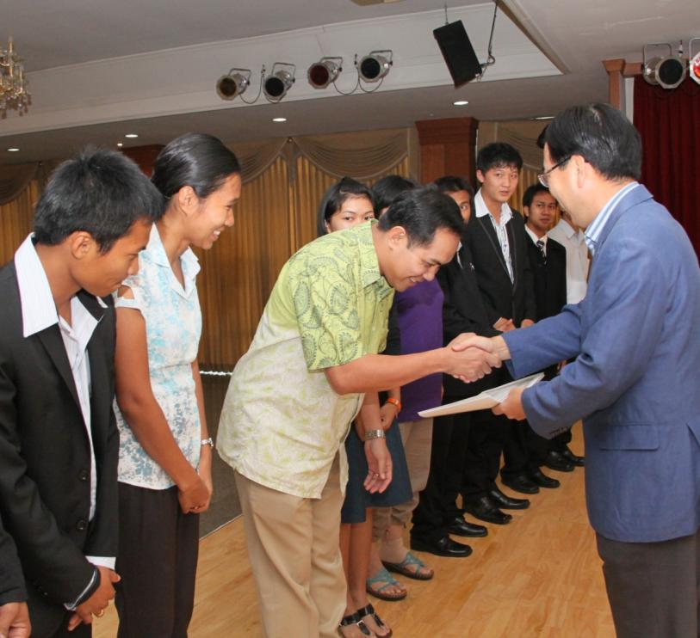
Certificate of Recognition by Regional President
139 members received Certificate of Recognition from Dr Yong for completing 100 times 1hour EDP reading October 9, 2011. Total 100 times 1-h EDP readers is 153

Slide 37
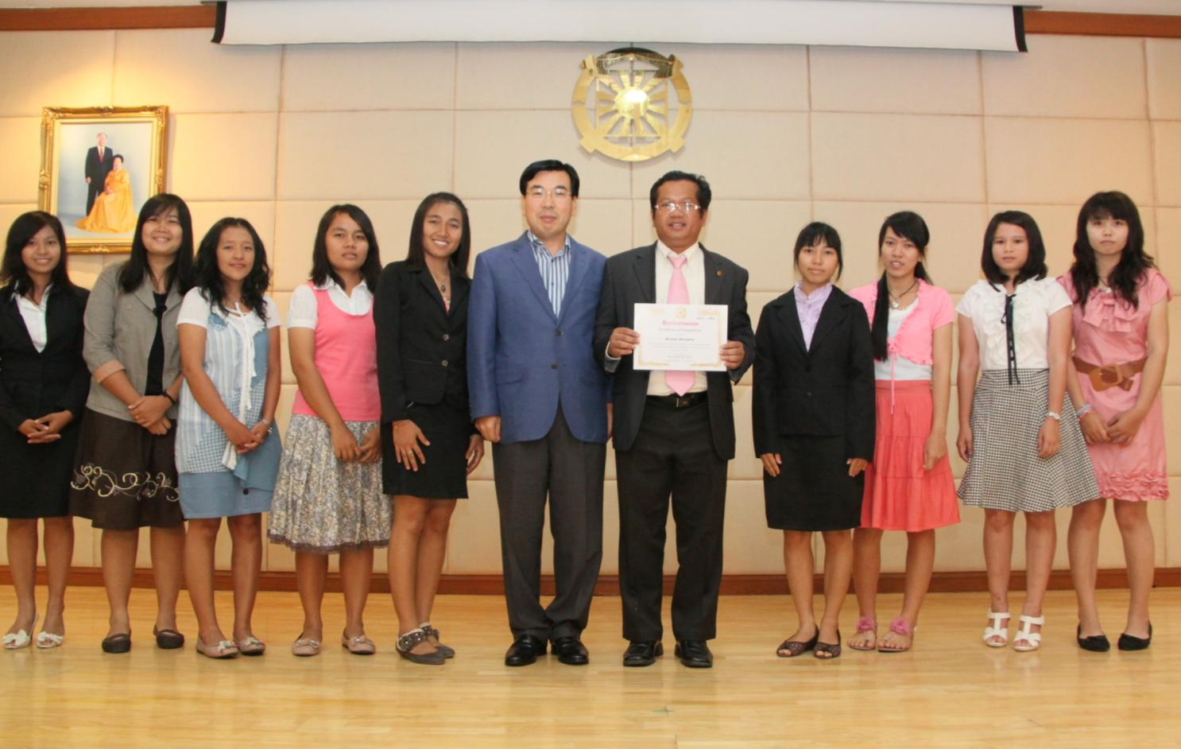
Certificate of Recognition by Regional President
139 members received Certificate of Recognition from Dr Yong for completing 100 times 1hour EDP reading October 9, 2011. Total 100 times 1-h EDP readers is 153

Slide 41

TESTIMONIES

Slide 42
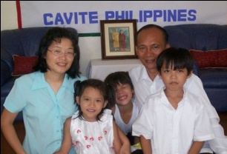
JOSHUA JOSOL (Filipino)
I started reading 1-hour EDP beginning of May 2011 and
completed 100 times on June 3, 2011. From the start I was
thinking that reading the 1-hour EDP 100 times would take me 3 months because of the astigmatism problem of my eyes. But miracles happened as I determined to finish reading it in a month, my eye problem had gone. Thanks to the great healing power of God. I could even read without stopping, straight 10 rounds in one day to be able to finish the goal of 100 times within just a month. Truly God's word is God's love and blessings for me. I was so intoxicated and falling in love reading the Divine Principle that no time is wasted every single day. My wife has been my model and the source of inspiration because she always finishes ahead of me.
My 3 children are following our example and my twin boys have completed 100 times 1-hour EDP and my girl is about to finish. I am grateful to Dr. Yong for all the encouragement and motivation for good experiences at each level of victory to embody the Divine Principle and receive the true love of God and True Parents.

Slide 43

RONNIE RODRIGUEZ (Filipino)
I read 1-hour EDP at the office, in the classroom, while washing
plates, In the car during traffic jam, after teaching in the school
and during Hoon Dok time. My time became more fruitful when
I am serious to follow the reading condition. I dream about True
Parents very often and I experienced many miracles in my life :
First Miracle: When I completed exactly at 40th times reading, my co- teachers approached me saying, “Teacher Ronnie! Why haven’t you finish reading that book? You have been reading this book for 2 months already?” I asked why? She said, “I want to read that book”. She wanted to know the author of the book. I gave her Father’s Autobiography. She finished reading the book within a day. One afternoon, she said to me that Father looks like Jesus. It surprised me as she had not even attended any workshop. She proclaimed also, “Rev. Sun Myung Moon is the Messiah! He is the savior of our time” Upon hearing this, other 3 teachers in the schools also asked me for True Parents’ photo to be put in their wallet. I gave each of them a pocket-size True Parents photo.

Slide 44
RONNIE RODRIGUEZ (Filipino)
Second miracle: On Oct. 16, 2011, while I was reading 1-hour EDP for the 70 times, I was reunited with my high school mate again after 14 years. She came to Thailand from Philippines and was interested in our movement. She has a positive view and understanding about our movement. After giving her the 16 chapters of DP lecture, she accepted Father is the Messiah and witnessed to her son. She testified many good things happening to her after started reading DP.
Third miracle: As I continued reading even though I am busy with my job, my children, and teaching in the school, I won lottery 4 times and paid all for my ancestors liberation and blessing. My financial situation is getting better and I am also offering help to others who are in need.

Slide 45

AI LI (2nd Gen. Phils.)
This is my reflection /experience during the 100 times reading of 1hr. EDP.
I had a dream when I was grade 1. I brought back home a pitiful little girl who was a street beggar. But in return she wanted to kill me because she could not receive enough love. I told my mother and she sought help from a spiritualist. She said that the little girl was a lost soul & wanting to feel more love, that’s why she wanted to kill me. In order to protect me, the spiritualist trapped her in a mirror. Many years have passed. On my Birthday each year, I would hear someone crying in my room. Until my 8th birthday, while combing my hair I saw a girl in the mirror, she was crying and her eyes were white I was so scared I started running for my life. I heard breaking sound and it was without a doubt the mirror where she was trapped broken. She was able get out of the mirror to catch me and she started to torture me by cutting off my feet, my hands and my hear. I was screaming for life and shouting for pain.

Slide 46
AI LI (2nd Gen. Phils.)
Recently, I have another dream, it was the same story. But this time the resentful girl was able to control boys; she took controll of my father, classmates & even my male pets. So again I was running for my life. But this time, I was holding my 1-hr EDP book. So I tried my best to read from the prayer. When I started praying, my father and all the boys were liberated and came back to normal. The resentful girl ran as fast as she could to catch me and shouted: “I am going to get you! Remember that!” but her voice is fading away.. and suddenly I heard a voice coming from above saying “Do not worry, I will protect you” So, I guess that voice must be God. I had this dream one day before finishing the 100 times 1-hr EDP reading. NOW BELIEVE THAT READING GOD’S WORDS IS THE ONLY THING THAT CAN SAVE US FROM EVIL.

Slide 47

Benjamin Y. Rabaňo (2nd Gen. Phils.)
When I read the 1-hour EDP, I can really feel the love of God surging upon me., I always cry and cry to repent for being arrogant in the past. Reading also helps me to remove my fallen natures and improves relationship with my family. Recently I had a spiritual experience with God. I was at the Tong-Il training in one of the chapters in Cavite. It was raining really hard; we couldn’t go for training. So, I spend my time reading the 1-hour EDP book. While reading it, I could hear whispers all over the place, it really scared me, the voice was calling for me to find them. I was trying to finish reading EDP for the 3rd time on that day.
Suddenly, the rain stopped. I was wondering what happened, then the sky became so bright and I got blinded. After that I heard God’s voice in my head saying, “I love you, I love you more than you ever know. Thank you for having some time of your day to receive my love through these words.” At that very moment, I cried and my body was shaking. This special experience made me determine to train myself harder, change myself and train others to become better than me.

Slide 48

Chou, Ju-Ying (Taiwan)
When I read DP the 9th time, “The portion of 5 % is used to indicate that the human portion of responsibility is extremely small when compared to God’s portion of responsibility” (P157, DP). This sentence stroked me, like the arrow of God’s love hit me. I am thinking “How wonderful to have God’s love” I was very much intoxicated in the word. The feeling is like floating in the air and “addicted” in the joy of reading. When I continue to read DP the 10th time, the Principle of Creation again made my heart joyful. I love the DP! I had never had this kind of feeling.
I had the experience of shedding tears when reading Cheon Seong Gyeong, but it never happened when I read the DP, not even during the 40-day workshop in Cheong Pyeong. I often fell asleep during Hoon Dok Hwe. I didn’t like reading DP in the past. This is the thing I should repent for. The Hoon Dok EDP movement gave me a new chance to experience the work of
the Holy Spirit and renew my life of faith.

Slide 49

Ceng, Fang-Rou (Taiwan)
I have a little presbyopia, It’s very difficult to see the small words of 1 hour EDP. In the beginning, it spends 72 minutes to read once. I feel that it needs to read a little faster. I pray “God! Your child desire for your love! Please make my sight become better to unite with DP and more close to you!”
Gradually, my sight become better and better and I read faster and faster. Even I feel not tried to read for 3-4 hours once. I appreciate so much that I beyond my limitation of ever. During Hoon Dok condition, my quality of sleep becomes better. My spinal pain had trouble for many years, but it’s cured without medication, so amazing, thanks to God and TP.

Slide 50

Huang, Ya-Huei (Taiwan)
My daughter Cheng-Chen started the Hoon Dok on EDP on
June 13th. She completed the 100th times reading on July
25th. I was excited by her success.
My 5-year old kid reminded me to read EDP every night like a little angel. So, I couldn’t let myself be lazy on reading even for once. My kids go to sleep with my EDP reading every night.
I sold three EDP books to non-members with the hoping that one day they will become members through the reading conditions. I want to imitate the Brazilian brother who was succeeded in his tribal messiah mission.

Slide 51

Chen, Shui-Mu (Taiwan)
When I was reading the DP at the 50th times, I felt my brain become crystal clear. My vision expanded and the way I look at things changes. One time, after finishing the Hoon Dok, I looked at my
wife and said to her: “Why are you looking so beautiful recently?” She replied that “Either you ‘eat’ too much God’s Words & everything became so beautiful to you or read too much that you are getting dizzy.” Relationship with my wife has improved so much. We have many heartistic conversations after the Hoon Dok conditions.
After I read DP 80th times, two teachers (I am a teacher) whom I tried to witness through Father’s autobiography came to me and we had close conversation on the Faith of Unificationist.
My two sons who are 7 & 9 years old are doing Hoon Dok with us daily. Sometimes they wake me up to do Hoon Dok together. After 100 times reading, many good fortune are coming to our family. We are determine to Hoon Dok on EDP continuously and moving on to the next level of EDP reading

Slide 52

Niratchada Insao (Thai)
As I read the 1-hour EDP, my conscience became stronger
and stronger. My original mind is so happy. It guides me
to serve and sacrifice for God and True Parents. I could make God and True Parents happy through my motivation.
The evil mind always persuades me to be lazy and stop reading.
I must control my eyes ,mouth ,ears and thinking to focus the word. I have to be patient and take a time to overcome myself. When I could overcome God smiles gently and was so happy with me.
This condition makes me love reading the word (HDK) more and more. The word is the source of True Love. Sometimes I receive the inspiration how to solve the problems. Reading make me forgive and love brothers and sisters. Hoon Dok reading changed my heart, character and brought close to God and True Parents.

Slide 53

Kashi Nath Khanal (Nepalese)
God’s Words is God’s Love for all humankind. As it is
Mentioned in the Bible: “in the beginning word was with God
and God was the word.” That’s why the only way to receive God’s
love is His Words. Every thing in the creation desire for love because they were created through and created for the sake of love. So love is the most powerful force in the whole creation. God exists for love and we exist for love.
Hoon Dok reading is like antibiotic that removes my fallen natures and it brought me to deep repentance. Members who used to complain and could not see new hope in the church started to have their mind and heart opened after doing the EDP Hoon Dok. Spiritually they are revived and revitalized and made determined to discover deeper experience with God.
I am confidence that as we are heading towards foundation day, this will open new pathway and vision and ideas to fulfill God’s Will.

Slide 54

The End

