Slide 1

Family Life
For CIG Citizens

Slide 2
Family Life
【Our motive to start a family life】
The major origin of the fall of man was in the “conjugality.”
For the restoration, the origin of the fall and enmity must be removed from the conjugality.
To clear enmity and stand as a couple of original value
Be selfless unlike Adam & Eve who married selfishly. Marriage with the spouse given by God
Keep monogamy unlike Eve who had two mates. My only husband / My only wife
Absolute conjugality ＝ “Absolute sex”

Slide 3
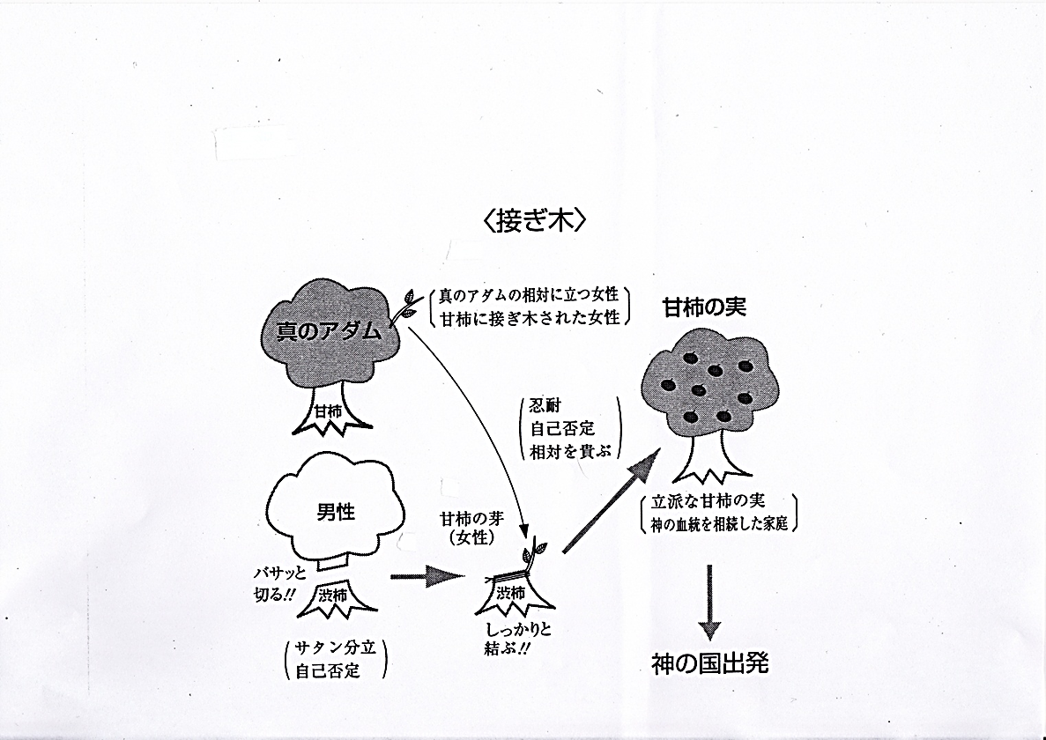
Grafting
Linkage of lineage by being grafted with the Messiah who has God’s lineage.
Inheritance of true love, true life, & true lineage from the victorious True Parents.
Satan’s false love, life & lineage
Woman’s role as an embryo of the sweet persimmon tree
Woman, being the object of True Adam
Woman grafted to the sweet persimmon tree
Fruits of sweet persimmon
Woman united with True Adam
True Adam
Tree of sweet persimmon
Perseverance
Self-denial
Honoring the spouse
Man
Embryo
(Woman)
Good fruits of sweet persimmon of the family of God’s lineage
Bitter persimmon tree cut off
bitter
bitter
Man separated from Satan through self-denial
Bound solid
Start of God’s Kingdom
(“Blessed Family” magazine, vol.14, Autumn, 1999)

Slide 4



Restoration of the Four Great Realms of Heart
Returning to the World of the Original Creation
God
“Living for the Sake of Others”
the central standard of the family
wishing to live for the sake of one another
Children’s love
Adam
Eve
wishing to be one
Sibling love
Concord
of
the Sexes
Appearance
of God
H
W
Blessed marriage
Conjugal love
Childbirth
Parental love
Children
Settling point of the Four Great Realms of Heart
God’s Ideal of Creation starts on the Earth

Slide 5



Conjugal Love (Third Heart)
Heart
Purpose of Marriage
God
God has His eyes, nose, mouth, genitals, and all.
＋
－
To resemble God and complete each other (Half pieces before marriage)
A
marriage
E
To complete God and complete the realm of liberation of love
Image of
God
God assumes the body of Adam and Eve and live together.
To multiply God’s true love, true life, and true lineage
Substantiation of God
(God can display His full power and full love.)

Slide 6
Relationships among the Four Great Realms of Heart, the Three Blessings, and the Three Rights
1. Children’s love (First Heart)
2. Sibling love (Second Heart)
Three Great Blessings
3. Conjugal love (Third Heart)
4. Parental love (Fourth Heart)
Eldest Son’s Right
Parents’ Right
King’s Right
(Kingship)

Slide 7
【Perfection of the Realm of Children’s Heart】
“Children’s heart is not anything neither parents nor teachers would teach them. Children themselves learn and acquire it by seeing their parents’ life-long dedication with true love for the sake of children. As they grow and become prudent, their filial love reaches perfection. That is, they come to establish a solid standard of life to offer everything willingly and for ever for the sake of their parents. They will read and realize the heart of their parents before they begin to speak. Such children will lead a life of following the wishes of their parents. Just seeing their eyes, the children will correctly guess their heart, and achieve true children’s duty in life. “
(“Faith of Daily Life in the Age after the Coming of Heaven” pp. 83-84)
【Perfection of the Realm of Sibling Heart】
“Sibling love, too, grows as brothers and sisters live altogether in one family, learning love from their parents’ way of living, and reaches perfection in the realm of the heart of true love. It comes to resemble the realm of parental heart. In human relationships, it has a front and back relationship. The elder is the subject and the younger is the object. It is, however the younger, the object, who respectfully sets the elder up in the subject’s position with an absolute value. This displays the perfection of the beautiful realm of heart, in which the younger brother attends the elder brother as to their father, and trusts and looks to the elder sister as to their mother. The elders take care of the youngers just as parents do their children with loving heart for their sake, and the youngers attend the elders as they do their father and mother. In this way, they practice true love.” (ibid. p.84)

Slide 8
【Perfection of the Realm of Conjugal Heart】
“How does the realm of conjugal heart reach perfection? A conjugal relationship does not start as an absolute one bound with common blood. A man and a woman who have grown up in different circumstances and situations come and create a new life together. They have made a really revolutionary decision and a determination. However, the husband and wife who are completely united with the bond of true love will have an absolute relationship stronger than bond of blood. In the conjugal relationship are limitless treasures latent forever. Once married centering on Heaven, their relationship becomes absolute and inseparable forever.”
(ibid. p.85)
【Perfection of the Realm of Parental Heart】
“The position of the parents is established at the moment their first baby is born. As I told you, God created man as His object of joy. Likewise, the husband and wife give birth to sons and daughters and bring them up, so that they may feel eternal joy like God does. This is a designed process of God’s act of creation.”
(ibid. p.87)

Slide 9
What is true love?
“Peace Message 10”
The essence of true love is to give, to live for the sake of others and for the sake of the whole. True love gives,
forgets that it has given, and continues to give without ceasing. True love gives joyfully.
The main attributes of God’s true love are that it is absolute, unique, unchanging and eternal. So, whoever practices true love will live with God, share His happiness, and enjoy the right to participate as an equal in His work. Therefore, a life led for the sake of others, or a life of true love in other words, is the absolute precondition for entering the Kingdom of Heaven.

Slide 10






Making Love
You are now loving couples. Upon separation from false love, you must live for the sake of each other and invest love in each other. Only in such a relationship, your conjugal love will arise and it will nourish a heart to wish to live forever together.
Making love=Spiritual and physical concord
Union in true love
Husband and wife loving each other
Unity of the two minds and two bodies
Their true love (Sungsang) and absolute sex (Hyungsang) are united.
mind
mind
Wife
Hus.
Their minds shake, and so do the cells of their bodies. The two persons melt into each other. Only then do they experience true joy and happiness for the first time.
body
body

Slide 11
God is the Origin of the Absolute Sex.
“Exposition of the Divine Principle” teaches the definition of God; “God is the Subject in whom the dual characteristics of original internal nature and original external form are in harmony. At the same time, God is the harmonious union of masculinity and femininity, which manifest the qualities of original internal nature and original external form.”
What works to bring the dual characteristics into oneness is “sex.” “Sex” combines masculinity and femininity, husband and wife, and we can know that it is in God. Since the origin of the “absolute sex” is in God, we know this is why human beings who resemble Him have sex.
The very God has an attribute to absolutize His object. Love does not start from oneself, but from the object (spouse). So, who is the master of love? The object (spouse) is. The conjugal relationship starts when the husband and wife absolutize each other.

Slide 12
When the two bodies unite into one, they begin to rotate like God, and form a four position foundation of love. It is exactly the ideal world of love. It is inviolable by false love. Only true love will be present there. If a man and a woman receive God’s blessing and reach perfection, God will visit them at any moment.
In the conjugality, the “absolute sex” is more valuable than life, and it should be protected by all means. This will be written in the Heavenly law for the “Absolute Chastity.”
Absolute Adam and absolute Eve become an eternal couple. They are the only man and the only woman in the world. Only such a couple can become the substantiation of God when united into one. Then, what does it mean that a couple loves each other? It means the husband, whose mind and body are united, and his wife, whose mind and body are united, unite into one centering on their sexual organs.
Whose sexual organs do the man and woman have by birth? The husband’s sexual organ belongs to his wife; and the wife’s, her husband.

Slide 13
Extract from the book, “神様の天宙安息圏と絶対「性」”
(“Realm of the Cosmic Sabbath for God and Absolute Sex”)
Since true love was lost through the misuse of sexual organs, it can only be recovered through a reversal of the fall. As false love was planted this way in the Garden of Eden, the phenomenon appearing as its result at the time of harvest in the Last Days is the youth problem. Thus, the age of sexual chaos is manifesting itself. There is nothing other than absolute sexual purity that can resolve this state of affairs. Only this idea of absolute sex can prevent family breakdown and prevent juvenile delinquency.
(“Cheon Seong Gyeong, True Family" 12.7)
What kind of weapons did Satan use? He used an airborne weapon: that is smoking. Next, the liquid weapon is liquor; and then the solid weapon is drugs. Through these means, everything including your spirit is made to rot. He makes everything rot – your body and spirit, and everything from the nostrils to the lungs.
So we do not drink liquor or smoke cigarettes. These are the weapons Satan uses to destroy human beings. These three things, which are elements that prevent one’s spirit from communicating with God, are the enemy’s best weapons.
(“Cheon Seong Gyeong, The Root of the Universe” 2.1.1)

Slide 14
【God comes to be at the summit of love making】
According to Father’s words, God comes down vertically at the moment when the loving couple, who has attained mind and body unity, reaches the supreme summit of sex, love, and all spiritual senses in their act of love.
According to Dr. Sang Hun Lee’s report from the spirit world, couples in the realm of Heaven of the Unification spirit world make love openly without any shyness in the sight of many spirits. They do in flowers, in the ocean, or in brilliant light.
However, you cannot become such a perfect couple and make such bright love without any shyness in the spirit world that God may directly come down to you, unless you experience such a life of love on earth. This you must know.
The time to make love is the time for God to show Himself. It is, of course, not sufficient to act just frequently. God comes in the midst of the husband and wife lifting each other high with the maximum investment of their sprit and flesh.

Slide 15
Encounter of the husband and wife
“They should encounter each other as if they were making a profound bow to their parents. They should have a heart higher than that which they had at the wedding, for their standard. That will motivate children’s lineage. The time of their encounter is the time they draw the best Heavenly fortune. It is the time God comes to be in them, because that’s the moment the spirit and flesh encounter.
God shows Himself there, so that the babies belong to Him. Right?
They are God’s children, not yours, as I told you. The presence of God qualifies the sexual life of the couple.
You had the ceremony for the change of blood lineage: formation, growth, and completion. You can have great children if you keep your sexual life always on that foundation.
Then, you won’t need to teach them anything. No problem, because they will have been born from the lineage at a fundamentally high level. Such children will always regard God as absolute.”
(“The Last Winners of History” Feb. 7, 1988, Seoul HQ Church)

Slide 16
【Love making of a couple】
“A couple should sleep naked”, said True Father repeatedly during the Hoon Dok Hae held in the East Garden in the spring of 2004, which marked the turning point from the “Age before the Coming of Heaven” to the “Age after the Coming of Heaven.” And True Parents themselves testified that they had started to practice sleeping naked from the springtime of 2004. One of the attendants asked a question, “Don’t you feel cold when you sleep naked?” Father answered, “While we are sleeping naked, our sexual organs produce heat, and I even kick away our blankets.”
【Sleeping positions of the husband and wife】
The husband on the right of the wife; and the wife, on the left of the husband.
Song of Solomon 2:6, 8:3
“His left hand caresses my head, and his right hand stimulates me.”

Slide 17
If a couple makes love centering on carnal desire, their heart will be cooled down as time goes by. They should be serious every time as if they were there for the first and last time.
The way of a couple is a way to go without hesitation in making love and that even in the spirit world. The spirit world is not a world to go after death, but it is here with you and for you to live in. Making love is the very way to deeply experience God.
Making love is not for you to abruptly begin.
Wishing to vitalize each other, wishing to give joy to each other, and wishing to love for the sake of each other, you can resurrect each other.
You should not just focus on satisfying your sexual desire. You should live for the sake of each other, embrace each other with God’s love, and love each other. This genuine love should motivate you, and with it you will vitalize each other.
Conjugal love has to lead to conjugal liberation. When the husband and wife have a good relationship of heart, they can enjoy free conjugal communications, even without having sex.

Slide 18
10 daily-life habits that make a supremely happy couple
We should always walk hand in hand when we go out with our spouse.
We should always hold our spouse’s hand when we watch TV together.
We should always hold each other’s hand in bed and have a pillow-talk before going to sleep.
We should sleep naked together in one bed every night.
We should call each other at least once a day in the daytime and always keep in touch.

Slide 19
We should bow (down) to the picture of True Parents, recite the Family Pledge, report to God facing each other and holding each other’s hands, and bow (down) to each other at the end, every morning and night.
We should always send off and welcome home our husband (wife), by holding his (her) hand, kissing, and/or hugging at the front door when he (she) goes out for work and returns from work.
We should always talk to each other politely with respect.
We should practice Hoon Dok Hae [i.e., reading True Parents’ speeches] together every day.
We should make love at least twice a week.

