Slide 1
The History of Restoration
Moses

Slide 2
National foundation for the Messiah is necessary
Nation
Society
Tribe
Family
Individual
Egyptian,
Assyrian
Empires
Family
Individual
Jacob’s Victory
Satan’s foundation
God’s foundation

Slide 3
The pattern for overcoming Satan
Jacob
Family

Slide 4
The pattern for overcoming Satan
Jacob
Moses
Family
National
Notes:
Many parallels between Jacob and Moses courses

Slide 5
The pattern for overcoming Satan
Jacob
Moses
Jesus
Family
National
World
Notes:
Many parallels between Jacob and Moses and Jesus courses

Slide 6
National foundation to receive the messiah
Foundation for the Messiah
And the Word
became flesh
Divine grace + Human will → God’s will
Foundation
of substance
Remove sinful nature
Unity between Moses and Hebrews
Moses
Foundation
of faith
Offering - Word of God
40 years
Notes:
Principles of restoration are based on principles of creation
Restoration involves restoring what went wrong at the fall so that is why have to establish Foundation of faith and substance. These are principles which are the basis of the patterns that appear again and again in the Bible and human life.
There is an interesting, the story behind the location of the Temple (today known as the Temple Mount) - was chosen because it was an area where 2 brothers lived and farmed. One brother noticed that his brother's hay stack was lower than his, so at night, he snuck off to give his brother hay. The next night the brother who received the hay noticed his hay stack was higher than his brother's, so he snuck off at night to give his brother his hay. This went on for many nights, until one night the brothers met midway, with stacks of hay in the hands of both. They both realized what was happening and embraced and cried out of the love. The spot where the tears fell - that is where the Temple of Jerusalem was built.
In Christianity theology, particularly in Eastern Orthodoxy, Oriental Orthodoxy and Eastern Catholic theology, theosis (written also: theiosis, theopoiesis, theōsis; Greek: Θέωσις, meaning divinization, or deification, or making divine) is the process of a believer in emulating the life example of Jesus Christ and of following the gospel of Christ in one's daily life; the process of seeking to become more holy.

Slide 7
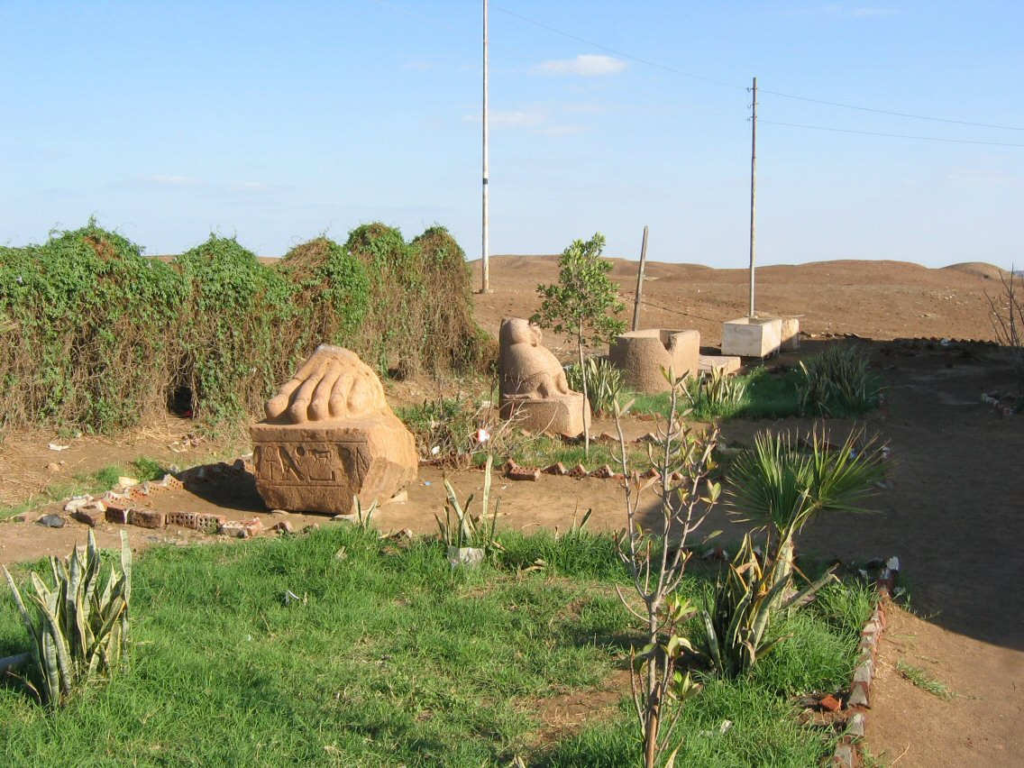
What was life like in Egypt?
Jacob took family into Egypt
Prospered and multiplied
Now there arose a new king over Egypt who did not know Joseph.
Ex. 1:8
Building projects
  Ramses, Pithom
Slavery
Goshen where Hebrews thought to have lived

Slide 8
First national course to restore Canaan
Notes:
Let us have a look at the 1st attempt

Slide 9
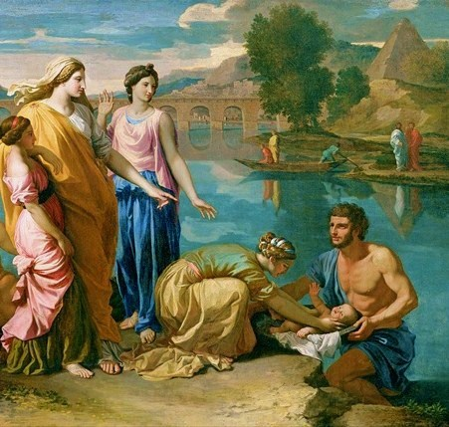
How did Moses become the central figure?
Son of Amram and Jochebed
Saved from death by midwives & mother & princess
Grew up in palace for 40 years
Identity as Hebrew
Strong sense of justice
Killed Egyptian slave driver
  Show people he was patriot
  Cut off attachment to palace
Moses rescue from the Nile
Notes:
Moses was a son of Amram, a member of the Levite tribe of Israel descended from Jacob, and his wife, Jochebed who was kin to Amram's father Kehath (Exodus 6:20). Moses had one older (by seven years) sister, Miriam, and one older (by three years) brother, Aaron.[6] According to Genesis 46:11, Amram's father Kehath immigrated to Egypt with 70 of Jacob's household, making Moses part of the second generation of Israelites born during their time in Egypt.
In Midian he stopped at a well, where he protected seven shepherdesses from a band of rude shepherds. The shepherdesses' father Jethro was immensely grateful for this assistance Moses had given his daughters, and adopted him as his son, gave his daughter Zipporah to him in marriage, and made him the superintendent of his herds.
Moses saved by Shifra and Puah, who were probably Egyptian midwives, to kill the first born of the Hebrews they refused. They were practisi...ng civil disobedience. Refusing, in our language, to commit a crime against humanity because out of compassion they recognised a higher moral authority than their leader. they defied the Pharaoh in the name of their common humanity with the Hebrew slaves.
The next woman was the Pharaoh's own daughter who disobeyed the royal command of her father and saved the life of Moses risking her own life to do so. Again, with great courage she acted out of compassion.
40 years to restore number 40 which unfallen Adam should have fulfilled to make f of f.
Killed Egyptian
1. Killing AA
2. Cut off Moses attachment to palace
3. Show israleiets should trust him as patriot
Lineage

Slide 10
What should have happened next?
Loved Moses
Respected Moses as mediator
Listened to Moses
Multiplied goodness
God
Canaan 21 days
What did happen?
1st national foundation
to receive the messiah
failed
Hebrews
Moses
“Who made you a prince and judge over us? Do you mean to kill me
as you killed the Egyptian?” Then Moses was afraid, and thought,
“Surely the thing is known.” Ex. 2:14

Slide 11
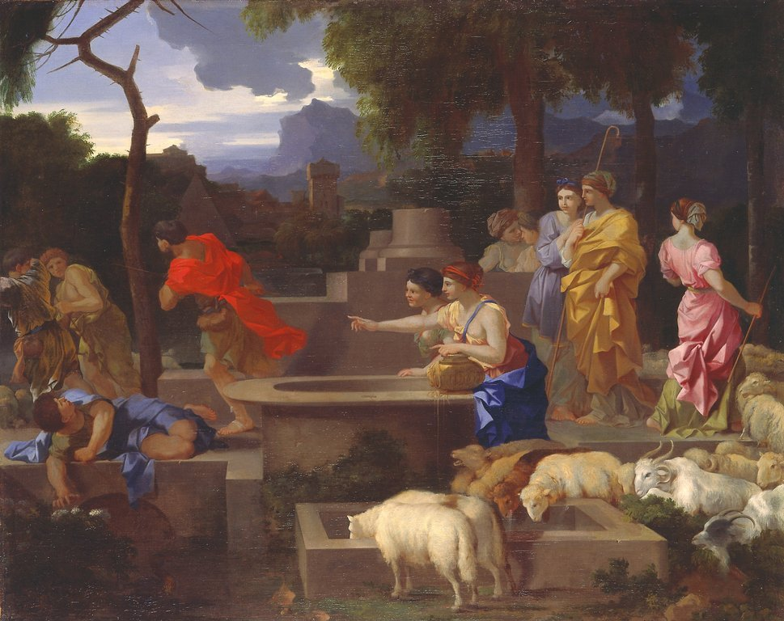
Moses in the wilderness
Flees to wilderness of Midian
Meets Jethro, the priest of Midian
Marries Zipporah
2 sons
Becomes a shepherd
Moses protecting the daughters of Jethro

Slide 12
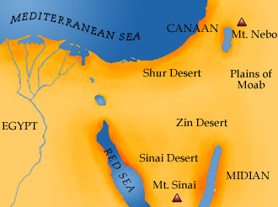
Where is all this happening?
21 days route
Ramsees •
Moses fled

Slide 13
Second national course to restore Canaan

Slide 14
What conditions should be established in the second course?
Foundation of faith
Central person: Moses
Object: Word - tablets
Time period: 40 years
God
Foundation of substance
Hebrews should
Love,
Respect,
Submit and
Multiply goodness
Hebrews
Moses
Notes:
Moses established faith in position of parent. He was in place of God

Slide 15
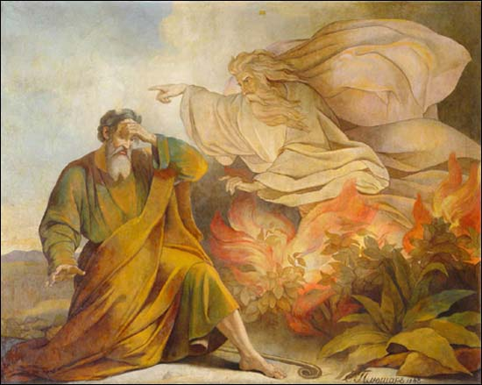
How did Moses encounter God?
Desert of Midian
40 years as shepherd
Burning bush
“I am the God of Abraham, the God of Isaac, and the God of Jacob. I have seen the misery of my people in Egypt. I have heard them crying out because of their slave drivers, and I am concerned about their suffering.”
Exodus 3:6-7
There the angel of the LORD appeared to him in flames of fire from within a bush
Notes:
40 years to restore 40 years Satan invaded
There the angel of the LORD appeared to him in flames of fire from within a bush. Moses saw that though the bush was on fire it did not burn up. ³ So Moses thought, “I will go over and see this strange sight—why the bush does not burn up.” ⁴ When the LORD saw that he had gone over to look, God called to him from within the bush, “Moses! Moses!”
And Moses said, “Here I am.”
⁵ “Do not come any closer,” God said. “Take off your sandals, for the place where you are standing is holy ground.” ⁶
God Appears to Moses in Burning Bush. Painting from Saint Isaac's Cathedral, Saint Petersburg
God ID himself as God of A I & J
God feels peoples suffering
Moses asks two questions, perhaps the most important questions: Who am I, and who are You? And maybe a third question: How can I do what You ask of me? We, each of us and all of us together, are in a relationship with the Divine, so we need to know who we are and Who the Divine is. That relation is based in a covenant, so we need to know what the Divine asks of us. We need to know how, and indeed whether, we can do it.
The only answer Moses gets to his mi anochi, ‘Who am I?’ is ehyeh imach, ‘I am with you,’ or ‘I will be with you,’ or ‘I am present to you.’ That is, you are the one to whom I am present. That is what matters about you, and that is how you will find the strength to do what you have to do. But as for what that means, and how we are to understand it, either for Moses or for ourselves, that is something else. That we go on learning, and forgetting, and learning again, throughout our lives.
The same holds true, only perhaps more so, for the other question: Who are You? Or to put it the way it appears in the text, ma sh’mo, What is His name? The answer to that one is truly astonishing. God describes God’s self as a verb, as a first person form of the verb ‘to be.’ ‘I am that I am’ is a ridiculous translation. The tenses in Hebrew, especially biblical Hebrew, are fluid, continuous, not fixed. So we need something more like ‘I go on being as I go on being.’ Or Martin Buber’s version, which has always felt truest to me (since I’ve known about it anyway): ‘I am and remain and shall always be present as I wish to be present’ That is, I am always with you but you cannot conjure me or command Me. But there again, precisely what that means or how we are to understand is something we struggle with for all of our lives.

Slide 16
Moses’ discussion with God
God: “I will send you to Pharaoh . . .”
Moses: “Who am I . . .?”
God: “But I will be with you . .”
Moses: “They will ask, what is your name?”
God: “I am who I am”
Moses: “They will not believe me.”
Notes:
7 The LORD said, "I have indeed seen the misery of my people in Egypt. I have heard them crying out because of their slave drivers, and I am concerned about their suffering. 8 So I have come down to rescue them from the hand of the Egyptians and to bring them up out of that land into a good and spacious land, a land flowing with milk and honey—the home of the Canaanites, Hittites, Amorites, Perizzites, Hivites and Jebusites. 9 And now the cry of the Israelites has reached me, and I have seen the way the Egyptians are oppressing them. 10 So now, go. I am sending you to Pharaoh to bring my people the Israelites out of Egypt."
11 But Moses said to God, "Who am I, that I should go to Pharaoh and bring the Israelites out of Egypt?"
12 And God said, "I will be with you. And this will be the sign to you that it is I who have sent you: When you have brought the people out of Egypt, you [a] will worship God on this mountain."
13 Moses said to God, "Suppose I go to the Israelites and say to them, 'The God of your fathers has sent me to you,' and they ask me, 'What is his name?' Then what shall I tell them?"
14 God said to Moses, "I am who I am . [b] This is what you are to say to the Israelites: 'I AM has sent me to you.' "
15 God also said to Moses, "Say to the Israelites, 'The LORD, [c] the God of your fathers—the God of Abraham, the God of Isaac and the God of Jacob—has sent me to you.' This is my name forever, the name by which I am to be remembered from generation to generation

Slide 17
So God gave Moses three miracles
Rod becomes a snake then a rod
  Restoration of Adam/messiah
Hand in bosom becomes leprous then wholesome
  Corruption and restoration of Eve/messiah’s bride
Water from the Nile becomes blood
  Restoration of fallen children through True Parents
Notes:
Moses answered, “What if they do not believe me or listen to me and say, ‘The LORD did not appear to you’?”
Moses’ serpent gobbles up Pharaoh's magicians serpents
Restoration of dominion over angel. Subjugation of Satan. Restoration of Adam
Rod – tree – Adam -> fall -> serpent -> restored to tree
Hebrew leaders would recognise the symbolism as knew story of Garden Eden

Slide 18
Moses turns down the offer
Moses: “Oh, my Lord, I am not eloquent. I am slow of speech and of tongue.”
God: “I will be your mouth and teach you what you shall speak.”
Moses: “Oh, my Lord, send, I pray, some other person.”
Then the Lord’s anger burned against Moses and he said, “What about your brother, Aaron the Levite? I know he can speak well.”
Notes:
God angry
Moses supported by Aaron and Miriam

Slide 19
Working together as a trinity
Moses
God
Aaron
Miriam
Adam
Eve
Notes:
Miriam 7 years older. Aaron 3 years older

Slide 20
God tries to kill Moses
On the way, at a place where they spent the night, the Lord met him and tried to kill him. But Zipporah took a flint and cut off her son’s foreskin, and touched Moses’ feet with it, and said, ‘Truly you are a bridegroom of blood to me!’ So he let him alone. It was then she said, ‘A bridegroom of blood by circumcision.’
Exodus 4:24-26
Notes:
Son Gershom
Before God can give a blessing have to pass test or Satan accuse. Better be struck by Gd than satan. Befroe or after a blessing have test.
God attcked him. Otherwise Satan would have. Better chastised by God than by Satan. Different heart. God wants to help us an teach us. Satan to destroy us.

Slide 21
Why did God try to kill Moses?
God does not grant a grace to people without a necessary condition, for if he were to do so, Satan would make an accusation. Therefore when God is about to give grace, he puts the person through a test, either before or after the grace, to prevent Satan’s accusation.
EDP, 266

Slide 22
What is the meaning of circumcision?
Removing the blood of death
  Change of lineage at risk of life
Restoration of right of dominion
  Abram Abraham
  Control over 243 limbs 248 limbs
Sign of the covenant that God restores people
  Change of identity
Three types of circumcision
  Mind, flesh and all things
Notes:
Circumcision is the covenant. Sexual organ is conection with God.
Circumcision - risk of life. Meant different from others. Set apart. Identity as belonging to God. God’s people
Covenant of blood. Saved through the shedding of blood.
R. Ammi b. Abba also siad: [First] Abram is written, then Abraham: at first God gave him mastery over 243 limbs, and later over 248, the additional ones being the two eyes, two ears, and the membrum.
A was given mastery over the organs which entice o ne into lust and sexual immorality as a reward for circumcision.
The numerical value of Abram is 243 a=1, b=2, r=200, m=40
The added h=5
The rabbis responded to Christian attacks on circumcision by investigating the text more closely and ended up designating it not merely as the sign of the covenant, but the covenant itself. (Hoenig 1963, p. 323) They argued that God, 田ommanded us to circumcise proselytes� as part of their joining the covenant (Shab. 137b) which was obviously a rebuke to Paul. For when Abraham had objected to the idea that his followers should be circumcised God told him, “Thou has no defect but this foreskin: remove it and the defect will be gone. Hence walk before me and be thy whole.� (Midrash Rabbah p. 390-91) In a penetrating exegesis of the meaning of circumcision: the word ‘orlah, which means foreskin, was found also refer to a tree (Leviticus 29:23) and thus, by extension, the ‘orlah can also refer to the member which produces offspring or fruit. This play on words led the rabbis to this exegesis: “And I will make my covenant between me and thee, and I will multiply thee exceedingly: Hence, with [That Member Through Which] I will multiply thee exceedingly, I will make my covenant between me and thee.� (Midrash Rabbah p.391) Thus the circumcision is bound inextricably to the covenant. An even closer examination of the Hebrew can be made using Gematria. In rabbinic thought a human being has 248 limbs. The numerical value of the name Abram is 243 (a=1, b=2, r=200, m=40). This is taken to mean that up until he was circumcised Abram had mastery over 243 of his limbs. When God made the covenant with Abram he changed his name to Abraham. This ‘h’ added 5 to the numerical value of his name which signified that he now had mastery over all 248 limbs, the additional ones being his eyes, ears and penis. (B.Ned 32b) So the reward he received for circumcision was control over the organs which tempt people into lust and sexual immorality. (Bowker 1969, p. 108-9) The Zohar further suggests that by being associated with the letter H�, the Shekinah came to rest on Abraham which is why God only spoke to Abram in visions before he was circumcised but afterwards he appeared to Abraham. (Zohar I p. 305) Here one can see the Jewish love for scripture, teasing out its meaning and implications.

Slide 23
Moses meets the Hebrew leaders
Moses and Aaron brought together all the elders of the Israelites, and Aaron told them everything the Lord had said to Moses. He also performed the signs before the people, and they believed. And when they heard that the Lord was concerned about them and had seen their misery, they bowed down and worshipped.
Exodus 4:29-31
Notes:
Moses and Herew elders unite

Slide 24
Moses meets Pharaoh
Moses: “This is what the Lord, the God of Israel, says: ‘Let my people go, so that they may hold a festival to me in the desert.’”
Pharaoh said, “Who is the Lord, that I should pay attention to him and let Israel go? I do not know the Lord and I will not let Israel go.”
Exodus 5:1-2
Notes:
Pharaoh increases work load. Get own straw for brick making.

Slide 25
How did the Hebrews react?
“May the Lord look upon you and judge you! You have made us a stench to Pharaoh and his officials and have put a sword in their hand to kill us.”
Moses returned to the Lord and said, “O Lord, why have you brought trouble upon this people? Is this why you sent me? Ever since I went to Pharaoh to speak in your name, he has brought trouble upon this people, and you have not rescued your people at all.”
Exodus 5:21-23

Slide 26
God to harden Pharaoh’s heart
“You are to say everything I command you, and your brother Aaron is to tell Pharaoh to let the Israelites go out of his country. But I will harden Pharaoh’s heart, and though I multiply my signs and wonders in Egypt, he will not listen to you.”
Exodus 7:2-4

Slide 27
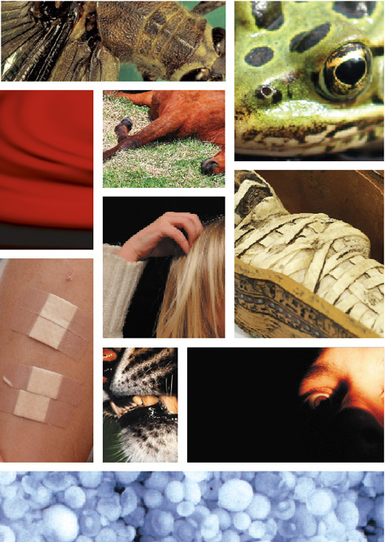
Ten plagues
Plague of blood
Plague of frogs
Plague of lice
Plague of flies
Plague of livestock death
Plague of boils
Plague of hail
Plague of locusts
Plague of darkness
Death of the Egyptian first born
Did they happen?
What about the ethical issues?
God hardened Pharaoh’s heart
Notes:
Defeating Eygptian gods. Nile God and Hecket – frog God of midwives
Moses went to P. P said what evidence you from God -> miracles -> nile -> blood
Hebrews endured 40 more years slavery than needed to. Through this Go wanted Hebrews to realise he was powerful and on their side. Wanted Hebrews to realise Moses was their leader and put trust in him. Also wanted Pharaoh realsied God was powerful and be gla for them to go. Also want Hebrews to want to go and realsie Egypt not home and Phaorah not nice. So God hardened Pharaoh’s heart.
Jacob decieved by Laban 10 times
God hardened P’s heart? P more and more stubborn. No U turn, turning back. Fight to biiter end. HITLER.
Researchers believe they have found evidence of real natural disasters on which the ten plagues of Egypt, which led to Moses freeing the Israelites from slavery in the Book of Exodus in the Bible, were based. But rather than explaining them as the wrathful act of a vengeful God, the scientists claim the plagues can be attributed to a chain of natural phenomena triggered by changes in the climate and environmental disasters that happened hundreds of miles away. They have compiled compelling evidence that offers new explanations for the Biblical plagues, which will be outlined in a new series to be broadcast on the National Geographical Channel on Easter Sunday. Archaeologists now widely believe the plagues occurred at an ancient city of Pi-Rameses on the Nile Delta, which was the capital of Egypt during the reign of Pharaoh Rameses the Second, who ruled between 1279BC and 1213BC.The city appears to have been abandoned around 3,000 years ago and scientists claim the plagues could offer an explanation. Climatologists studying the ancient climate at the time have discovered a dramatic shift in the climate in the area occurred towards the end of Rameses the Second's reign. By studying stalagmites in Egyptian caves they have been able to rebuild a record of the weather patterns using traces of radioactive elements contained within the rock. They found that Rameses reign coincided with a warm, wet climate, but then the climate switched to a dry period. Professor Augusto Magini, a paleo-climatologist at Heidelberg University's institute for environmental physics, said: "Pharaoh Rameses II reigned during a very favourable climatic period.” There was plenty of rain and his country flourished. However, this wet period only lasted a few decades. After Rameses' reign, the climate curve goes sharply downwards.” There is a dry period which would certainly have had serious consequences.” The scientists believe this switch in the climate was the trigger for the first of the plagues. The rising temperatures could have caused the river Nile to dry up, turning the fast flowing river that was Egypt's lifeline into a slow moving and muddy watercourse. These conditions would have been perfect for the arrival of the first plague, which in the Bible is described as the Nile turning to blood. Dr Stephan Pflugmacher, a biologist at the Leibniz Institute for Water Ecology and Inland Fisheries in Berlin, believes this description could have been the result of a toxic fresh water algae. He said the bacterium, known as Burgundy Blood algae or Oscillatoria rubescens, is known to have existed 3,000 years ago and still causes similar effects today. He said: "It multiplies massively in slow-moving warm waters with high levels of nutrition. And as it dies, it stains the water red.” The scientists also claim the arrival of this algae set in motion the events that led to the second, third and forth plagues ﾐ frogs, lice and flies .Frogs development from tadpoles into fully formed adults is governed by hormones that can speed up their development in times of stress. The arrival of the toxic algae would have triggered such a transformation and forced the frogs to leave the water where they lived. But as the frogs died, it would have meant that mosquitoes, flies and other insects would have flourished without the predators to keep their numbers under control. This, according to the scientists, could have led in turn to the fifth and sixth plagues ﾐ diseased livestock and boils Professor Werner Kloas, a biologist at the Leibniz Institute, said: "We know insects often carry diseases like malaria, so the next step in the chain reaction is the outbreak of epidemics, causing the human population to fall ill.” Another major natural disaster more than 400 miles away is now also thought to be responsible for triggering the seventh, eighth and ninth plagues that bring hail, locusts and darkness to Egypt. One of the biggest volcanic eruptions in human history occurred when The ra, a volcano that was part of the Mediterranean islands of Santorini, just north of Crete, exploded around 3,500 year ago, spewing billions of tons of volcanic ash into the atmosphere. Nadine von Blohm, from the Institute for Atmospheric Physics in Germany, has been conducting experiments on how hailstorms form and believes that the volcanic ash could have clashed with thunderstorms above Egypt to produce dramatic hail storms. Dr Siro Trevisanato, a Canadian biologist who has written a book about the plagues, said the locusts could also be explained by the volcanic fall out from the ash. He said: "The ash fall out caused weather anomalies, which translates into higher precipitations, higher humidity. And that's exactly what fosters the presence of the locusts.” The volcanic ash could also have blocked out the sunlight causing the stories of a plague of darkness. Scientists have found pumice, stone made from cooled volcanic lava, during excavations of Egyptian ruins despite there not being any volcanoes in Egypt. Analysis of the rock shows that it came from the Santorini volcano, providing physical evidence that the ash fallout from the eruption at Santorini reached Egyptian shores. The cause of the final plague, the death of the first borns of Egypt, has been suggested as being caused by a fungus that may have poisoned the grain supplies, of which male first born would have had first pickings and so been first to fall victim .But Dr Robert Miller, associate professor of the Old Testament, from the Catholic University of America, said: "I'm reluctant to come up with natural causes for all of the plagues. The problem with the naturalistic explanations, is that they lose the whole point.” And the whole point was that you didn't come out of Egypt by natural causes, you came out by the hand of God."ﾊ

Slide 28
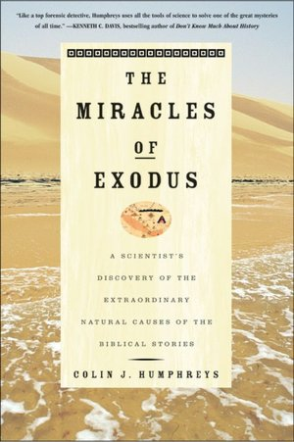
A scientific view of the plagues
Professor Sir Colin John Humphreys, former Goldsmiths’ Professor of Materials Science at Cambridge University, Professor of Experimental Physics at the Royal Institution in London

Slide 29

Notes:
http://www.youtube.com/watch?v=kGACkMBxZNs&feature=related

Slide 30
Notes:
http://www.youtube.com/watch?v=o_oreLXrEXg&feature=related

Slide 31
Were they miracles?
Supernatural?
  God?
  Angels?
  How can one tell?
Natural?
  Coincidence?
“There are two ways to live: you can live as if nothing is a miracle; you can live as if everything is a miracle.” Albert Einstein

Slide 32
Moses meets Pharaoh
Aaron threw his staff down in front of Pharaoh and his officials, and it became a snake. Pharaoh then summoned wise men and sorcerers, and the Egyptian magicians also did the same things by their secret arts: Each one threw down his staff and it became a snake. But Aaron’s staff swallowed up their staffs. Yet Pharaoh’s heart became hard and he would not listen to them, just as the Lord had said.
Exodus 7:10-13
Notes:
then Nile turns to blood

Slide 33
Pharaoh hardens his heart
Pharaoh said, “Pray to the Lord to take the frogs away from me and my people, and I will let your people go to offer sacrifices to the Lord.”
But when Pharaoh saw that there was relief, he hardened his heart and would not listen to Moses and Aaron, just as the Lord had said.
Exodus 8:8,15

Slide 34
After the gnats
Since the gnats were on people and animals everywhere, the magicians said to Pharaoh, “This is the finger of God.” But Pharaoh’s heart was hard and he would not listen, just as the Lord had said.
Exodus 8:18-19

Slide 35
After the flies
Pharaoh said, “I will let you go to offer sacrifices to the Lord your God.” Moses answered, “I will pray to the Lord, and tomorrow the flies will leave. Only let Pharaoh be sure that he does not act deceitfully again by not letting the people go to offer sacrifices to the Lord.” Then Moses prayed and the flies left. But this time also Pharaoh hardened his heart and would not let the people go.
Exodus 8:28-32

Slide 36
After the livestock
Pharaoh investigated and found that not even one of the animals of the Israelites had died. Yet his heart was unyielding and he would not let the people go.
Exodus 9:7

Slide 37
After the hail
Pharaoh said, “This time I have sinned. The Lord is in the right, and I and my people are in the wrong. I will let you go; you don’t have to stay any longer.”
Moses replied “But I know that you and your officials still do not fear the Lord God.”
When Pharaoh saw that the hail had stopped, he sinned again: He and his officials hardened their hearts.
Exodus 9:27-28, 30,34

Slide 38
God hardens Pharaoh’s heart
Then the Lord said to Moses, “Go to Pharaoh, for I have hardened his heart and the hearts of his officials so that I may perform these signs of mine among them that you may tell your children and grandchildren how I dealt harshly with the Egyptians and how I performed my signs among them, and that you may know that I am the Lord.”
Exodus 10:1-2
Notes:
1st 5 plagues Pharaoh hardens own heart. At this time is free to say yes or no. realise he is wrong and sinners yet continue to do what know to be wrong. By doing evil to others becomes evil. Becomes hard hearted. Becomes trapped, slave to evil. Pharaoh obsessed. Tragic figure. No longer rational. Like Hitler, Saddam Hussein. Self deceived.
Is Pharaoh free? Torah examines through narrative not abstract. Pharaoh descends into self destructive madness. Gradual loss of freedom. Obstinacy. Obtuseness. Could no longer act rationally but trapped by obsession.

Slide 39
The locusts
Pharaoh’s officials said to him, “How long will this man be a snare to us? Let the people go, so that they may worship the Lord their God. Do you not yet realise that Egypt is ruined?”
Pharaoh said, “Go, worship the Lord your God, but tell me who will be going.”
Pharaoh said, “No! Have only the men go and worship the Lord.”
But the Lord hardened Pharaoh’s heart, and he would not let the Israelites go.
Exodus 10:7,9,11
Notes:
Only Pharaoh, individual tyrant the problem.

Slide 40
After the darkness
Pharaoh said, “Go, worship the Lord. Even your women and children may go with you; only leave your flocks and herds behind.”
But Moses said, “Our livestock too must go with us; not a hoof is to be left behind.”
But the Lord hardened Pharaoh’s heart, and he was not willing to let them go.
Exodus 10:24-27
Notes:
²⁴ Then Pharaoh summoned Moses and said, “Go, worship the LORD. Even your women and children may go with you; only leave your flocks and herds behind.”
²⁵ But Moses said, “You must allow us to have sacrifices and burnt offerings to present to the LORD our God. ²⁶ Our livestock too must go with us; not a hoof is to be left behind. We have to use some of them in worshiping the LORD our God, and until we get there we will not know what we are to use to worship the LORD.”
²⁷ But the LORD hardened Pharaoh’s heart, and he was not willing to let them go.

Slide 41
Death of the first born
Every firstborn son in Egypt will die, from the firstborn son of Pharaoh.
During the night Pharaoh called Moses and Aaron and said, “Leave my people, you and the Israelites! Go, worship the Lord. Take your flocks and herds and go. And also bless me.”
The Israelites asked the Egyptians for silver and gold. The Lord had made the Egyptians favourably disposed toward the people, and they gave them what they asked for.
Exodus 11:5; 12:31,35-36
Notes:
First Pharaoh and officials and Egyptians wanted Hebrews to stay. Then Pharaoh and officials. Then just Pharaoh. Officials realised madness and destroying Egypt. Ordinary people had sympathy for Hebrews. Also opposed Pharaoh. So Egyptians and Hebrews parted on good terms. Animosity directed not to Egyptians but to Pharaoh, to tyranny and dictatorship.

Slide 42
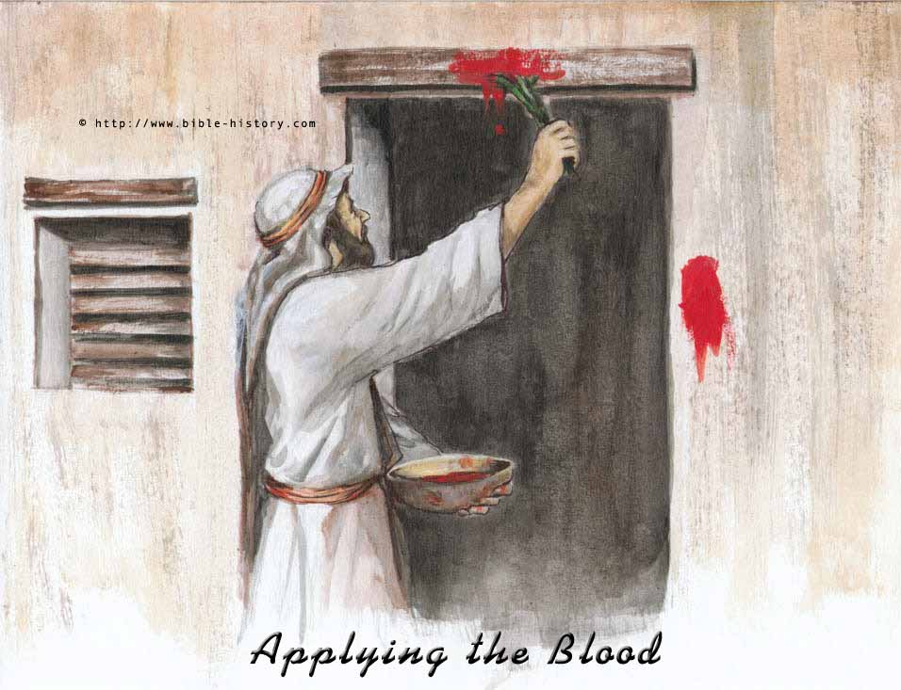
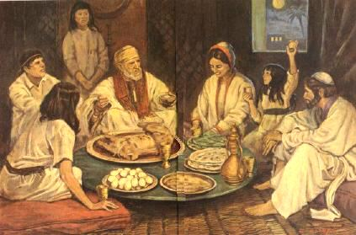
Passover
Roasted lamb
Blood on lintels
Unleavened bread
Angel of death ‘passed over’
Egyptians gave jewelry and clothing
Pharaoh allowed to depart for 3 days
Notes:
3 days
Abraham 3 day journey to Mount Moriah. Overcome Satan’s temptation. Muslim stoning tradition.
Jacob left Haran for 3 days before Laban caught up with him. Iols under Rachel’s seat.
Jesus 3 days in tomb
3 days - period to separate from Satan before new providence

Slide 43
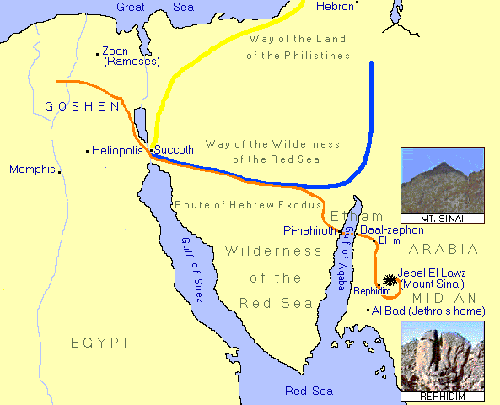
Exodus
Notes:
Could originally have gone 21 days through way of philistines but God worried be afraid of war and turn back
3 days to Succoth. From there pillar of cloud and fire to guide as walked day and night.
600,000 left.
Crossing at Pi-hahiroth/Baal-zephon where is a land bridge. Now 3500 years later worn in the middle. But like a bridge between mainland and Mount St Michael which is covered by tide.

Slide 44
Crossing the Red Sea
Thus says the LORD, “who makes a way in the sea, and a path in the mighty waters; who brings forth the chariot and horse, the army and the power; they shall lie down together, they shall not rise: they are extinct, they are quenched as a wick.”
Isaiah 43:16-17
Pillar of cloud and fire
  Jesus and Holy Spirit
Moses stretched out his rod
Sea parted
Crossed over
Egyptians engulfed
Wilderness of Shur
Bitter water at Marah
Notes:
Ex 14 As Pharaoh approached, the Israelites looked up, and there were the Egyptians, marching after them. They were terrified and cried out to the LORD. 11 They said to Moses, "Was it because there were no graves in Egypt that you brought us to the desert to die? What have you done to us by bringing us out of Egypt? 12 Didn't we say to you in Egypt, 'Leave us alone; let us serve the Egyptians'? It would have been better for us to serve the Egyptians than to die in the desert!"
13 Moses answered the people, "Do not be afraid. Stand firm and you will see the deliverance the LORD will bring you today. The Egyptians you see today you will never see again. 14 The LORD will fight for you; you need only to be still."
15 Then the LORD said to Moses, "Why are you crying out to me? Tell the Israelites to move on. 16 Raise your staff and stretch out your hand over the sea to divide the water so that the Israelites can go through the sea on dry ground. 17 I will harden the hearts of the Egyptians so that they will go in after them. And I will gain glory through Pharaoh and all his army, through his chariots and his horsemen. 18 The Egyptians will know that I am the LORD when I gain glory through Pharaoh, his chariots and his horsemen."
Marah - Moses threw tree into water -> sweet

Slide 45
Manna from heaven
People: “If only we had died by the Lord’s hand in Egypt! There we sat around pots of meat and ate all the food we wanted, but you have brought us out into this desert to starve this entire assembly to death.”
God: “I will rain down bread from heaven for you. The people are to go out each day and gather enough for that day. In this way I will test them and see whether they will follow my instructions. On the sixth day they are to prepare what they bring in, and that is to be twice as much as they gather on the other days.”
Exodus 16:3-5
Notes:
God testing/training them. Already made agree to be obedient at Marah
Manna and quail signified life giving flesha nd bloo of Jesus
Jesus: “I am the living bread which came down from heaven.” John 6:51

Slide 46
Water at Rephidim
The people found fault with Moses, and said, “Give us water to drink.” The people murmoured against Moses, and said, “Why did you bring us out of Egypt to kill us with thirst.”
Moses cried out to the Lord, “What shall I do with this people? They are ready to stone me?”
Exodus 17:2-4

Slide 47
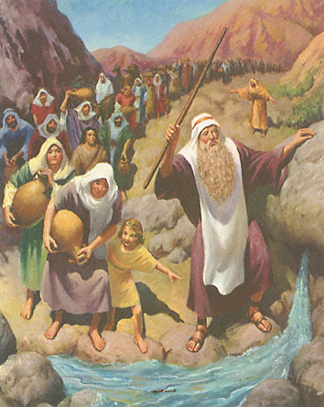
Meaning of the rock and water
Moses struck the rock
Water came out
‘The rock was Christ.’ I Cor. 10:4
Jesus: “Whoever drinks of the water that I shall give him will never thirst; the water I shall give him will become in him a spring of water welling up to eternal life.” John 4:14
Moses strikes the rock at Rephidim

Slide 48
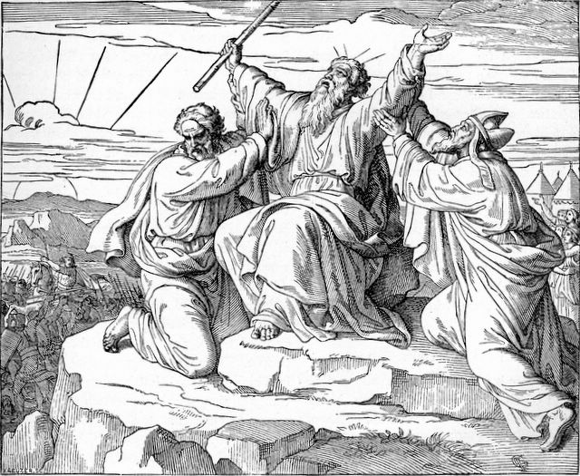
Fighting Amalek at Rephidim
Amalek = Satanic world
Moses = God
Aaron and Hur
= True Parents
Aaron, Moses and Hur

Slide 49
How did Moses rule?
Moses has lunch with Jethro
The next day Moses sat to judge the people, and the people stood about Moses from morning till evening.
Jethro: “What are you doing? Why do you sit alone?” “You will wear yourself out.”
  Represent the people before God
  Teach people the statutes and decisions
  Appoint honest people to judge small matters
  Set up an appeals system
  Only judge the hard cases
Moses did as he suggested
Notes:
Moses humble - accepted good ideas from others
Basis for modern judicial system with appeals courts etc.

Slide 50
Providence of restoration centring on the tabernacle

Slide 51
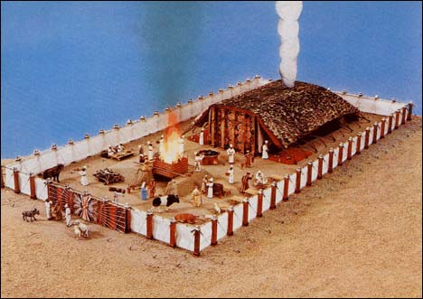
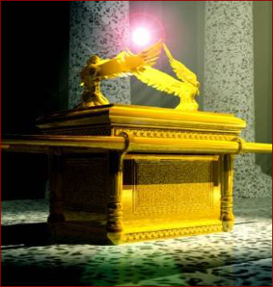
What is the tabernacle?
Tabernacle
= temple = messiah
“Destroy this temple and in three days I shall raise it up.” John 2:21
Ark of the Covenant
  Two tablet of stone
  Aaron’s rod
  Manna in golden urn
  Two cherubim on the Mercy Seat
Foundation to receive the tabernacle is foundation to receive the messiah
Ark of the
Covenant
Notes:
Tabernacle was symbol of the messiah.
Inside Ark of Covenant were tablets of stone, Aaron’s staff, manna in golden urn.
Mercy seat. 2 cherubim. EXPLAIN LATER. God appear between cherubim to guide people. Cherubim - facing each other - lovers. True parents. God speaks from love of TP.
3 miracles. Lost faith becomes 3 graces of ark, tabernacle, tablets
10 plagues. Lost faith becomes 10 commandments

Slide 52
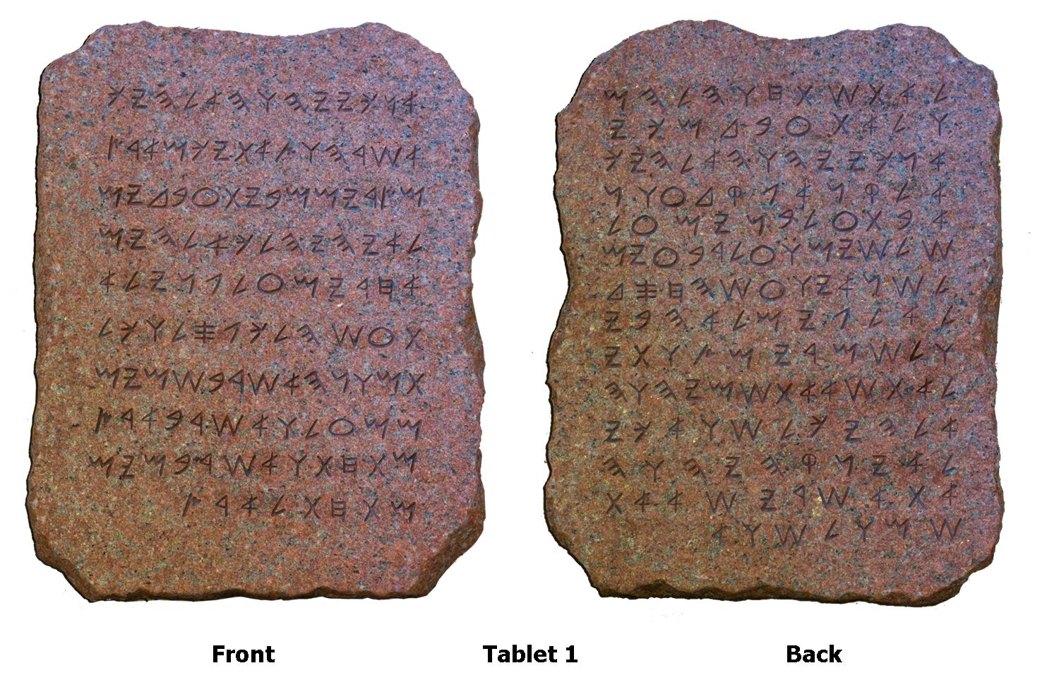
Why did God give the tabernacle?
If followed original course
  Moses family = tabernacle and source of heavenly law
  Moses = Ark and Tablets
Set up an object of faith to attend
Foundation of faith could be passed on
Two tablets of stone

Slide 53
Previous providential age
God
Material
Offering
Fallen
man

Slide 54
New providential age
God
God
Material
offering
Word
Fallen
man
Fallen
man

Slide 55
Second course of restoration into Canaan
The first foundation for the tabernacle

Slide 56
God woos the Hebrews
“You yourselves have seen what I did to the Egyptians, and how I bore you on eagles wings and brought you to myself. Now therefore, if you will indeed hearken to my voice and keep my covenant, you shall be my treasured possession among all peoples, for all the earth is mine; and you shall be to me a kingdom of priests and a holy nation.”
Exodus 19:4-6
Notes:
Change of self identity to people of God. God made an agreement with whole people, not just 1 man.

Slide 57
How did the people respond?
So Moses came and called the elders of the people and set before them all these words that the Lord had commanded him. All the people answered together and said, “All that the Lord has spoken we will do.” And Moses reported the words of the people to the Lord.
Exodus 19:7-8
Notes:
3 days purification
Moses wnet up mountain and received 10 commandments

Slide 58
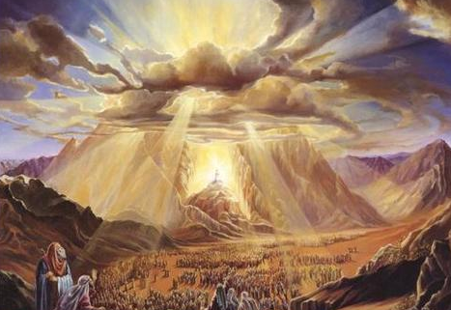
How did the people prepare to receive God?
3 days of purification
Consecration - prayer
Wash and clean clothes
No marital relations
Not to touch the mountain
Moses and Aaron go up the mountain to receive God’s Words
God descends on Mount Sinai

Slide 59
How was the covenant made?
Moses rose early in the morning and built an altar at the foot of the mountain, and twelve pillars, for the twelve tribes of Israel. And he sent young men to sacrifice oxen to the Lord. And Moses took half of the blood and put it in basins, and half of the blood he threw against the altar. Then he took the Book of the Covenant and read it in the hearing of the people. And they said, “All that the Lord has spoken we will do, and we will attend him.” And Moses took the blood and threw it on the people and said, “Behold the blood of the covenant that the Lord has made with you in accordance with all these words.”
Exodus 24:4-8
Notes:
Ceremony of change of blood lineage. Ritual created a community that has lasted 3500 years
shall be to me a kingdom of priests and a holy nation
Moses and 70 elders shared a meal before the Lord on Mt Sinai c.f. TP on Holy Days, Coronation Day etc.
Keep faith at risk of life - Hannukah
Only marry other Jews

Slide 60
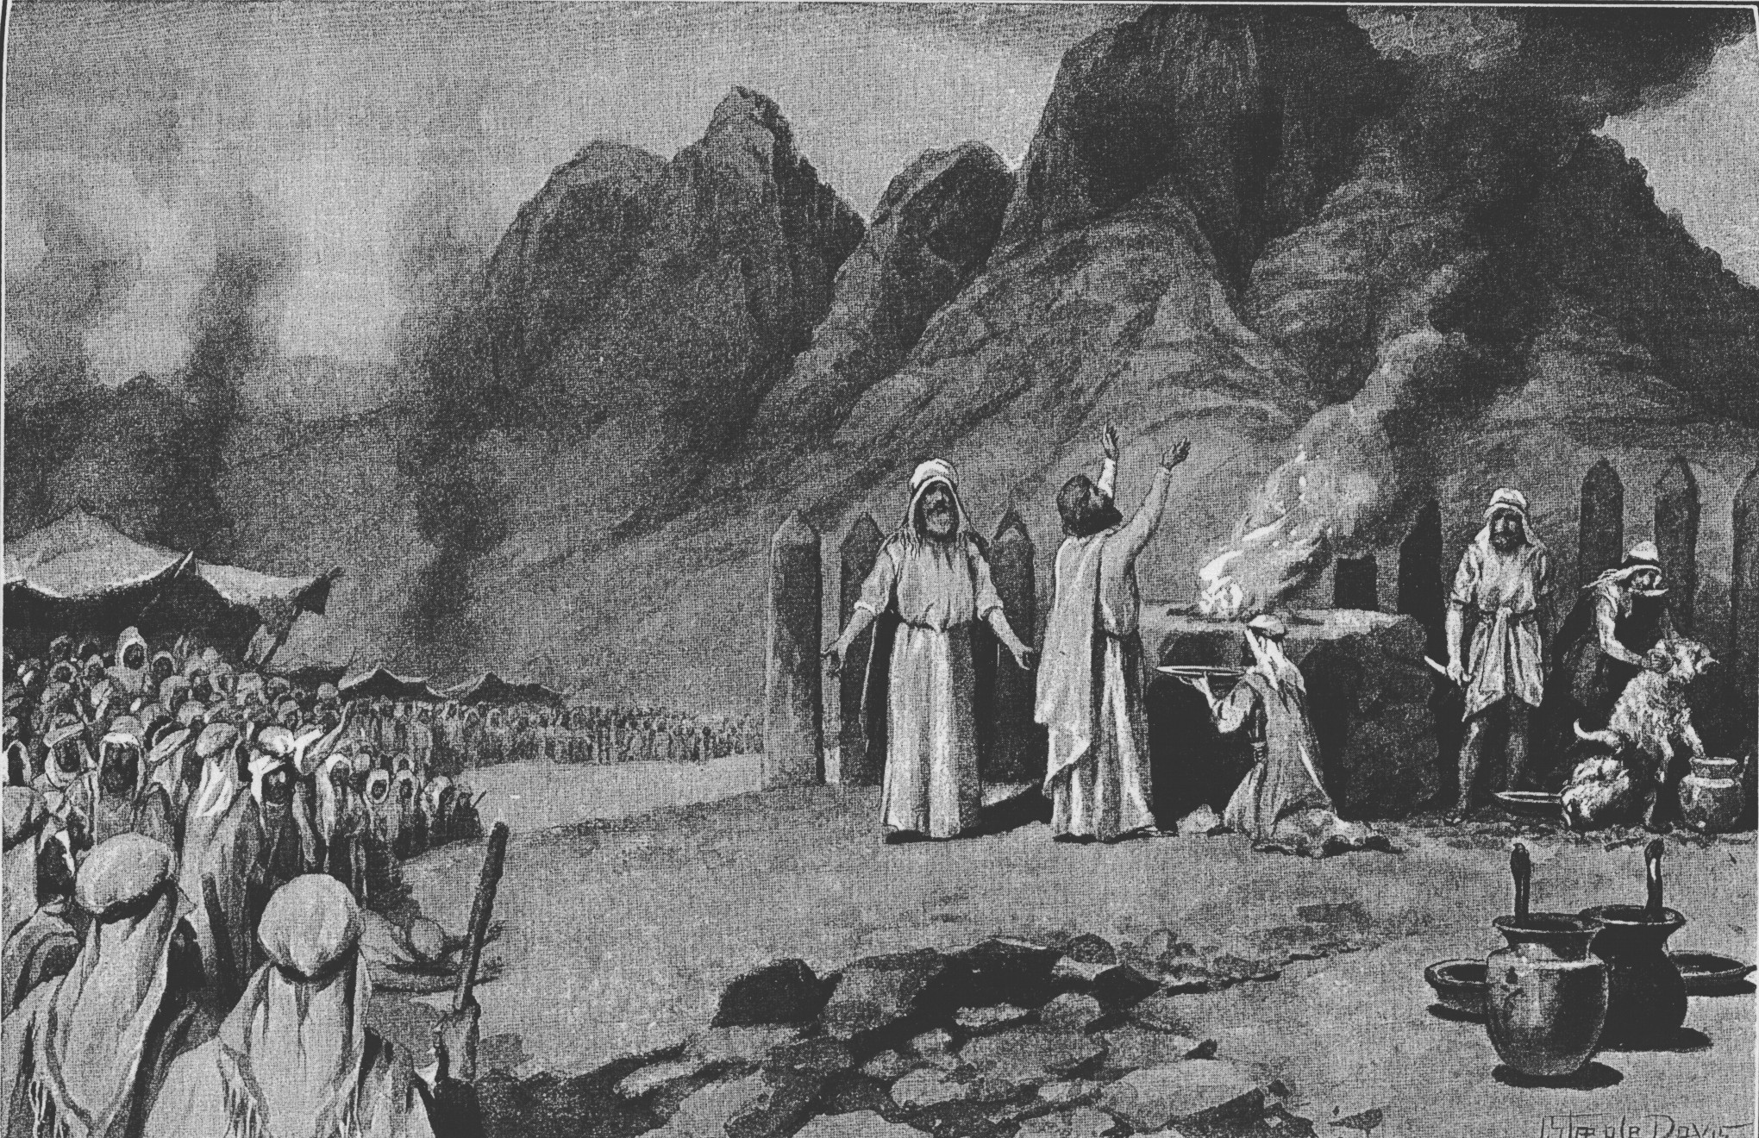
Becoming the people of God

Slide 61
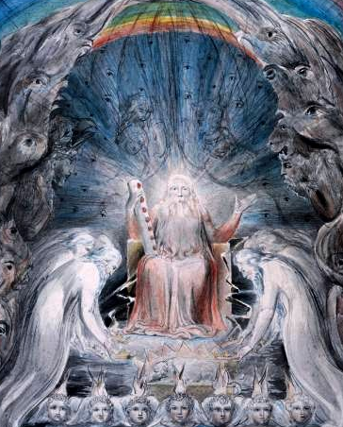
Celebrating the covenant
Moses and Aaron, and the seventy elders of Israel went up and saw the God of Israel. Under his feet was something like a pavement made of sapphire, clear as the sky itself. But God did not raise his hand against these leaders of the Israelites; they saw God, and they ate and drank.
Exodus 24:9-11
The elders before the throne of God
Notes:
William Blake
Sacred meal with God. Holy Days.

Slide 62
What was change of lineage?
Change of identity to the people of God
Change from Satan’s way of life to God’s way of life

Slide 63
What is Satan’s way of life?
False sense of identity
Things are purpose of life
Bad language
Workaholic or fun loving
Disrespecting parents

Slide 64
What is Satan’s way of life?
Violence and murder
Promiscuity
Stealing
Lying
Envy

Slide 65
The Ten Words challenge Satan’s tradition and establish the minimum for living a righteous life
Notes:
Games have rules. Best games have many rules. Rules create order but also freedom within the rules
Mitzvot
613 commandments.
365 negative commandments like the number of days in the solar year,
and 248 positive commandments corresponding to a person's limbs

Slide 66
1. I am the Lord your God. You shall have no other gods before me
Right order, get priorities right - Put God first
Identity - Most fundamental identity from relationship with the divine
Football fan and/or fan of God
PSP or HDH
Not nationalism but patriotism
Worship ever more deeply in your own religion: let God as you see him or her challenge your whole life
Notes:
Chariots of fire film. What’s it with Edward VIII
Can worship other things. Mariage vows, “with my body I thee worship”
Religion can become a barrier
Not worshipping money sex power.

Slide 67
2. You shall not make any graven image
God is invisible
God is infinite, eternal, absolute, mysterious, transcendent, awesome
All images of God are finite, relative, temporal
Worshipping the self, making relative absolute
No expectations, preconceptions
Idealism is idolatry
Don’t think you’ve got God-questions answered: there are always more divine surprises for the searcher
Notes:
Invisible - show me god
Any picture or image is false. -> worship image and not God. Fight over whose image or concept of God is correct.
Making relative out to be absolute. Think the way I brought up the obly way, the right way. Only my religion is the true religion
People fight over b eliefs about God. God in a box. Create God in own image. Self serving. Tame God.
Golden calf story
Worshiping car - polishing etc.
What more valuble/powerful painter or painting?
Abraham and the idols
Man is lord of creation so shouldn’t worship creation
Don’t have preconceptions about God or people. Be open minded. Love a person, not an image of a person. Infatuation. Loving a person but disappointed that they don’t match expectations. Love person as they are. Recognise mystery of person. Love unconditionally.
Intercultrual and international marriages lead to breakdown of concepts. Recognise that one’s upbringing is relative, let go of concepts, become more universal.
Respect differences.
Leader - can’t follow someone because they are not perfect Abel!!! I.e. they are not how I think they ought to be.

Slide 68
3. You shall not take the Lord’s name in vain
Words are powerful, creative
  Blessing or curse
Don’t misuse language
Sacred words become swear words
Priest craft
  Misusing God’s name
Be a learner, and speak respectfully of all spiritual life: don’t criticise what you can’t understand
Notes:
God created with word.
Misuse of language -> breakdown communication
Words create. Create atmsophere. Swear words - sexual words
Priest craft - using God’s name to threaten, intimidate, manipulate people. ‘if you don’t do this God will punish you’ ‘You’ll go to hell’ etc
Father said . . . .
A blessing, (also used to refer to bestowing of such) is the infusion of something with holiness, divine will, or one's hope or approval. Make something sacred by a sacrificial custom. Mark something with blood. AS bledsian
Blessed - favoured by God.
"I will bless you, I will make your name great.” God to Abram
The Priestly Blessing is set forth at Numbers 6:24-26:
May the LORD bless you, and keep you;
May the LORD make His countenance shine upon you, and be gracious to you;
May the LORD turn His countenance to you and grant you peace.
Blessing - permission
Rectification of names
Zi-lu said, "The ruler of Wei has been waiting for you, in order with you to administer the government. What will you consider the first thing to be done?"
The Master replied, "What is necessary to rectify names."
"So! indeed!" said Zi-lu. "You are wide off the mark! Why must there be such rectification?"
The Master said, "How uncultivated you are, Yu! A superior man, in regard to what he does not know, shows a cautious reserve.
If names be not correct, language is not in accordance with the truth of things.
If language be not in accordance with the truth of things, affairs cannot be carried on to success.
When affairs cannot be carried on to success, proprieties and music do not flourish.
When proprieties and music do not flourish, punishments will not be properly awarded.
When punishments are not properly awarded, the people do not know how to move hand or foot.
Therefore a superior man considers it necessary that the names he uses may be spoken appropriately, and also that what he speaks may be carried out appropriately. What the superior man requires is just that in his words there may be nothing incorrect."
(Analects XIII, 3, tr. Legge)

Slide 69
4. You shall observe the Sabbath
Sabbath most holy day for Jews. What makes Jews who they are
Time for God and family
More to life than work
More to life than fun
Rest when you are weary: spiritual refreshment can be found with nature, friends, music, worship and solitude
Notes:
No translation for the word Sabbath into European or world languages.
Practical way ot bring God into family life. Why don’t UC do this? No foundation.

Slide 70
Significance of the Sabbath
“Observe the Sabbath, because it is holy to you. For six days, work is to be done, but the seventh day is a Sabbath of rest, holy to the Lord. The Israelites are to observe the Sabbath, celebrating it for the generations to come as a lasting covenant. It will be a sign between me and the Israelites forever, for in six days the Lord made the heavens and the earth, and on the seventh day he abstained from work and rested.”
Notes:
How does this apply to UC? Eternal covenant

Slide 71
5. You shall honour your father and mother
Father and mother
  Equal value of men and women
Lineage is important
Vertical - lineage, tradition, wisdom
Love your family and aim to be thankful for your parents, especially when it seems most difficult
Notes:
Not like the oriental tradition of father - son
Make parents proud of you
Treat with respect
Look after when old
Carry on their mission
Tolstoy’s story of making trough

Slide 72
6. You shall not murder
Life is precious
Love life
Murder versus killing
Self-defence justified
Notes:
Cain and Abel
Hebrew word is murder not kill. Not kill is too far -> impractical and immoral. Sometimes need to kill - self defence. War

Slide 73
7. You shall not commit adultery
Love is precious
Adultery destroys love, trust & family
Notes:
Love, life and lineage
David and Bathsheba

Slide 74
8. You shall not steal
Respect ownership
Things extension of self
Love people, never steal
Tithing
Notes:
Something steal accuses one. Boy in trouble - police visiting. Got rid of all stolen goods. -> empty flat. Never stole again.
Jack and beanstalk story
There is ownership ad private prioperty
Tithing determines church membership

Slide 75
9. You shall not bear false witness
Love the truth - never lie
Truth -> perception of reality
Support justice
Notes:
Honesty and courage are necessary for justice
False witness -> injustice. Innocent go to prison and guilty get off scot free. Intolerable. Speak truth to power. Journalism, free press
Lie breaks reationship
Truth - describes, conveys picture of reality. Duty to present true picture of the world. False information, intelligence leads to wars etc.
12 spies

Slide 76
10. You shall not covet
Happiness commandment
The grass isn’t greener on the other side of the hill
Be happy when others are successful
Be happy when others are rich
  Don’t be like Lucifer
Be sad when others suffer
Love others
Notes:
Lucifer coveted Adam
Don’t be envious. Envy leads to poverty. Equality means no progress.
10 commanments plus others reorientation of life to worship of God. Puification of thoughts, words deeds. Passed on through generations. High standard of Jews. Gradual elimination of evil elements. Gradual change of linegae from idol worhsiping to child of God.
Development of God consciousness

Slide 77
Development of the moral life
“You shall not wrong a stranger or oppress him, for you were strangers in the land of Egypt.” (Exodus 22:20)
Earliest appearance of empathy in ancient world
Empathy and compassion the basis of morality
Notes:
“You shall not wrong a stranger or oppress him, for you were strangers in the land of Egypt” (Exod. 22:20). It is extremely unusual for the Torah to provide an explanation for a commandment, and that is what we have here. The reason why we must not oppress a stranger is an appeal to the past, to history: we were strangers in the land of Egypt.
In ancient Greece, when they were looking for task-masters to place in charge of a group of slaves, they would take someone who had been a slave himself, because he would remember the kind of sanction that was most painful to him and therefore be able to inflict it most effectively on the slaves he was now responsible for. The experience of suffering in the past does not automatically, necessarily produce an unwillingness to make others suffer
you know the feelings (literally ‘the soul’) of the stranger, for you were strangers in the land of Egypt” (Exod. 23:9). According to this verse, the historic memory of having been outsiders, aliens, enables you to understand what it is like to be an alien, and that requires that when you see aliens today, you must imagine that you are in their place, and treat them accordingly, the way you would want to be treated yourself.
This act of imagination is what we call empathy. It is a buzz word in contemporary discourse. But we should appreciate that it is not at all self-evident. Indeed, this verse, and the ideas and feelings that it evokes, may well represent a monumental innovation in human thinking. There seems to be no evidence of this kind of attitude previously in the ancient world – not in the literature of the Babylonians or the Egyptians or the Greeks. For the ancient Greeks, the world was divided into categories: you were Greek or you were barbarian, you were free or you were slave. No act of the imagination led to identification with the Other across these boundary lines. In our own experience, seeing a person who is horribly disfigured, or living in squalor, is as likely to trigger feelings of disgust in the observer as feelings of compassion.
It was the innovation of the Torah that all human beings share a common essence, expressed in that enigmatic phrase “tselem Elohim”, and that we can imagine, understand, have compassion for the feelings of others apparently quite different from us. And so this commandment rooted in empathy is repeated frequently in the Torah, and it appears also in the rabbinic literature, as in the statement:
Do not judge your associate until you stand in his place (Avot 2:5).“You must not oppress the stranger, ki atem yedatem et nefesh ha-ger, for you know the soul of the stranger.” You are capable of imagining what it is like to be a stranger and acting accordingly. That is one of the great gifts of our Torah and our people to world consciousness. What a tragedy that the insight expressed in this mitzvah seems to be falling increasingly into abeyance in our time.

Slide 78
What is the Biblical attitude to the law?
I rejoice in following your statutes
as one rejoices in great riches.
I shall walk at liberty,
for I have sought out your precepts.
How sweet are your words to my taste,
sweeter than honey to my mouth!
Your statutes are wonderful;
therefore I keep them.
Streams of tears flow from my eyes,
for your law is not followed.
Psalm 119
Notes:
A primitive root; to hear intelligently (often with implication of attention, obedience, etc.; causatively, to tell, etc.) -- X attentively, call (gather) together, X carefully, X certainly, consent, consider, be content, declare, X diligently, discern, give ear, (cause to, let, make to) hear(-ken, tell), X indeed, listen, make (a) noise, (be) obedient, obey, perceive, (make a) proclaim(-ation), publish, regard, report, shew (forth), (make a) sound, X surely, tell, understand, whosoever (heareth), witness.

Slide 79
Law as mitzvah (act of human kindness)
Tikkun olam
  “Repairing the world” or “perfecting the world.”
Performing ritual mitzvot hastens the messianic age
Strengthens good spiritual forces
Makes Jews better people which influences society and thus the world
Notes:
613 commandments
248 positive
365 negative
Moral
Ritual
Health
Chukkim
Jews believe that performing of ritual mitzvot (commandments or religious obligations) is a means of tikkun olam, helping to perfect the world, and that the performance of more mitzvot will hasten the coming of the Messiah and the Messianic Age. This belief dates back at least to the early Talmudic period. According to Rabbi Yochanan, a rabbi who lived during that period, the Jewish people will be redeemed when every Jew observes Shabbat (the Sabbath) in two consecutive weeks.[4]
In Jewish thought ethical mitzvot as well as ritual mitzvot are important to the process of tikkun olam. Some Jews believe that performing mitzvot will create a model society among the Jewish people, which will in turn influence the rest of the world. By perfecting themselves, their local Jewish community or the state of Israel, the Jews set an example for the rest of the world. The theme is frequently repeated in the sermons and writings of across the Jewish spectrum: Reconstructionist, Reform, Conservative, and Orthodox.
According to Moshe Chaim Luzzatto, an influential 18th century interpreter and systemic philosopher of Lurianic Kabbalah[10], the physical world is connected to spiritual realms above, and these spiritual realms in turn influence the physical world.[11] In his view, as developed in his Derech Hashem, Jews have the ability, through physical deeds and free will, to direct and control these spiritual forces.[12] These spiritual forces include tikkun (rectification, good; the presence of Divine light) and kilkul (damage, evil; not merely the absence of goodness and Divine light, but its own force that is strengthened by the absence of goodness and Divine light).[13] God's desire in creation is that God's creations ultimately will recognize God's unity and overcome evil; this will constitute the perfection (tikkun) of creation.[14] Jews have the Torah now and are aware of God's unity, but when all of humanity recognizes this fact, the rectification will be complete.[15] Only the actions of Jews further creation; the deeds of non-Jews do not.[16] Instead, God gave non-Jews the Noachide Laws so that they may obtain individual portions in the Olam Haba (afterlife).[17]

Slide 80
What was the holiness code?
“Consecrate yourselves and be holy, because I am the Lord your God. Keep my decrees and follow them. I am the Lord, who makes you holy.”
“Speak to the entire assembly of Israel and say to them: 'Be holy because I, the Lord your God, am holy.’”
  Many laws on sexual relations, sexual purity
  Justice, animal welfare, etc.
Notes:
motivation

Slide 81
Foundation of faith and substance
Foundation of faith
Central person: Moses
Object: Word - tablets
Time period: 40 days
God
Foundation of substance
Hebrews should
Love,
Respect,
Submit and
Multiply goodness
Hebrews
Moses
Cain
Abel

Slide 82
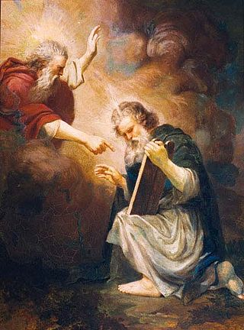
What was the foundation of faith to receive the tabernacle?
The Lord said to Moses, “Come up to me on the mountain and stay here, and I will give you the tablets of stone, with the law and commands I have written for their instruction.”
On the seventh day he called Moses.
Exodus 24:12
Central figure - Moses
Object of faith - Word
Time period - 40 days prayer and fasting
Moses receiving the tablets
Notes:
40 days fast necessary because Israleietes fallen into faithless after leaving Egypt.
Recreating word so 6 days creation needed to be restored.

Slide 83
What was the foundation of substance?
Israelites should keep the covenant, keep the commandments and follow Moses in worshipping and attending the tabernacle
“And now, Israel, what does the Lord your God require of you, but to fear the Lord your God, to walk in all his ways, to love him, to serve the Lord your God with all your heart and with all your soul, and to keep the commandments and statutes of the Lord, which I command you this day for your good?”
Deut. 10:12-13

Slide 84
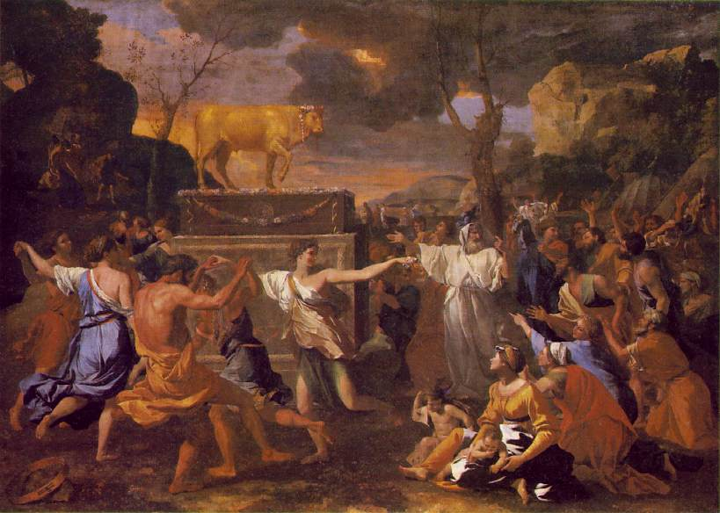
Making the golden calf
“And I looked, and behold, you had sinned against the Lord your God; you had made yourselves a molten calf; you had turned aside quickly from the way which the Lord had commanded you.”
Deut. 9:16
Worshipping the golden calf
Notes:
When the people saw that Moses was so long in coming down from the mountain, they gathered around Aaron and said, "Come, make us gods [a] who will go before us. As for this fellow Moses who brought us up out of Egypt, we don't know what has happened to him."
2 Aaron answered them, "Take off the gold earrings that your wives, your sons and your daughters are wearing, and bring them to me." 3 So all the people took off their earrings and brought them to Aaron. 4 He took what they handed him and made it into an idol cast in the shape of a calf, fashioning it with a tool. Then they said, "These are your gods, [b] O Israel, who brought you up out of Egypt."
5 When Aaron saw this, he built an altar in front of the calf and announced, "Tomorrow there will be a festival to the LORD." 6 So the next day the people rose early and sacrificed burnt offerings and presented fellowship offerings. [c] Afterward they sat down to eat and drink and got up to indulge in revelry.

Slide 85
How did God react?
Then the Lord said to Moses, “Go down, because your people, whom you brought up out of Egypt, have become corrupt. They have been quick to turn away from what I commanded them and have made themselves an idol cast in the shape of a calf. They have bowed down to it and sacrificed to it and have said, ‘These are your gods, O Israel, who brought you up out of Egypt.’ “I have seen these people,” the Lord said to Moses, “and they are a stiff-necked people. Now leave me alone so that my anger may burn against them and that I may destroy them. Then I will make you into a great nation.”
Exodus 32:7-10

Slide 86
What did Moses say to God?
But Moses sought the favour of the Lord his God. “O Lord,” he said, “why should your anger burn against your people, whom you brought out of Egypt with great power and a mighty hand? Why should the Egyptians say, ‘It was with evil intent that he brought them out, to kill them in the mountains and to wipe them off the face of the earth’? Turn from your fierce anger; relent and do not bring disaster on your people. Remember your servants Abraham, Isaac and Israel, to whom you swore by your own self: ‘I will make your descendants as numerous as the stars in the sky and I will give your descendants all this land I promised them, and it will be their inheritance forever.’” Then the Lord relented and did not bring on his people the disaster he had threatened.
Exodus 32:11-14

Slide 87
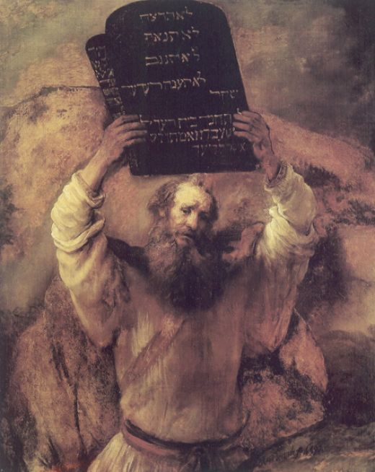
What did Moses do next?
When Moses approached the camp and saw the calf and the dancing, his anger burned and he threw the tablets out of his hands, breaking them to pieces at the foot of the mountain. And he took the calf they had made and burned it in the fire; then he ground it to powder, scattered it on the water and made the Israelites drink it.
Exodus 32:19-20
Moses breaking tablets
Notes:
Rembrandt
Who is on the Lord’s side? 3000 put to death

Slide 88



First foundation for the tabernacle
Tabernacle
Foundation of Faith
Foundation of Substance
Central person: Moses
God
Object: Word - tablets
People
Moses
Time Period: 40 day fast

Slide 89
Second course of restoration into Canaan
Second foundation for the tabernacle

Slide 90
Foundation of faith and substance
Foundation of faith
Central person: Moses
Object: Word - tablets
Time period: 40 days
God
Foundation of substance
Hebrews should
Love,
Respect,
Submit and
Multiply goodness
Hebrews
Moses
Cain
Abel

Slide 91
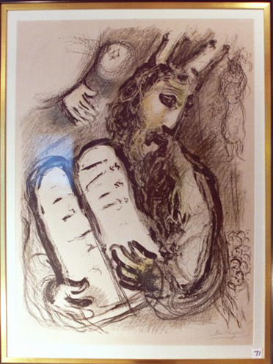
Foundation of faith
Central figure: Moses
40 day fast
“Cut two tablets of stone like the first and I will write upon the tablets the words that were in the first tablets, which you broke.”
Exodus 34:1
Moses receives the tablets
Notes:
This time moses had to cut tablets.
40 days to restore previous 40 day period
Told moses they would drive out other tribes, destroy altars etc. not to marry
Chagall

Slide 92
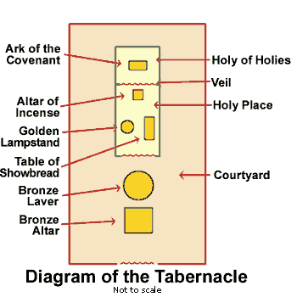
Foundation of substance
While Moses was on the mountain the people kept faith
Followed Moses instructions to build the Tabernacle
“Take from among you an offering to the Lord; whoever is of generous heart let him bring gold . . .”
Exodus 35:5
Notes:
Were supposed to honour tabernalce and follow until entered canaan
Veil in temple torn when Jesus crucified signified every person could now approach God and be saved through Jesus

Slide 93
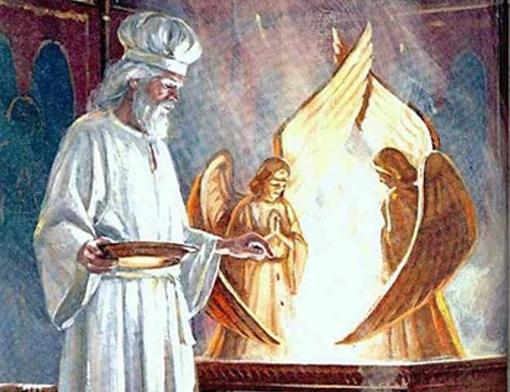
Where did God speak to Moses?
“The cherubim shall spread their wings above, over the mercy seat with their faces one to another. There I will meet with you, from above the mercy seat, from between the two cherubim I will speak with you.”
Exodus 25:20-24
Cherubim represent True Parents
Notes:
Cherubim - facing each other - lovers. True Parents

Slide 94
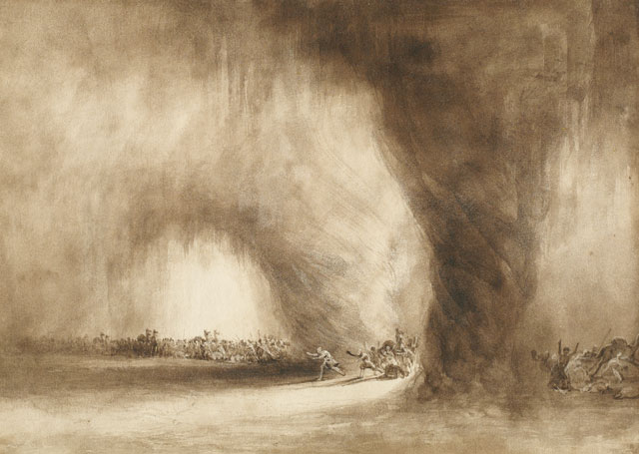
Setting out for Canaan
On the twentieth day of the second month of the second year, the cloud lifted from above the tabernacle of the testimony. Then the Israelites set out from the Desert of Sinai and travelled from place to place until the cloud came to rest in the Desert of Paran. They set out, this first time, at the Lord's command through Moses.
Exodus 10:11-13
The Israelites passing through the
wilderness preceded by the
pillar of clouds
Notes:
William west

Slide 95
Satan invades
Now the people complained about their hardships in the hearing of the Lord, and when he heard them his anger was aroused. Then fire from the Lord burned among them and consumed some of the outskirts of the camp. When the people cried out to Moses, he prayed to the Lord and the fire died down.
The rabble with them began to crave other food, and again the Israelites started wailing and said, “If only we had meat to eat! We remember the fish we ate in Egypt at no cost—also the cucumbers, melons, leeks, onions and garlic. But now we have lost our appetite; we never see anything but this manna!”
Exodus 11:1-2, 4-6
Notes:
Attachment to egyspt. Can’t move forwards. Need to change way of thinking
Complaining - slave or servant mentality. Chjild of God - see problem, try to solve. Repsonsibile. Invove. Engaged. Support leader, manager etc.

Slide 96
God gives them quail
“Now the Lord will give you meat, and you will eat it. You will not eat it for just one day, or two days, or five, ten or twenty days, but for a whole month—until it comes out of your nostrils and you loathe it—because you have rejected the Lord, who is among you, and have wailed before him, saying, ‘Why did we ever leave Egypt?’”
Now a wind went out from the Lord and drove quail in from the sea.
Exodus 11:18-20, 31

Slide 97
Second foundation
Israelites listen to Moses and leave Sinai guided by pillar of cloud
Tabernacle
Foundation of Faith
Foundation of Substance
Central person: Moses
God
Offering: Word - tablets
Hebrews
Moses
Time Period: 40 day fast
Cain
Abel

Slide 98
Second foundation is lost
Israelites complain
God burns their camp
They still long for Egypt
Tabernacle
Foundation of Faith
Foundation of Substance
Central person: Moses
God
Offering: Word - tablets
Hebrews
Moses
Time Period: 40 day fast
Cain
Abel

Slide 99
Second course of restoration into Canaan
Third foundation for the
tabernacle

Slide 100
Foundation of faith and substance
Foundation of faith
Central person: Moses
Object: Word - tabernacle
Time period: 40 days
God
Foundation of substance
Hebrews should
Love,
Respect,
Submit and
Multiply goodness
Hebrews
Moses
Cain
Abel

Slide 101
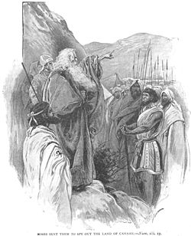
Foundation of faith
Central person: Moses
Offering: Word - tablets
Time period: 40 days scouting by 12 spies representing 12 tribes
Moses sends out 12 spies

Slide 102
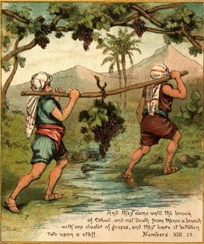
Foundation of substance
“We came to the land. It flows with milk and honey, and this is its fruit. Yet the people who dwell in the land are strong, and the cities are fortified.”
Caleb said, “Let us go up at once and occupy; for we are well able to overcome it.”
Numbers 13:27-30

Slide 103
Satan invades
“We are not able to go up against the people; for they are stronger than we.” So they brought to the people of Israel an evil report.”
People lamented
“Let us choose a captain and return to Egypt.”
Only 2 spies, Joshua and Caleb, argue against them
God
12 spies
Moses
Notes:
You can get the Jews out of Egypt. It’s harder to get Egypt out of the Jews.

Slide 104
Moses pleads with God
God: “How long will this people despise me? I will strike them and disinherit them, and I will make of you a nation greater and mightier than they.”
Moses replied: “The Egyptians will hear of it.”
Moses reminded God of what he had said,
“The Lord is slow to anger, and abounding in steadfast love, forgiving iniquity . . . Pardon the iniquity of this people.”
Exodus 14:11-13, 18-19

Slide 105
40 days becomes 40 years
“According to the number of days in which you spied out the land, forty days, for every day a year, you shall bear your iniquity, forty years, and you shall know my displeasure.”
Exodus 14:34
All those over 20 years old to die in the wilderness
Some decide to enter Canaan immediately
  Defeated
Korah’s rebellion -> earth swallowed up
Rebellion against this -> 14,700 died in plague
Notes:
God angry. Not punishment. Take 40 years to get back to restore position of being ready to enter Canaan
Korah accused Moses of elevating himself and using God’s name for own agrandisment. Argued everyone holy. Earth swallowed up. Rebellion gainst what happened to Korah.
What follows is what I consider to be one of the most provocatively subver-sive passages in the rabbinic literature. It appears in the first chapter of the Midrash on Psalms. Its purpose is to relate the Psalms to material in the To-rah, and in our case it takes the first verse of Psalm 1 - Happy is the one who has not followed the counsel of the wicked, or taken the path of sinners, or joined the company of the insolent (Ps. 1:1) - and applies it to the uprising led by Korah who, in the rabbinic reading, ﾒspoke insolently against Moses and Aaron. What did Korah do? He assembled all the congregation against Moses and Aaronﾓ - up to here the Midrash is merely following the Torah text - ﾒand in their presence he began to speak words of scorn. This is what he said.ﾓ At this point, the Torah text in our parashah is entirely abandoned, and a new speech is crafted and placed in Korahﾕs mouth. It is this speech that I find so extraordinary, worth citing in full.
In my neighbourhood there was a widow, and with her were her two fatherless daughters. The widow had only one field, and when she was about to plough, Moses said unto her, ﾒThou shalt not plough with an ox and an ass togetherﾓ (Deut. 22:10). When she was about to sow, Moses said to her, ﾒThou shalt not sow thy field with two kinds of seedﾓ (Lev. 19:19). So far, it is just making life a bit more difficult for the widow by restricting the range of her activities. But it gets worse. ﾊWhen she was about to reap the harvest and to stack the sheaves, Moses said to her: ﾒThou shalt not harvest the gleanings, the over-looked sheaves, and the corners of the fieldﾓ (based on Lev. 19:9 and Deut. 24:19) [these were, of course, to be left for the poor]. When she was about to bring the remaining harvest into the granary, Moses said to her, ﾒGive me the heave-offering, the first tithe, and the second titheﾓ (Num. 18:8ff, 18:26ff, Deut. 14:22ff). She submitted to Godﾕs decree and gave them to him. What did the poor woman do then? She sold the field and bought two sheep, so that she might clothe herself in the wool shorn from them, and so that she might profit out of the lambs. As soon as the sheep brought forth their young, Aaron came and said to the widow, ﾒGive me the firstling males, for this is what the Holy One, blessed be He, said to me, ﾔAll the firstling males that are born of thy herd and of thy flock thou shalt sanctify unto the Lord thy Godﾕﾓ (Deut. 15:19). Again she submitted to Godﾕs decree, and gave the young of her sheep to Aaron. When the time for shearing arrived, she sheared her two sheep. Then Aaron came again and said to the widow, ﾒGive me the first portion of the shearing.ﾓ She said, ﾒThere is no strength in me to withstand this man. I will slaughter the sheep and eat them. After she slaughtered them, Aaron came again and said to her, ﾒGive me the shoulder, the jaws, and the mawﾓ (cf. Lev. 7:32).The widow said, ﾒThough I have slaughtered my sheep, I am still not free of your demands; behold, I devote my sheep to the uses of the Temple.ﾓ But Aaron said to her, ﾒIf the sheep are to be devoted to the uses of the Temple, they belong entirely to me, for it was said to me, ﾔEverything devoted in Israel shall be thineﾕﾓ (Num. 18:14). Thereupon Aaron lifted up the sheep, went on his way, and left her weeping with her daughters.ﾕ That is the end of the story that Korah tells the assembled Israelites, according to the Midrashic imagination. All that is left is a rhetorical flourish at the end, placed into Korahﾕs mouth: ﾒIs such a thing right? Oh, the despoiled woman! The hapless woman! Moses and Aaron have done all these things to her, but hang the blame on the Holy One, blessed be He!ﾓ What are we to make of this passage?ﾊ Some unknown rabbinic author has fabricated a supposedly villainous speech by a would-be demagogue that can hardly avoid evoking sympathy for the widow and for the man who stands up in her defence. I will focus on two serious issues are raised by this speech. The first comes at the very end: ﾒMoses and Aaron have done all these things to her, but hang the blame on God.ﾓ In other words, the Korah of the rabbinic imagina-tion is presenting the religious claim that God is the source of all these laws as a fraud. He articulates the dissident view that religious rules, including the commandments of the Torah, are invented by human beings for their own self-interest. The extensive laws relating to the sacrifices in the book of Leviticus include a substantial percentage said to be owed to the Priests and the Levites, to be consumed only by them. This can be seen as a kind of tax system for the benefit of an elite, hereditary in-group that uses the taxes for its own self-perpetuation - represented by Aaron claiming a portion of the slaughtered sheep, and eventually seizing the entire animal. In this analysis, God is cynically invoked in order to justify the self-aggrandizement of the privileged. How many of the commandments come from God, how many from human beings, who may conceive of them with their own interest either in the front or the back of their minds? Cynical secularists from Machiavelli to Marx to Dawkins would say that they are all of this nature; Orthodox Jews would of course recoil from the thought. Most Progressive Jews would say that they are the words of human beings engaged in a sincere effort to under-stand what God wants of us in order to create a sacred and just society. But those human beings were products of their own time and culture, political position and social status, all of which may have affected their own understanding of what God wants. The Midrashic story of Korah warns us that we must not take any human authority as self-evident, that we must always probe for our own insight into what God demands.ﾊ ﾊ A second serious claim is expressed by the widowﾕs statement of exasperation: ﾒThere is no strength in me to withstand this manﾓ (Aaron). This suggests that the commandments of the Torah are an oppressive system that is especially burdensome to the poor, and that cannot be fulfilled even by those who - like the widow - seem sincerely committed to trying. No matter how sincere they are, no matter how much they try, the religious leaders will never be satisfied. This was, indeed, the critique of Judaism articulated by the Apostle Paul in his Epistles to various Christian communities: The Torah is too demanding, human beings will never be able to fulfil all of its demands, it is impossible to be sanctified in Godﾕs sight through the acts we perform as we will always fall short, therefore God provides an alternative way: justification through what we believe rather than how we behave. Here too, the Progressive approach to Judaism strikes me as relevant and helpful. The Orthodox system is essentially all or nothing. Every one of the commandments, every detail of the rabbinic interpretation and expansion of the commandments, is an integral part of Godﾕs literal revelation and therefore binding on every Jew. Many years ago, a young Chabad Hasid said to me, ﾒIf you eat beef from a non-kosher butcher (today, he probably would have said, from a non-glatt kosher butcher), thatﾕs exactly the same as eat-ing ham or pork. Treif is treif.ﾓ I suspect we all prefer the approach that, instead of making each failure to observe a sin that requires atonement, makes each observance into a posi-tive, re-enforcing affirmation of oneﾕs Jewish identity. Contrary to the Hasidﾕs approach, keeping some of the dietary laws is better than keeping none; keeping Shabbat incompletely from a halakhic perspective is far preferable to ignoring it completely. It may indeed be the case, as the story of the widow suggests, that schwer tzu sein a Yid. But no Jew should feel that the obligations upon him or her are an impossible task.ﾊﾊ ﾊ Though in jarring counterpoint to what the biblical narrative originally intended, the issues raised by the rabbinic retelling the story of his challenge are also issues we need to take seriously:･ﾊﾊ ﾊto remember that our understanding of Godﾕs demands upon us is imperfect and that we must therefore be wary of imposing it on others;･ﾊﾊ ﾊto appreciate the special difficulties faced by those near the bottom of the economic ladder in meeting the obligations we accept for ourselves;･ﾊﾊ ﾊto ensure that our tradition is experienced not as an oppressive burden, but rather as a set of life-affirming options. Korahﾕs widow may be a product of the rabbinic imagination, but she embodies the pain of many real people. Her voice deserves to be heard. Rabbi Professor Marc Saperstein

Slide 106
Third foundation
for the tabernacle
Three failures to lay foundation for the tabernacle
Satan invades the second national
course to restore Canaan

Slide 107
Third national course to restore Canaan

Slide 108
Foundation of faith and substance
Foundation of faith
Central person: Moses
Object: Word - tablets
Time period: 40 years
God
Foundation of substance
Hebrews should
Love,
Respect,
Submit and
Multiply goodness
Hebrews
Moses

Slide 109
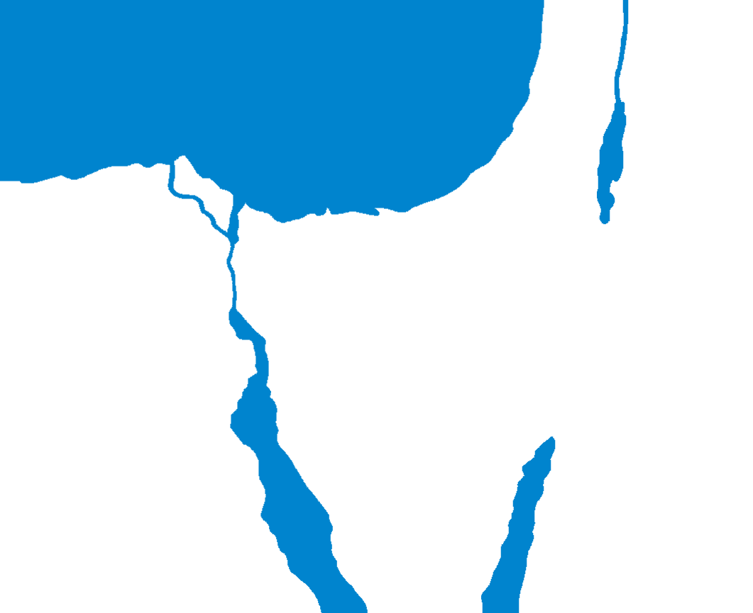
Wandering in the wilderness
C A N A A N
M e d i t e r r a n e a n S e a
Jericho
Rameses
40 years
Kadesh-barnea
E G Y P T
SINAI PENINSULA
M I D I A N
Mt. Sinai

Slide 110
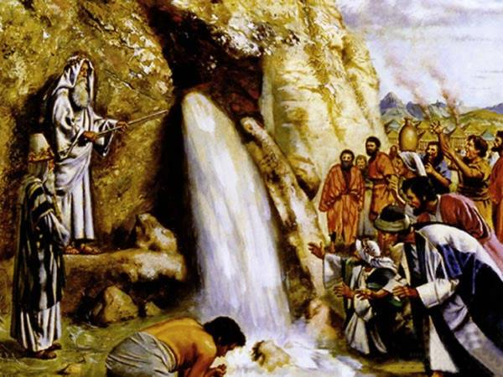
Starting out from Kadesh
Now there was no water for the congregation; and they assembled them-selves against Moses and Aaron.
The Lord said to Moses, “Take the rod and tell the rock before their eyes to yield its water.”
Exodus 20:2,8
Moses strikes the rock

Slide 111
Moses makes a mistake
“Hear now, you rebels; shall we bring forth water for you out of this rock?” And Moses lifted up his hand and struck the rock with his rod twice; and water came forth.
And the Lord said, “Because you did not believe in me to sanctify me in the eyes of the people, you shall not bring this assembly into the land I have given them.”
Exodus 20:10-12
Notes:
One of saddest verses in Bible. Imagine how Moses felt.
God told Moses to speak to rock , not strike it. For the first rock he struck it. People used to a stick being used from slavery. 2nd time they were different. Responded to words. Moses I what he did before. treating them as they were before. They had changed and he should have.
“God said take a stick” Last time that meant strike the rock. This time I will strike the rock again”.
Slaves understand that with a command comes the stick. Free men and women don’t respond to sticks but to words. They need leaders who speak not strike. Responses right in one age may be wrong in another.
Raged in uncontrolled anger. failure of leadership. True leaders must never become alienated from their people, must never treat their people with condescension or disdain.
Rabbi Moses ben Nachman placing the emphasis on the word ﾒweﾓ. In his view, Moses and Aaron gave the impression that they were the ones would perform the miracle, not God. Their sin in this reading is one of hubris, leaders so impressed by their own importance that they forget they are only instruments of a far greater force.

Slide 112
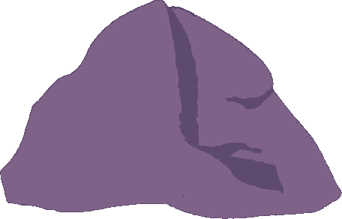

Why was this a problem?
Moses
First strike
Second strike
Rock without water
Rock with water
Rock with water
Fallen Adam
Restored Adam
Restored Adam
=
=
Messiah
Messiah
Notes:
Hitting 1st time - striking fallen nature. Correcting someone. Chastising. 2nd time - hitting heart. Hurting heart. Lost posiiton in front of people.
Don’t make leader hit rock twice. Leader shouldn’t accuse or get angry with people. Correct.
Get angry sya things regret.
Tablets come from rock,. Rock more essential as origin.
Influenced by Satan
Allowed Satan to invade. Satan had claim on Moses so couldn’t enter Canaan
But Moses heart still for God. Also Joshua didn’t lose faith. Worshipped at tabernacle

Slide 113
Joshua inherits Moses position as Abel
So the Lord said to Moses, “Take Joshua son of Nun, a man in whom is the spirit, and lay your hand on him. Have him stand before Eleazar the priest and the entire assembly and commission him in their presence. Give him some of your authority so the whole Israelite community will listen to him.”
Exodus 27:18-20
Notes:
Moses asks God to appoint a replacement for him before he dies
The narrative that begins the second component of this week’s double parashah, Va-Yelekh, recounts a stunningly poignant transfer of authority. We might suppose that Moses would be full of resentment and bitterness. After his years of devotion, his successful challenging Pharaoh in Egypt, his enduring of the people’s constant complaints in the wilderness, he is deprived of the opportunity to lead the Israelites across the Jordan into the land of their destiny. Someone else will take the credit for that, someone perhaps not as talented, nor as wise. But the biblical account of what Moses says and does (Deut. 31:1-13) contains not a hint of such feelings. He first announces his imminent retirement to the people. Realizing that he is the only leader they have known and that they will find it difficult to envision any future without him, he begins by disparaging himself, emphasizing his advanced age and his present inability to fulfil a successful leader’s responsibilities (Deut. 31:2). Since the final verses of the Torah describe Moses’ unabated vigour at the time of his death (Deut. 34:7), his protestation appears to be a conscious self-deprecation, intended to comfort the people for his loss by exaggerating his incapacities. Moses then reassures the people that his presence is not necessary to provide them with access to God’s continued help. No individual not even Moses, is indispensable for God’s purpose to be accomplished. He enjoins the people to rely not on him but on themselves and on God: “Be strong and resolute, be not in fear or in dread of them; for it is indeed the Eternal your God who marches with you” (Deut. 31:6). He reiterates that they do not need him, Moses, to succeed. Having minimized his own importance, Moses turns to his successor. Again in the sight of ”all Israel”, he ratifies the legitimacy of Joshua, defines Joshua’s role - to lead the people into the land of Canaan and apportion it to them - and insists that God will not forsake this new and untried replacement (Deut. 31:7–8). Finally, Moses sees to the continuity of the Teaching, the Torah, by giving the written text to the priests and the elders, and enjoining the future practice of periodic public reading of it for the entire people, including the generations that will be born in the new land (Deut. 31:9–13). Through a Law, a doctrine, a constitution that is accessible to everyone, “Jewish continuity” transcends the careers of both Moses and Joshua. In all of this, there is no hint of Moses’ preoccupation with his own needs, psychological or physical. The narrative is about what lies beyond one person in the form of a future for a people, for a Teaching, and for a land. In this context, even Moses fades into relative insignificance. Among so many other lessons, we learn from Moses that no matter how successful and distinguished a career we may have, the world and the causes we cherish will go on without us. Therefore, we should not allow our personal issues to blind us to the larger picture. In preparing someday to pass the baton to another as our own lap nears its end, we have no model more illuminating and inspiring than the one we encounter in this week’s verses.
Joshua made foundation of faith by being good spy and also tabernacle etc. intact and Joshua devoted

Slide 114
God commissions Joshua
After the death of Moses the Lord said to Joshua: “Moses my servant is dead. Now then, you and all these people, get ready to cross the Jordan River into the land I am about to give to the people of Israel. As I was with Moses, so I will be with you; I will never leave you nor forsake you. Be strong and courageous, because you will lead these people to inherit the land I swore to their forefathers to give them. Be careful to keep all the laws my servant Moses gave you; do not turn from it to the right or to the left, that you may be successful wherever you go. Do not let this Book of the Torah depart from your mouth; meditate on it day and night, so that you may be careful to do everything written in it. Then you will be prosperous and successful.”
Joshua 1:2, 5-6

Slide 115
The people unite with Joshua
Then they answered Joshua, “All that you have commanded us we will do, and wherever you send us we will go. Just as we listened to Moses in all things, so we will listen to you. Only may the Lord your God be with you as he was with Moses! Only be strong and of good courage.”
Joshua 1:16-18

Slide 116
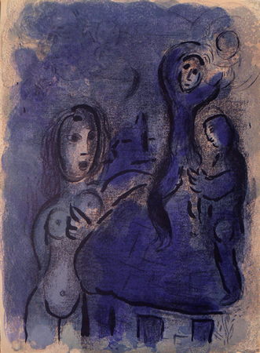
Spying out Jericho
Two spies go to Jericho
Rahab the prostitute hides them
They report back:
“Truly the Lord has given all the land into our hands; and moreover the inhabitants of the land are fainthearted because of us.”
Joshua 2:24
Rahab and the spies
Notes:
2 spies restored failure of 12
Chagall

Slide 117
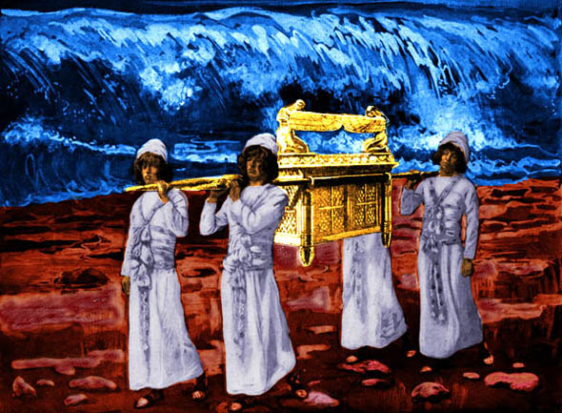
Setting out for Canaan
3 days before Jordan
Ark crossed the river
Took 12 stones
Built altar
Circumcised people
Celebrated Passover
Met commander of the army of the Lord
Crossing the River Jordan
with the Ark of the Covenant
Notes:
Stones taken from river and set up in gilgad as a memorial. 12 stones for 12 tribes.

Slide 118
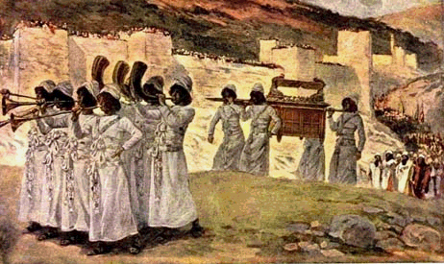
Capture of Jericho
40,000 soldiers
7 priests blowing trumpets
6 times circled city
7th day shouted
Walls came down
Defeated 31 kings
Circling Jericho with trumpets and Ark

Slide 119
The national level foundation
to receive the Messiah
was established

Slide 120
What lessons can we learn from Moses’ course?
The pattern for subjugating Satan on national level
Outcome depends on responsibility
  Responses that are made to situations
God acts on results
Mission is inherited
Greater the mission, the greater the test

