Slide 1
The Life of Jesus
Part two

Slide 2
Jesus came into conflict with some religious leaders
“But woe to you, scribes and Pharisees, hypocrites! because you shut the kingdom of heaven against men; for you neither enter yourselves, nor allow those who would to go in.”
Matthew 23: 27
Notes:
Explain about who opposed Jesus. Apparent anti-S of gospels. Written during time of separation and conflict between church and Judaism.
Pharisees were basis of modern Judaism. Jesus often called a rabbi.
Jesus became angry with the stubborn attitude of the religious leaders because they were obstructing his work and mission – to bring the kingdom of heaven on earth.
“Woe to you, scribes and Pharisees, hypocrites! for you are like whitewashed tombs, which outwardly appear beautiful, but within they are full of dead men’s bones and all uncleanness.”
Matthew 23: 27

Slide 3
Who are these religious groups?
Sadducees
  Ruling aristocratic priestly group, collaborators
Pharisees
  Popular, democratic, synagogue, Oral Torah
Essenes
  Break away priestly group, near Dead Sea
Zealots
  Nationalist freedom fighters against Roman rule
Different responses to occupation and religious life
Notes:
In Jesus time many Judaisms. Not monolithic. Never has been. Always different ways to interpret and apply the Torah. Many arguments but this meant a lot of religious freedom. Jesus group one of many.
The Sadducees were a priestly group, Aaronites, associated with the leadership of the Temple in Jerusalem. Sadducees represented the aristocratic group of the Hasmonean High Priests. This Priestly lineage had been blamed by the Pharisees for allowing the Syrian Emperor Antiochus IV Epiphanes to desecrate the Temple of Jerusalem with idolatrous sacrifices and to martyr monotheistic Jews. The Hasmoneans ruled as "priest-kings", claiming the titles of high priest and king simultaneously, and like other aristocracies across the Hellenistic world became increasingly influenced by Hellenistic syncretism and Greek philosophies. Sadducees followed the Hebrew Bible literally. Rejected Oral Torah, rejected life after death and resurrection. Disappeared after destruction of the Temple. Collaborators with the Romans. High priest apponited by the Roamns. Thye kept his vestamanets.
Then, in 167 BCE, Antiochus IV invaded Judea, entered the Temple, and stripped it of money and ceremonial objects. He imposed a program of forced hellenization, requiring Jews to abandon their own laws and customs, and precipitating the Maccabean Revolt. Jerusalem was liberated in 165 BCE and the Temple was restored. In 141 BCE an assembly of priests and others affirmed Simon Maccabeus as high priest and leader, in effect establishing the Hasmonean dynasty.
Pharisees – ‘set apart’. a political party, a social movement, and a school of thought among Jews during the Second Temple period under the Hasmonean dynasty (140–37 BC) in the wake of the Maccabean Revolt. Focused on synagogue. When in Babylon developed synagogue for worhsip, prayer and study. After return to Jerusalem. Popular, democratic, progressive, develop oral Torah for application to everyday life. Became normative Judaism after 70 AD.
The Essenes were a Jewish religious group that flourished from the 2nd century BCE to the 1st century CE that some scholars claim seceded from the Zadokite priests.^{[1]} Being much fewer in number than the Pharisees and the Sadducees (the other two major sects at the time) the Essenes lived in various cities but congregated in communal life dedicated to asceticism, voluntary poverty, daily baptisms, and abstinence from worldly pleasures, including marriage. Many separate but related religious groups of that era shared similar mystic, eschatological, messianic, and ascetic beliefs. These groups are collectively referred to by various scholars as the "Essenes." Josephus records that Essenes existed in large numbers, and thousands lived throughout Judæa. The Essenes believed they were the last generation of the last generations and anticipated Teacher of Righteousness, Aaronic High Priest^{[citation needed]}, and High Guard Messiah,^{[citation needed]} similar to the Prophet, Priest and King expectations of the Pharisees.
Zealotry was originally a political movement in first century Second Temple Judaism which sought to incite the people of Iudaea Province to rebel against the Roman Empire and expel it from the Holy land by force of arms, most notably during the Great Jewish Revolt (66-70). The Zealots were a "fourth sect", founded by Judas of Galilee (also called Judas of Gamala) and Zadok the Pharisee in the year 6 against Quirinius' tax reform, shortly after the Roman state declared (what had most recently been the territory of Herod Archelaus) a Roman Province, The Zealots objected to Roman rule and violently sought to eradicate it by generally targeting Romans and Greeks. Zealots engaged in violence against other Jews were called the Sicarii^{[8]}. They raided Jewish habitations and killed Jews they considered apostate and collaborators, while also urging Jews to fight Romans and other Jews for the cause. The Zealots had the leading role in the Jewish Revolt of 66. After the destruction of Jerusalem and the Second Temple in AD 70, 960 Zealots under the lead of Elazar ben Yair took refuge by capturing the Roman fortress of Masada and taking no prisoners. Rome sent the Tenth Legion to retake the stronghold, but it failed for three years. It is estimated that they took over 1,000 casualties in the process. The Zealots held the fortress even after the Romans invented new types of siege engines. Finally, in the third year of the siege, 73, The Romans completed a massive earthwork siege ramp up one face of the mountain on which Masada sat. This allowed them to bring the full strength of their siege to bear and penetrate the walls, a feat impossible before due to the topography of the mountain itself. When the Romans stormed in to capture the Zealots, they found that the fighters and their families had all committed suicide.
Scribes in Ancient Israel, as in most of the ancient world, were distinguished professionals who could exercise functions we would associate with lawyers, government ministers, judges, or even financiers. Some scribes copied documents, but this was not necessarily part of their job.^{[15]}
In 586 B.C., Jerusalem was captured by the Babylonians. The Temple was looted and then destroyed by fire. The Jews were exiled.
About 70 years later, the Jewish captives returned to Jerusalem from Babylon. According to the Bible, Ezra recovered a copy of the Torah and read it aloud to the whole nation.

Slide 4
Who is Jesus attacking?
Two rival groups amongst the Pharisees
30 BCE-70 CE
Rabbi Shammai
Majority time of Jesus
Connected to Zealots
Strict and extreme
Rejected converts
Gentiles can’t be saved
  18 measures
Rabbi Hillel
Minority until Yavneh
Connected to Essenes
Liberal and moderate
Welcomed converts
Gentiles could be saved
  Follow Noahic code
Notes:
Much conflict although at other times friendship over 100 years. ‘2 Torahs’. Shammai in majority. Hillel accepted rulings when Shammai won but not other way around. Hillel more humble. After Hillel died 10 CE his followers amy have joined Essenes. Passing of 18 measures - against Gentiles - led to murder of bet Hillel prophets. 20 BCE People became more anti-Gentile as Shammai controlled Sanhedrin. Shammai became vice-president of Sanhedrin when Menaham - a follower of Hillel led a large outreach program to Gentiles.
In Talmud explanation for fall of Temple is “hatred without cause” around 30 CE.
The 18 measures were worse than the sin of the golden calf because they nullified the purpose of Israel to be a witness.
Hillel - wanted to fulfill mission of Jews - witness to Gentiles. Sent missionaries out among Gentiles to promote Noahide code. May have led to God-fearers groups.
Rabbi Shammai a sage but group - bet Shammai - became corrupted. Would hand over to Saducees people they didn’t like to be death with by Romans
Zealots founded by Judah the Galilean and Rabbi Zadok the Pharisee. Shammai intellectual sponsors of Zealots. Very anti-Gentile. Rabbi Eliezar follower of Shammai. Only rabbi to say eye for eye is literal. Mt 27:23 - Shammai doctrine against converts.
Zealots murderers. Probably murdered a number of followers of Hillel who were called prophets in Talmud. So when Jesus is accusing the Pharisees of murdering prophets he is referring to event 20-10 BCE. Josephus accuses Zealots of causing destruction of Temple.
Jesus criticism about heavy burdens - followers of Shammai made harder to follow rulings
Jesus' healing by prayer on Sabbath - Hillel OK; Shammai oppose
Dispute about washing - same
Tithing -same
Temple offerings - Jesus cruising the Shammite practice of not accepting Gentile offerings. Moneychangers accepted gifts from Gentiles but Zealot moneychangers didn't pass money on but pocketed it. Zealots controlled. Temple and siphoning off Gentile offerings/money. Refusal of Emperors sacrifice led to destruction of Temple.
Bet Shammai later partially broke with Zealots.
Jesus wanting to bring universal salvation. Start a religion that can be for Gentiles too - Noahidic code. Hille supported. Followers of Jesus mostly bet-Hillel. Bet Shammai rejected such an attempt. No salvation for Gentiles and also but giving Gentiles a religion they would marginalise the `Jews and eventually wipe out.
Paul a follower of Gamelial - a follower of Hillel. Protected early church. Opposition to Paul from followers of Shammai?
Jesus comments are not anti-Jewish. Merely intra-Jewish dispute. Mistake for Christian church to think all Jews opposed Jesus or that Jesus was opposed to Judaism.He was criticising ruling group just as followers fo Hillel were doing.
In Talmud follower if Hillel says followers of Shammai deserve to be put to death. Followers of Hillel accused those of Sahmmai of being followers o of Satan. “Anyone who rules according to beit-Shammai - when it disagrees with beit-Hillel - has no place in the world to come.” (Maimonides)

Slide 5
What is going on here?
Is the conflict between Jesus and the Jews?
Jesus born, lived and died a practising Jew
All Jesus’ followers were Jews
The early church were Jews who believed in Jesus
Conflicts in the gospels are conflicts between Jews
The Pharisees were liberal reforming Jews who became the leaders of Judaism after 70 AD
Jesus was probably a Pharisee

Slide 6
Why does the New Testament appear to be anti-Jewish?
The gospels were written by Jews who believed in Jesus at a time when there was a lot of conflict between the early church and Judaism
Parting of the Ways – defining identities
Conflicts projected back into Jesus time
Gospel writers blamed the Jews and not the Romans for the crucifixion
Notes:
In A.D. 324 Constantine became the ruler of the entire Roman Empire.
The pagan emperor Constantine wanted to unify the rival Christian factions in the Roman Empire for political reasons.
In A.D. 325, he convened the Council of Nicea.
Jesus of Nazareth was declared divine. Jesus was now a god, not a mortal prophet.
Only four of the gospels were chosen as the official gospels of the Church.
New versions of the gospels had to be written. They were edited to make the Romans less culpable and the Jews more culpable for the Crucifixion of Jesus.
Over three hundred other gospels were ordered to be destroyed
(including all Gospels written in Hebrew).
An edict was issued stating that anyone found in possession of
an unauthorized gospel would be put to death.
The Council of Nicea changed the birthday of Jesus from January 6th to December 25th (Natalis Invictus) to match the birthday of Sun-God Sol Invictus (Mithras), and shifted the Sabbath from Saturday to Sunday.
This assimilation of aspects of the pagan Roman religion made Christianity more palatable to the Roman masses.
The Romans felt great animosity toward the Jews because of their constant rebellions against Roman rule.
Blaming the Crucifixion of Jesus on the Jews, unified the Roman pagans and the Christians.

Slide 7
Opposition to Jesus
Some religious leaders were jealous that Jesus was so popular
Some disagreed with his teaching. (E.g. the dispute about washing) Mt. 15:1-20
Some disagreed with his actions.
(E.g. healing on the Sabbath)
Notes:
Without the protection of John’s testimony the opposition to Jesus grew stronger and stronger. Jesus was a very controversial person. He stirred up the Jewish people and of course many of the religious leaders came to oppose him.
Many of disagreements Jesus took position of Hillel

Slide 8
Some were outraged about the claims he made about himself
He said he was the manifestation of God
(Jn. 14:9-10)
He said he was greater than the temple (Mt. 12:6)
He claimed to be more important than Abraham (Jn. 8:58)
He claimed to be above the Mosaic Law (Mt. 5:17)
He said he was the mediator between people and God (Jn. 14:6)
Notes:
Although what Jesus said was shocking and controversial, if he had been supported by John, he would have been protected by his authority and prestige.

Slide 9
Jesus’ disciples struggle
"For my flesh is true food, and my blood is true drink.” John 6:55
Therefore many of his disciples, when they heard this said, "This is a difficult statement; who can listen to it?" John 6:60
As a result of this many of His disciples withdrew and were not walking with Him anymore. John 6:66
Notes:
So Jesus said to them, "Truly, truly, I say to you, unless you eat the flesh of the Son of Man and drink His blood, you have no life in yourselves. "He who eats My flesh and drinks My blood has eternal life, and I will raise him up on the last day."For My flesh is true food, and My blood is true drink. "He who eats My flesh and drinks My blood abides in Me, and I in him. Jn 6:53

Slide 10
Jesus wanted people to believe in him
“. . . even though you do not believe me, believe the works that you may know and understand that the Father is in me and I am in the Father.”
John 10:38
Notes:
Jesus realised that they couldn’t believe in him because of what he said so pleaded with them to at least judge him on the basis of his actions such as miracles and good works

Slide 11
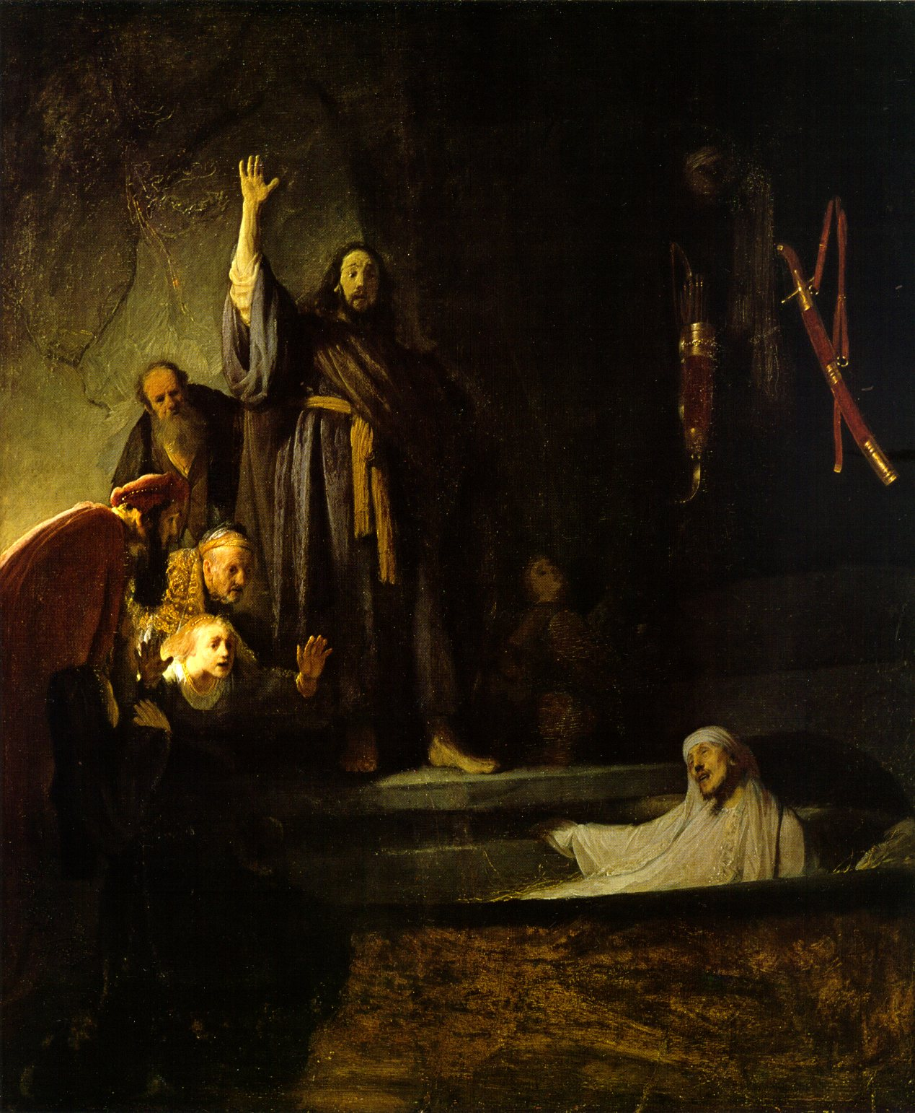
Why did Jesus do miracles?
And Jesus lifted up his eyes and said, “Father, . . . I know that you hear me always, but I have said this on account of the people standing by, that they might believe that you did send me.”
John 11:41-42
Jesus raising Lazarus from the dead
Notes:
Jesus tried desperately to persuade people to accept him. On his way to Jerusalem for the final confrontation he raised Lazarus from the dead. He didn’t do such miracles merely as an act of love but because he was desperate for people to recognize him.
Picture Rembrandt

Slide 12
How did some leaders respond?
But when the Pharisees heard it [the healing of the blind and dumb demoniac] they said, “It is only by Beelzebub, the prince of demons, that this man casts out demons.”
Matthew 12:24
Notes:
Again not all Pharisees opposed. Bet Shammai Many friends eg Nicodemus, Cyrus,

Slide 13
Change of course
Jesus began to show his disciples that he must go to Jerusalem and suffer many things from the elders and chief priests and scribes, and be killed, and on the third day be raised. And Peter took him and began to rebuke him saying, “God forbid Lord! This shall never happen to you.”
Matthew 16:21
Notes:
Jesus realises that with John dead and the growing hostility of the religious leaders there is strong possibility that he will be rejected and put to death. It is at this point that Jesus BEGAN to tell his disciples that things might not work out as they expected. Peter is shocked because this is a real change in the Jesus teaching from the optimistic message of the imminent coming of the kingdom of God.

Slide 14


The two possible courses
God’s Will
Lord of Glory
Lord of Suffering
Isaiah 9
Luke 1
Isaiah 53
Accepted by Jewish people
Rejected by Jewish people
Jesus Christ
“I desire mercy, not sacrifice.” Matthew 9:13
Notes:
It was God’s original will for the people to accept Jesus and for him to become the Lord of Glory establishing the Kingdom of Heaven on earth.
Echoes of Saul and Samuel “I desire obedience not sacrifice’
If he was rejected it was God’s will for him to go the way of the cross.
“I desire mercy not sacrifice”. Sacrifice becomes necessary when there is no mercy.

Slide 15
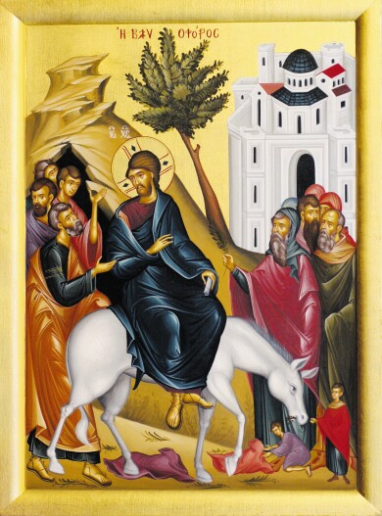
Entry into Jerusalem
"Hosanna!" "Blessed is he who comes in the name of the Lord!" "Blessed is the King of Israel!”
“Look how the whole world has gone after him!”
Yet at the same time many even among the leaders believed in him.
John 12: 13,19,42
Notes:
Jesus cheered, not jeered.

Slide 16
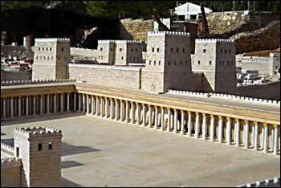
What effect did this have?
‘King of Israel’ and Messiah are political titles
  Jesus rejected attempt to make him king
  Jesus told disciples not to say he was messiah
Threat to Roman authority and rule
Roman fortress next to the Temple
Notes:
Antonia fortress built by Herod

Slide 17
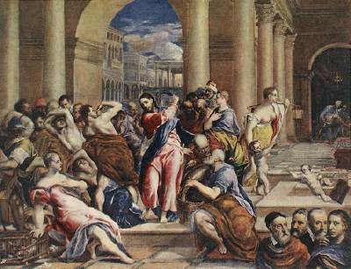
Cleansing the Temple
And he was teaching daily in the temple. The chief priests and the scribes sought to destroy him; but they did not find anything they could do, for all the people hung upon his words.
Luke 19:47-48
Christ driving the money
changers from the Temple
Notes:
Palm Sunday. People welcomed Jesus. Actually people followed him everywhere.
Cleansed Temple - mistake. Threatened the Temple system. Threatened to cause unrest and riots. Threatened to bring Romans down on people. Threatened the position of priestly authorities who were charged with keeping order. Passover was the time when expected the messiah to come.
Temple offerings - Jesus critising the Shammite practice of not accepting Gentile offerings. Moneychangers accepted gifts from Gentiles but Zealot moneychangers didn't pass money on but pocketed it. Zealots controlled. Temple and siphoning off Gentile offerings/money. Refusal of Emperors sacrifice led to estruction of Temple.
During Passover the Roman governor and extra troops in Jerusalem to maintain order.
Religious authorities couldn’t arrest Jesus in the Temple or by day because he was so popular. So had to do it slyly by night and trial by night and execute next morning.
Picture El Greco

Slide 18
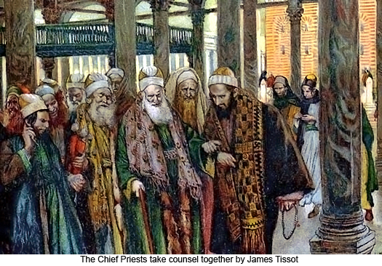
Chief priests plot against Jesus
Then the chief priests and elders gathered and took counsel to arrest Jesus by stealth and kill him. But they said, “Not during the feast, lest there be a tumult among the people.”
Matthew 26:3-5

Slide 19
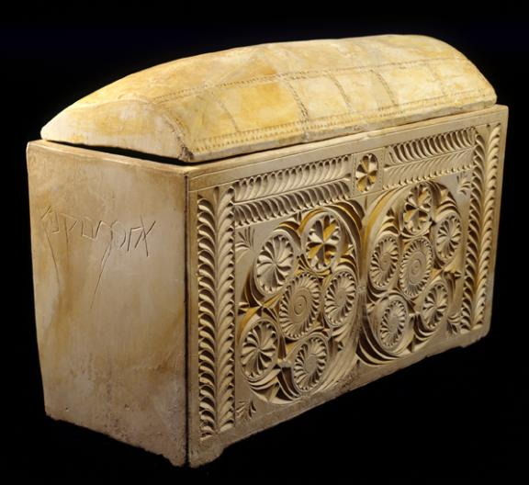
Why did they do this?
“If we let him go on like this, every one will believe in him, and the Romans will come and destroy our holy place and our nation.” Caiaphas said, “It is expedient that one man should die for the people, and that the whole nation should not perish.”
John 11:48-51
Ossuary of the high priest
Joseph Caiaphas
Notes:
Discovered 1990. 1st centruy

Slide 20
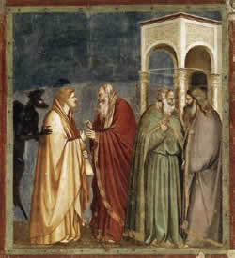
Judas ‘betrays’ Jesus
Then Satan entered into Judas . . .
Luke 22:3
Judas Iscariot, went to the chief priests and said, “What will you give me if I deliver him to you?” And they paid him thirty pieces of silver.
Matthew 26:14
Judas getting paid
Notes:
Judas went after incident woman and expensive oil
Treasurer. Stole money

Slide 21
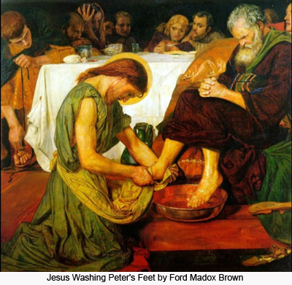
The Last Supper
Predicts betrayal by Judas and denial by Peter
“. . . woe to that man by whom the Son of man is betrayed! It would have been better for that man if he had never been born.”
Matthew 26:24
Washes the disciples’ feet
Notes:
Ford Maddox Brown

Slide 22
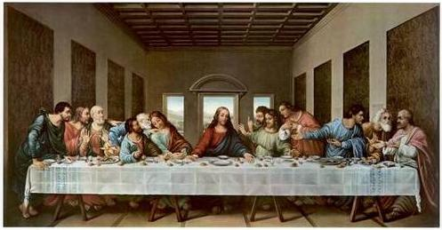
Instituting the Eucharist
Jesus took bread, and blessed, and broke it, and gave it to his disciples and said, “Take, eat; this is my body.” And he took a cup and gave it to them saying, “Drink of it, for this is my blood of the covenant, which is poured out for the forgiveness of sins.” Matthew 26: 26-28

Slide 23
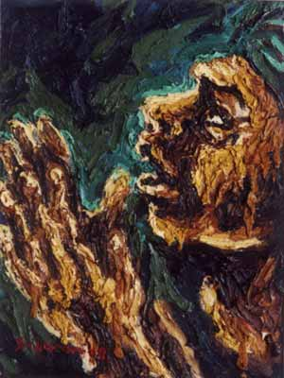
Prayer in Gethsemane
And being in great agony he prayed more earnestly and his sweat became like great drops of blood falling down onto the ground.
Luke 22:44
Notes:
After the Last Supper they went to stay in the Garden of Gethsemane (Olive Press). Jesus went to pray with 3 disciples who fell asleep.
Agony in front of God – why? What was the content of his prayer?

Slide 24
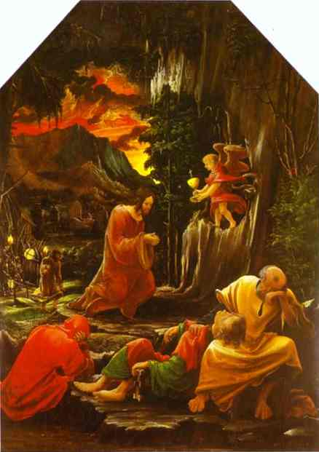
“My Father, if it be possible, let this cup pass from me, nevertheless, not as I will but as thou wilt.”
Matthew 26:39
God’s purpose in sending the Messiah was to save the Jewish people and all humanity. God was determined to save humankind, even if it meant delivering Jesus into the hands of Satan.
EDP, 278
Three disciples fall asleep
Notes:
Jesus didn’t want to go the way of the cross. 3 times prayed. Not out of fear or cowardness but because he knew that by dying he couldn’t accomplish as much as he wanted to – he couldn’t build the kingdom of heaven on earth. He also knew that if the Jewish people rejected him they would have a miserable future.
On the other hand, had Jesus run away everything would have been lost. He was so committed to do his mission that even death would not deter him. He welcomed death on the cross if that would advance the will of God. He freely offered himself up as a sacrifice. He freely accepted his future death as the will of God.
“For this reason the Father loves me, because I lay down my life, that I may take it again. No one takes it from me, but I lay it down of my own accord. I have power to lay it down, and I have power to take it up again; this charge I have received from my Father.” John 10: 17-18

Slide 25
Why didn’t Jesus want to die?
He didn’t want God’s heart to be broken
He wanted to bring complete salvation to his followers
He knew his followers would suffer
He knew that the people of Israel would go through untold suffering
The Jewish people have suffered oppression and persecution
as a tragic consequence of the mistake of their ancestors.
Jews and many faithful Christians have shouldered the cross as
their portion for the collective sin of having killed Jesus. EDP, 117
Notes:
Jesus was no coward
The moment they turned against his only beloved so, God tearfullu had to turn his back and allow Satan to lay claim to them.
Suffering a consequence – not necessary or desirable. Not a punishment. Due to anti-semtisim of Christian church

Slide 26
Jesus sacrificed himself
“For this reason the Father loves me, because I lay down my life, that I may take it again. No one takes it from me, but I lay it down of my own accord. I have power to lay it down, and I have power to take it up again; this charge I have received from my Father.”
John 10:17-18
Notes:
But Jesus freely decided to offer his life. He could have run away. He could have complained. But instead he made himself a perfect sacrifice.

Slide 27
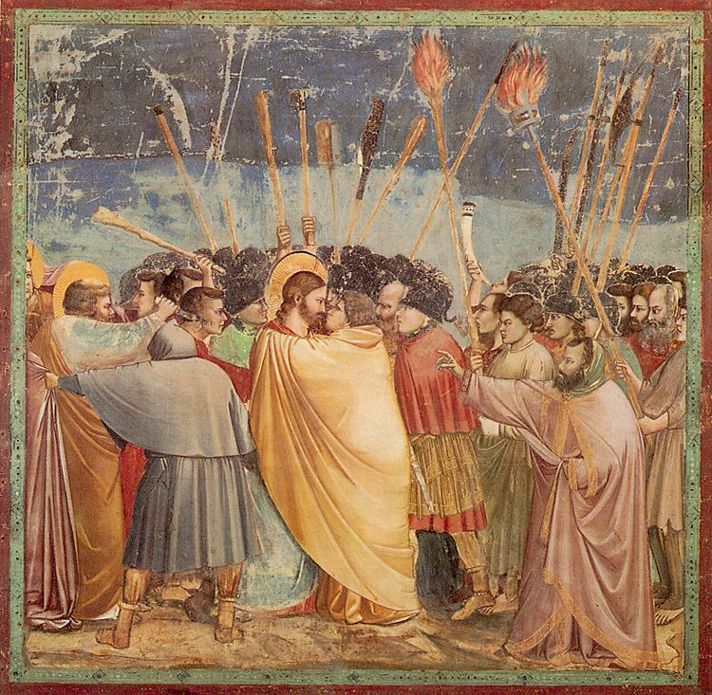
Betrayal by Judas
So Judas came to the grove, guiding a detachment of soldiers and some officials from the chief priests and Pharisees.
Then the detachment of soldiers with its commander and the Jewish officials arrested Jesus.
John 18:3,12
Notes:
Satan was the one who wanted to kill Jesus because he knew Jesus was a threat to his rule. After Jesus overcame Satan’s temptations he was looking for other ways to get at him. Jesus was betrayed by one of his closest friends and disciples with a kiss
Jesus arrested by roman soldiers

Slide 28
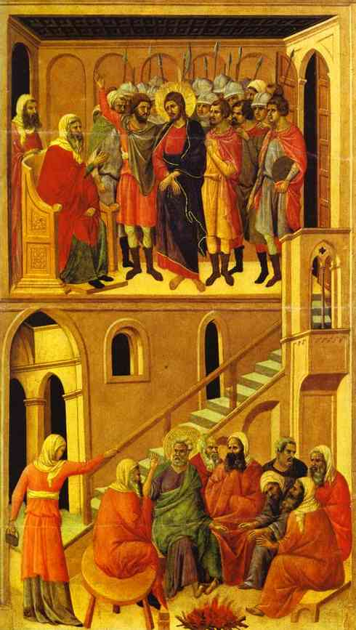
The trials of Jesus
The disciples ran away
Peter denied him
Unfair trial by Sanhedrin
  At night
  Not proper procedure
  Not valid charge
  No real evidence
  Try to frame him
He was despised and rejected by men; a man of sorrows, and acquainted with grief.
Isaiah 53:3
Judas tries to return the money
and then kills himself
At the High Priest’s house
Notes:
Jesus was let down by nearly everyone. The prophecies in Isaiah of the Lord of Suffering come to pass. Jesus was accused but never defended himself.

Slide 29
A perfect sacrifice
He offered himself without blemish to God, a spiritual and eternal sacrifice; and his blood will cleanse our conscience from the deadness of our former ways and fit us for service of the living God.
Hebrews 9:14
Notes:
Instead he made himself a perfect sacrifice – an unconditional offering. BUT remember, God desires mercy NOT sacrifice. His suffering became the condition for the salvation of humanity.

Slide 30
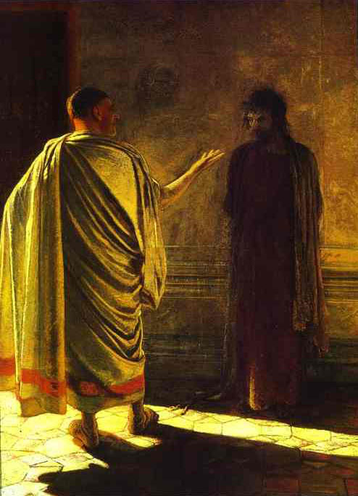
Jesus in front of Pilate
Pilate asked him, “Are you the King of the Jews?” Jesus said to him, “You have said so.” But when he was accused by the chief priests he made no answer, not even a single word.
Matthew 27:11-12
Pilate asks “What is truth?”
Notes:
Gay Nikolay Nikolayevich (1831-1894)
The construct of a trial by the Jewish High Priest and the Jewish mobs screaming for the execution of Jesus, (These were the same Jews who celebrated Jesus' triumphant entry into Jerusalem on the back of a donkey on Sunday. These were the same Jews who thronged the streets waving palm branches to welcome Him. They shouted "Hosanna" and laid their cloaks and palm branches from the nearby trees in His path.) served as means to blame the Jews for the death of Jesus and make the conversion of pagan Romans to Christianity more palatable. All four Gospel stories were edited to make Jewish authorities, not Roman authorities, primarily responsible for the death of Jesus of Nazareth.
Pilate orders Jesus to be scourged. Christian Gospels portray Pilate as "innocent".
[Philo (Ad Gaium, 38) describes him as inflexible, merciless, and obstinate. Pontius Pilate was an exceptionally cruel and corrupt man. Pontius Pilate routinely crucified Jews without benefit of trial. He was so brutal that the Romans withdrew him (in A.D. 36) in disgrace to Rome because of his excesses.]
The Romans were absolved, the Jews were blamed.
Many historians attribute these accounts of the trial of Jesus to efforts by early Christians to make their message more palatable to Roman audiences.
Pontius Pilate sentenced Jesus of Nazareth to crucifixion.
The Romans and their Roman collaborators (Caiaphas, who the Romans appointed as High-Priest) killed Jesus of Nazareth not the Jewish People.
Many historical experts and Biblical scholars have expressed doubt that Jesus ever appeared before Jewish or Roman leaders before his execution.
During World War II, The Nazis invaded France. They installed a puppet government in Vichy.
The Vichy Government was responsible for numerous atrocities.
When the Allies recaptured France, the members of the Vichy Government were tried and executed.
The French people were not held responsible for the atrocities of the Vichy Government.
However, for 2,000 years the Jewish people have been held responsible for the acts of a puppet government installed by the Romans.

Slide 31
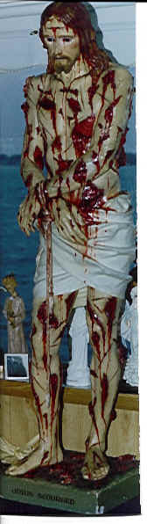
Scourging of Jesus
He was wounded for our transgressions, he was bruised for our iniquities; upon him was the chastisement that made us whole, and with his stripes we are healed.
Isaiah 53:5
Notes:
Jesus paid the price. He made himself a perfect sacrifice. He took responsibility for the sins of mankind – for my sins. He was beaten and tortured for our sins. He was sinless and yet did not complain. He took responsibility for the sins and failings of humanity. He never defended himself not complained. Every beating and wounding he offered up as a condition of indemnity to save humanity.

Slide 32
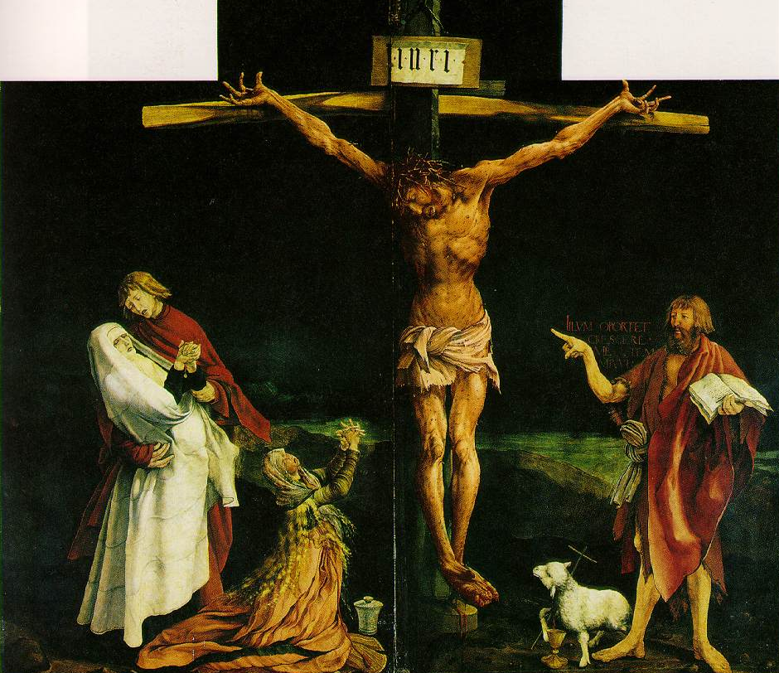
The crucifixion of Christ
And those who passed by derided him, wagging their heads and saying, “You would destroy the temple and build it up in three days, save yourself.”
Matthew 27:39-40
Satan was fixed on killing one man, Jesus Christ, even though he might have to hand back all humanity, including the Jewish people, to God.
EDP, 278
Notes:
Jesus must have been in such pain. On Palm Sunday they were shouting Hosanna. 5 days later they were mocking him. Yet despite this Jesus never changed his heart or attitude.

Slide 33
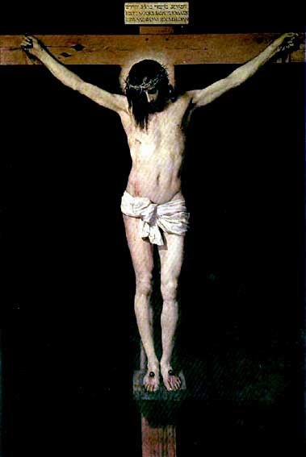
What were Jesus’ last words?
On the cross Jesus established the foundation of faith and substance
“My God, my God, why have you forsaken me?” Mark 15:34
“Father, into your hands I commit my spirit.” Luke 23:46
“Father, forgive them; for they know not what they do.” Luke 23:34
Satan thought by killing the messiah he could destroy the entire providence of God.
EDP, 278
Notes:
Despite being mocked Jesus never left the position of being the son of God. He didn’t curse the people for rejecting and crucifying him. Instead he practised what he preached and asked God to forgive them. He loved and gave his life for his enemies. Satan couldn’t accuse Jesus. He had done his utmost to destroy and break Jesus but had been unsuccessful. Satan had tempted and dominated Adam, but he couldn’t tempt Jesus. Even on the cross Jesus continued to love. Even when he didn’t feel God’s presence, Jesus still kept faith. Even though things didn’t turn out how he expected, Jesus continued to love and trust God. Satan had to bow down and acknowledge that Jesus was greater than he was. So Satan had to release anyone who believed in Jesus.
Psalm 22
He was even abandoned by God. But he didn’t lose faith or curse God. He said, “Father, into thy hands I commit my spirit.”
On the cross Jesus restored Foundation of Faith and Substance – kept faith in God even though he felt abandoned by God, and loved his enemies. This was condition for him to be resurrected

Slide 34
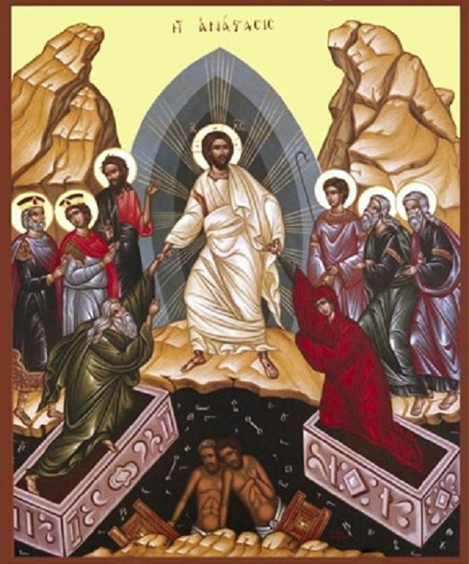
The harrowing of hell
Jesus went and made a proclamation to the spirits in prison, who in former times did not obey, when God waited patiently in the days of Noah.
I Peter 3:19-20
Notes:
Satan nor death could hol dhim

Slide 35
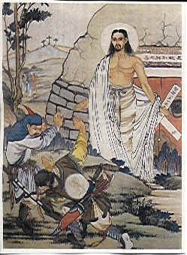
Resurrection
God handed over Jesus to Satan as the condition of indemnity to save all humankind.
In compensation for Satan’s exercise of his maximum power in killing Jesus, God exercised his maximum power and resurrected Jesus.
EDP, 279
Notes:
Because Jesus kept his position of the son of God, Satan couldn’t keep him. Jesus was victorious over death. He resurrected and during 40 days Jesus revived the faith and spirits of his disciples and thus established the church, the body of Christ against which “the gates of hell cannot prevail.”

Slide 36
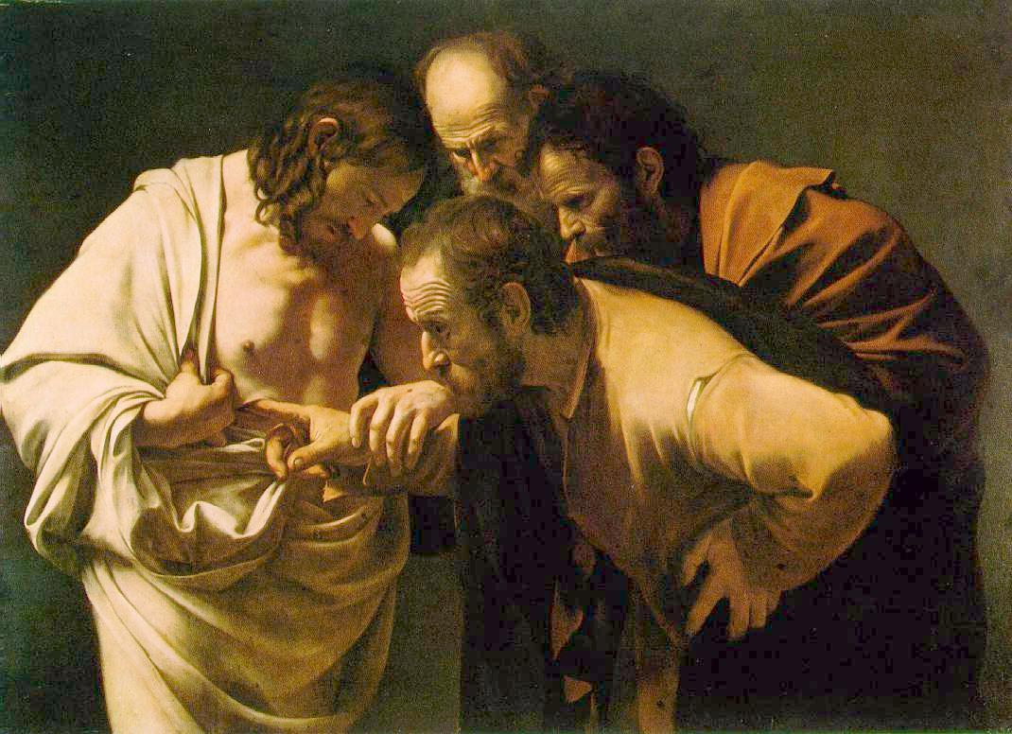
What happened at the resurrection?
The empty tomb
Missing body
Appeared to
500 followers
Appeared in
locked room
Ate food
Jesus and Thomas
Notes:
caravaggio

Slide 37
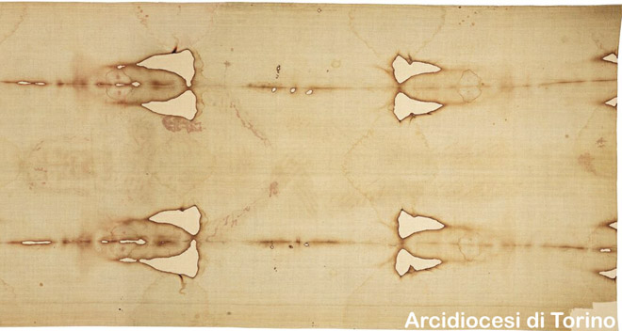
Shroud of Turin

Slide 38
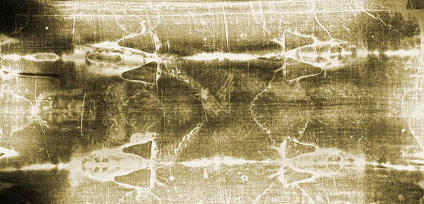
Shroud of Turin in negative
Notes:
Markings on the lines include:^{[22]}
one wrist bears a large, round wound, claimed to be from piercing (the second wrist is hidden by the folding of the hands)
upward gouge in the side penetrating into the thoracic cavity. Proponents claim this was a post-mortem event and there are separate components of red blood cells and serum draining from the lesion
small punctures around the forehead and scalp
scores of linear wounds on the torso and legs. Proponents claim that the wounds are consistent with the distinctive dumbbell wounds of a Roman flagrum.
swelling of the face from severe beatings
streams of blood down both arms. Proponents claim that the blood drippings from the main flow occurred in response to gravity at an angle that would occur during crucifixion
no evidence of either leg being fractured
large puncture wounds in the feet as if pierced by a single spike
Pollen, dirt from Palestine. Clothe typical 1st century Syria. Folding pattern 1st century Palestine. Blood same on shroud and sudarium. AB
No pigment, no photo method,

Slide 39
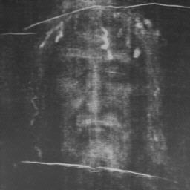
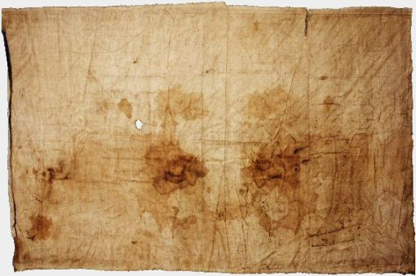
The face of Jesus
The Sudarium of Oviedo
Shroud of Turin
Notes:
One of the relics held by the cathedral in the town of Oviedo, in the north of Spain, is a piece of cloth measuring approximately 84 x 53 cm. There is no image on this cloth. Only stains are visible to the naked eye, although more is visible under the microscope. The remarkable thing about this cloth is that both tradition and scientific studies claim that the cloth was used to cover and clean the face of Jesus after the crucifixion. We are going to present and look into these claims.
Such a cloth is known to have existed from the gospel of John, chapter 20, verses 6 and 7. These verses read as follows, "Simon Peter, following him, also came up, went into the tomb, saw the linen cloth lying on the ground, and also the cloth that had been over his head; this was not with the linen cloth but rolled up in a place by itself." John clearly differentiates between this smaller face cloth, the sudarium, and the larger linen that had wrapped the body.
According to this history, the sudarium was in Palestine until shortly before the year 614, when Jerusalem was attacked and conquered by Chosroes II, who was king of Persia from 590 to 628. It was taken away to avoid destruction in the invasion, first to Alexandria by the presbyter Philip, then across the north of Africa when Chosroes conquered Alexandria in 616. The sudarium entered Spain at Cartagena, along with people who were fleeing from the Persians. The bishop of Ecija, Fulgentius, welcomed the refugees and the relics, and surrendered the chest, or ark, to Leandro, bishop of Seville. He took it to Seville, where it spent some years.

Slide 40
Third worldwide course to restore Canaan
Foundation for the Messiah
Pentecost
and rebirth
Foundation
of Substance
Restored disciples
Central person - Jesus
Foundation
of Faith
Offering – Word
Time period – 40 days
Notes:
At Pentecost the Trinity was established and the Holy Spirit descended and the disciples were born again. This was the birth of the church, the bride of Christ, the body of Christ.

Slide 41
Foundation to receive the Messiah
God
Foundation of faith
Central figure: Jesus in the position
of John the Baptist
Conditional object: Word
Period: 40 days
Jesus becomes
spiritual messiah
Jesus
Disciples
(Abel)
(Cain)
Foundation of substance
Central figure: Jesus in the position of John the Baptist
Indemnity condition: remove fallen nature
Love, Respect, Submit and Multiply goodness
Notes:
Jesus made foundation of faith on the cross. Satan thought he’d won but he lost. Satan used max power to kill Jesus. God able to exercise max power to resurrect.
Rssurrected Jesus not same physical body. Appear and disappear.

Slide 42
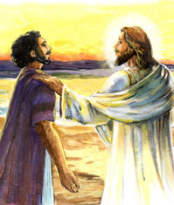
How was the foundation of substance restored?
Peter denied Jesus three times
Jesus set up a situation which enabled Peter to restore this
Asked Peter three times, “Do you love me?”
Notes:
5When they had finished eating, Jesus said to Simon Peter, "Simon son of John, do you truly love me more than these?"
"Yes, Lord," he said, "you know that I love you."
Jesus said, "Feed my lambs."
John 21
15When they had finished eating, Jesus said to Simon Peter, "Simon son of John, do you truly love me more than these?"
"Yes, Lord," he said, "you know that I love you."
Jesus said, "Feed my lambs.”
16Again Jesus said, "Simon son of John, do you truly love me?"
He answered, "Yes, Lord, you know that I love you."
Jesus said, "Take care of my sheep."
17 The third time he said to him, "Simon son of John, do you love me?"
Peter was hurt because Jesus asked him the third time, "Do you love me?" He said, "Lord, you know all things; you know that I love you."
Jesus said, "Feed my sheep.

Slide 43
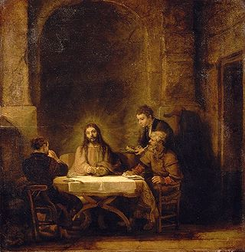
The road to Emmaus
“But we hoped that he was the one to redeem Israel.”
Luke 24:21
“Was it not necessary that the Christ should suffer these things and enter into his glory?”
Luke 24:26
Notes:
The disciples were in shock. They didn’t expect Jesus to be rejected and put to death. Jesus in his love didn’t accuse them. He had accepted what had happened as the will of God and explained it to his disciples in that way. Through this he restored their spirits and their faith.

Slide 44
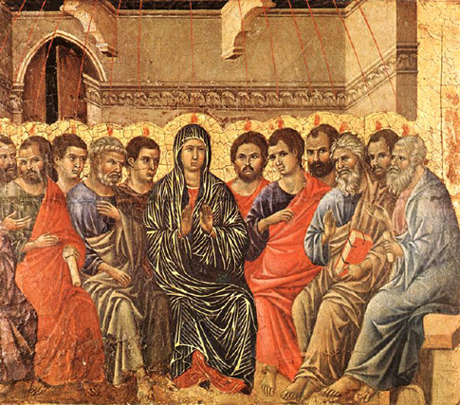
What happened at Pentecost?
Jesus sends Holy Spirit
Jesus and Holy Spirit became spiritual True Parents bringing spiritual rebirth
Spiritual salvation - enter realm where Satan cannot invade
EDP, 280
The Holy Spirit descends

Slide 45
Spiritual salvation
But to all who believed in his name, he gave power to become children of God; who were born, not of blood nor of the will of the flesh nor of the will of man, but of God.
John 1:12-13
God
Jesus
Holy Spirit
Believers
Only Christianity has placed importance on the lineage and laid down the conversion of lineage as its main ideology. Sun Myung Moon CSG, 1274
The precious blood of Jesus and the ritual of the Last Supper all symbolise
the providence of becoming the children of God through the conversion of lineage.
Sun Myung Moon CSG, 1272
Notes:
Jesus and Holy Spirit are True Parents giving spiritual rebirth to sinful humanity so that we can become ‘children of God.’ Spiritual change of blood lineage. Sins are forgiven, cleansed by the holy Spirit. New life, new beginning.

Slide 46
Salvation through the cross
Satan
God
Jesus
Physical
Self
Spiritual Self
Christians
Spiritual Salvation
Physical
Self
Spiritual Self
Jesus’ blood on the cross became the price for the redemption of mankind.
DP Level 4 p.59
Notes:
Satan trying to destroy Jesus. On the cross Satan thought he’d won. Due to faithlessness of people God paid the price by giving Jesus as a ransom. Jesus blood on cross became price for redeeming humanity.

Slide 47
Salvation through the cross
Spiritual Salvation
Spirit
“. . . we ourselves, who have the first fruits of the spirit, groan inwardly as we wait for adoption as sons, the redemption of our bodies.” Romans 8:23
Jesus
Physical Salvation
Body
Romans 7:21-25
Notes:
Jesus offered himself up as a sacrifice. He ransomed himself so that we could be saved. Because of this Satan was able to claim his body but not his soul. So although he couldn’t bring physical salvation, Jesus was able to bring spiritual salvation the tremendous grace that no other religious founder could bring – the forgiveness of sins and reconciliation with God.
Satan thought that by crucifying Jesus he had won. But Jesus never left his position as the Son of God. He didn’t run away. He didn’t curse his persecutors. Instead he showed absolute unconditional love. So Satan could not accuse him. Even Satan had to bow down to Jesus and release people who call on Jesus’ name. Jesus conquered death. He went to hell and liberated those drowned in the flood.
So by his death Jesus could redeem people’s spirits from Satan. But the body continues to be dominated by Satan. Also the world is NOT the kingdom of heaven.

Slide 48
The human situation
For I delight in the law of God, in my inmost self, but I see in my members another law at war with the law of my mind making me captive to the law of sin which dwells in my members. Wretched man that I am!
Romans 7:22-24
Notes:
Despite being born again and saved by the blood of Christ, we still struggle with the flesh.

Slide 49
Complete salvation
Spiritual Salvation
Spirit
Messiah
Physical Salvation
Body
Thy kingdom come, thy will be done, on earth as it is in heaven.
Matthew 6:10
Notes:
Remember, Jesus came to bring complete salvation. This is what he would have brought if he had been accepted. Jesus prayer would have been realised in his lifetime. The kingdom of heaven would have been established. There would be no need for a second coming.

Slide 50
Second Advent
Marriage Supper
of the Lamb
New Heaven
And New Earth
God
.
True Father
True Mother
True Children
Society
Nation
World

Slide 51
The course to restore the substantial Canaan led by the Lord of the Second Advent

Slide 53
Why do Christians traditionally believe that Jesus was supposed to be crucified?

Slide 54
The road to Emmaus
“But we hoped that he was the one to redeem Israel.”
Luke 24:21
“Was it not necessary that the Christ should suffer these things and enter into his glory?”
Luke 24:26
Notes:
The disciples were in shock. They didn’t expect Jesus to be rejected and put to death. Jesus in his love didn’t accuse them. He had accepted what had happened as the will of God and explained it to his disciples in that way. Through this he restored their spirits and their faith.

Slide 55
What were the consequences of the rejection of Jesus?
From the moment his beloved chosen people turned against his only begotten son, God tearfully had to turn his back and allow Satan to claim them. EDP
The destruction of the Temple and Jewish nation for 2000 years
The separation of Judaism and Christianity
The corruption of Christianity by Gentile culture
The breakdown of the Roman Empire
The sending of Muhammad and rise of Islam
Notes:
Christianity lost much of its Jewish foundation and developed based on Greek philosophy and thought more than Jewish thought. E.g. predestination; idea of Jesus as pre-existent saviour; distant God; worship on Sunday; low opinion of sex and marriage.
Church instead of being volunteers became compulsory State religion. Christianity served purposes of the State. Roman Catholic church took on external hierarchical form of Roman Empire. Constantine made the church draw up creeds thus creating heretics. Church became rich and membership helped career.
Roman Empire collapsed due to immorality. Took nearly 1500 years for Europe to approach same technological level.
Jesus would have gone East been accepted by Arabs – descendants of Ishmael. Because he didn’t God sent prophet to the descendants of Ishmael – Muhammad. Islam started as a reforming movement within Judeo-Christian Middle East and North Africa.

Slide 56
Jesus’ judgement
“The men of Nineveh will arise at the judgement with this generation and condemn it; for they repented at the preaching of Jonah, and behold
something greater than Jonah is here.”
Matthew 12:41
Notes:
For such a faithless reaction Jesus condemned the Jewish leaders, The men of Ninevah believed in the message of the faithless Jonah

Slide 57
Jesus’ prophecy
“For the days shall come upon you, when your enemies will . . . Dash you to the ground, you and your children within you, and they will not leave one stone upon another in you; because you did not know the time of your visitation.”
Luke 19:43-44

Slide 58
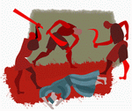
Parable of the Tenants
Landlord = God
Vineyard = Israel
Tenants = Leaders
Servants = Prophets
Son = Jesus Christ
“They will respect my son.”
Matthew 21:37
Tenants murder the son
Notes:
Isputes with religious leaders - money etc.
Jesus expressed his own understanding of God’s expectation for his life and mission and its outcome in the parable of the wicked tenants Mt. 21:33-43

