Slide 1
God’s providence of restoration from
Abraham until Jesus

Slide 2
Pattern of Restoration
Abraham
Isaac
Jacob to
Harlan
Jacob
Returns
Jacob to
Egypt
Adam
Noah
Jacob
1600 | 400 | 120 | 40 | 21 | 40
120 years
building
the Ark
40 day
flood
judgement
Sending
out dove
3 times

Slide 3
Why is there is pattern?
To restore through indemnity a previous failure, a similar situation arises where people have to not repeat earlier mistakes
Repeated attempts to restore foundation for the messiah
More prolonged, heavier the conditions
  Horizontal restoration of vertical conditions

Slide 4
Jewish History
Slavery in Egypt
Abraham’s mistake in the offering
Jacob’s 12 sons and 70 kinsmen in Egypt
Maintained their identity
  Circumcision, Sabbath, offerings
Pyramid building
Moses - Pharaoh humbled
  3 signs, 10 plagues
Exodus
Mount Sinai - Covenant, Torah and Tabernacle
Entered Promised Land
400
Gen. 15:13
Notes:
Abraham 1812 -1637 BC by Biblical dating
Maintained ID through circumcision, Sabbath
Exodus date 1440 - Biblical 1 Kings 6. 480 years before Solomon began Temple in 4th year of reign
Late 1200 BC William Albright
Early 1500 BC Hyskos
Xns established ID through baptism and credo “I believe that Jesus is Lord”
Constantine converted 312
Xty became dominated by the Roman state. Arm of government. Cain dominated Abel? Loss of freedom of faith
Emperor Theodosius made Xty state religion

Slide 5
Jewish History
Judges
  Prophet, priest, ‘king’
  Divided land, loose confederation of 12 tribes
  Ruled by God and law
  Gideon told them, "I will not rule over you, nor will my son rule over you. The Lord will rule over you.” Judges 8:23
Struggles with Philistines
No foundation of faith
  Should have destroyed 7 Canaanite tribes
  “Went after other gods”
No foundation of substance
  Lack of unity between tribes
Slavery in Egypt
Judges
400
After that whole generation had been gathered to their fathers, another generation grew up, who knew neither the Lord nor what he had done for Israel. Then the Israelites did evil in the eyes of the Lord and served the Baals. Then the Lord handed them over to raiders who plundered them.
Then the Lord raised up judges, who saved them out of the hands of these raiders. Judges 2:10-16
Notes:
In Canaan should have maintained faith in God, kept the law and be united with judge and each other. Usually supported Judge but after judge fell into faithlessness. Judges 2:16-19
People not bound together by central govt but common devotion to God, common religious festivals and law. Tribal independence. People followed conscience not king. Authority of judges non-hereditary and charismatic. God rules, not king like other people. Theocracy. Valued freedom and independence after slavery in Egypt. Abimelech with support of priests of Baal tried to become king and create Canaanite type of government but people rebelled at the idea of human king.
Wanted to make Gideon and descendants `King “The Israelites said to Gideon, "Rule over usﾑyou, your son and your grandsonﾑbecause you have saved us out of the hand of Midian."ﾊ23 But Gideon told them, "I will not rule over you, nor will my son rule over you. The LORD will rule over you.”
Later wanted a king so they could become as other nations. Rejected freedom and responsibility and uncertainties of divine rule and leadership.

Slide 6
The people demand a king
People said to Samuel: “We want a king over us. Then we will be like all the other nations, with a king to lead us and to go out before us and fight our battles.”
God replied to Samuel: “Listen to all that the people are saying to you; it is not you they have rejected, but they have rejected me as their king.” Samuel 9
Notes:
10 Samuel told all the words of the LORD to the people who were asking him for a king. 11 He said, "This is what the king who will reign over you will do: He will take your sons and make them serve with his chariots and horses, and they will run in front of his chariots. 12 Some he will assign to be commanders of thousands and commanders of fifties, and others to plow his ground and reap his harvest, and still others to make weapons of war and equipment for his chariots. 13 He will take your daughters to be perfumers and cooks and bakers. 14 He will take the best of your fields and vineyards and olive groves and give them to his attendants. 15 He will take a tenth of your grain and of your vintage and give it to his officials and attendants. 16 Your menservants and maidservants and the best of your cattle [b] and donkeys he will take for his own use. 17 He will take a tenth of your flocks, and you yourselves will become his slaves. 18 When that day comes, you will cry out for relief from the king you have chosen, and the LORD will not answer you in that day."

Slide 7
What will the king do?
God warned the people that a king would:
  Enlist their sons as soldiers
  Turn their daughters into servants
  Take best fields and vineyards
  Take one tenth of harvest
  Take one tenth of flocks
  “You shall be his slaves”

Slide 8
Jewish History
Slavery in Egypt
Samuel anointed Saul
  Lack of unity
Samuel anointed David
Judges
United Israelite Monarchy
120
1040 - 922 BC
Saul, David & Solomon, 3 x 40
Notes:
OT Prophet, priest and king
NT Saint, pope, king
Saul 1020 BC. 3 times 40 for kings
Saul was king, should have listened to prophet but prophet obey king. Separation of functions. Samuel failed to respect position of king. Killed Saul
David listened to prophet and repented. Nathan spoke to power. David reign - rebellion of Absalom
Solomon other foreign wives and their gods - I Kings 11 - 700 wives, 300 concubines, When he was old his heart went after other gods. Ashteroth, Milcom

Slide 9
How did David inherit the throne?
Samuel
Own sons corrupt
Saul
Tried to
kill
Filial
piety
Providence for the start
Filial
piety
Won love and respect
Jonathan
David
Goliath
Offered his position
Satan
Cain
Abel
Jonathan made a covenant with David, because he loved him as his own soul.
And Jonathan gave his robe and armour and sword and bow to David. I Samuel 18:3-4
Notes:
Saul tragic figure. Wanted to do right but let down by Samuel.
David killed Goliath - providence for start like Moses killing Egyptian and God smiting Pharaoh
David established position of Abel before Jonathan
Won Jonathan’s love and respect. Voluntarily submitted
Practising filial piety to Saul - played lute. Evil spirit and Saul tried to kill
Jonathan filial piety but wouldn’t follow Saul’s evil direction. Loyalty to friendship and covenant
Saul tried to kill David. David didn’t kill Saul when twice had the chance to
Saul and Jonathan died together fighting
David lamented when hear they’d been killed

Slide 10
Jewish History
Slavery in Egypt
Samuel anointed Saul
  Lack of unity
  Jonathan and David
Samuel anointed David
  Psalms of David
  House of God
  House of David
  Bathsheba & Uriah affair
  Decline
Judges
United Israelite Monarchy
120
1040 - 922 BC
Saul, David & Solomon, 3 x 40
Notes:
10
OT Prophet, priest and king
NT Saint, pope, king
Saul 1020 BC. 3 times 40 for kings
Saul was king, should have listened to prophet but prophet obey king. Separation of functions. Samuel failed to respect position of king. Killed Saul
David listened to prophet and repented. Nathan spoke to power. David reign - rebellion of Absalom
Solomon other foreign wives and their gods - I Kings 11 - 700 wives, 300 concubines, When he was old his heart went after other gods. Ashteroth, Milcom

Slide 11
Lineage is the House of God
David offered to build God a house to dwell in - Temple
God replied: “I will make for you a great name.
I will make you a house.
And your house and your kingdom
shall be made sure forever before me;
Your throne shall be established forever.”
I Samuel 7
House = Temple = dynasty = lineage

Slide 12
David and Bathsheba
Nathan the prophet:
Why have you despised the
word of the Lord?
Maachah
David
Bathsheba
Uriah
Adam
Eve
Lucifer
Rebellion
Killed
He called his name
Solomon and the
Lord loved him.
Amnon
Absalom
Solomon
Raped Tamar
Absalom’s sister
Cain
Abel
Notes:
After Bathsheba affair Amnon raped Tamar, David’s daughter and his half sister
Absalom killed Amnon
Absalom gathered people to him
Absalom rebelled
David wept when killed. Didn’t treat supporters with respect and weep over those lost lives protecting him.

Slide 13
Solomon becomes King
Nathan
Haggith
David
Bathsheba
Adam
Eve
Adonijah, the son of
Haggith exalted himself,
saying, “I will be king”.
I Kings 1:5
Adonijah
Solomon
King
Cain
Abel
Notes:
After Bathsheba affair Amnon raped Tamar, David’s daughter and his half sister
Absalom killed Amnon
Absalom gathered people to him
Absalom rebelled

Slide 14
Jewish History
Slavery in Egypt
Samuel anointed Saul
  Lack of unity
  Jonathan and David
Samuel anointed David
  Psalms of David
  House of God
  House of David
  Bathsheba & Uriah affair
  Decline
Nathan anointed Solomon
  Built the Temple
  Song of Solomon
  Proverbs of Solomon
Foundation of faith invaded
  Married foreign women
  Went after other gods
No foundation of substance
  Rehaboam and Jeroboam
Judges
United Israelite Monarchy
120
1040 - 922 BC
Saul, David & Solomon, 3 x 40
Notes:
14
Solomon should have used God given skill to unify nations of near East an assimilate Egypt, Minoa, Mesopotamia and create worldwoiide dominion for messiah.
OT Prophet, priest and king
NT Saint, pope, king
Saul 1020 BC. 3 times 40 for kings
Saul was king, should have listened to prophet but prophet obey king. Separation of functions. Samuel failed to respect position of king. Killed Saul
David listened to prophet and repented. Nathan spoke to power. David reign - rebellion of Absalom
Solomon other foreign wives and their gods - I Kings 11 - 700 wives, 300 concubines, When he was old his heart went after other gods. Ashteroth, Milcom

Slide 15
Rehaboam and his subjects
Jeroboam chosen by God to rule 10 tribes
  Ahijah the prophet (I Kings 11:27-40)
  ‘If you walk in my ways . . . I will be with you.’
Rehaboam succeeds Solomon
Jeroboam and tribal leaders
  “Your father made our yoke heavy. Lighten the yoke upon us ad we will serve you faithfully.”
Rehaboam replied:
  “I will add to your yoke; my father chastised you with whips, but I will chastise you with scorpions.”
Division
Notes:
Jeraboam - leader of forced labour. Told ‘if you harken to all that I command you and will walk in my ways, and do what is right in my eyes by keeping my statutues and commandments I wll be with you and build you a sure house as I built for David and I will give Israel to you.’ when Solomon heard this tried to kill Jeroboam so fled to Egypt.
R - “My little finger is thicker than my father’s loins. And now, whereas my father laid upon you a heavy yoke, I will ad to your yoke. My father chastised you with whips, but I will chastise you with scorpions.”

Slide 16
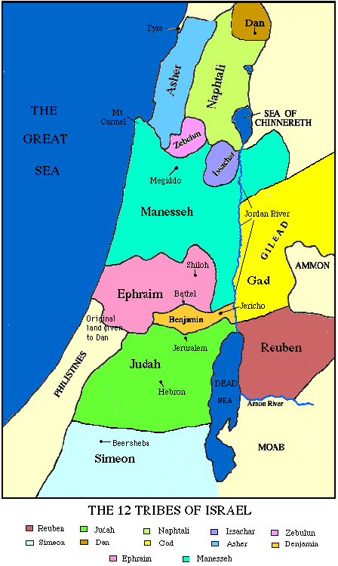
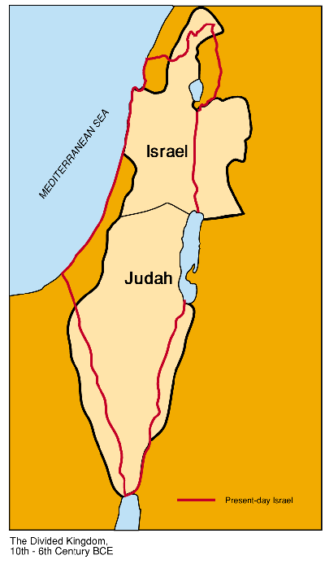
How was the kingdom divided?

Slide 17
Jewish History
Slavery in Egypt
Northern Kingdom Israel
  Jeroboam (exiled leader)
  19 kings in 260 years
  Prophets - Elijah, Elisha, Amos
  No repentance
  721 BC Assyrians invaded
Southern Kingdom Judah
  Rehaboam
  20 kings in 394 years
  Idolatry and corruption
  Prophets - Isaiah, Jeremiah
  597 BC Babylonians invaded
Collapse of autocratic society
Judges
United Israelite Monarchy
Divided Kingdoms
400
922 - 597 BC
Kingdom divided into
Israel (North) and Judah (South)
Notes:
I dynasty David to Zedekiah. Many good. Esp Josiah and reform and Deuteronomy. Later bad.
Rehaboam - Solomon’s son.
Jeroboam - capable leader in charge of forced labour.
1 Kings 12:4 “Your father made our yoke heavy. Now therefore lighten the hard service of your father and his heavy yoke upon us, and we will serve you.”
R - “My little finger is thicker than my father’s loins. And now, whereas my father laid upon you a heavy yoke, I will ad to your yoke. My father chastised you with whips, but I will chastise you with scorpions.”
Israel - 19 unrighteous kings in 260 years
Judah - many good kings 394 years. 1 lineage. Also fell into corruption and idol worship

Slide 18
Jewish History
Slavery in Egypt
Babylonian Exile
  King Nebuchadnezzar
  King Jehoiachin + 10,000 Jews into captivity
  597 - 527 BC
  Purification
Persians conquer Babylon
Return to Jerusalem
  Edict of King Cyrus 538 BC
  Return in 3 waves
  Reformation of nation
  Rebuilding Temple
  Ezra the Scribe 458 BC
  Nehemiah 445 BC
Judges
United Israelite Monarchy
Divided Kingdoms
Exile and Return
210
Captivity 70 years: 597- 527 BC
Return 140 years: 527- 400 BC
Notes:
Ezra was a Jewish priestly scribe who led about 5,000 Israelite exiles living in Babylon to their home city of Jerusalem in 459 BC. Ezra reconstituted the dispersed Jewish community on the basis of the Torah and with an emphasis on the law. Ezra resolved the identity threat which arose by the intermarriage between Jews and foreigners and provided a definite reading of the Torah. Ezra is highly respected in the Jewish tradition. His knowledge of the Torah is considered to have been equal with Moses. Like Moses, Enoch, and David, Ezra is given the honorific title of "scribe". Son of exiled HP. Eunuch
Malachi is often thought to have been Ezra
Nehemiah - cup-bearer of Artaxerxes. Allowed to go to Jerusalem as governor. Rebuilt walls and restored administration. D. 413 BC

Slide 19
Jewish History
Preparation for messiah
  Temple rebuilt
  Study scripture
  Malachi 430 BC
  Prophesied that Elijah would come before the Messiah
Slavery in Egypt
Judges
United Israelite Monarchy
Divided Kingdoms
Exile and Return
Prep. for the Messiah
400
400 BC – Birth of Christ

Slide 20
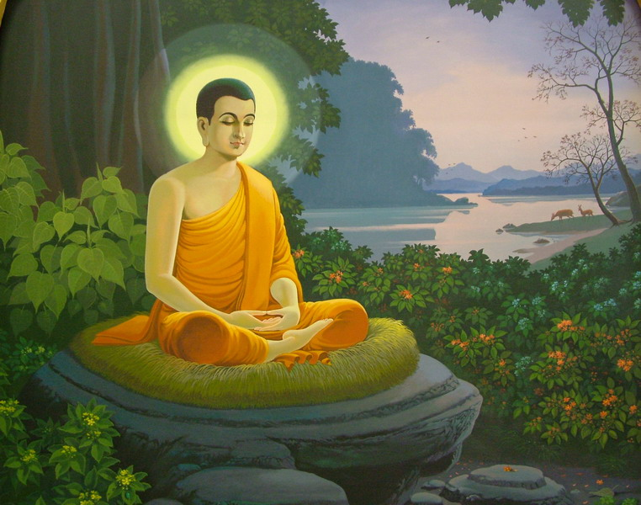
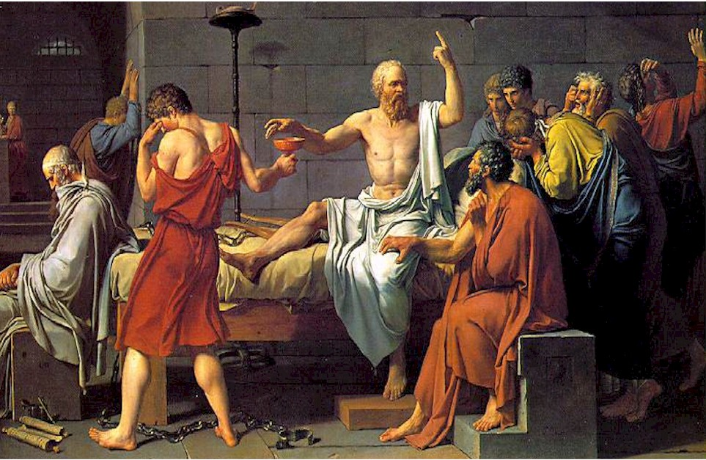
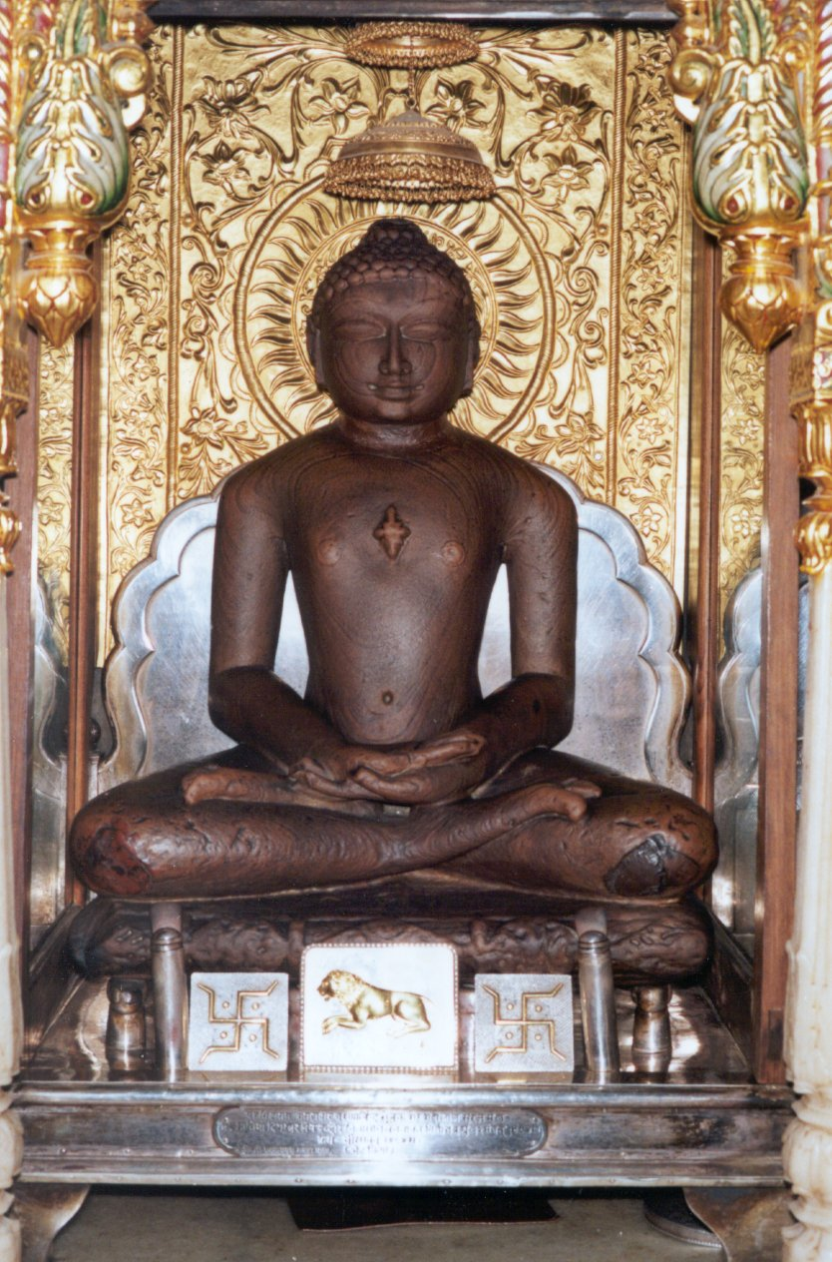
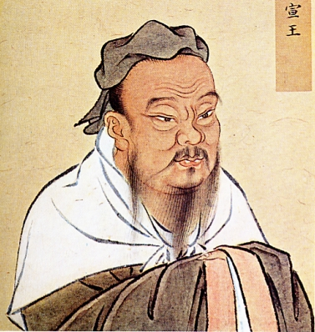
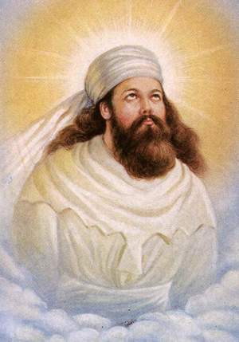
Worldwide reformation
Buddha (565 - 485 BC)
Socrates (470 - 389 BC)
Confucius (552 - 479 BC)
Zarathustra 600 BC
Mahavir (599-527 BC)
Notes:
General shift towards spiritual and ethical life and away from ritualism an reliugion and theology
Jainism (pronounced /ˈdʒeɪnɪzəm/) is an ancient religion of India that prescribes a path of non-violence towards all living beings. Its philosophy and practice emphasize the necessity of self-effort to progress the soul towards divine consciousness and liberation. Any soul that has conquered its own inner enemies and achieved the state of supreme being is called Jina (Conqueror or Victor). Jains have an ancient tradition of scholarship and have the highest degree of literacy in India; Jain libraries are the oldest in the country. Mahavira 599 – 527 BCE
Zarathrustra - zoroastrianism. Persia

Slide 21
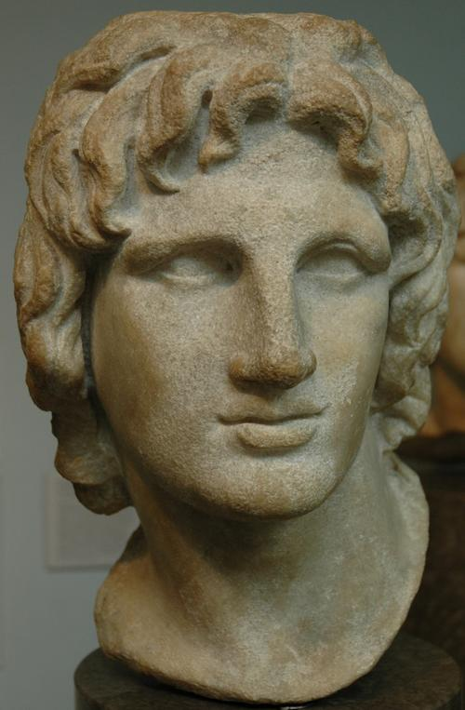
Jewish History
Malachi
Other religious leaders
  Buddha (565 - 485 BC)
  Confucius (552 - 479 BC)
  Socrates (470 - 389 BC)
Empire of Alexander the Great (356 - 323 BC)
Slavery in Egypt
Judges
United Israelite Monarchy
Divided Kingdoms
Exile and Return
Prep. for the Messiah
400
400 BC – Birth of Christ
Notes:
21

Slide 22
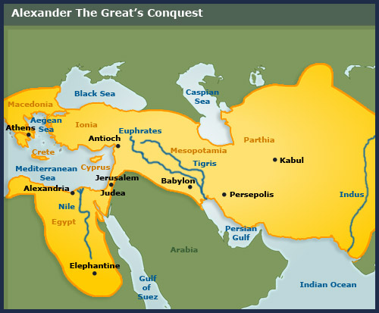
Empire of Alexander the Great (356 - 323 BC)
Hellenisation:
Spread of
Greek culture:
Philosophy
Democracy
Science
Games
Theatre
Art
Government
Language
Population
  Seleucid Empire
  Hellenisation Loss of faith
  Corruption
  Antiochus IV Epiphanes
  Intense suffering
  Macaabean revolt 164 BC
  Roman Empire 63 BC
Synthesis of Hebraism and Hellenism
Notes:
Buddhism influenced by Greek ideas and religion

Slide 23
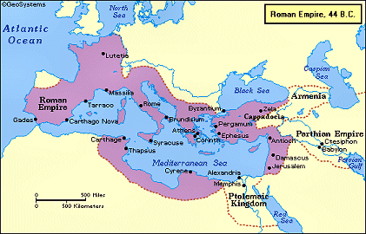
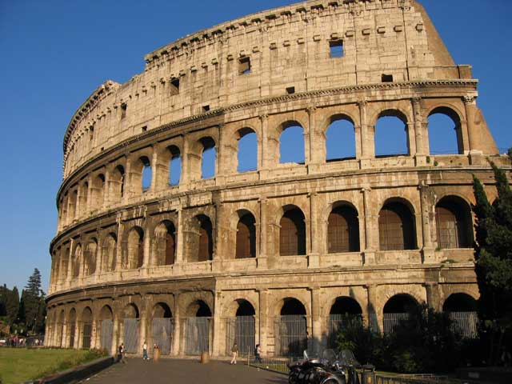
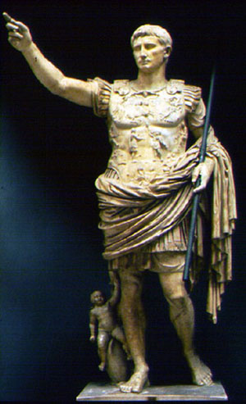
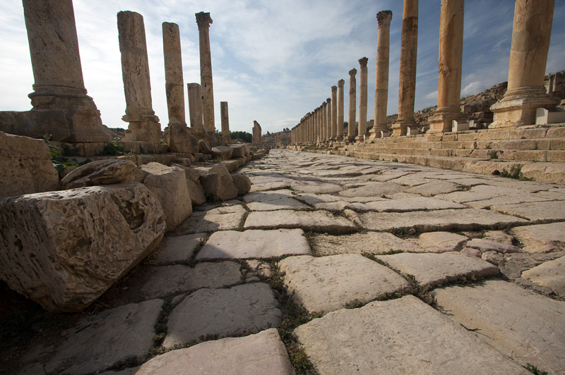
Roman Empire
Buildings
Roads
Law
Peace
Trade
Currency
Religious
toleration

Slide 24
Jewish History
Slavery in Egypt
Malachi
Other religious leaders
  Buddha (565 - 485 BC)
  Confucius (552 - 479 BC)
  Socrates (470 - 389 BC)
Empire of Alexander the Great (356 - 323 BC)
  Spread Hellenism
Synthesis Hebraism and Hellenism
  Philo of Alexandria
Roman Empire
  Roads, Buildings
  Pax Romana
Judges
United Israelite Monarchy
Divided Kingdoms
Exile and Return
Prep. for the Messiah
400
400 BC – Birth of Christ
Notes:
24

Slide 25
Jewish History
Slavery in Egypt
400
Judges
400
Israelite Monarchy
120
Divided Kingdoms
400
Exile and Return
210
Prep. for the Messiah
400
Jesus

Slide 26
Jewish History
Slavery in Egypt
400
Judges
400
Israelite Monarchy
120
Divided Kingdoms
400
Exile and Return
210
Prep. for the Messiah
400
Jesus
Put to death
Notes:
26

