Slide 1
Who made the foundation for the second advent of the messiah?
The last 400 years

Slide 2
Abraham’s family

Slide 3
Abraham’s family
Hagar
Abraham
Sarah
Ishmael
Isaac
Sarah said to Abraham, ‘Cast out this slave woman with her son; for the son of this slave woman shall not be the heir with my son Isaac.’ Genesis 21:10

Slide 4
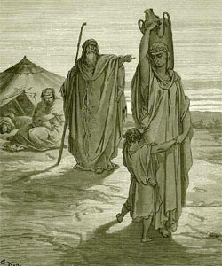
What promises did God make to Ishmael?
“I will bless [Ishmael] and make him fruitful and he shall be the father of 12 princes and I will make him a great nation. But I will establish my covenant with Isaac.”
Genesis 17:20-21
Abraham sending Hagar and Ishmael away

Slide 5
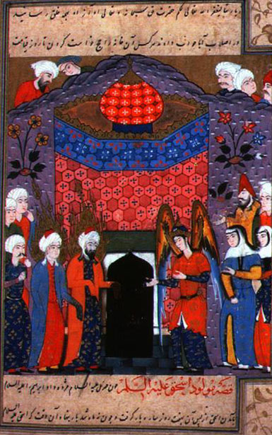
Building the Ka’aba
Abraham and Ishmael built the Ka’aba, the first house for the worship of God
‘As Abraham raised the foundations of the shrine, together with Ishmael (they prayed): “Our Lord, accept this from us. You are the Hearer, the Omniscient.”’
Qu’ran 2:127
Ishmael and Abraham pray
after building the Ka’aba
Notes:
According to Islamic tradition, the Stone fell from Heaven to show Adam and Eve where to build an altar and offer a sacrifice to God. The Altar became the first temple on Earth. Muslims believe that the stone was originally pure and dazzling white, but has since turned black because of the sins it has absorbed over the years.[7] Islamic tradition holds that Adam's altar and the stone were lost in the process of Noah's Flood and forgotten. It was Abraham who found the Black Stone at the original site of Adam's altar when the Archangel Gabriel revealed it to him.[8] Abraham ordered his son—and the ancestor of Muhammad--Ishmael to build a new temple in which to imbed the Stone. This new temple is the Kaaba in Mecca.

Slide 6
Abraham’s descendants
Hagar
Abraham
Sarah
Ishmael
Isaac
Arab nation
Jewish people
Jesus
Muhammad
Islam
Judaism
Christianity

Slide 7
The place of Jesus
Jesus was crucified
The Arab descendents of Ishmael missed out on the blessing they should have received
Christianity deviates from Judaism
Influenced by Gnosticism and Roman culture
Islam comes as a reforming movement

Slide 8
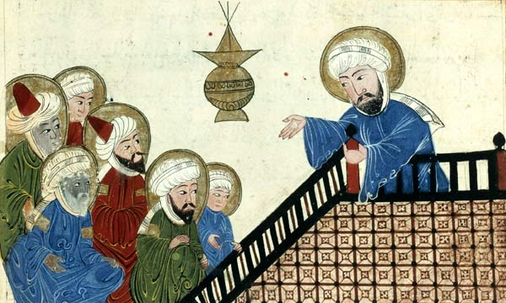
Rise of Islam
Muhammad “the Seal of the Prophets” born 570
Islam the heir of the promises given to Abraham, Moses and Jesus
Jihad to establish Muslim hegemony to facilitate the spread of Islam
Muslims believe Jesus was the messiah and waiting for his return
Muhammad preaching in Makkah
Notes:
Muhammad saw himself as the successor to Abraham, Moses, David and Jesus and the inheritor of their legacy and position. Thus he expected Jews and Christians to recognise the legitimacy of his revelation and authority as a prophet.
By building the Dome of the Rock Muslims were claiming the legacy of Abraham and the Temple.
The Qu’ran teaches Muslims to respect Jews and Christians and their scriptures
Ibn Khaldun, the greatest of all Islamic historians and a key witness from the period just after the Crusades, compares Islam with Christianity and Judaism in this respect:
In the Muslim community, the holy war is a religious duty, because of the universalism of the Muslim mission and the obligation to convert everybody to Islam either by persuasion or force . . . The other religious groups did not have a universal mission, and the holy war was not a religious duty to them, save only for purposes of defence.

Slide 9
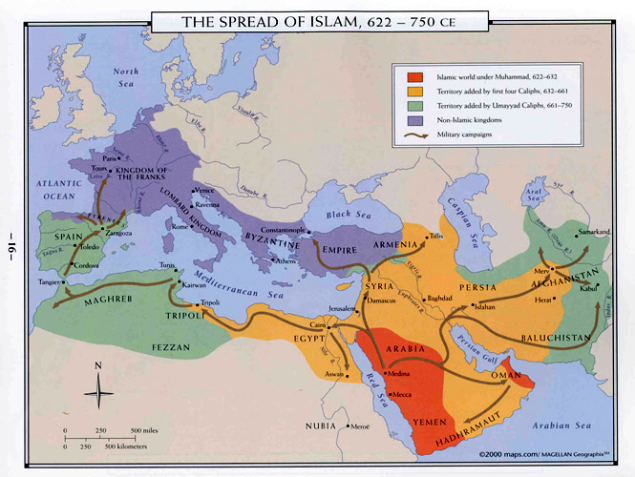
Expansion of the Islamic Empire
Notes:
Spain invaded in 711.
Muslim expansion into Europe halted in 732 at the Battle of Tours by Charles Martel
Huge expansion in very short time. Pressure on Europe from east and west. Jihad for 1000 years until temporary stop after defeat at gates of Vienna in 1683
Muslim sharia law has concept of waqf – any land conquered by Muslims has been consecrated as belonging to all future generations of Muslims until day of resurrection and can never be relinquished.

Slide 10
Will the messiah be born in a Muslim country?
Foundation for the Messiah
Foundation of Faith
Separation from Satan
Time period
Foundation of Substance
Cain and Abel unity
Internal and external
Faith and reason
Science and religion
Hellenism and Hebraism

Slide 11
Original nature
of human being
Internal aspect
External aspect
Hebraism
Hellenism
Movements to restore original human nature
Both are good and necessary
Both need to be integrated with Hebraism in subject position
Only by Cain-type Hellenism submitting to Abel-type Hebraism could Satan be separated from the prevailing spirit of the age. Then the foundation of substance necessary for receiving Christ at the Second Advent could be established worldwide. EDP, 350

Slide 12
Hebraism and Hellenism
Israel
Spiritual culture, Abel
Listening
Free will
Theist
Divine laws
Revelation, faith
Worshipping community
Modest dress
Sexually conservative
Greece
Material culture, Cain
Seeing
Fate
Humanist
Human laws
Reason, science
Political community
Exercise in nude
Sexually liberal
Notes:
The trends of Hebraism and Hellenism had formed long ago and had encountered each other several times in the course of prior history. From 2000 B.C., the Minoan civilization flourished on the island of Crete, succeeded by the Mycenaean civilization on the Greek mainland. By the eleventh century, these civilizations had created a Cain-type Hellenic civilization, whose guiding ideology was humanism. Around the same time in the Near East, the Abel-type Hebraic civilization was born, with Jewish monotheism as its guiding ideology. This was the period of the united kingdom. Had the kings of Israel in that period laid the foundation for the Messiah and received him, this flourishing Hebraic civilization could have assimilated the waning Hellenic civilization to form one worldwide civilization. However, when the kings failed to fulfill the Will of God, this dispensation was not accomplished. Instead, after the Jews were taken into exile in Babylon, they returned only to be put under subjection to the Greeks in 333 B.C. and then to Rome in 63 B.C. Thus, during the centuries leading up to and including Jesus' time, Hebraism was placed under the dominion of Hellenism.
Gk need to separate from Satan especially sexual stuff
“How does luck work? Luck, or heavenly fate, always follows theheartistic current. Like the black current: if you follow it, you knowwhere you will go. If there is heavenly luck, that means the heartisticcurrent is being followed, and you're in luck. “ SMM 1990

Slide 13
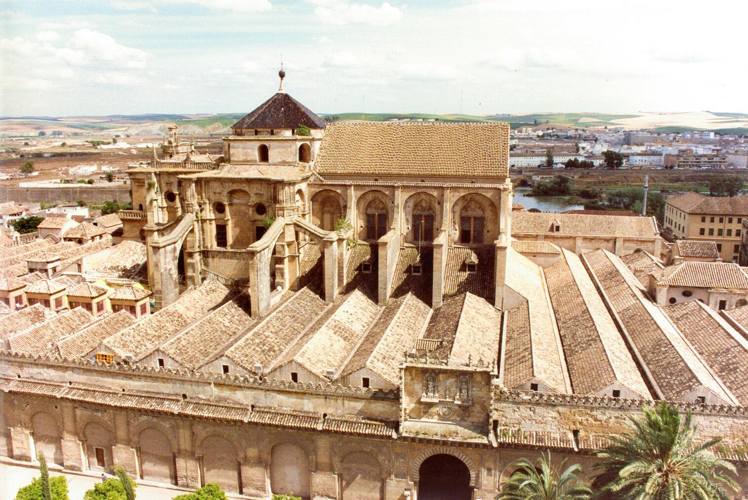
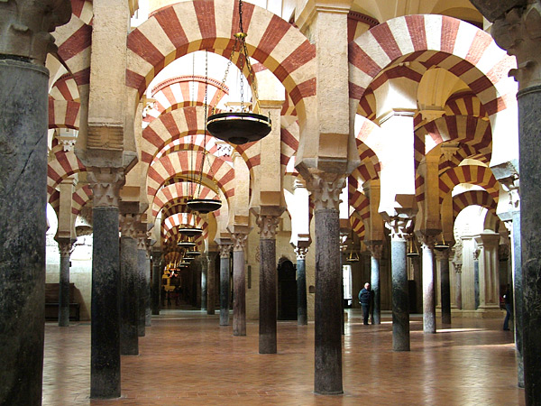
Islamic Spain - Al-Andalus 711-1492
Caliphate of Cordoba 929-1031
Golden age of culture, science, art, architecture, philosophy, libraries, medicine, astronomy
Relatively tolerant of Jews and Christians
Possibility of messiah?
Notes:
Cordoba a Umayyad dynasty rival to Abbasids of Baghdad. Lot of inter-communication between them
Maybe the messiah could have come here. Time of Charlemagne

Slide 14
How did Islamic thought develop?
Al-Farabi (870-950) Turkic/Persian
Revelation and philosophy 2 ways to same truth
Avicenna (980-1037) Uzbekistan
Physician, philosopher, scientist
Synthesised Islam and Aristotle
Al-Ghazali (1058-1111) Persia
Systematised Sufism
Criticised Avicenna in Incoherence of the Philosophers
Rejected Plato and Aristotle
Notes:
Translated Greek classics into Arabic in Baghdad. Distributed throughout Islamic Empire.
Al-darabi. Based in Bagdad. polymath and one of the greatest scientists and philosophers of the Islamic world in his time. He was also a cosmologist, logician, musician, psychologist and sociologist. known to the Arabs as the 'Second Master' (after Aristotle) 'Father of Islamic Neoplatonism and while he was also saturated with Aristotelianism and certainly deploys the vocabulary of Aristotle, it is this Neoplatonic dimension which dominates much of his corpus. This is apparent in his most famous work, al-Madina al-fadila (The Virtuous City) which, far from being a copy or a clone of Plato's Republic, is imbued with the Neoplatonic concept of God.
Avicenna. 7 learnt Koran. Medical texts standard works in Europe. Prayed to understand Aristotle.

Slide 15
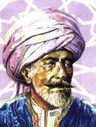
Averroes (1126-1198)
Cordova, Spain
Physician, mathematician, jurist
Commentator on Plato and Aristotle
Reconciled Islam and Aristotle
Incoherence of the incoherence
Exiled, books burnt, disowned by Islamic scholars
Notes:
a master of Aristotelian philosophy, Islamic philosophy, Islamic theology, Maliki law and jurisprudence, logic, psychology, politics, Arabic music theory, and the sciences of medicine, astronomy, geography, mathematics, physics and celestial mechanics. He was born in Córdoba, Al Andalus, modern-day Spain, and died in Marrakech, modern-day Morocco. His school of philosophy is known as Averroism. He has been described by some^{[1]} as the founding father of secular thought in Western Europe and "one of the spiritual fathers of Europe,”
Averroes's works were spread over 20,000 pages covering a variety of different subjects, including early Islamic philosophy, logic in Islamic philosophy, Arabic medicine, Arabic mathematics, Arabic astronomy, Arabic grammar, Islamic theology, Sharia (Islamic law), and Fiqh (Islamic jurisprudence). In particular, his most important works dealt with Islamic philosophy, medicine and Fiqh. He wrote at least 67 original works, which included 28 works on philosophy, 20 on medicine, 8 on law, 5 on theology, and 4 on grammar, in addition to his commentaries on most of Aristotle's works and his commentary on Plato's The Republic.

Slide 16
Islam
Hebraism but rejected Hellenism
No foundation to receive Messiah
Cultural, economic, political decline
Islamic extremism
Very limited religious freedom

Slide 17
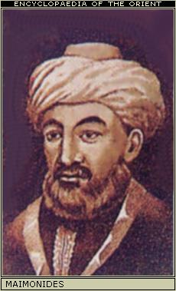
Maimonedes (1135-1204)
Born Cordoba
Almohades invaded 1148
Physician, philosopher, commentator on Mishnah
Learnt from Averroes
Reconciled Torah and Aristotle
Guide for the Perplexed
Basis of Orthodox Judaism
Notes:
Judaism - Hebraism and Hellenism but no nation

Slide 18
Judaism
Synthesis of Hebraism and Hellenism
Basis for Jewish culture and contribution to world culture and civilisation
No country so no national foundation
No foundation to receive the messiah

Slide 19
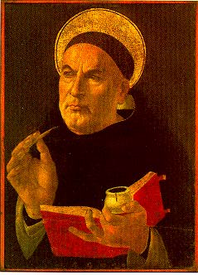
Thomas Aquinas (1225-1274)
Philosopher, theologian, monk
Combined Aristotle and Christian thought
Medieval synthesis
Basis of Western Christianity
Notes:
Summa theological

Slide 20
European Christianity
Synthesis of Hebraism and Hellenism
Foundation to receive the messiah

Slide 21

The Three Blessings
God’s Work Through History
Notes:
Lack of freedom

Slide 22
Late medieval society
Original mind repressed and free development blocked by
Feudalism - social stratification
Little social or economic freedom
Little social mobility
Church - secularisation and corruption
Ritualistic, dogmatic, simony, loss of spiritual authority
No religious freedom
Path of restoration of original nature blocked
Impulse of heart to realise 3 blessings irrepressible
Breakdown barriers
Notes:
Pope Alexander VI (1 January 1431 – 18 August 1503) Borgia family. 4 children by mistress. Nepotism. Because Alexander needed funds to carry out his various schemes, he began a series of confiscations, of which one of the victims was his own secretary. The process was a simple one: any cardinal, nobleman or official who was known to be rich would be accused of some offence; imprisonment and perhaps murder followed at once, and then the confiscation of his property. The least opposition to the Borgia was punished with death.
Girolamo Savonarola (21 September 1452, Ferrara, Emilia-Romagna – 23 May 1498, Florence) was an Italian Dominican priest and leader of Florence from 1494 until his execution in 1498. He was known for his book burning, destruction of what he considered immoral art, and hostility to the Renaissance. He vehemently preached against the moral corruption of much of the clergy at the time, and his main opponent was Rodrigo Borgia, who was Pope Alexander VI from 1492, through Savonarola's death, to 1503).
Social strat - people do job brn to do. No social mobility. Can’t move.
Let us begin by looking back at medieval society and examining what influences it exerted upon the original nature of the people of that age which led them to embark upon the Renaissance and the Protestant Reformation. In the late Middle Ages, man's original mind was repressed, its free development blocked by the social environment of feudalism and the secularization and corruption of the Roman church. Faith is the path each person must walk in search of God. Faith should be nurtured through a direct vertical relationship between God and each individual. Yet in that age, the papacy and the clergy, with their rituals and dogmas, constrained the people's devotional life. Moreover, the rigid social stratification of feudalism did not allow for religious freedom. Meanwhile, religious offices were bought and sold. Bishops and priests often exploited their offices to lead lives of luxury and decadence. As a consequence, the papacy lost its sanctity and became no different than other institutions of worldly power. It lost the ability to guide the spiritual lives of the people. In this way, the social environment of the late Middle Ages blocked the path through which the original nature of the people could be restored. Fettered by such circumstances, medieval Europeans were prompted by the impulses of their innermost hearts to break down their social environment to open the way for the restoration of their original nature.

Slide 23



Three Blessings
Renaissance
God’s Work
Reformation
Religious freedom
Rule of law
Property ownership
Only by Cain-type Hellenism submitting to Abel-type Hebraism could Satan be separated from the prevailing spirit of the age. Then the foundation of substance necessary for receiving Christ at the Second Advent could be established worldwide. EDP, 351
Notes:
Fredom of original mind. Like grass cracking concrete
Freedom to become perfect through fuliflling own responsibility
Freedom to make mistakes, to learn, to grow
Medieveal church - don’t have freedom to make mistake
Individual truth body -> develop individuality. Reject conformism
God created physical environment first
Restoration external first and then internal. FofF which is external and symbolic then FofS which is internal an substantial
So for FforM first ext then int
As people pursued the recovery of the internal and external aspects of their original nature, the thought of the age branched out into two movements to recover the heritage of the past, which we distinguish in relative terms as Abel-type and Cain-type.
Had the popes and emperors who were responsible for restoring the foundation of faith in the Carolingian period not become faithless, the foundation for the Second Advent of the Messiah would have been established at that time. Hebraism would have completely assimilated Hellenism to form one worldwide civilization. Instead, their faithlessness and immorality allowed Satan to corrupt the guiding medieval ideology, which was founded upon Hebraism. As a consequence, God had to conduct a new dispensation for the separation of Satan. Just as God had divided fallen Adam into Cain and Abel to separate Satan, God divided the prevailing ideology of the Middle Ages into two trends of thought: the movements to revive Cain-type Hellenism and Abel-type Hebraism. These bore fruit in the Renaissance and the Reformation, respectively.

Slide 24
What was the impetus behind the Renaissance?
We are created to attain perfection by fulfilling our given responsibility of our own free will, without God's direct assistance. We are then to attain oneness with God and acquire true autonomy. Therefore, it is the calling of our original nature to pursue freedom and autonomy. A person of perfect character understands the Will of God and puts it into practice through his own insight and reason, without the need to rely on revelations from God. Hence, it is only natural that we pursue reason and understanding. We also are endowed with the God-given right to master the natural world, to tame and cultivate it in order to create a pleasant living environment, by investigating the hidden laws of nature through science. Hence, we value the natural world, pursue science, and esteem the practical life. EDP, 351
Notes:
Renasiaane was an expression of SS pursuit of HS aspect of human nature

Slide 25
Where did it start and why?
Florence - Italian city-state, 14th century
Loved freedom to be creative and pursue beauty, truth, goodness
Good governance, Medici patronage
Greek scholars and texts after the conquest of Constantinople in 1453 by Ottoman Turks
Imitating Greek and Roman thought and culture
Driving force behind modern world
Notes:
There is a general, but not unchallenged, consensus that the Renaissance began in Florence, Tuscany in the 14th century. Various theories have been proposed to account for its origins and characteristics, focusing on a variety of factors including the social and civic peculiarities of Florence at the time; its political structure; the patronage of its dominant family, the Medici;[5] and the migration of Greek scholars and texts to Italy following the Fall of Constantinople at the hands of the Ottoman Turks.
Historian and political philosopher Quentin Skinner points out that Otto of Freising (c. 1114 - 1158) , a German bishop visiting north Italy during the 12th century, noticed a widespread new form of political and social organisation, observing that Italy appeared to have exited from Feudalism so that its society was based on merchants and commerce. Linked to this was anti-monarchical thinking, represented in the famous early Renaissance fresco cycle Allegory of Good and Bad Government in Siena by Ambrogio Lorenzetti (painted 1338–1340) whose strong message is about the virtues of fairness, justice, republicanism and good administration. Holding both Church and Empire at bay, these city republics were devoted to notions of liberty. Skinner reports that there were many defences of liberty such as Matteo Palmieri’s (1406–1475) celebration of Florentine genius not only in art, sculpture and architecture, but “the remarkable efflorescence of moral, social and political philosophy that occurred in Florence at the same time”.[34]

Slide 26
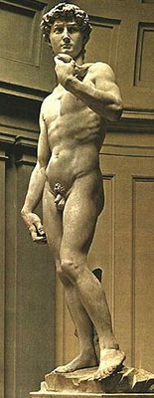
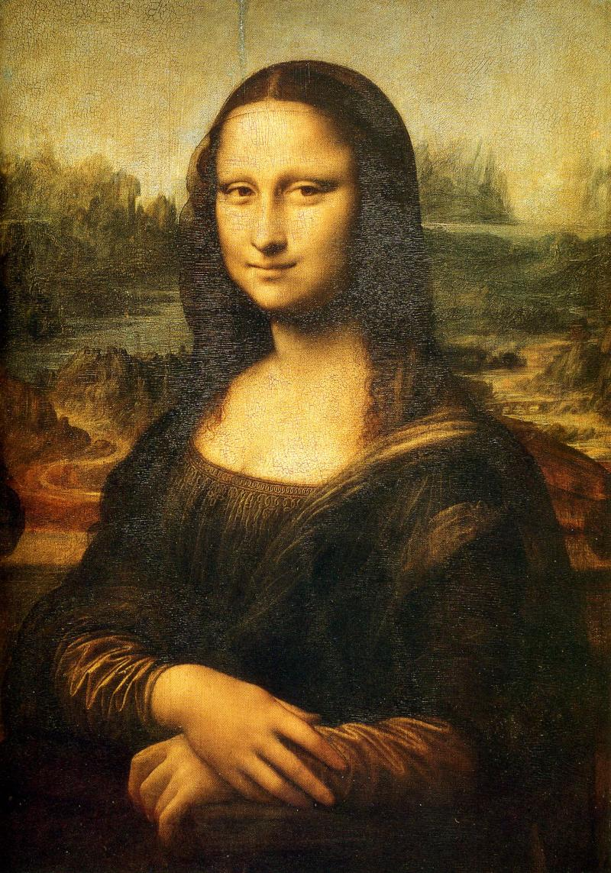
How was this expressed in art?
Michelangelo
1475-1564
“David”
Renaissance humanists
did not reject Christianity;
many of the Renaissance's
greatest works were devoted
to it, and the Church
patronized Renaissance art
Leonardo da Vinci
1452-1519
“Mona Lisa”
Notes:
Started 14c Italy
Immitated Gk and Rm
Transformed medieval way of life -> ploitics, economics, religion
Construction of modern worl
Michelangelo 1475-1564
Painter, sculptor, architect, poet, engineer
Copernicus 1473-1543, Astronomer – formualted the first heliocentric model of the solar system – had been considered by Greek, Indian and Islamic scholars before
Perhaps the most significant development of the era was not a specific discovery, but rather a process for discovery, the scientific method.[53] This revolutionary new way of learning about the world focused on empirical evidence, the importance of mathematics, and discarding the Aristotelian "final cause" in favor of a mechanical philosophy. Early and influential proponents of these ideas included Copernicus and Galileo.

Slide 27
How was this expressed in science?
“I do not feel obliged to believe that the same God who has endowed us with sense, reason, and intellect has intended us to forgo their use.”
Galileo Galilei
Copernicus (1473-1543)
Earth goes around the sun
Kepler (1571-1630)
Laws of planetary motion
Galileo (1564-1642)
Laws of nature are mathematical
Francis Bacon (1561-1626)
Scientific method
Notes:
Nicolaus Copernicus (German: Nikolaus Kopernikus; in his youth, Niclas Koppernigk;[1] Polish: Mikołaj Kopernik; Italian: Nicolò Copernico; 19 February 1473 – 24 May 1543) was a Renaissance astronomer and the first to formulate a comprehensive heliocentric cosmology, which displaced the Earth from the center of the universe.[2]
Johannes Kepler (German pronunciation: [ˈkɛplɐ]; December 27, 1571 – November 15, 1630) was a German mathematician, astronomer and astrologer, and key figure in the 17th century scientific revolution. He is best known for his eponymous laws of planetary motion, codified by later astronomers based on his works Astronomia nova, Harmonices Mundi, and Epitome of Copernican Astronomy. They also provided one of the foundations for Isaac Newton's theory of universal gravitation.
Galileo Galilei (Italian pronunciation: [ɡaliˈlɛo ɡaliˈlɛi]; 15 February 1564[4] – 8 January 1642)[1][5] was an Italian physicist, mathematician, astronomer, philosopher, and flautist who played a major role in the Scientific Revolution. His achievements include improvements to the telescope and consequent astronomical observations, and support for Copernicanism. Galileo has been called the "father of modern observational astronomy,"[6] the "father of modern physics,"[7] the "father of science,"[7] and "the Father of Modern Science."[8] Stephen Hawking says, "Galileo, perhaps more than any other single person, was responsible for the birth of modern science."[9]
Francis Bacon, 1st Viscount of St. Alban, KC (22 January 1561 – 9 April 1626) was an English philosopher, statesman, scientist, lawyer, jurist and author. He served both as Attorney General and Lord Chancellor of England. Although his political career ended in disgrace, he remained extremely influential through his works, especially as philosophical advocate and practitioner of the scientific revolution.
His works established and popularized deductive methodologies for scientific inquiry, often called the Baconian method or simply, the scientific method. His demand for a planned procedure of investigating all things natural marked a new turn in the rhetorical and theoretical framework for science, much of which still surrounds conceptions of proper methodology today.

Slide 28
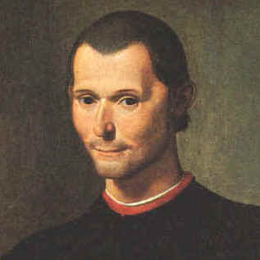

How was this expressed in literature and politics?
Politics:
Machiavelli
Thomas More
Literature:
Boccaccio
Shakespeare
Milton
Machiavelli
1469-1527
Shakespeare
1564-1616
Humanists asserted, "the genius of man
... the unique and extraordinary ability
of the human mind.”
Notes:
Machiavelli – political philosopher, musician, poet, playwright – ‘The Prince’. – ‘Force and prudence are the might of all governments that ever have been or will be in the world’
Shakespeare – pre-eminent dramatist. Poet and playwright. Competely-realised characters capable of expressing the wdie range of human experience – other characters were flat, or simple archetypes. So even villains command audience understanding – if not sympathy – flawed human beings, not monsters.
Renaissance scholars were most interested in recovering and studying Latin and Greek literary, historical, and oratorical texts. Broadly speaking, this began in the fourteenth century with a Latin phase, when Renaissance scholars such as Petrarch, Coluccio Salutati (1331–1406), Niccolò de' Niccoli (1364–1437) and Poggio Bracciolini (1380–1459 AD) scoured the libraries of Europe in search of works by such Latin authors as Cicero, Livy and Seneca.
The fall of the Byzantine Empire in 1453, accompanied by the closure of its schools of higher learning by the Ottoman Turks, brought many other Greek scholars to Italy and beyond, who brought with them Greek manuscripts, and knowledge of the classical Greek literature, some of which had been lost for centuries in the West.[31]
humanism "a middle of the road definition... the movement to recover, interpret, and assimilate the language, literature, learning and values of ancient Greece and Rome".[43] Above all, humanists asserted "the genius of man ... the unique and extraordinary ability of the human mind.
Pico della Mirandola who lived to only twenty-three years wrote what is often considered the manifesto of the Renaissance, a vibrant defence of thinking, the Oration on the Dignity of Man.

Slide 29
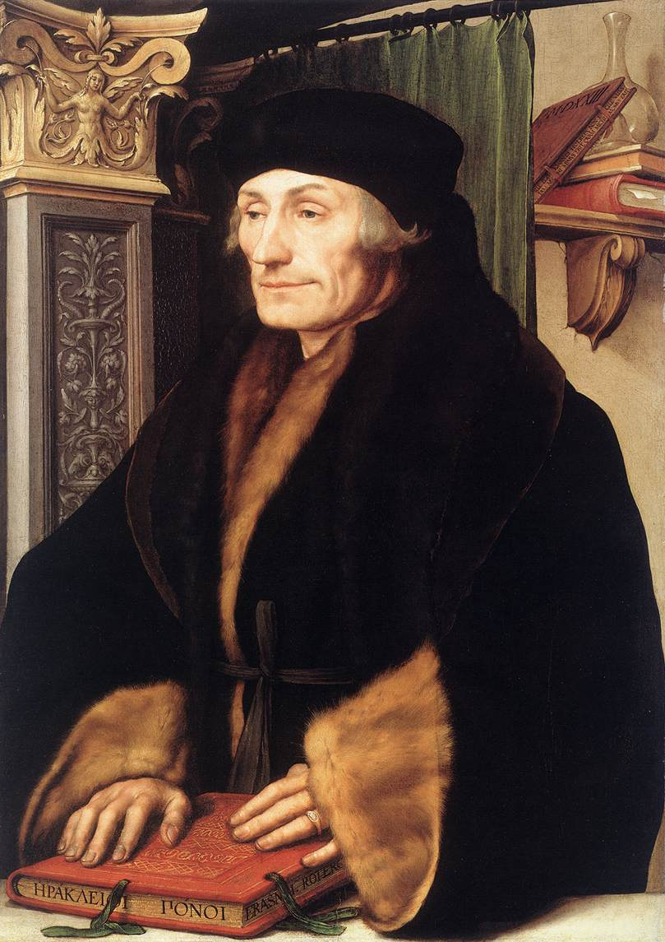
How did the Renaissance lead to the Reformation?
Religion:
Erasmus
Zwingli
Calvin
Luther
Fall of Constantinople 1453
Byzantine scholars
‘Back to the text’
New Testament
Revival of spirit of early Christianity
Erasmus
1466-1536
The Renaissance began in times of religious turmoil. It had a profound effect
on contemporary theology, particularly in the way people perceived the
relationship between man and God.
Notes:
The Renaissance began in times of religious turmoil. The late Middle Ages saw a period of political intrigue surrounding the Papacy, culminating in the Western Schism, in which three men simultaneously claimed to be true Bishop of Rome
the Renaissance had a profound effect on contemporary theology, particularly in the way people perceived the relationship between man and God.[14] Many of the period's foremost theologians were followers of the humanist method, including Erasmus, Zwingli, Thomas More, Martin Luther, and John Calvin.
Churchmen such as Erasmus and Luther proposed reform to the Church, often based on humanist textual criticism of the New Testament.
However, a subtle shift took place in the way that intellectuals approached religion that was reflected in many other areas of cultural life.[14] In addition, many Greek Christian works, including the Greek New Testament, were brought back from Byzantium to Western Europe and engaged Western scholars for the first time since late antiquity. This new engagement with Greek Christian works, and particularly the return to the original Greek of the New Testament promoted by humanists Lorenzo Valla and Erasmus, would help pave the way for the Protestant Reformation.
Erasmus of Rotteram was a classical scholar who wrote in a "pure" Latin style and enjoyed the sobriquet "Prince of the Humanists." He has been called "the crowning glory of the Christian humanists."[2] Using humanist techniques for working on texts, he prepared important new Latin and Greek editions of the New Testament. These raised questions that would be influential in the Protestant Reformation and Catholic Counter-Reformation. He also wrote The Praise of Folly, Handbook of a Christian Knight, On Civility in Children, Copia: Foundations of the Abundant Style, Julius Exclusus, and many other works.

Slide 30
What was the impetus behind the Reformation?
As the people advocated humanism, they also rebelled against the ritualism and rules of the Church which were constraining their free devotion. They fought against the stratified feudal system and papal authority which deprived them of autonomy. They protested the medieval view that faith required unquestioning obedience to the dictates of the Church in all areas of life, which denied them the right to worship God according to the dictates of conscience based on their own reading of the Bible. They also questioned the other-worldly and ascetic monastic ideal which devalued the natural world, science and the practical affairs of life. Out of these grievances, many medieval Christians revolted against the rule of the papacy. EDP, 352
Notes:
Pursued repressed internal aspirations

Slide 31
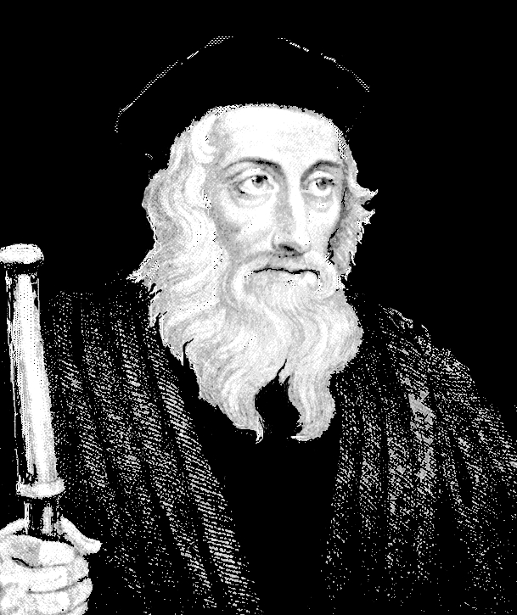
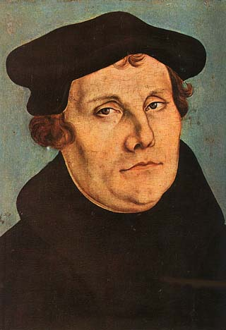
How was this expressed?
Revival of spirit of early Christianity
95 theses 1517
Criticised indulgences
Supported by German princes
Justification by faith
Bible source of authority
Translated Bible
Married priests
John Wycliffe
1324-84
Jan Huss
1369-1415
Martin Luther
1483-1546
Notes:
Accordingly, as medieval Europeans sought to realize the external aspirations of their original nature, they also began to pursue its repressed internal aspirations. They called for the revival of the spirit of early Christianity, when believers zealously lived for the Will of God, guided by the words of Jesus and the apostles. This medieval movement to revive Hebraism began with John Wycliffe (1324-1384), Master Balliol, a professor of theology at Oxford University, who translated the Bible into English. He asserted that neither the papacy nor the priesthood could determine the standard of faith, but only the Bible itself. Demonstrating that many of the dogmas, ceremonies and rules of the Church had no basis in Scripture, he denounced the priesthood for its decadence, exploitation of the people and abuse of power. Lollards
The Council of Constance declared Wycliffe (on 4 May 1415) a stiff-necked heretic and under the ban of the Church. It was decreed that his books be burned and his remains be exhumed. The exhumation was carried out in 1428 when, at the command of Pope Martin V, his remains were dug up, burned, and the ashes cast into the River Swift, which flows through Lutterworth.
The false doctrine and scandalous conduct of the "pardoners" were an immediate occasion of the Protestant Reformation. In 1517, Pope Leo X offered indulgences for those who gave alms to rebuild St. Peter's Basilica in Rome. The aggressive marketing practices of Johann Tetzel in promoting this cause provoked Martin Luther to write his Ninety-Five Theses, condemning what he saw as the purchase and sale of salvation. In Thesis 28 Luther objected to a saying attributed to Tetzel: "As soon as a coin in the coffer rings, a soul from purgatory springs”. The Ninety-Five Theses not only denounced such transactions as worldly but denied the Pope's right to grant pardons on God's behalf in the first place: the only thing indulgences guaranteed, Luther said, was an increase in profit and greed, because the pardon of the Church was in God's power alone.^{[41]}
Martin Luther – German monk, theologian, church reformer. 1883-1546
challenged authority of Papacy – Bible source of religious authority. Church as priesthood of ALL believers. Salvation through faith in Jesus – does not need mediation of the church. Translated Bible into German vernacular. Justification by faith alone. 95 theses nailed to door of church in Wittenberg. Church had over 5,000 relics including vials of the milk of the virgin Mary, straw from the manger of Jesus and the body of one of the innocents massacred by Herod. Leo X sold indulgence for St Peter’s remit penalty for sin in next life

Slide 32
What happened next? European wars of religion
The Reformation split Germany
Conflict between Catholics and Protestants
Peace of Augsburg 1555
Division of Europe
Thirty Years War 1618-1648
Most destructive war in European history
Treaty of Westphalia 1648
New political order - sovereign states
Decentralisation of Germany
Equality of Catholics and Protestants
Notes:
The European wars of religion were a series of wars waged in Europe from ca. 1524 to 1648, following the onset of the Protestant Reformation in Western and Northern Europe. Although sometimes unconnected, all of these wars were strongly influenced by the religious change of the period, and the conflict and rivalry that it produced. Spanish Armada 1588
gave Lutheranism official status within the domains of the Holy Roman Empire.
The Thirty Years' War (1618–1648) was fought primarily in what is now Germany, and at various points involved most countries in Europe. It was one of the most destructive conflicts in European history.
The origins of the conflict and goals of the participants were complex, and no single cause can accurately be described as the main reason for the fighting. Initially, the war was fought largely as a religious conflict between Protestants and Catholics in the Holy Roman Empire, although disputes over the internal politics and balance of power within the Empire played a significant part. Gradually, the war developed into a more general conflict involving most of the European powers
The male population of the German states was reduced by almost half.[53] The population of the Czech lands declined by a third due to war, disease, famine and the expulsion of Protestant Czechs
The Swedish armies alone may have destroyed up to 2,000 castles, 18,000 villages and 1,500 towns in Germany, one-third of all German towns
One result of the war was the division of Germany into many territories — all of which, despite their membership in the Empire, won de facto sovereignty. This limited the power of the Holy Roman Empire and decentralized German power.
the rulers of the Imperial States to independently decide their religious worship. Protestants and Catholics were redefined as equal before the law, and Calvinism was given legal recognition. Also, each of the 400 or so princes of the Holy Roman Empire were given equal authority to that of the Emperor, de-centralizing the government and effectively ending the power of the Holy Roman Empire.[3] [4]

Slide 33
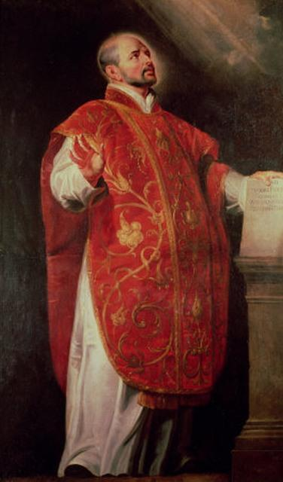
Counter/Catholic Reformation
Council of Trent 1545-63
Church restructuring
Religious orders
Spiritual movements
Political dimensions
Ignatius Loyola
Notes:
The Counter-Reformation (also the Catholic Revival^{[1]} or Catholic Reformation) denotes the period of Catholic revival beginning with the Council of Trent (1545–1563) and ending at the close of the Thirty Years' War, 1648 as a response to the Protestant Reformation. The Counter-Reformation was a comprehensive effort, composed of four major elements:
Ecclesiastical or structural reconfiguration
Religious orders
Spiritual movements
Political dimensions
Such reforms included the foundation of seminaries for the proper training of priests in the spiritual life and the theological traditions of the Church, the reform of religious life by returning orders to their spiritual foundations, and new spiritual movements focusing on the devotional life and a personal relationship with Christ, including the Spanish mystics and the French school of spirituality. It also involved political activities that included the Roman Inquisition.
However, in this movement to strengthen the authority of the Catholic Church, it has been argued that it also inadvertently helped set the stage for the Scientific Revolution, which would eventually present a more fundamental challenge to that authority.
RC retrenched. Saint Ignatius of Loyola, 1491-1556. Founder of Jesuits – direct service to the Pope. Complied ‘Spiritual Exercises’ . Fought against the Protestant Reformation. Key companion – Francis Xavier (went to Japan)

Slide 34
Original nature
of human being
Internal aspect
External aspect
Hebraism
Hellenism
Movements to restore original human nature
Both are good and necessary
Both need to be integrated with Hebraism in subject position
Only by Cain-type Hellenism submitting to Abel-type Hebraism could Satan be separated from the prevailing spirit of the age. Then the foundation of substance necessary for receiving Christ at the Second Advent could be established worldwide. EDP, 351

Slide 35
Period of religious and ideological conflict - 1648-1789
Cain-type view
Renaissance | Enlightenment
Reformation | Second Reformation
Cain-type world is to submit
to the Abel-type world
to establish the worldwide
foundation of substance.
EDP, 353
Abel-type view
Reformation and Renaissance
Freedom of thought led to conflict between religion and philosophies

Slide 36
What led to the Enlightenment?
Renaissance
Elevated dignity of human being and value of natural world over devotion to God
Exalted value of the human being and nature
Sought to understand by reason and experience; logic and experiment
Rationalism and Empiricism
Breakdown of medieval synthesis
Questioning of values, traditions, doctrines
Rejection of revelation as sole authority
Some streams of Enlightenment invaded by Satan by becoming materialistic and atheistic
Notes:
God and religion pushed a little to the edge

Slide 37
English Enlightenment 1630 -1750
Deism
Lord Herbert of Cherbury (1583-1648)
Theology based only on reason practical atheism
Intellectually defeated by William Law and Bishop Butler
Satan’s invasion of Cain-type view defeated
John Locke (1632-1704)
Empiricism, liberal democracy
Reasonable Christianity
Isaac Newton (1643-1727)
Maths, physics, alchemy and religion
Bishop Berkeley (1685-1753)
Empiricism
English Revolution 1640, Glorious Revolution 1688
Religious, liberal, democratic
Empiricism
Truth from
experience
Scepticism
Notes:
Deism is a religious and philosophical belief that a supreme being created the universe, and that this (and religious truth in general) can be determined using reason and observation of the natural world alone, without the need for either faith or organized religion. Many Deists reject the notion that God intervenes in human affairs, for example through miracles and revelations.
In the realm of religion, Herbert believed that there were five common notions
* There is one Supreme God.
* He ought to be worshipped.
* Virtue and piety are the chief parts of divine worship.
* We ought to be sorry for our sins and repent of them
* Divine goodness doth dispense rewards and punishments both in this life and after it.
Lord Herbert of Cherbury
Matthew Tindal (1657 – 16 August 1733) was an eminent English deist author. His works, highly influential at the dawn of the Enlightenment, caused great controversy and challenged the Christian consensus of his time. Christianity as Old as the Creation; or, the Gospel a Republication of the Religion of Nature came to be regarded as the "Bible" of deism. Tindal's redefined the foundation of deist epistemology as knowledge based on experience or human reason. This effectively widened the gap between traditional Christians and what he called "Christian deists" since this new foundation required that revealed truth be validated through human reason. Tindal's system was based on the empirical principles of Locke
John Toland (1670 – 1722) was a rationalist philosopher and freethinker, and occasional satirist, who wrote numerous books and pamphlets on political philosophy and philosophy of religion, which are early expressions of the philosophy of the Age of Enlightenment. Born in Ireland, he was influenced by the philosophy of John Locke. Christianity Not Mysterious, Toland's views became gradually more radical. His opposition to hierarchy in the church also led to opposition to hierarchy in the state; bishops and kings, in other words, were as bad as each other, and monarchy had no God-given sanction as a form of government. First person to be called a free thinker. Advocate of liberty. Pantheist and basically atheist. All revelation is human revelation; that which is not rendered understandable is to be rejected as gibberish.
William Law (1686 – 9 April 1761) was a cleric, divine and theological writer. Wrote Case of Reason (1732), in answer to Tindal's Christianity as old as the Creation.
Joseph Butler 1692 -1752) was an bishop, theologian, apologist, and philosopher. Analogy of Religion, Natural and Revealed (1736). The Analogy is an important work of Christian apologetics in the history of the controversies over deism. Butler's apologetic concentrated on "the general analogy between the principles of divine government, as set forth by the biblical revelation, and those observable in the course of nature, [an analogy which] leads us to the warrantable conclusion that there is one Author of both.” Butler's arguments combined a cumulative case for faith using probabilistic reasoning to persuade deists and others to reconsider orthodox faith. Aspects of his apologetic reasoning are reflected in the writings of twentieth century Christian apologists such as C. S. Lewis
Thomas Hobbes (1588 – 1679) was an English philosopher, best known today for his work on political philosophy. His 1651 book Leviathan established the foundation for most of Western political philosophy from the perspective of social contract theory.
John Locke 1632-1704
English philosopher – first of British Empiricists. Important for ‘social contract’ theory – philosophy to define the self through a continuity of ‘consciousness’. Mind is blank slate, ‘tabula rasa’, no innate ideas. Influenced ideas in Constitution of US and Declaration of Independence
NEWTON: 1643-1727, English physicist, mathematician, astronomer, natural philosopher. Universal gravitation, laws of motion, groundwork for classical mechanics, optics. Credited, along with Leibniz, for calculus
George Berkeley (1685 – 1753), also known as Bishop Berkeley (Bishop of Cloyne), was an Anglo-Irish philosopher whose primary achievement was the advancement of a theory he called "immaterialism" (later referred to as "subjective idealism" by others). This theory denies the existence of material substance and instead contends that familiar objects like tables and chairs are only ideas in the minds of perceivers, and as a result cannot exist without being perceived. Thus, as Berkeley famously put it, for physical objects "esse est percipi" ("to be is to be perceived"). His chief philosophical work A Treatise Concerning the Principles of Human Knowledge in 1710. In 1732, he published Alciphron, a Christian apologetic against the free-thinkers such as Tindal and Toland. The city of Berkeley, California, was named after him

Slide 38
English spiritual revival
Many spiritual groups following Reformation
Puritans
Emigrated to America on Mayflower 1640
George Fox (1624-1691)
Quakers
John Wesley (1703-1791)
Methodism
Personal and social regeneration
George Whitefield (1714-1770)
Evangelical revival
Great Awakening in American colonies
Religious freedom and pluralism
Notes:
Religious leaders in communcation with philosophers
Wesley 15th of 19 children. His mother was 25th child. travelled generally on horseback, preaching two or three times each day. Stephen Tomkins writes that he "rode 250,000 miles, gave away 30,000 pounds, . . . and preached more than 40,000 sermons. Wesley was the first to put the phrase 'agree to disagree' in print Because of his charitable nature he died poor, leaving as the result of his life's work 135,000 members and 541 itinerant preachers under the name "Methodist". Religious pluralism
Puritans anti-Catholic

Slide 39
Scottish Enlightenment 1730 -1800
David Hume (1711-1776)
Empiricism, Treatise on Human Nature, free market, humanism, liberal democracy
Adam Smith (1723-1790)
Wealth of Nations, Theory of Moral Sentiments
Francis Hutcheson (1694-1746)
Moral philosopher, utilitarianism
Robert Burns (1759-1796)
Poet
Thomas Reid (1710-1796)
Philosopher - Principles of Common Sense
Notes:
In Scotland, the Enlightenment was characterised by a thoroughgoing empiricism and practicality where the chief virtues were held to be improvement, virtue, and practical benefit for both the individual and society as a whole.
The learned Scots were remarkably unlike the French philosophes; indeed, they were unlike any other group of philosophers that ever existed.
In the Scottish group there was little of the bristling, charged, and exclusionary fervour of the Diderot-d’Alembert circle; or of the ruthless atmosphere found in Germany in the group that included Fichte, the Schelling brothers, and Hegel; or of the conscious glamour of the existentialists in postwar Paris. The Scots vigorously disagreed with one another, but they lacked the temperament for the high moral drama of quarrels, renunciations, and reconciliation. Hutcheson, Hume and Smith, along with Adam Ferguson and Thomas Reid, were all widely known, but none of them were remotely cult figures in the style of Hegel, Marx, Emerson, Wittgenstein, Sartre, or Foucault.
To an astonishing degree, the men supported one another’s projects and publications, which they may have debated at a club that included amateurs (say, poetry-writing doctors, or lawyers with an interest in science) or in the fumy back room of some dark Edinburgh tavern.

Slide 40
Britain
Synthesis of Hebraism and Hellenism
Foundation to receive the Messiah
1. Freedom of religion
2. Democracy, rule of law
3. Property ownership, free market
God’s 2000 years providence has prepared a
democratic social and legal environment which
will protect Christ at the Second Advent. EDP, 282
Expanded to USA, British Empire, Korea
Notes:
On this basis comes industrial revolution. Freedom of speech and thought and meeting and inquiry and publishing and research etc. law of contract, Henry VIII abolished internal tariffs -> single market, free internal trade, justice, law,
God's spiritual providence of restoration during the two thousand years since Jesus' day has prepared a democratic social and legal environment which will protect Christ at the Second Advent. Jesus was killed after being branded a heretic by the Jews and a rebel by the Roman Empire. In contrast, even if Christ at the Second Advent is persecuted as a heretic, in the democratic society to which he will come, such accusations will not be sufficient grounds for him to be condemned to death. 3.3.2

Slide 41
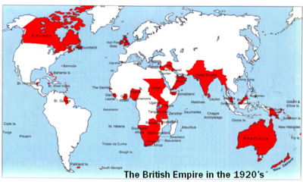
The British Empire
Notes:
The British Empire comprised the dominions, colonies, protectorates, mandates and other territories ruled or administered by the United Kingdom. It originated with the overseas colonies and trading posts established by England in the late 16th and early 17th centuries. At its height it was the largest empire in history and, for over a century, was the foremost global power. By 1922 the British Empire held sway over about 458 million people, one-quarter of the world's population at the time, and covered more than 13 million square miles (34 million km²), almost a quarter of the Earth's total land area. As a result, its political, linguistic and cultural legacy is widespread. At the peak of its power, it was often said that "the sun never sets on the British Empire" because its span across the globe ensured that the sun was always shining on at least one of its numerous territories.
During the Age of Discovery in the 15th and 16th centuries, Portugal and Spain pioneered European exploration of the globe, and in the process established large overseas empires. Envious of the great wealth these empires bestowed, England, France and the Netherlands began to establish colonies and trade networks of their own in the Americas and Asia. A series of wars in the 17th and 18th centuries with the Netherlands and France left England (Britain, following the 1707 Act of Union with Scotland) the dominant colonial power in North America and India. The loss of the Thirteen Colonies in North America in 1783 after a war of independence deprived Britain of some of its most populous colonies. British attention soon turned towards Africa, Asia and the Pacific. Following the defeat of Napoleonic France in 1815, Britain enjoyed a century of almost unchallenged dominance, and expanded its imperial holdings across the globe. Increasing degrees of autonomy were granted to its white settler colonies, some of which were reclassified as dominions.
The growth of Germany and the United States had eroded Britain's economic lead by the end of the 19th century. Subsequent military and economic tensions between Britain and Germany were major causes of the First World War, during which Britain relied heavily upon its Empire. The conflict placed enormous financial strain on Britain, and although the Empire achieved its largest territorial extent immediately after the war, it was no longer a peerless industrial or military power. The Second World War saw Britain's colonies in South-East Asia occupied by Japan, which damaged British prestige and accelerated the decline of the Empire, despite the eventual victory of Britain and its allies. India, Britain's most valuable and populous colony, won independence within two years of the end of the war.
During the remainder of the 20th century, as part of a larger decolonisation movement by European powers, most of the territories of the British Empire became independent, ending with the handover of Hong Kong to the People's Republic of China in 1997. Fourteen territories remain under British sovereignty, the British overseas territories. After independence, many former British colonies joined the Commonwealth of Nations, a free association of independent states. Sixteen Commonwealth nations share their head of state, Queen Elizabeth II, as Commonwealth realms.
Gifts of British empire
English language
Common law
Representative government
English land tenure
English and Scottish banking
Protestantism
Games and sports
Limited state
The idea of Liberty

Slide 42
French Enlightenment 1637-1815
Descartes (1596-1650)
Rationalism, Universalism
Deism - Destructive and atheistic
Satan invaded Cain view
Voltaire
Mocked religion
Rousseau (1712-1788)
Democratic totalitarianism
Encyclopedists
Atheistic and materialistic
Saint Simon (1760–1825)
State technocratic socialism
Revolution (1789)
Atheistic, bloody, dictatorship
Revolutionary and Napoleonic wars (1792-1815)
Rationalism
Truth from
Reason
Dogmatism
Universalism
Notes:
Jean Bodin, (1530-1596) who was renowned for his powerful intellect and breadth of knowledge and was truly a renaissance man: “His works on political and legal thought set him apart as one of the most brilliant minds of the period. Although he is perhaps less known for his writing on religious questions of his day, his Colloquium remains a unique contribution to religious dialogue. It circulated in its Latin manuscript form, but it was not published until the nineteenth century. Marion L. Kuntz offers the first English translation of this masterpiece. Structured as a conversation between a Catholic, a Jew, a Lutheran, a Calvinist, a Muslim, a skeptic, and a philosophical naturalist, the Colloquium encourages religious tolerance and poses challenging questions for anyone interested in the nature of religious and philosophical thought. Bodin also came up with idea of divine right of kings. The Six Books of the Commonwealth represents the sum total of legal and political thought of the French Renaissance. His Method for the Easy Comprehension of History is at the pinnacle of early-modern, European humanism's Ars historica. Finally, his work Colloquium of the Seven about Secrets of the Sublime, …”
Voltaire - mocked religion
Rousseau - totalitarian democracy
Encyclopedists - atheistic materialists
Robspeare - idealist dictator
Napoleaon
Disputative
Revolutionary Enlightenment, more dominant in France, was represented by the thought of Denis Diderot (1713–1784), Baron d'Holbach (1723–1789), Jean le Rond d'Alembert (1717–1783) and Claude Adrien Helvétius (1715–1771)
Saint Simon: he advocated a form of state technocratic socialism, an arrangement where industrial chiefs should control society. In place of the church, he felt the direction of society should fall to the men of science. Men who are fitted to organize society for productive labour are entitled to rule it.
Universalism - one size fits all

Slide 43
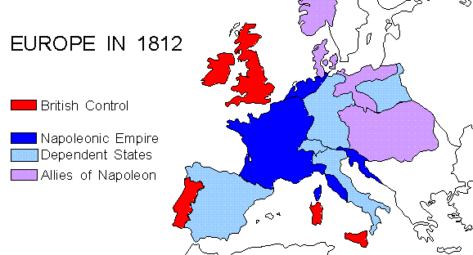
Napoleonic Empire
Russia
Prussia
Confed.
of the
Rhine
French
Empire
Austria
Ottoman
Empire
Portugal
Spain
Notes:
Rise of Napoleon 1795-1805 At the time of the French Revolution, Napoleon was a lowly army cadet. The revolution opened the army to promotion on the basis of talent - in the old regime, you became an officer through noble birth, patronage or by bribing officials. As a military genius with ruthless ambition, Napoleon rose rapidly in the revolutionary armies. France was being attacked on all sides as the kings of Europe feared the revolution would spread, and that its ideas of liberty and equality would appeal to their own subjects. It was a time of great opportunity for an ambitious young army officer.
1795 - appointed commander of French revolutionary forces in Italy 1797 - appointed to command French forces for invasion of England 1798 - sailed down the Mediterranean to invade Egypt. 1799 - followed by British Admiral Nelson, who defeated the French fleet at the battle of the Nile - ending hopes of extending the French Empire in the Middle East and blocking British trade with India. Napoleon returned to Paris. Things were going badly for the French, and he led a military coup which overthrew the weak government (the "Directory"), replacing it with a military junta called the Consuls. 1802 - after successfully beating off the hostile coalition led by Britain, the Consuls made a temporary peace. 1803 - to raise money for another war everyone expected, Napoleon sold the French colony of Louisiana in north America - a huge area from New Orleans up the Mississippi to the Canadian border. The USA bought it for $3 million (the "Louisiana Purchase"), borrowing the money from British and Dutch bankers! With his war chest full, Napoleon planned to invade England. He massed a "Grand Armée" camped on the hills above Boulogne, and set about building a flotilla of barges by which they could invade England. This set off panic reaction across the Channel, with enormous resources poured into strengthening defences against invasion - the Royal Military Canal around Romney Marsh, the ring of coastal gun turrets called Martello Towers, and huge fortifications on the hills either side of Dover harbour. 1804 - elected "Consul for life", then crowned himself as "Emperor of France" in Paris, in the presence of the Pope. 1805 - British Admiral Nelson defeats combined French and Spanish fleets in the battle of Trafalgar.
1805 - Napoleon was forced to abandon plans to invade England (he realised he could not stop the British fleet attacking his troop-carrying barges as they crossed the Straits of Dover). Meanwhile he had already marched his army eastwards, and defeated the Russians and Austrians at the battle of Austerlitz. 1806 - With opposition to the east greatly weakened, Napoleon united most of the small German states into the "Confederation of the Rhine" under his control. He destroyed the Prussian army at the battle of Jena, and took over Prussia's Polish territories. To undermine the British war effort, he started the "Continental System": his Customs Officers were ordered to stop British goods being landed in France or anywhere in Europe under French control. He hoped this embargo would ruin British trade and industry, which provided the wealth that enabled Britain to keep a powerful navy and large armies. 1807 - He made peace with Britain's other potential coalition ally, Russia. Napoleon agreed to allow Russia a "sphere of influence" round its borders. He established a Duchy of Warsaw to keep most of Poland under French control. 1808 - He invaded Spain and Portugal, setting up his brother as King of Spain. 1809 - A British expeditionary army into Spain was beaten at Corunna, and almost driven into the sea. Reorganised under the Duke of Wellington, the British fought through the peninsula until 1814, helped by fierce resistance by Spanish peasants who waged a guerrilla war that tied up French forces.
1810 - Napoleon was at the height of his powers. His main enemy Britain was almost isolated: France had made peace with Britain's main former coalition allies: Russia, Austria and Prussia, having weakened them in decisive land battles. The French Empire ruled over 10 million of Europe's 175 million inhabitants. Only Britain's continued sea power stopped France taking over the distant Spanish and Dutch colonies in America, India and the Far East to create an even bigger world empire.
1812 - Napoleon decided to invade Russia. They had stopped boycotting British goods, and Napoleon suspected they were going to re-join the coalition with Britain. He led the Grand Army from Poland, beating the Russians at the battle of Borodino at the gates of Moscow. But the Russians beat him with a "scorched earth" policy, destroying everything so there was no food or shelter for the French army. Napoleon was forced to retreat from Moscow. In the cruel Russian winter, only 100,000 men out of 600,000 made it back to France.
1813 - Encouraged by the French catastrophe, Prussia and Austria switched sides, allied with Britain who financed them to declare war on France. Napoleon won several early battles, but the enlarged coalition routed him in the "battle of Nations" at Leipzig. Together they invaded France, and French public opinion turned against Napoleon and his endless wars.
The Napoleonic Wars were a series of wars declared against Napoleon's French Empire by opposing coalitions that ran from 1803 to 1815. As a continuation of the wars sparked by the French Revolution of 1789, they revolutionised European armies and played out on an unprecedented scale, mainly due to the application of modern mass conscription. French power rose quickly as Napoleon's armies conquered much of Europe but collapsed rapidly after France's disastrous invasion of Russia in 1812. Napoleon's empire ultimately suffered complete military defeat resulting in the restoration of the Bourbon monarchy in France. The wars resulted in the dissolution of the Holy Roman Empire and sowed the seeds of nascent nationalism in Germany and Italy that would lead to the two nations' individual consolidation later in the century. Meanwhile, the global Spanish Empire began to unravel as French occupation of Spain weakened Spain's hold over its colonies, providing an opening for nationalist revolutions in Spanish America. As a direct result of the Napoleonic wars, the British Empire became the foremost world power for the next century thus beginning Pax Britannica.
The Napoleonic Wars brought great changes both to Europe and the Americas. Napoleon had succeeded in bringing most of Western Europe under one rule—a feat that had not been accomplished since the days of the Roman Empire (although Charlemagne had nearly done so around 800 CE). However, France's constant warfare with the combined forces of the other major powers of Europe for over two decades finally took its toll. By the end of the Napoleonic Wars, France no longer held the role of the dominant power in Europe, as it had since the times of Louis XIV. In its place, the United Kingdom emerged as by far the most powerful country in the world and the Royal Navy gained unquestioned naval superiority across the globe. This, coupled with Britain's large and powerful industrial economy, made it perhaps the first truly global superpower and ushered in the Pax Britannica that lasted for the next 100 years.
In most European countries, subjugation in the French Empire bought with it many products of the French Revolution including democracy, due process in courts, abolition of privileges, etc. The increasing prosperity of the middle classes with rising commerce and industry meant that restored European monarchs found it difficult to restore pre-revolutionary absolutism, their basic laws—an enduring legacy of the Napoleonic Code.
Another concept emerged – that of a unified Europe. After his defeat, Napoleon deplored the fact that his dream of a free and peaceful "European association" remained unaccomplished. Such a European association would share the same principles of government, system of measurement, currency and Civil Code. Some one-and-a-half centuries later, and after another major conflagration (the Second World War), several of these ideals re-emerged in the form of the European Union.

Slide 44
France
No unity of Hebraism and Hellenism
Expanded to continental Europe
Totalitarian democracy German Counter-Enlightenment Communism, Europeanism
Notes:
"Counter-Enlightenment" is a term used to refer to a movement that arose in the late-eighteenth and early-nineteenth centuries in opposition to the eighteenth century Enlightenment. The term is usually associated with Isaiah Berlin, who is often credited with coining it, perhaps taking up a passing remark of the German philosopher Friedrich Nietzsche, who used the term Gegenaufklärung at the end of the nineteenth century. It has not been widely used since. The first known use of the term 'counter-enlightenment' in English was in 1949. Berlin published widely about the Enlightenment and its enemies and did much to popularise the concept of a Counter-Enlightenment movement that he characterised as relativist, anti-rationalist, vitalist and organic and which he associated most closely with German Romanticism. Some recent scholarship has challenged this view for focusing too narrowly on Germany and stopping abruptly in the early nineteenth century, thereby ignoring the Enlightenment's many subsequent critics, particularly in the twentieth century

Slide 45
German Enlightenment 1650-1800
Spener (1635-1705)
Pietism
Leibnitz (1646–1716)
Monodology - spiritual atoms
Universe a manifestation of a perfect God
Kant (1724-1804)
Synthesised rationalism and empiricism
Transcendental idealism
Goethe (1749–1832)
Young Werther Sturm und Drang
Hamann (1730-1788) , Herder (1744-1803)
Romanticism - emotion over reason - reaction to French view
Pluralism instead of universalism
Emotional
Mystical
Irrationalism
Notes:
Pietism (from the word piety) was a movement within Lutheranism, lasting from the late 17th century to the mid-18th century and later. It proved to be very influential throughout Protestantism and Anabaptism, inspiring Anglican priest John Wesley and Alexander Mack to begin the Brethren movement. The Pietist movement combined the Lutheranism of the time with the Reformed emphasis on individual piety and living a vigorous Christian life. Though pietism shares an emphasis on personal behavior with the Puritan movement, and the two are often confused, there are important differences, particularly in the concept of the role of religion in government. The main difference between the new Pietistic Lutheran school and the orthodox Lutherans arose from the Pietists' conception of Christianity as chiefly consisting in a change of heart and consequent holiness of life. Orthodox Lutherans rejected this viewpoint as a gross simplification, stressing the need for the church and for sound theological underpinnings. As forerunners of the Pietists in the strict sense, certain voices had been heard bewailing the shortcomings of the Church and advocating a revival of practical and devout Christianity. Amongst them were Christian mystic Jakob Böhme. Spener founded Halle University
Leibniz proposed the idea that everything in the universe consisted of monads, which he conceived of essentially as “spiritual atoms” that constitute our perception of the world but lack physical dimension. Unlike many figures in the French and English Enlightenment, Leibniz was very religious and in fact saw monads as reflections of a structured, harmonious universe—the work of a perfect God. Leibniz’s deep religious faith and affinity for tradition kept him conservative in his approach to his work, permeated his writings, and paved the way for the mysticism of the rest of the German Enlightenment. Leibniz a Platonist and not a Christian. Rarely went to church although involved in Prot-Cath reunion.
Kant’s work with skepticism perfectly sums up the German Enlightenment’s mistrust of empiricism. The Critique suggests that we all are born with our own ideas and perceptions of the world and, as such, can never know what is “real” and what is “our perception.” In other words, reality is in the eyes of the beholder. However, because nothing really exists separate from its existence in the eyes of the observer, then perceptions and observations in the world cannot be trusted. As a result, empirical evidence cannot be trusted either. By thus stating that only a select few universal truths in the world were valid, Kant effectively disagreed with the premise of the entire French Enlightenment. Kant’s transcendental idealism was a modest philosophical doctrine about the difference between appearances and things in themselves, which claimed that the objects of human cognition are appearances and not things in themselves. Fichte, Schelling, and Hegel radicalized this view, transforming Kant’s transcendental idealism into absolute idealism, which holds that things in themselves are a contradiction in terms, because a thing must be an object of our consciousness if it is to be an object at all. The German idealists attempted to derive all the different parts of philosophy from a single, first principle. This first principle came to be known as the absolute, because the absolute, or unconditional, must precede all the principles which are conditioned by the difference between one principle and another.
Goethe’s novel The Sorrows of Young Werther (1774), about a young boy who falls for an unattainable girl and eventually kills himself out of despair, had an unimaginable impact on German youth at the time. It is primarily for that work that Goethe is considered the most prominent figure in Germany's Sturm und Drang (“storm and stress”) movement, a roughly twenty-year period from the 1760s to 1780s in which young German intellectuals, inspired by Rousseau’s emphasis on emotion, revolted against optimism and reason and plunged into darker, more anarchic themes.
Sturm und Drang literally "Storm and Urge", although usually translated as "Storm and Stress” is the name of a movement in German literature and music taking place from the late 1760s through the early 1780s, in which individual subjectivity and, in particular, extremes of emotion were given free expression in reaction to the perceived constraints of rationalism imposed by the Enlightenment and associated aesthetic movements. The philosopher Johann Georg Hamann is considered to be the ideologue of Sturm und Drang, and Johann Wolfgang von Goethe was a notable proponent of the movement; though he and Friedrich Schiller ended their period of association with it by initiating what would become Weimar Classicism.
Goethe released numerous essays, poems, and critiques over the following thirty years, then unveiled the literary masterpiece that would solidify his place in history. The first part of the epic verse drama Faust was published in 1808, the second in 1832. The work—a retelling of the German legend of a man who promises his soul to the devil in exchange for knowledge and power (previously told in Christopher Marlowe’s 1604 Dr. Faustus)—was massively successful. Goethe, however, died the same year that the second part was published.
Romanticism movement that arose primarily in late eighteenth and early nineteenth century Germany against the rationalism, universalism and empiricism commonly associated with the Enlightenment.
Counter-Enlightenment thought did not really 'take off' until the Germans 'rebelled against the dead hand of France in the realms of culture, art and philosophy, and avenged themselves by launching the great counter-attack against the Enlightenment.' This reaction was led by the Konigsberg Pietist philosopher J. G. Hamann, (1730-1788) 'the most passionate, consistent, extreme and implacable enemy of the Enlightenment', according to Berlin. This German reaction to the imperialistic universalism of the French Enlightenment and Revolution, which had been forced on them first by the Francophile Frederick II of Prussia, then by the armies of Revolutionary France, and finally by Napoleon, was crucial to the epochal shift of consciousness that occurred in Europe at this time, leading eventually to Romanticism. According to Berlin, the surprising and unintended consequence of this revolt against the Enlightenment has been pluralism, which owes more to the Enlightenment's enemies than it does to its proponents, most of whom were monists whose political, intellectual and ideological offspring have often been terror and totalitarianism.
Twentieth-century interpretations of Hegel were mostly shaped by British Idealism, logical positivism, Marxism, and Fascism. The Italian Fascist Giovanni Gentile, according to Benedetto Croce, "...holds the honor of having been the most rigorous neo-Hegelian in the entire history of Western philosophy and the dishonor of having been the official philosopher of Fascism in Italy."

Slide 46
Later German philosophy
Fichte (1762-1814)
Idealism, nationalism, authoritarianism
Hegel (1770-1831)
Dialectical idealism
French atheism Left-wing Hegelians
Satan invades Cain view
Feuerbach (1804-1872)
Atheism, materialism Marx, Freud
Marx (1818-1883) Engels (1820-1895)
Dialectical materialism, historical materialism, scientific atheism
Nietzsche (1844-1900)
Rejected Christianity as slave morality
‘Death of God’
Idealism
Communism
Fascism
Nazism
Anti-Semitism
Notes:
Johann Gottlieb Fichte (May 19, 1762 – January 27, 1814 was a German philosopher. He was one of the founding figures of the philosophical movement known as German idealism, a movement that developed from the theoretical and ethical writings of Immanuel Kant. Fichte is often perceived as a figure whose philosophy forms a bridge between the ideas of Kant and the German Idealist Hegel. Recently, philosophers and scholars have begun to appreciate Fichte as an important philosopher in his own right due to his original insights into the nature of self-consciousness or self-awareness. Like Descartes and Kant before him, he was motivated by the problem of subjectivity and consciousness. Fichte also wrote political philosophy and is considered one of the fathers of German nationalism. In 1805, Fichte was appointed to a professorship. The disaster at Jena in 1806, in which Napoleon completely crushed the Prussian army, drove him to Königsberg for a time, but he returned to Berlin in 1807 and continued his literary activity.
The deplorable situation of Germany stirred him to the depths and led him to deliver the famous Addresses to the German Nation (1808) which guided the uprising against Napoleon. Fichte made important contributions to political nationalism in Germany. In his Addresses to the German Nation (1808), a series of speeches delivered in Berlin under French occupation, he urged the German peoples to "have character and be German"--entailed in his idea of Germaness was anti-semitism, since he argued that "making Jews free German citizens would hurt the German nation”. Historian Robert Nisbet thought him to be "the true author of National Socialism”.
Jewish liberal philosopher Isaiah Berlin listed Fichte, along with his fellow German idealist G.W.F. Hegel, French materialist and utilitarian philosophe Claude Adrien Helvétius, Swiss collectivist philosophe Jean-Jacques Rousseau, French utopian socialist Henri de Saint-Simon, and Savoyard conservative Joseph de Maistre as thinkers who constituted the ideological basis for modern authoritarianism, in his book Freedom and Its Betrayal: Six Enemies of Human Liberty.
Georg Wilhelm Friedrich Hegel ( (August 27, 1770 – November 14, 1831) was a German philosopher, one of the creators of German Idealism. His historicist and idealist account of reality as a whole revolutionized European philosophy and was an important precursor to Continental philosophy and Marxism.
Hegel developed a comprehensive philosophical framework, or "system", of Absolute idealism to account in an integrated and developmental way for the relation of mind and nature, the subject and object of knowledge, and psychology, the state, history, art, religion and philosophy. In particular, he developed the concept that mind or spirit manifested itself in a set of contradictions and oppositions that it ultimately integrated and united, without eliminating either pole or reducing one to the other. Examples of such contradictions include those between nature and freedom, and between immanence and transcendence.
Those who maintain that God created man in God’s image and likeness have got it the wrong way around, according to some thinkers. According to them, the truth is that man has created God in man’s image and likeness. Ludwig Feuerbach (1804-1872) says the following: “Such are a man’s thoughts and dispositions, such is his God;” “Consciousness of God is self-consciousness, knowledge of God is self-knowledge;” and “All attributes of the divine nature are attributes of the human nature.” Thus, for Feuerbach, God is a human creation, and each person thinks of God as a being who personifies her own thoughts, interests, and values. Because human thoughts, interests, and values can differ, there may be as many different conceptions of God as there are believers in God. For Feuerbach then, “consciousness of God is the self-consciousness of man.” However, Feuerbach says that we are not aware that our consciousness of God is really a kind of consciousness of ourselves. In fact, our ignorance of this matter “is fundamental to the peculiar nature of religion.”
For Sigmund Freud (1856-1939) God is also a projection of the human mind, and represents a supreme parent or father figure. Children think that their parents are all-knowing and all-powerful, but later find that they are not. The need for an all-knowing and all-powerful figure which a parent once fulfilled now is fulfilled by the concept of God as father.
Nietzsche : "God is dead" never meant that Nietzsche believed in an actual God who first existed and then died in a literal sense. It may be more appropriate to consider the statement as Nietzsche's way of saying that the conventional "God" of 19th century middle class Christianity is no longer a viable or believable source of any received wisdom. Nietzsche recognizes the crisis which the death of God represents for existing moral considerations, because "When one gives up the Christian faith, one pulls the right to Christian morality out from under one's feet. This morality is by no means self-evident... By breaking one main concept out of Christianity, the faith in God, one breaks the whole: nothing necessary remains in one's hands.” This is why in "The Madman", a work which primarily addresses atheists, the problem is to retain any system of values in the absence of a divine order. The death of God is a way of saying that humans are no longer able to believe in any such cosmic order since they themselves no longer recognize it. The death of God will lead, Nietzsche says, not only to the rejection of a belief of cosmic or physical order but also to a rejection of absolute values themselves — to the rejection of belief in an objective and universal moral law, binding upon all individuals. In this manner, the loss of an absolute basis for morality leads to nihilism. This nihilism is what Nietzsche worked to find a solution for by re-evaluating the foundations of human values. This meant, to Nietzsche, looking for foundations that went deeper than Christian values. He would find a basis in the "will to power" that he described as "the essence of reality."

Slide 47
Germany
No foundation to receive the messiah

Slide 48
Maturation of politics, economy
and ideology (1789-1918)
Cain-type view
Renaissance | Enlightenment | Communism
Reformation | Second Reformation | Liberal Democracy
Abel-type view
Reformation and Renaissance
Conflict between religion and philosophies
Maturing of political structure, economy,
Agricultural & industrial revolution

Slide 49
Ideas have consequences
Cain view of life
French rationalism
German idealism
Materialism, atheism
Totalitarian
Democracy
Abel view of life
British empiricism
Spiritual revival
Liberal
Democracy
Notes:
France, German enlightenments invaded by Satan. British one not
Democracy is Britain grew out of the church. Parliament met in Chapter House of Westminster Abbey for centuries before moving to Palace of Westminster. Peace basis of English political life. Keeping the King’s Peace. Justice of the Peace. Breaking the peace. Very Biblical.

Slide 50
Cain-type democracy: totalitarian democracy
France
Powerful monarchy
Justinian legal code
Little democracy
Revolution 1789
Atheistic
Rationalistic
Idealistic - remodel society
Statist, collectivist
Totalitarian

Slide 51
Abel-type democracy: liberal democracy
Anglo-Saxon England
Witan, rule of law, freedom, separation of powers, value of the individual, tradition, custom, Christian
Magna Carta 1215
Trial by jury, monarchy limited by law
Parliament 1297
Government by consent
English Civil War 1640
Abolition of arbitrary rule, religious freedom
Glorious Revolution 1688
Parliamentary independence

Slide 52
Separation of powers
American Revolution 1776
Constitution, individual rights
From the very beginning the separation of powers was to be characteristic of the ideal society which God has been working to realise to prevent the concentration of power in the hands of a single individual. EDP, 361
God
Legislature
Judiciary
Executive
Makes laws
Executes policies
Upholds justice
With the establishment of constitutional democracy, the
framework for the ideal political system was set up. EDP, 362
Notes:
Cf football, games

Slide 53
Industrial revolution
The Industrial Revolution which began in England arose out of God's providence to restore the living environment to one suitable for the ideal world.
Promoted trade which led to empire
Supported spreading of the Gospel
Notes:
The Industrial Revolution was a period from the 18th to the 19th century where major changes in agriculture, manufacturing, mining, transportation, and technology had a profound effect on the socioeconomic and cultural conditions of the times. It began in the United Kingdom, then subsequently spread throughout Europe, North America, and eventually the world.
The Industrial Revolution marks a major turning point in human history; almost every aspect of daily life was influenced in some way. Most notably, average income and population began to exhibit unprecedented sustained growth. In the two centuries following 1800, the world's average per capita income increased over 10-fold, while the world's population increased over 6-fold

Slide 54

Mechanisation and factories
Mechanisation of textile production
Factories
Huge increase in productivity
Lowering of cost of manufacture
Cheap textiles and clothes
Spinning Mule
Samuel Crompton 1769

Slide 55
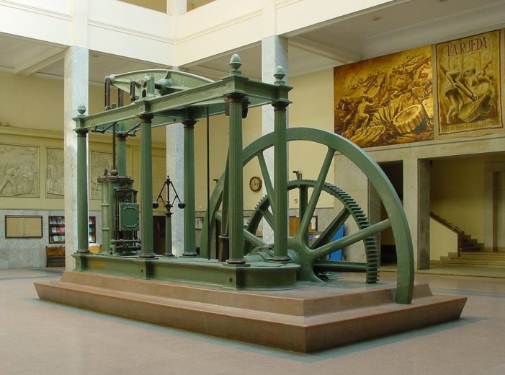
Steam power
Steam power
Used in mines
Power machines
Factories away from water power
Transport
Railways, ships, tractors etc.
Steam Engine
James Watt 1775
Notes:
James Watt (1736 – 1819) was a Scottish inventor and mechanical engineer whose improvements to the Newcomen steam engine were fundamental to the changes brought by the Industrial Revolution in both the Kingdom of Great Britain and the world.

Slide 56

Iron making
Iron making
Quakers
Abraham Darby developed iron production using coke 1720
Cheap, quality iron
Iron Bridge
Abraham Darby III 1779
Notes:
Abraham Darby I (1678 – 1717) was the first, and most famous, of three generations with that name in an English Quaker family that played an important role in the Industrial Revolution. He developed a method of producing pig iron in a blast furnace fuelled by coke rather than charcoal. This was a major step forward in the production of iron as a raw material for the Industrial Revolution.

Slide 57
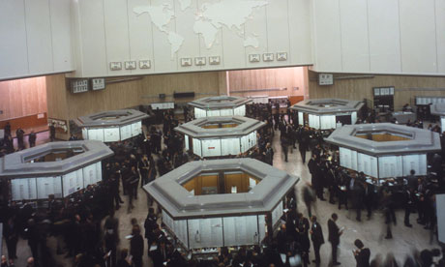
Financial markets
City of London
Safe place to buy and sell (exchange) commodities
International trade
Raise capital
Transfer risk
London stock exchange

Slide 58
How important was it?
“Industrial Revolution is the most important event in the history of humanity since the domestication of animals and plants.”
The Cambridge Economic History of Modern Britain
“For the first time in history, the living standards of the masses of ordinary people have begun to undergo sustained growth. Nothing remotely like this economic behaviour has happened before.”
Robert Emerson Lucas, Nobel Laureate Economics
Notes:
ese represent three 'leading sectors', in which there were key innovations, which allowed the economic take off by which the Industrial Revolution is usually defined. This is not to belittle many other inventions, particularly in the textile industry. Without some earlier ones, such as the spinning jenny and flying shuttle in the textile industry and the smelting of pig iron with coke, these achievements might have been impossible. Later inventions such as the power loom and Richard Trevithick's high pressure steam engine were also important in the growing industrialisation of Britain. The application of steam engines to powering cotton mills and ironworks enabled these to be built in places that were most convenient because other resources were available, rather than where there was water to power a watermill.
In the textile sector, such mills became the model for the organisation of human labour in factories, epitomised by Cottonopolis, the name given to the vast collection of cotton mills, factories and administration offices based in Manchester. The assembly line system greatly improved efficiency, both in this and other industries. With a series of men trained to do a single task on a product, then having it moved along to the next worker, the number of finished goods also rose significantly.
Also important was the 1756 rediscovery of concrete (based on hydraulic lime mortar) by the British engineer John Smeaton, which had been lost for 1300 years.

Slide 59
Who were the people?
Non conformists
Quakers
Iron industry
Banking
Huguenots
Glass making, machine tools
Steel making
Textiles
Notes:
Arkwright partnered with Jedediah Strutt and Samuel Need, wealthy hosiery manufacturers, who were nonconformists
Edward (Edmund) Cartwright (1743 – 1823) was an English clergyman and inventor of the power loom.
Benjamin Huntsman (1704 – 1776) was an English inventor and manufacturer of cast or crucible steel. Huntsman was born the third son of a Quaker farmer in Epworth, Lincolnshire. His parents were Germans who had emigrated only a few years before his birth.
Thomas Newcomen (born shortly before 24 February 1664; died 5 August 1729) was an ironmonger by trade and a Baptist lay preacher by calling. Newcomen created the first practical steam engine for pumping water, the Newcomen steam engine. Consequently, he can be regarded as a forefather of the Industrial Revolution.
James Watt’s parents were both were Presbyterians and strong Covenanters.
Huguenots from Waldensians. Since the seventeenth century, Huguenots have been commonly designated "French Protestants", the title being suggested by their German co-religionists or "Calvinists". Protestants in France were inspired by the writings of John Calvin in the 1530s
Huguenot migrants possessed considerable knowledge of the textiles industries –especially silk-making. The Courtauld family established a prospering silk industry at Braintree,
Elsewhere, the Huguenot brothers Henry and Sealy Fourdrinier invented their revolutionary papermaking machine and Henry Bessemer, born in England of a Huguenot family, pioneered the first cheap, mass-production steel making process.

Slide 60
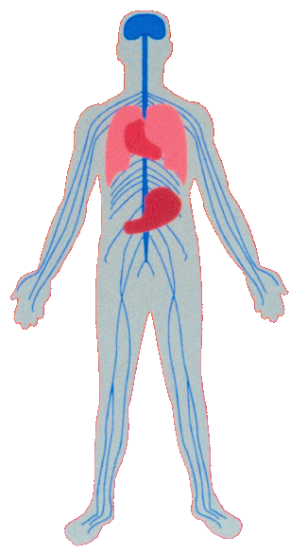
Person is the model for society
Brain
Spine
Nervous System
Heart
Lungs
Stomach
Limbs
Cells
God
Christ
Political leaders and parties
Executive
Legislative
Judiciary
Organizations
Individuals
In the ideal world, because people’s horizontal relationships with each other are
rooted in their vertical relationship with God, they will form one integrated and
interdependent society. EDP, 362

Slide 61
What kind of economic system?
In front of God all people have the same value
God wants to provide a good environment and living conditions equally for all his children
No destructive competition due to over production
No unfair distribution leading to excessive accumulation and consumption EDP, 342
What kind of system?

Slide 62
One where there is . . .
Interdependence, mutual prosperity and universally shared values EDP, 342
Original mind pursues socialist values
Community
Support
Equality
Freedom
Democracy

Slide 63
How has Satan been working?
Satan has worked through fallen people to realise, in advance of God, a perverted form of the ideal society which God intends to realise.
As a result in human history we witness the rise of unprincipled societies which are built upon twisted versions of the Principle. EDP, 329

Slide 64
What kind of socialism?
God’s plan is to develop a socialistic economy, although with a form and content utterly different from the state socialism and communism actually established. EDP, 341
Not a planned economy
Not a welfare state
Not a state educational system
Not a state health system
No state owned banks and industries
Limited state social security

Slide 65
Where do we find . . .
Excessive production
Communist and planned economies
But planning is inherently impossible
Notes:
Butter mountains. Unwanted products.
Versailles 30,000 workers
Calculation necessary for planning is impossible: Ludwig von Mises (1881-1973) initiated this devastating critique of socialist economics based on the impossibility of calculation in a socialist economy. The advantage of the free market is that it enables economic calculations to be made so that scarce resources are not squandered. There are limitless ways of doing different things with natural resources, labour and capital. The problem is in deciding what is the best and most advantageous—which should be implemented because it is urgent, and which postponed or discarded. In the free market these decisions are made based on market prices. In a modern economy there are billions of market exchanges between the producers, distributers and consumers. There are thus also billions of prices which each represent the value of a commodity to the person buying or selling it. These prices will typically be subject to constant change. The structure of the relative prices will be in a state of constant change because resources and preferences are not static.
Knowledge necessary for planning is inaccessible: Polanyi's thesis attacks the notion that there can be objective knowledge upon which to base economic planning. Most knowledge is tacit, practical, local, implicit, inchoate, traditional knowledge embodied in skills, intuitions, relationships, hunches, flairs and disposi­tions, which can never be formulated explicitly or articulated in a way that would be of any scientific value. Theoretical knowledge is just the visible tip. Thus the market is valuable because it is a device for,
. . . the transmission and utilization of unarticulated, and sometimes inarticulable, tacit and local knowledge.
John Gray, The Moral Foundations of Market Institutions (London: Institute of Economic Affairs, 1992), 8.
Knowledge necessary for planning does not exist: G.L.S. Shackle. He argued that planning was impossible, not because the knowledge was inaccessible, but because the knowledge planners would need to plan successfully did not exist. The future is unknowable in every detail. We make a guess, or extrapolate and make predictions, but there are always singularities and novelties which defy being incorporated into a plan. Such changes may be wrought by war, political upheaval, the weather, panics, fashion and people's subjective unpredictable whims, fancies and predilections. We cannot know what people will choose in the future because they are free to choose and to change. G.L.S. Shackle, Epistemics and Economics: A Critique of Economic Doctrine (Cambridge: Cambridge University Press, 1972).

Slide 66
Why is planning impossible?
Impossibility of calculation
Ludwig von Mises, F.A. Hayek
All knowledge is tacit knowledge
Michael Polanyi, F.A. Hayek
Knowledge for planning does not exist
G.L.S. Shackle
Notes:
No price mechanism which indicates about supply and demand, shortages and excesses. Billions of calculations and feedback loops
Hayek deepened Mises critique of socialism by showing that it is not merely a calculational problem, but that no one has the knowledge required to make the necessary calculations even if they were possible. For Hayek the role of the market is primarily epistemic, in that it is a device for transmitting and generating information that is otherwise distributed throughout society. Knowledge of the economy is mainly local knowledge of fleeting economic environments. It is often embodied in skills or in entrepreneurial insight, a sensitivity for kairós, the propitious, non-recurring moment for action. Little of it is propositional or factual. The price mechanism is thus the way that information is communicated. To know that there is a shortage of a particular good, one does not have to know the whole circumstance of the industry, its suppliers, and labour problems. One has only to look at the price. The price mechanism is extremely sensitive to all the factors affecting the economy. Price is thus knowledge. Radnitzky, 170.
Polanyi furthered the epistemological critique of socialism through his understanding of knowledge. All knowledge, he says, is tacit knowledge or at least rooted in tacit knowledge. There is no such thing as knowledge which is wholly explicit. For example when we are aware of the knowledge of driving a car (A) while driving the car (B), our awareness of (A) is a subsidiary awareness. It is (B) which is the focal point of our attention. While we are focusing on the driving itself (B), the knowledge (A) may be unidentifiable. The driving itself gives the meaning to the knowledge of driving. When we switch our attention to (A) it loses its previous meaning. This Polanyi say is the structure of tacit knowing. He also distinguishes between tacit and explicit knowledge. A driving manual is an example of explicit knowledge (though of course it is rooted in the tacit knowledge of the author who can drive). Memorizing the manual does not mean one has learnt how to drive. Michael Polanyi, "The Logic of Tacit Inference," Knowing and Being (Chicago: University of Chicago Press, 1969), 144.
As applied to the economic sphere, Polanyi's thesis attacks the notion that there can be objective knowledge upon which to base economic planning. Most knowledge is tacit, practical, local, implicit, inchoate, traditional knowledge embodied in skills, intuitions, relationships, hunches, flairs and disposi­tions, which can never be formulated explicitly or articulated in a way that would be of any scientific value. Theoretical knowledge is just the visible tip
The next step in the epistemological critique of socialist planning was that of G.L.S. Shackle. He argued that planning was impossible, not because the knowledge was inaccessible, but because the knowledge planners would need to plan successfully did not exist. The future is unknowable in every detail. We make a guess, or extrapolate and make predictions, but there are always singularities and novelties which defy being incorporated into a plan. Such changes may be wrought by war, political upheaval, the weather, panics, fashion and people's subjective unpredictable whims, fancies and predilections. We cannot know what people will choose in the future because they are free to choose and to change. The economy is not an equilibrium but a dynamic process. With the growth of scientific knowledge should come the realisation that the knowledge that we have is far smaller than the knowledge that we do not have. The market is the only way to make use of knowledge we do not have and which no one has explicitly. Socialism is therefore impossible because it faces calculational chaos. G.L.S. Shackle, Epistemics and Economics: A Critique of Economic Doctrine (Cambridge: Cambridge University Press, 1972).

Slide 67
“Socialism is therefore impossible because it faces calculational chaos.”
G.L.S. Shackle, Epistemics and Economics: A Critique of Economic Doctrine (Cambridge: Cambridge University Press, 1972).

Slide 68
Where do we find . . .
Excessive production
Communist and planned economies
But planning is inherently impossible
Unfair distribution
Feudalism where monarchy and aristocracy accumulate and consume excessively
Socialism where state employees are at an unfair advantage
Notes:
Butter mountains. Unwanted products.
Versailles 30,000 workers
Calculation necessary for planning is impossible: Ludwig von Mises (1881-1973) initiated this devastating critique of socialist economics based on the impossibility of calculation in a socialist economy. The advantage of the free market is that it enables economic calculations to be made so that scarce resources are not squandered. There are limitless ways of doing different things with natural resources, labour and capital. The problem is in deciding what is the best and most advantageous—which should be implemented because it is urgent, and which postponed or discarded. In the free market these decisions are made based on market prices. In a modern economy there are billions of market exchanges between the producers, distributers and consumers. There are thus also billions of prices which each represent the value of a commodity to the person buying or selling it. These prices will typically be subject to constant change. The structure of the relative prices will be in a state of constant change because resources and preferences are not static.
Knowledge necessary for planning is inaccessible: Polanyi's thesis attacks the notion that there can be objective knowledge upon which to base economic planning. Most knowledge is tacit, practical, local, implicit, inchoate, traditional knowledge embodied in skills, intuitions, relationships, hunches, flairs and disposi­tions, which can never be formulated explicitly or articulated in a way that would be of any scientific value. Theoretical knowledge is just the visible tip. Thus the market is valuable because it is a device for,
. . . the transmission and utilization of unarticulated, and sometimes inarticulable, tacit and local knowledge.
John Gray, The Moral Foundations of Market Institutions (London: Institute of Economic Affairs, 1992), 8.
Knowledge necessary for planning does not exist: G.L.S. Shackle. He argued that planning was impossible, not because the knowledge was inaccessible, but because the knowledge planners would need to plan successfully did not exist. The future is unknowable in every detail. We make a guess, or extrapolate and make predictions, but there are always singularities and novelties which defy being incorporated into a plan. Such changes may be wrought by war, political upheaval, the weather, panics, fashion and people's subjective unpredictable whims, fancies and predilections. We cannot know what people will choose in the future because they are free to choose and to change. G.L.S. Shackle, Epistemics and Economics: A Critique of Economic Doctrine (Cambridge: Cambridge University Press, 1972).

Slide 69
What is a free market?
A place where people can freely buy and sell without interference
The price mechanism regulates production
Too much lower price reduce production
Too little high price increase production
Price and market regulate distribution
Goods sold to person willing and able to pay the market price

Slide 70
The Principle and the free market economy
Give and take
Freedom and responsibility
Three Blessings
Promise keeping
Law of contract
Ownership of property
Welfare and education organised within civil society
Charity, business, cooperatives, insurance

Slide 71
Next
The three world wars and beyond

Slide 72

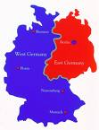
The last four hundred years
Free market
State control
Liberal
Democracy
Totalitarianism
America
Korea
China
Travels WEST
Travels EAST
British Empire
Fascism
Britain
Russia
Nazism
Protestantism
Communism
Germany
Martin Luther
1517
Karl Marx
1848
Notes:
72

