Slide 1
The world wars in the providence of restoration

Slide 2
What causes historical events?
Purpose
Free will
Real situation
Historical event
Notes:
People make decisions depending on their circumstances and environment to achieve a purpose -> event. Not deterministic. Not pre-destined.

Slide 3
Internal and external causes
Internal cause -
God’s providence
Historical event
Which is expressed as:
External cause -
Clash of political and economic interests

Slide 4
What are the providential causes of the world wars?
Satan’s attempt to preserve sovereignty
Worldwide indemnity condition to restore the three blessings
Satanic imitations of the three blessings
Individual champion of Satan’s causes
Multiplication of Satanic children
Conquest of the world under Satanic domination
Three world conflicts to restore 3 blessings

Slide 5
What are the providential causes of the world wars?
Overcome on the world level the three temptations of Jesus
WW 1 – 1st blessing -- 1st temptation
WW 2 – 2nd blessing -- 2nd temptation
WW 3 – 3rd blessing -- 3rd temptation
Indemnity condition to restore God’s sovereignty
Cain and Abel restoration through 3 stages
Abel world prevails over the Cain world

Slide 6
Who is on God’s and who is on Satan’s side?
God’s side | Satan’s side
Support God’s providence | Oppose God’s providence
Abel view of life | Cain view of life
Support Christianity | Oppose Christianity
Attacked | Aggressor
Notes:
Those who support God’s providence
Moses and the slave driver
Israelites and the Canaanites
Jesus and Judaism
Abel view of life – Christian democracy and religious freedom. Cain – humanism, atheism
Christianity is the central religion for God’s providence

Slide 7
The First World War
1914-1918
Notes:
World War I was a military conflict centered on Europe that began in the summer of 1914. The fighting ended in late 1918. This conflict involved all of the world's great powers,^{[1]} assembled in two opposing alliances: the Allies (centred around the Triple Entente) and the Central Powers.^{[2]} More than 70 million military personnel, including 60 million Europeans, were mobilized in one of the largest wars in history.^{[3][4]} More than 9 million combatants were killed, due largely to great technological advances in firepower without corresponding ones in mobility. It was the second deadliest conflict in history.

Slide 8
What were the causes of WW I?
Archduke Ferdinand, heir to Hapsburg throne, assassinated by Serbian nationalists 28th June 1914
Austria-Hungary declares war on Serbia 28th July
Russian mobilisation 30th July
Germany declares war on Russia 1st August
Germany and Ottoman Empire sign treaty 2nd August
Germany declares war on France 3rd August
Britain declares war on Germany 4th August
Austria-Hungary declares war on Russia 6th August

Slide 9
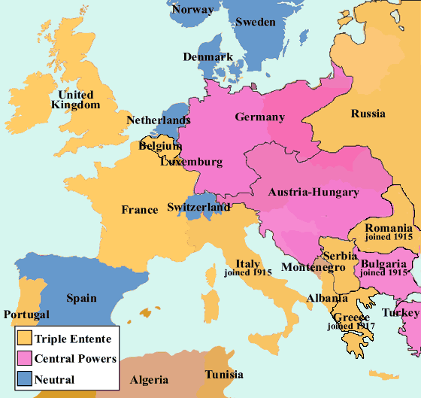
Where is all this happening?

Slide 10
What was behind this?
Alliances of support
Unresolved territorial disputes in Balkans
Shifting balance of power
Germany vs. France
Imperial rivalry
Colonies, power, raw materials and trade
Arms race
Growth of nationalism e.g Serbia
Notes:
In the 19th century, the major European powers had gone to great lengths to maintain a balance of power throughout Europe, resulting by 1900 in a complex network of political and military alliances throughout the continent.^{[2]} These had started in 1815, with the Holy Alliance between Prussia, Russia, and Austria. Then, in October 1873, German Chancellor Bismarck negotiated the League of the Three Emperors (German: Dreikaiserbund) between the monarchs of Austria–Hungary, Russia and Germany. This agreement failed because Austria–Hungary and Russia could not agree over Balkan policy, leaving Germany and Austria–Hungary in an alliance formed in 1879, called the Dual Alliance. This was seen as a method of countering Russian influence in the Balkans as the Ottoman Empire continued to weaken.^{[2]} In 1882, this alliance was expanded to include Italy in what became the Triple Alliance.^{[17]}
After 1870, European conflict was averted largely due to a carefully planned network of treaties between the German Empire and the remainder of Europe orchestrated by Chancellor Bismarck. He especially worked to hold Russia at Germany's side to avoid a two-front war with France and Russia. With the ascension of Wilhelm II as German Emperor (Kaiser), Bismarck's system of alliances was gradually de-emphasized. For example, the Kaiser refused to renew the Reinsurance Treaty with Russia in 1890. Two years later the Franco-Russian Alliance was signed to counteract the force of the Triple Alliance. In 1904, the United Kingdom sealed an alliance with France, the Entente cordiale and in 1907, the United Kingdom and Russia signed the Anglo-Russian Convention. This system of interlocking bilateral agreements formed the Triple Entente.^{[2]}
From the time of the Balkan Wars, which had increased the size of Serbia, it had been the opinion of leading Austrian officials, (most notably the Foreign Minister), Count Leopold von Berchtold, that Austria would have to wage a "preventive war" to greatly weaken or destroy Serbia as a state in order to preserve the dual monarchy which held extensive Serb-populated Balkan territories.^{[3]} Between January 1913 and January 1914, Conrad advocated a preventive war against Serbia twenty four times.^{[4]}
In November 1912 Russia, humiliated by its inability to support Serbia during the Bosnian crisis of 1908 or the First Balkan War, announced a major reconstruction of its military.
Wilhelm II called British balance of power principles “idiocy,” but agreed that Haldane’s statement was a “desirable clarification” of British policy.^{[5]} His opinion was that Austria should attack Serbia that December, and if “Russia supports the Serbs, which she evidently does…then war would be unavoidable for us, too,” ^{[5]} and that would be better than going to war after Russia completed the massive modernization and expansion of their army that they had just begun. Moltke agreed. In his professional military opinion “a war is unavoidable and the sooner the better” ^{[5]}. Moltke “wanted to launch an immediate attack”^{[7]}.
Both Wilhelm II and the Army leadership agreed that if a war were necessary it were best launched soon. Admiral Tirpitz, however, asked for a “postponement of the great fight for one and a half years” ^{[5]} because the Navy was not ready for a general war that included Britain as an opponent. He insisted that the completion of the construction of the U-boat base at Heligoland and the widening of the Kiel Canal were the Navy’s prerequisites for war
French president Poincaré was more interested in the idea of French expansion in the Middle East than a war of revenge to regain Alsace-Lorraine. Had the Reich been interested in improved relations with France before August 1914, the opportunity was available, but the leadership of the Reich lacked such interests, and preferred a policy of war to destroy France.
German-Austrian treaty (1879) or Dual Alliance Italy joining Germany and Austria in 1882 Franco-Russian Alliance (1894) The "Entente Cordiale" between Britain and France (1904) which left the northern coast of France undefended, and the separate "entente" between Britain and Russia (1907) forming the Triple Entente
Rivalries for not just colonies, but colonial trade and trade routes developed between the emerging economic powers and the incumbent great powers. Although still argued differently according to historical perspectives on the path to war, this rivalry was illustrated in the Berlin-Baghdad Railway, which would have given German industry access to Iraqi oil, and German trade a southern port in the Persian Gulf. A history of this railroad in the context of World War I has arrived to describe the German interests in countering the British Empire at a global level, and Turkey's interest in countering their Russian rivals at a regional level.^{[31]} As stated by a contemporary 'man on the ground' at the time, Jastrow wrote "It was felt in England that if, as Napoleon is said to have remarked, Antwerp in the hands of a great continental power was a pistol leveled at the English coast, Bagdad and the Persian Gulf in the hands of Germany (or any other strong power) would be a 42-centimetre gun pointed at India.
fear that "windows of opportunity for victorious wars" were closing, "the arms race did precipitate the First World War". Some historians see the German naval build-up as the principal cause of deteriorating Anglo-German relations.
The Franco-Prussian War was initiated by Napoleon III of France, who was alarmed at the rapid growth in population and unity among the German people and eventually chose to declare war in the face of potential loss of French international prestige. This period marked a relative decline in the strength of France, which continued into the 20th century.
The war ended with a Prussian victory, and Germany unified soon after. Alsace-Lorraine, a border territory, was transferred from France to Germany. The resulting disruption in the balance of power led France to seek alliances with Russia and the United Kingdom.

Slide 11
What were the providential causes?

Slide 12
Providential causes of WW 1
Restore the 3 blessings on the formation stage: Satanic imitation of the 3 blessings:
Anti-type of Adam – Kaiser Wilhelm II
Pan-Germanism
World domination
Overcome 1st temptation of Jesus
Foundation for birth of the messiah
Restoration of God’s sovereignty through expansion of democracy and Christianity
Notes:
After 40 days Jesus tempted. 40 days to restore 400 years lost because JB failure. If UK occupied Korea maybe no WW necessary???
Wilhelmine Germany is that from 1897 it was run as a "functioning monarchy" with power concentrated in the hands of one man (thought by many who knew him to be mad) and that, as a result, "the Kaiser, the royal family, the Kaiser's circle of friends, the [imperial entourage and the court form[ed] the heart of this system on which the very highest officials of the Reich and state bureaucracy (as well as the leaders of the army and the navy) were psychologically dependent." the period 1888-1890 was dominated by the conflict with the 'all-powerful" Bismarck; the years 1890-1897 were ones of transition from an "improvised" to "an institutionalised personal rule" (the latter phrase borrowed from the German constitutional historian, Huber); the period 1897 -1908 represented Bulow's promised "personal rule in the good sense" (i.e. with the cooperation of a sycophantic Chancellor), a period which may well have extended till 1914. Almost all the controversial legislation of the Wilhelmine period, according to Rohl, can be traced back to the Kaiser's own initiative. best examples of the Kaiser's personal rule, according to Rohl, were "the social and socialist policies, the gigantic fleet-building programme and the Prussian canal policy." The building of the fleet was, of course, to have tremendous consequences driving Great Britain into the arms of Russia and France and thus helping Germany lose the First World War. by 1902 Maximilian Harden was writing in Die Zukunft that "the Kaiser (was) his own Reich Chancellor" and that "all the important decisions of the past twelve years [had] been taken by him." The situation was such that no high-ranking minister, army or naval officer, courtier or civil servant would risk disagreeing with the Kaiser in case he dismissed them- negative personal rule”. Wilhelm did not even like ministers to submit their own resignations--that showed too much independence- although a frosty glance, a curt dismissal, a lack of conversation or an imperial contradiction might all be motives for resignation none the less. In the end courtiers, diplomats, civil servants and officers all became sycophants. Certainly, he always remained immature, with one courtier complaining in 1908: "he is a child and will always remain one." He was also an egomaniac with a complete over-estimation of his own abilities which he loved to talk about. Unfortunately these did not include a sense of reality, for he saw things only as he wished. Thus the French and English were once described in a racial diatribe as " not Whites at all but Blacks" while Jesus of Nazareth, he claimed, "had never been a Jew." Nor did he have any sense of proportion or moderation, always calling for revenge on enemies who had to die or be punished, since he hated all sorts of groups and classes, not to mention individuals such as his parents. His sense of humour, perhaps not surprisingly therefore, included hitting, beating, stabbing or otherwise humiliating colleagues and servants. As far as his sex life was concerned, he had innumerable affairs with prostitutes before ascending the throne in 1888, after which time he became more interested in men, particularly- soldiers. He had a withered left arm and was later to suffer deafness in the right ear. The most important fact, however, was that he suffered from growths and discharges in the inner ear near the brain, a condition which drove him al most mad. Lord Salisbury thought him "not quite normal", Sir Edward Grey, "not quite sane". Other European dignitaries thought him "mentally ill" or having "a screw loose." Leading German princes and statesmen felt the same, with Bismarck explaining that he had only wanted to remain in office after 1888 because he knew of Wilhelm's "abnormal mental condition", something which even Eulenburg was shocked and frightened by. Indeed, on one occasion Eulenburg recorded: "Pale, ranting wildly, looking restlessly about him and piling lie upon lie, he made such a terrible impression on me that I still cannot get over it."
Such Hitler-like rages made Eulenburg predict an imperial nervous breakdown, something, however, that never occurred. Still, there were occasions when rumours spread that the Kaiser would have to be committed--again, something which never actually took place. Fits of rage, unfortunately, were not the only characteristic that the Kaiser shared with Hitler. Full-blooded anti-Semitism was another and Rohl makes it perfectly clear that Wilhelm II had nothing to learn in this respect from the Fuhrer. If, like Hitler, he had Jewish friends as a youth, he later turned on the Jews as Germany's most deadly enemy, informing Sir Edward Grey, for example, in 1907 that "They want stamping out." He also believed in a international conspiracy of Jewish capitalists and communists - the Golden International, blaming the First World War, Germany's defeat and his own - abdication on an international} conspiracy of Jewish freemasons, so that in exile in Holland his anti-Semitism reached fever pitch. In 1919 he wrote to General von Mackensen: "Let no German.... rest until these parasites have been destroyed and exterminated." He called for an international, Russian-style pogrom against them condemning them as a "nuisance" that humanity must in some way destroy. Then in his own hand, he added: " I believe the best would be gas." It was altogether natural, therefore, that, before he died in June 1941, he welcomed Hitler's victories as confirmation of the fighting qualities of the troops of 1914-1918. He boasted: " The hand of God is creating a new World and working miracles....We are becoming a U.S. of Europe under German leadership, a united European Continent, nobody ever hoped to see.....The Jews are being (sic) thrust out of their nefarious positions in all countries, whom they have driven to hostility for centuries.” Rohl also believes that, like Hitler, the Kaiser was responsible for starting a world war. His analysis of the December 1912 War Council makes clear that the people who counted were the Kaiser's naval and military friends and that the civilian leaders--the Chancellor and the Foreign Secretary-- took second place. As a result, the 1913 Army Bill was pushed through, naval plans for war against Britain were prepared, stockpiling of gold and fodder was approved and the course set for war in 1914 when the Kiel Canal would be ready - as Tirpitz demanded. Moltke, of course, wanted war straight away. Rohl makes clear that, despite early doubts, the Kaiser gave unconditional support to Austria during the First Balkan War and was ready to unleash a world war to defend Austria- Hungary's position in the Balkans. In short the "blank cheque" of 1914 was ready for delivery as soon as the other preparations were completed. Rohl doesn't say so in his book, but I know from seminar discussions with him, that he suspects that Berlin may even have been behind Franz Ferdinand's assassination at Sarajevo in 1914.
Pan-Germanism (German: Pangermanismus or Alldeutsche Bewegung) was a political movement of the 19th century aiming for unity of the German-speaking populations of Europe, identified as Volksdeutsche ("ethnic Germans").

Slide 13
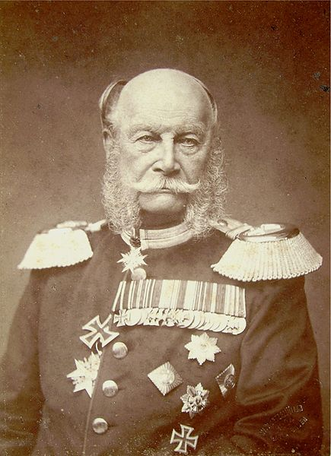
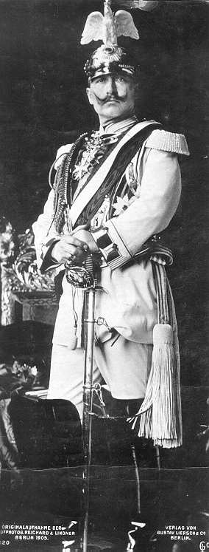
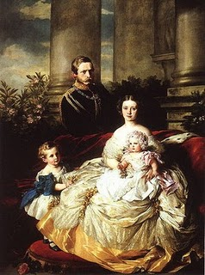
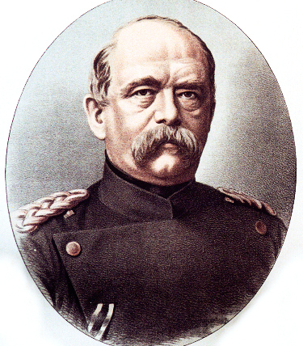
Wilhelm I
Frederick and Victoria
Bismark
Wilhelm II

Slide 14
Who’s who in World War I?
Adam’s Family
Abel Side
Cain Side
Russia | Adam Position | Germany
Great Britain | Eve Position | Austria-Hungary
France | Archangel Position | Ottoman Empire
1917 Revolution
Notes:
By 1917, the Russian economy finally neared collapse under the strain of the war effort. While the equipment of the Russian armies actually improved due to the expansion of the war industry, the food shortages in the major urban centres brought about civil unrest, which led to the abdication of the Tsar and the February Revolution. The large war casualties also created disaffection and mutinous attitudes in the army, which was fueled by Bolshevik agitators and the Russian Provisional Government’s new liberalization policies towards the army (stripping officers of their mandate by giving wide sweeping powers to "soldier committees", the abolition of the death penalty). On 29 November 1917, the Communist Bolsheviks took power under their leader Vladimir Lenin. Lenin’s new Bolshevik government tried to end the war but the Germans demanded enormous concessions. Finally, in March 1918, the Treaty of Brest-Litovsk was signed and the Eastern Front ceased to be a war zone.

Slide 15
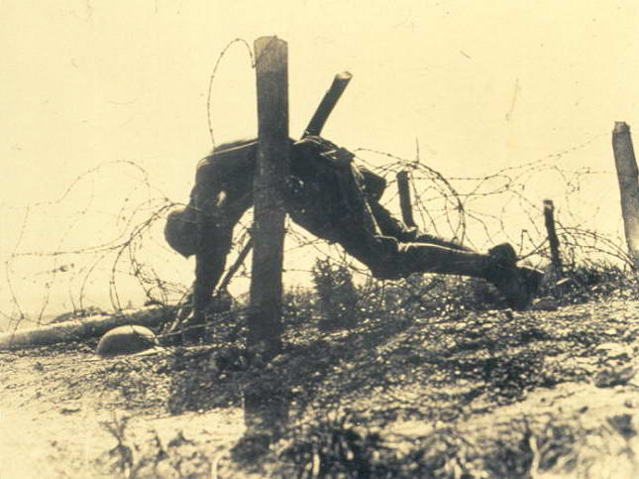
Notes:
First World War 8.5 m total died military, 15m total
37.5 m total casualties

Slide 16
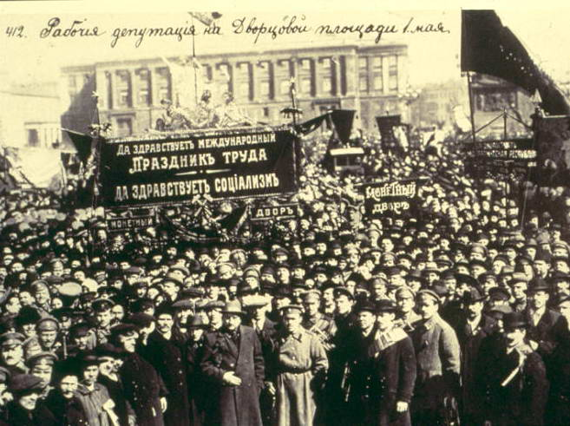

Slide 17
America joins the war 1917
Adam’s Family
Abel Side
Cain Side
April 1917 USA | Adam Position | Germany
Great Britain | Eve Position | Austria-Hungary
France | Archangel Position | Ottoman Empire
Notes:
The United States was a formal participant in World War One from April 6, 1917 until the war's end in 1918. Up to that point, the US had remained neutral, though the US had been an important supplier to The United Kingdom and other Allied powers. During the war, the US mobilized over 4,000,000 military personnel and suffered over 300,000 casualties, including over 110,000 deaths. The war saw a dramatic expansion of the US government in an effort to harness the war effort and a significant increase in the size of the US military.
The United States originally pursued a policy of non-intervention, avoiding conflict while trying to broker a peace. When a German U-boat sank the British liner Lusitania in 1915, with 128 Americans aboard, U.S. President Woodrow Wilson vowed, "America is too proud to fight" and demanded an end to attacks on passenger ships. Germany complied. Wilson unsuccessfully tried to mediate a settlement. He repeatedly warned the U.S. would not tolerate unrestricted submarine warfare, in violation of international law and U.S. ideas of human rights.
In January 1917, after the Navy pressured the Kaiser, Germany resumed unrestricted submarine warfare. Britain's secret Royal Navy cryptanalytic group, Room 40, had broken the German diplomatic code. They intercepted a proposal from Berlin (the Zimmermann Telegram) to Mexico to join the war as Germany's ally against the United States, should the U.S. join. The proposal suggested that if the U.S. were to enter the war then Mexico should declare war against the United States and enlist Japan as an ally. This would prevent the United States from joining the Allies and deploying troops to Europe, and would give Germany more time for their unrestricted submarine warfare program to strangle Britain's vital war supplies. In return, the Germans would promise Mexico support in reclaiming the territories of Texas, New Mexico, and Arizona that Mexico lost during the Mexican-American War 70 years earlier. Crucial to U.S. participation was the sweeping domestic propaganda campaign executed by the Committee on Public Information, overseen by George Creel.^{[5]} The campaign consisted of tens of thousands of government-selected community leaders giving brief carefully scripted pro-war speeches at thousands of public gatherings.^{[6]} Along with other branches of government and private vigilante groups like the American Protective League, it also included the general repression and harassment of people either opposed to American entry into the war or of German heritage.

Slide 18
First World War ends - 1918
Allies
Central Powers
USA/Russia
Britain & Empire
France
Germany
Austria-Hungary
Ottoman Empire
Military casualties
Dead 5.5 million
Wounded 12.8 million
Missing 4.1 million
Military casualties
Dead 4.3 million
Wounded 8.4 million
Missing 3.6 million
Armistice Day
11am 11th November 1918
Notes:
Wilson gave very idealistic speech was widely disseminated as an instrument of propaganda to encourage the Allies to victory. Copies were also dropped behind German lines, to encourage the Central Powers to surrender in the expectation of a just settlement. Indeed, a note sent to Wilson by Prince Maximilian of Baden, the German imperial chancellor, in October 1918 requested an immediate armistice and peace negotiations on the basis of the Fourteen Points.
The speech was made without prior coordination or consultation with Wilson's counterparts in Europe. As the only public statement of war aims, it became the basis for the terms of the German surrender at the end of the First World War, as negotiated at the Paris Peace Conference in 1919 and documented in the Treaty of Versailles.
Opposition to the Fourteen Points among British and French leaders became clear after hostilities ceased: the British were against freedom of the seas; the French demanded war reparations. Wilson was forced to compromise on many of his ideals to ensure that his most important point, the establishment of the League of Nations, was accepted. In the end, the Treaty of Versailles went against many of the principles of the Fourteen Points, both in detail and in spirit. Rather than Wilson's proposed "peace without victory,"^{[3]} the treaty sought harsh punishment of Germany both financially and territorially. The resulting bitterness in Germany together with U.S. loans, laid the seeds for the rise of Nazism in the 1930s which resulted, in part, from the economic depression of the 1920s in Germany (which the Versailles Treaty helped create). The United States Senate refused to consent to the ratification of the Treaty of Versailles, making it invalid in the U.S. and effectively hamstringing the nascent League of Nations envisioned by Wilson.

Slide 19
Woodrow Wilson’s 14 Points
“Peace without victory”
Free trade and freedom of the seas
Self-determination of colonies
No reparations
Armaments reductions
League of Nations
Germany agreed to peace upon this basis
BUT Wilson didn’t consult Allies

Slide 20
What happened at Versailles?
Germany and allies held responsible for the war: ‘War Guilt Clause’
Reparations for the damage and loss of life (£217 billion in 2010 money)
Rhineland occupied by Allies
Military restrictions on Germany
Germany lost territory and colonies
Germany felt humiliated, ‘stab in the back’
Notes:
Germans didn’t feel war just their fault. The compulsory signing was especially bitter because Germans of all political persuasion “had rushed to arms in 1914 in the sincere conviction that they were fighting a war of self-defense.”
Felt hadn’t lost as army still in France and no big defeat. Stab in the back by government , jews, capitalists, communists
Expected to be part of negotiations but excluded
Reparations normal but excessive. Reparations after 1870 war etc.
France's chief interest was security. France had lost some 1.5 million military personnel and an estimated 400,000 civilians (See World War I casualties) and had suffered great devastation during the war. Like Belgium, which had been similarly affected, France needed reparations to restore its prosperity and reparations also tended to be seen as a means of weakening any future German threat.^{[9]} Clemenceau particularly wished to regain the rich and industrial land of Alsace-Lorraine, which had been stripped from France by Germany in the Franco-Prussian War of 1871.^{[10]}
On 29 April the German delegation under the leadership of the Foreign Minister Ulrich Graf von Brockdorff-Rantzau arrived in Versailles. On 7 May when faced with the conditions dictated by the victors, including the so-called "War Guilt Clause", von Brockdorff-Rantzau replied to Clemenceau, Wilson and Lloyd George: "We know the full brunt of hate that confronts us here. You demand from us to confess we were the only guilty party of war; such a confession in my mouth would be a lie."^{[29]} Because Germany was not allowed to take part in the negotiations, the German government issued a protest against what it considered to be unfair demands, and a "violation of honour"^{[30]} and soon afterwards, withdrew from the proceedings of the Treaty of Versailles.
Conservatives, nationalists and ex-military leaders condemned the peace and democratic Weimar politicians, socialists, communists, and Jews were viewed by them with suspicion, due to their supposed extra-national loyalties.^{[citation needed]} It was rumoured that the Jews had not supported the war and had played a role in selling out Germany to its enemies. Those who seemed to benefit from a weakened Germany, and the newly formed Weimar Republic, were regarded as having "stabbed Germany in the back" on the home front, by either opposing German nationalism, instigating unrest and strikes in the critical military industries or profiteering.^{[citation needed]} These theories were given credence by the fact that when Germany surrendered in November 1918, its armies were still on French and Belgian territory. Furthermore, on the Eastern Front, Germany had already won the war against Russia and concluded the Treaty of Brest-Litovsk. In the West, Germany had seemed to have come close to winning the war with the Spring Offensive earlier in 1918.^{[citation needed]} Its failure was blamed on strikes in the arms industry at a critical moment of the offensive, leaving soldiers with an inadequate supply of materiel. The strikes were regarded by nationalists as having been instigated by traitors, with the Jews taking most of the blame.^{[citation needed]}

Slide 21
Different reactions
"We know the full brunt of hate that confronts us here. You demand from us to confess we were the only guilty party of war; such a confession in my mouth would be a lie.”
German Foreign Minister Ulrich von Brockdorff-Rantzau
"This is not Peace. It is an Armistice for twenty years.”
French Field Marshall Ferdinand Foch
The USA refused to ratify the treaty and did not join the League of Nations
Notes:
Count von Brockdorff-Rantzau led the German delegation which arrived at Versailles on April 29, and was kept waiting for several days. When the first session began on May 7, French newspapers suggested that this was because it was the anniversary of the sinking of the RMS Lusitania. After Georges Clemenceau had accused Germany of being responsible for the war, Brockdorff-Rantzau said that the issue was to reach a lasting peace but admitting that the power of German arms was broken, he nevertheless declared that admission of sole German responsibility for the war would be a lie. He stated that the policy of revenge, as well as the policy of expansion, in disregard of the fight of peoples to determine their own affairs contributed to the sickness of Europe, which reached its crisis in the World War. Russian mobilisation took the possibility of curing the disease out of the hands of statesmen and placed the decision into the hand of military force. Whilst he admitted wrongs carried out by the former leaders of Germany, he argued that these and other wrongs committed by other nations should be considered by an objective commission with access to all the archives. The German delegation was then granted seven days to respond to the 440 articles.
In this capacity, Count von Brockdorff-Rantzau attended the signing of the Treaty of Versailles (1919). He had set out to negotiate a peace based on President Woodrow Wilson's Fourteen Points and a request for the union of Austria with Germany. In practice, he found himself trying to defend Germany against the accusation of sole war guilt; he attacked the atrocities of the Allied blockade on Germany following the armistice on November 11th, and even made the prediction (which was later borne out), that such a treaty would be impossible to fulfill, and cause continual discontent amongst the German people.
Clemenceau had failed to achieve all of the demands of the French people, and he was voted out of office in the elections of January 1920. French Field Marshal Ferdinand Foch, who felt the restrictions on Germany were too lenient, declared (quite accurately), "This is not Peace. It is an Armistice for twenty years.” The French delegation wanted to break Germnay up into parts so it could never try to dominate the continent again. I.e. leave France to dominate as it had done for centuries.
Wilson's friend Edward Mandell House, present at the negotiations, wrote in his diary on 29 June 1919:
I am leaving Paris, after eight fateful months, with conflicting emotions. Looking at the conference in retrospect, there is much to approve and yet much to regret. It is easy to say what should have been done, but more difficult to have found a way of doing it. To those who are saying that the treaty is bad and should never have been made and that it will involve Europe in infinite difficulties in its enforcement, I feel like admitting it. But I would also say in reply that empires cannot be shattered, and new states raised upon their ruins without disturbance. To create new boundaries is to create new troubles. The one follows the other. While I should have preferred a different peace, I doubt very much whether it could have been made, for the ingredients required for such a peace as I would have were lacking at Paris.[

Slide 22
What were the providential results of the First World War?
Indemnity condition to restore 3 blessings
Overcame first temptation of Jesus
Rejected the temptation to submit to the Kaiser and German domination of Europe
God’s side made indemnity condition for birth of the Lord of the Second Advent
Victory of Abel over Cain
Democracy over authoritarianism

Slide 23
Some other results
Establishment of the League of Nations
Break up of the Austro-Hungarian Empire
Balkan problems, nationalism
Break up of the Ottoman Empire
Problems in Middle East
Establishment of a Jewish homeland
Russian revolution
Spread of communism
Notes:
One major issue after the dissolution of Austria-Hungary was that the self-determination principle proposed by President Woodrow Wilson failed to achieve its goal. While some problems had been solved, a whole new set of issues emerged at the same time as a consequence of the treaties of Trianon and Saint Germain.
Former lands of Austria-Hungary were divided up arbitrarily after the war in order to suit the ambitions of the victorious powers, and large groups of national minorities remained trapped in other countries. For example, a significant portion of Hungarians and Germans ended up under foreign rule. Hungary was held responsible for the war and stripped of two thirds of its territory and inhabitants; while Austria, which had been an equal partner in the Austro-Hungarian government, received Burgenland (formally part of Hungary), while losing the part of Tyrol that makes up Trentino-Alto Adige/Südtirol. German-speaking areas of Bohemia (so-called Sudetenland) remained part of it inside Czechoslovakia. In addition, Yugoslavia (originally the Kingdom of Serbs, Croats, and Slovenes) was home of five major ethnic groups (Serbs, Croats, Macedons, Montenegrins, and the Slovenes), and was created after the war.

Slide 24
The Second World War
1939-1945
Notes:
World War II, or the Second World War^{[1]} (often abbreviated as WWII or WW2), was a global military conflict lasting from 1939 to 1945, which involved most of the world's nations, including all of the great powers, organised into two opposing military alliances: the Allies and the Axis. It was the most widespread war in history, with more than 100 million military personnel mobilised. In a state of "total war," the major participants placed their entire economic, industrial, and scientific capabilities at the service of the war effort, erasing the distinction between civilian and military resources. Marked by significant events involving the mass death of civilians, including the Holocaust and the only use of nuclear weapons in warfare, it was the deadliest conflict in human history,^{[2]} that resulted in 50 million to over 70 million fatalities.

Slide 25
How did World War 2 start?
Japan invades China 1931
2nd Sino-Japanese War 1937-45
Molotov–Ribbentrop Pact 1939
Germany and Soviet Union non-aggression pact
Divided Poland between them
Divided Northern and Eastern Europe into German and Soviet spheres
German-Soviet Axis talks November 1940
Discussed Soviet Union joining Axis Powers
Divide British Empire between them
Notes:
Unfinished business from WWI
The Molotov–Ribbentrop Pact, colloquially named after the Soviet foreign minister Vyacheslav Molotov and the German foreign minister Joachim von Ribbentrop, was an agreement officially titled the Treaty of Non-Aggression between Germany and the Soviet Union^{[1]} and signed in Moscow in the late hours of 23 August 1939.^{[2]} It was a non-aggression pact under which the Soviet Union and Nazi Germany each pledged to remain neutral in the event that either nation were attacked by a third party. It remained in effect until 22 June 1941, when Germany implemented Operation Barbarossa, invading the Soviet Union.
In addition to stipulations of non-aggression, the treaty included a secret protocol dividing Northern and Eastern Europe into German and Soviet spheres of influence, anticipating potential "territorial and political rearrangements" of these countries. Thereafter, Germany and the Soviet Union invaded their respective sides of Poland, dividing the country between them. Part of eastern Finland was annexed by the Soviet Union after the Winter War. This was followed by Soviet annexations of Estonia, Latvia, Lithuania and Bessarabia.

Slide 26
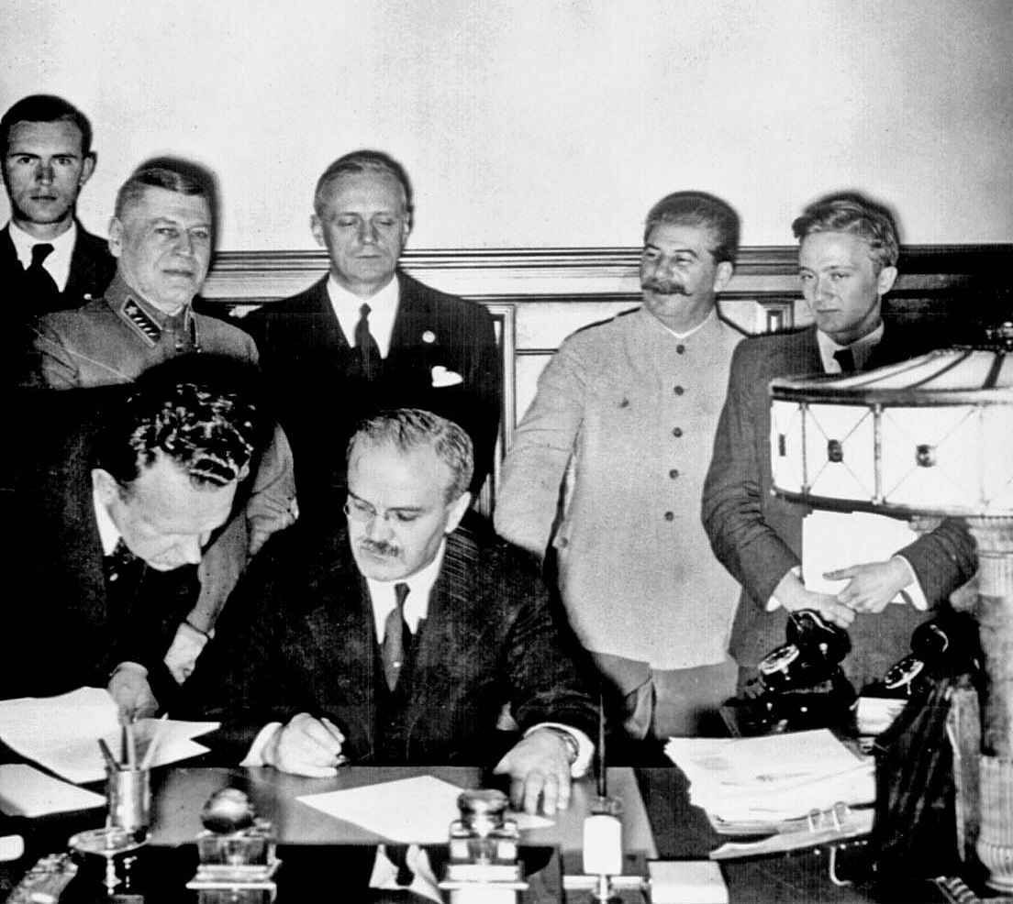
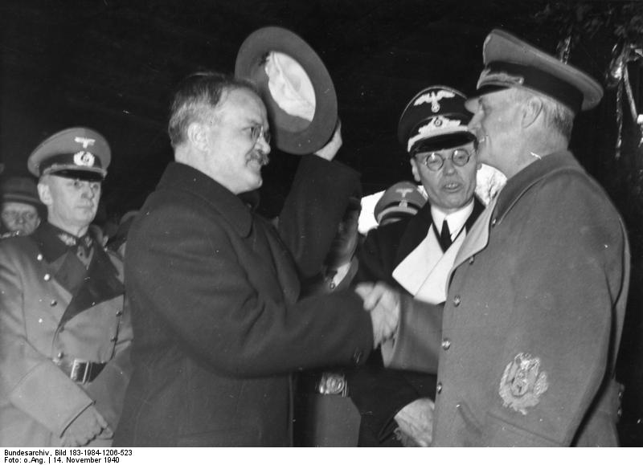
Signing Molotov-Ribbentrop
Pact August 1939
Ribbentrop welcoming
Molotov in Berlin
November 1940

Slide 27
How did World War 2 start?
Japan invades China 1931
Germany invades Poland 1st Sept 1939
France, Britain and Commonwealth declare war on Germany 3rd September
Soviet Union invades Poland 17th Sept
Soviet Union invades Finland
Germany invades France and others 1940
Italy declares war on Britain and France
France surrenders 22nd June 1940
Notes:
The Molotov–Ribbentrop Pact, colloquially named after the Soviet foreign minister Vyacheslav Molotov and the German foreign minister Joachim von Ribbentrop, was an agreement officially titled the Treaty of Non-Aggression between Germany and the Soviet Union^{[1]} and signed in Moscow in the late hours of 23 August 1939.^{[2]} It was a non-aggression pact under which the Soviet Union and Nazi Germany each pledged to remain neutral in the event that either nation were attacked by a third party. It remained in effect until 22 June 1941, when Germany implemented Operation Barbarossa, invading the Soviet Union.
In addition to stipulations of non-aggression, the treaty included a secret protocol dividing Northern and Eastern Europe into German and Soviet spheres of influence, anticipating potential "territorial and political rearrangements" of these countries. Thereafter, Germany and the Soviet Union invaded their respective sides of Poland, dividing the country between them. Part of eastern Finland was annexed by the Soviet Union after the Winter War. This was followed by Soviet annexations of Estonia, Latvia, Lithuania and Bessarabia.

Slide 28
To cut a long story short . . .
Axis powers invade Soviet Union 1941
Japan attacks USA 7th December 1941
Japan conquers south east Asia
Council of Christians and Jews established 1942
Germany defeated in North Africa 1942
D-day northern France 6th June 1944
Soviet Union offensive against Germany
Germany surrenders 7-8th May 1945
Japan surrenders 15th August 1945
Korea occupied by Soviet Union and USA
Notes:
CCJ founded at Britains darkest hour. After that success

Slide 29
What were the causes of the Second World War?
German resentment at Versailles Treaty
“Stabbed in the back”
Great Depression 1929-33
Rise of nationalism, fascism
Desire for expansion ‘living space’
Japan in China
Germany to the east ‘Greater Germany’
Racism, Nazism
Teuton vs. Slav; anti-Semitism
Notes:
Believed stabbed in the back by Jews. If not for Jews would have won. Therefore needed to exterminate Jews to prevent another defeat.
The treaty created bitter resentment towards the victors of World War I, who had promised the people of Germany that U.S. President Woodrow Wilson's Fourteen Points would be a guideline for peace; many Germans felt that the German government had agreed to an armistice based on this understanding, while others felt that the German Revolution had been orchestrated by the "November criminals" who later assumed office in the new Weimar Republic. Wilson was not able to get the Allies to agree to adopt them, nor could he persuade the U.S. Congress to join the League of Nations.
Versailles – would have stopped when regained rhineland and other bits
Fallout from the collapse of the United States economy following the 1929 Stock Market Crash reverberated throughout the world. European countries, especially Germany, were hit hard by the Great Depression, which led to high rates of unemployment, poverty, civil unrest, and an overall feeling of despair.
The Great Depression resulted in a 25% unemployment rate in the United States and a 33% unemployment rate in Germany. The lure of a steady job and adequate food led many people to support dictatorships like those established by Adolf Hitler, Benito Mussolini, and other totalitarians.
The Great Depression hit Germany second only to the United States. Severe unemployment prompted the Nazi Party, which had been losing favor, to experience a surge in membership. This more than anything contributed to the rise of Hitler in Germany, and therefore World War II in Europe. After the end of World War I many American industries and banks invested their money in rebuilding Europe. This happened in many European countries, but especially in Germany. After the 1929 crash, many American investors fearing that they would lose their money, or having lost all their capital, stopped investing as heavily in Europe.
more Jews proportionally than their fellow citizens made the supreme sacrifice for what they mistakenly thought was their Fatherland, that sacrifice was invisible to Hitler, the German High Command, and, increasingly, the German public. On the contrary, in October1916, the German High Command ordered a Judenzählung, a “Jew census,” to demonstrate that Jews were less patriotic than what at the time were considered their “fellow Germans.” The findings demonstrated the opposite. Approximately eighty percent of the Jews in the German army served in the front-lines. Over 100,000 Jews served out of a total German Jewish population of 550,000; 12,000 died in battle; 30,000 were decorated for bravery.

Slide 30
What is fascism?
National Socialism
State control of economy and society
Abolition of democracy, free press, freedom of speech, association, individual rights etc.
Personal will of the leader determines policy and ideology (dictatorship), cult of personality
Race and nationality highest values
Individuals exist for the sake of the state
All power and authority invested in supreme leader
Notes:
All power and authority invested in supreme leader
Individual’s duty to sacrifice himself for the state

Slide 31
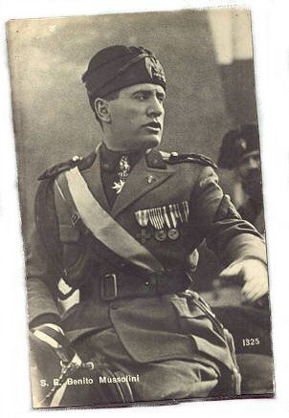
Mussolini Ruler of Italy 1925-1944
“I send greetings to all my followers. I am Il Duce, your great leader. I am like a god. I have done so much for all the Italian people.”

Slide 32
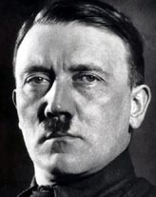
Adolph Hitler Ruler of Germany 1933-1945
“I am the greatest leader of all time. I have great plans.
“Soon there will be a special German church where the Bible is replaced by my book called Mein Kampf. The cross will be replaced by a sword.”
Notes:
anti-Semitic Deutsche Christen (German Christian) movement which claimed to have hundreds of thousands of Protestant members by the mid-1930s.
A study by historian Manfred Gailus calculated that about a quarter of Berlin's Protestant parishes were run by pro-Nazi clergy, with many others acquiescent.

Slide 33
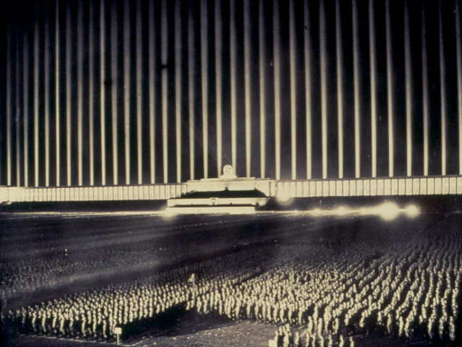

Slide 34
God’s side and Satan’s side
Adam’s family
Abel side
Cain side
USA | Adam Position | Germany
Great Britain and Empire | Eve Position | Japan
France | Archangel Position | Italy

Slide 35
Why?
Britain, USA and France
Democratic, Christian, religious freedom, Abel-view of life
Germany
Anti-democratic, anti-Christian, anti-Semitic, neo-pagan, Cain-view of life
Japan
Militaristic, imperialistic, forced Shinto worship
Italy
Fascist, dictatorship

Slide 36
What happened to the Jews of Europe?

Slide 37
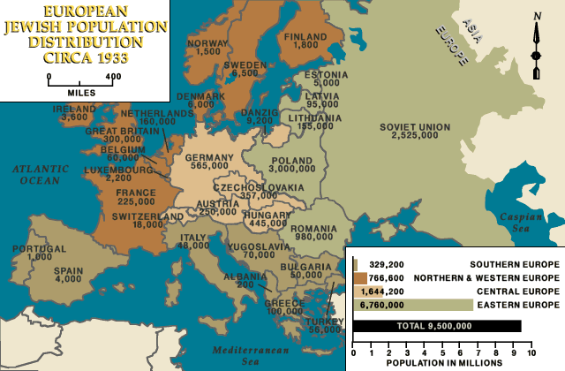
Jews in Europe in 1933
Notes:
The Jews are the oldest extant community in Europe

Slide 38
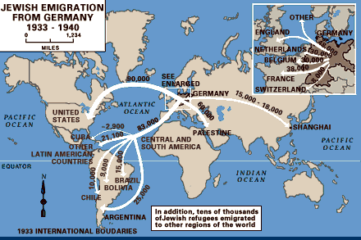
Jewish emigration after Hitler came to power
Notes:
After Hitler came to power many Jews left Germany

Slide 39
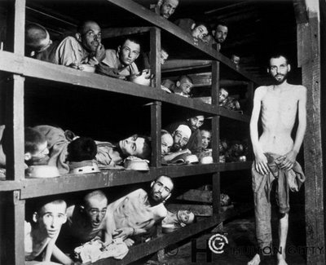
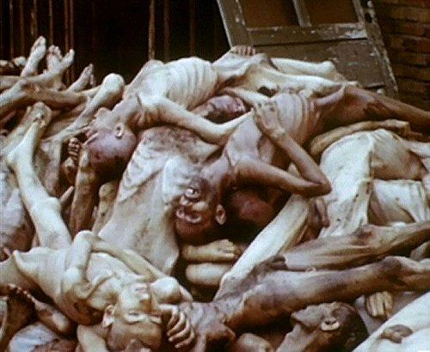
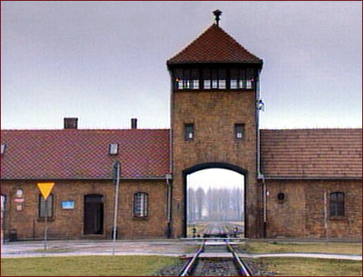
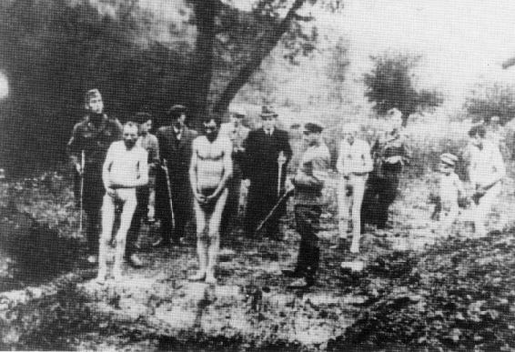
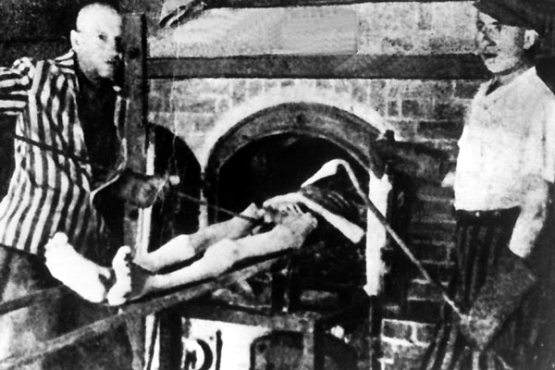
"The Holocaust was a Cain inspired action, one of Hitler’s satanic designs
and plans which should have been prevented by a unified front of all
Christian and Jewish forces.” Sun Myung Moon 1975

Slide 40
How many perished in the Holocaust?
Country | Jewish pop. Sept. 1939 | Number Jews murdered | Percentage of Jews murdered
Poland | 3,300,000 | 2,800,000 | 85
Soviet Union | 2,100,000 | 1,500,000 | 71
Romania | 850,000 | 425,000 | 50
Hungary | 404,000 | 200,000 | 50
Czechoslovakia | 315,000 | 260,000 | 82
France | 300,000 | 90,000 | 30
Germany | 210,000 | 171,000 | 81
Lithuania | 150,000 | 135,000 | 90
Holland | 150,000 | 90,000 | 60
Others | 522,000 | 313,000 | 60
Total | 8,301,000 | 5,978,000 | 72
Notes:
Source: Cited in Landau, The Nazi Holocaust, Chicago: Ivan R. Dee, 1994. These data originally appeared in Poliakov and Wulf (eds), Das Dritte Reich und die Juden: Documente und Aufsatze (Arani Verlag, GmbH, Berlin, 1955)

Slide 41
Letter found near a dead child at Ravensbruch concentration camp
O, Lord, remember not only the men and women of good will, but also those of evil will. But do not remember all the suffering they have inflicted upon us; remember the fruits we have borne thanks to this suffering— our comradeship, our loyalty, our humility, our courage, our generosity, the greatness of heart which has grown out of all this; and when they come to the judgement, let all the fruits that we have borne be their forgiveness.
Notes:
Tikkum olam

Slide 42
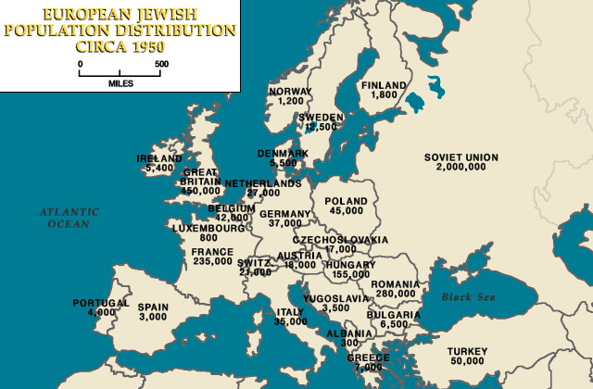
Jews in Europe in 1950
Notes:
After the Holocaust many Jews wanted to go to Israel. They were not welcome and had no desire to go back to their homes which had often been confiscated and the new inhabitants would not give them back.

Slide 43
What were the providential causes of the Second World War?
Restore 3 blessings on growth stage
False Adam – Hitler anti-type of Jesus Christ
Multiplication – Racial purity and ‘master race’
Dominion – World conquest
Overcome Jesus’ second temptation
Temptation not to oppose Hitler and Nazism
Indemnity condition to restore 2nd blessing
Restoration of God’s sovereignty
Expansion of freedom and democracy
Notes:
2nd temprtation. Hitler didn’t want war with UK. Saw British as Aryan. UK an US overcame temptation to side with Hitler or not to oppose hi. Was not in UK interest to defend Poland. After war UK bankrupt.
Appeasement

Slide 44
Second World War ends - 1945
Allies
Axis Powers
USA
USSR
Britain & Empire
France
Germany
Japan
Italy
Military dead 16 million
Civilian dead 45 million
Military dead 8 million
Civilian dead 4 million
Peace
1945
United Nations

Slide 45
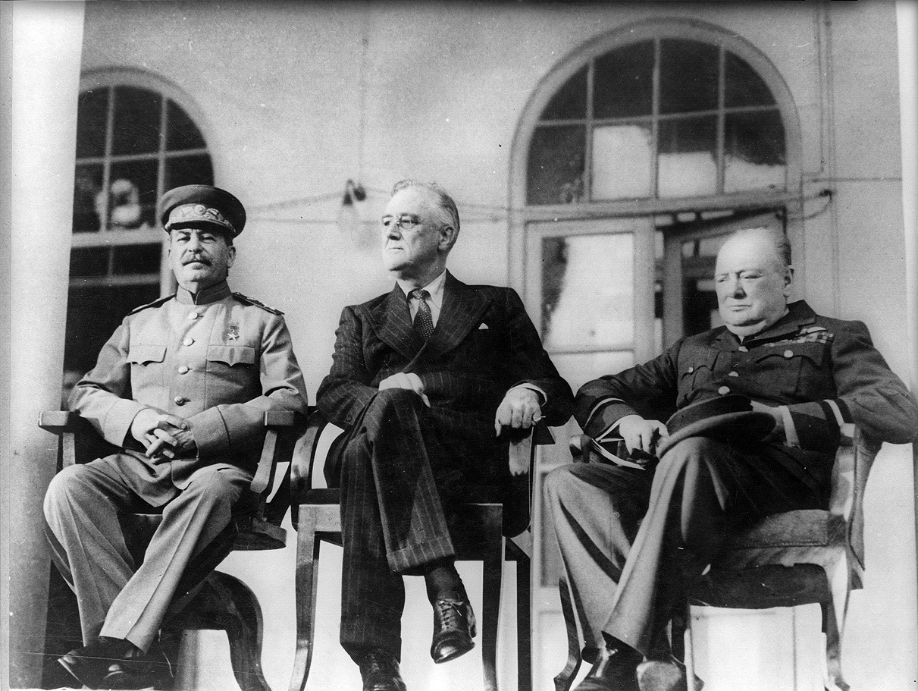
Tehran Conference – Dec 1943
Plan the war
Roosevelt weak
UK & USA disunited
Stalin confident
Soviet Union ‘given’ East Europe
Stalin, Roosevelt and Churchill
Notes:
Churchill and Roosevelt met at Cairo. Churchill wanted to worlk out a joint approach to Stalin. Roosevelt wanted to deal with Stalin alone. Roosevelt very anti-British empire
Stalin wanted 2nd front
The main objective of the United States and Great Britain was to ensure full cooperation and assistance from the Soviet Union for their war policies. Stalin agreed, but at a price: Roosevelt and Churchill would have to support his reign and the partisans in Yugoslavia, and also allow for the manipulation of the border between Poland and the USSR.
Despite accepting the above arrangements, Stalin dominated the conference, using the Soviet victory at the Battle of Kursk and military might, as well as key positions on the German front, to get his way. Roosevelt attempted to cope with Stalin's onslaught of demands, but was able to do little except appease Stalin. Churchill mostly argued for his Mediterranean plan instead of Operation Overlord, to the annoyance of diplomats and officials. These weaknesses and divisions played into Stalin's hands.
One of Roosevelt and Churchill's main concessions concerned post-war Poland. Stalin wished for an area in the Eastern part of Poland to be added to the USSR, and for the border to be lengthened elsewhere in the country. Roosevelt and Churchill agreed to this demand, and Poland’s borders were declared to lie along the Oder and Neisse rivers and the Curzon line, despite protests of the Polish government-in-exile in London. Churchill and Roosevelt also gave Stalin free rein in his own country, and consented to the USSR setting up puppet communist governments in Poland, Czechoslovakia, the Baltic states, Romania, and other Eastern European countries which would result in a loss of freedom by these countries for the next fifty years and would be the genesis of the Cold War. After the conference it was agreed that military leaders of the three countries would meet together often, for further discussion.
Roosevelt acknowledged that the U.S. had a traditional antipathy towards the British Empire. In One Christmas in Washington,^{[113]} a dinner meeting between Roosevelt and Churchill is described, in which Roosevelt is quoted as saying:
"It's in the American tradition, this distrust, this dislike and even hatred of Britain– the Revolution, you know, and 1812; and India and the Boer War, and all that. There are many kinds of Americans of course, but as a people, as a country, we're opposed to Imperialism—we can't stomach it."

Slide 46
Roosevelt on Stalin
“I just have a hunch that Stalin is not that kind of a man. . . . I think that if I give him everything I possibly can and ask for nothing from him in return, noblesse oblige, he won't try to annex anything and will work with me for a world of democracy and peace.”
President Franklin D. Roosevelt, 1943
Notes:
In 1942, U.S. Ambassador to the Soviet Union William Christian Bullitt, Jr.'s thesis prophesied the "flow of the Red amoeba into Europe". Roosevelt responded to Bullitt, Jr. with a statement summarizing his rationale for war time relations with Stalin

Slide 47
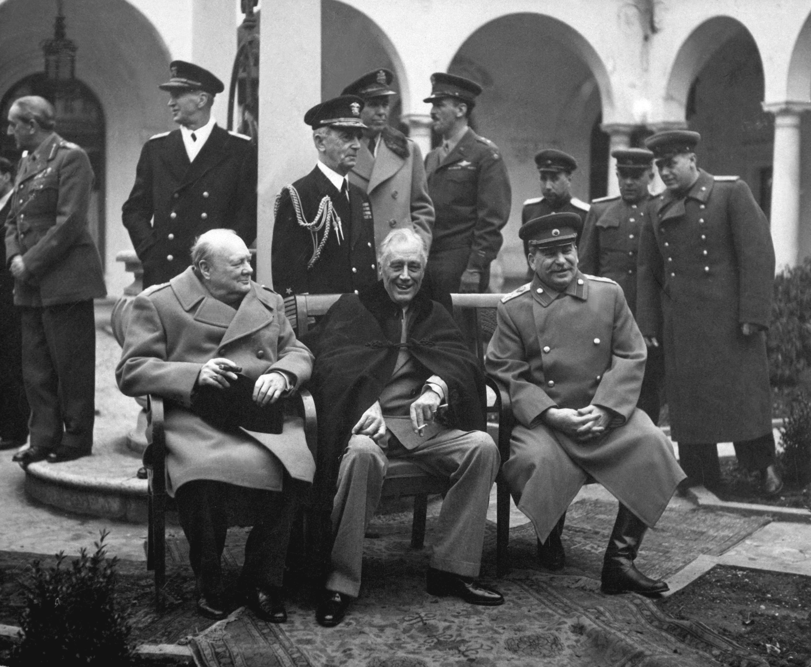
Yalta Conference – Feb 1945
Reorganisation of Europe after the war
Red Army 40 miles from Berlin
Free democratic elections in East Europe
Polish self government to be respected by Soviet Union
Churchill, Roosevelt and Stalin

Slide 48
Churchill on Stalin
“Stalin I’m sure means well to the world and Poland. Stalin has offered the Polish people a free and more broadly based government to bring about an election . . . My hopes lie in a single man, he will not embark on bad adventures.”
Winston Churchill, after Yalta

Slide 49
What were the providential results?
Victory of God’s side over Satan’s side
Restored three blessings
Overcame second temptation of Jesus: indemnity condition to restore 2nd blessing
Messiah could marry and start his mission
Restoration of God’s sovereignty through democracy on growth stage
Establishment of the State of Israel
On Satan’s side communism strengthened
Notes:
Spiritual phenomena from end WW2

Slide 50
Churchill’s ‘Iron Curtain’ speech March 1946
“An iron curtain has descended across the Continent. Behind that line lie all the capitals of the ancient states of Central and Eastern Europe. . . All these famous cities and the populations around them lie in what I must call the Soviet sphere, and all are subject in one form or another, not only to Soviet influence but to a very high and, in many cases, increasing measure of control from Moscow.”
Notes:
Churchill called a war monger and extremist but proved right. Speech given in Westminster College Fulton, Missouri

Slide 51
The Third World War
1945-
Notes:
Still not over. Finished in the west.

Slide 52
Third World War
Nature of conflict depends on human responsibility
Military conflict
Cain - Abel Struggle
Fail
Responsibility
Fulfil
Ideological conflict

Slide 53
What is this ideological conflict?
Abel-type
view of life
Cain-type
view of life
Democracy
Communism
Freedom
Totalitarianism
Religious worldview
Atheism
Dual characteristics
Dialectical materialism
Co-operation & reconciliation
Historical materialism

Slide 54
A new ideology is required
A new ideology to resolve conflict must arise out of the democratic world which is rooted in the Abel-type view of life
This new truth is the essence of the Abel-view of life and the core of democracy
The new truth will conquer the communist ideology and unify the world EDP, 377

Slide 55
What is this ‘new ideology’?
Liberal democracy
F.A. Hayek, Constitution of Liberty
Michael Oakeshott, On Human Conduct
Karl Popper, The Open Society and its Enemies

Slide 56
What was the providential cause of the Third World War?
Completion stage restoration of the three blessings
Anti-type of Christ – Stalin
Class struggle and proletariat
World domination/state ownership of economy
Communism is unprincipled flawed imitation of God’s ideal
Overcome Jesus third temptation
Restoration of God’s sovereignty

Slide 57
God’s side and Satan’s side
Adam’s family
Abel side
Cain side
South Korea West Germany | Adam Position | North Korea East Germany
Japan Great Britain | Eve Position | China
USA | Archangel Position | USSR

Slide 58
What were the origins of the third world war?
Bolshevik seizure of power in Russia 1917
Allied intervention in Russian Civil War
Establishment of Third International 1919
Foment revolution in Europe and world
Molotov-Ribbentrop Pact 1939-41
Wartime Alliance 1941-45
Different visions of post-war Europe
Democracy vs. one party Communist state
Free market vs. state control of economy
Notes:
The Communist International (abbreviated as Comintern, also known as the Third International) was an international communist organization founded in Moscow in March 1919. The International intended to fight "by all available means, including armed force, for the overthrow of the international bourgeoisie and for the creation of an international Soviet republic as a transition stage to the complete abolition of the State. The Comintern was founded in these conditions at a congress held in Moscow March 2-6, 1919,^{[2]} against the backdrop of the Russian Civil War. There were 52 delegates present from 34 parties]
As early as 1925, Stalin stated that he viewed international politics as a bipolar world in which the Soviet Union would attract countries gravitating to socialism and capitalist countries would attract states gravitating toward capitalism while the world was in a period of "temporary stabilization of capitalism" preceding its eventual collapse.^{[8]} Several events fueled suspicion and distrust between the western powers and the Soviet Union: the Bolsheviks' challenge to capitalism;^{[6]} the Polish-Soviet War; the 1926 Soviet funding of a British general workers strike causing Britain to break relations with the Soviet Union;^{[9]} Stalin's 1927 declaration that peaceful coexistence with "the capitalist countries . . . is receding into the past";^{[10]} conspiratorial allegations in the Shakhty show trial of a planned French and British-led coup d'etat;^{[11]} the Great Purge involving a series of campaigns of political repression and persecution in which over half a million Soviets were executed;^{[12]} the Moscow show trials including allegations of British, French, Japanese and German espionage;^{[13]} the controversial death of 6–8 million people in the Ukrainian Soviet Socialist Republic in the 1932–3 Ukrainian famine; western support of the White Army in the Russian Civil War; the US refusal to recognize the Soviet Union until 1933;^{[14]} and the Soviet entry into the Treaty of Rapallo.^{[15]} This outcome rendered Russian–American relations a matter of major long-term concern for leaders in both countries.
Both sides, held very dissimilar ideas regarding the establishment and maintenance of post-war security. The Americans tended to understand security in situational terms, assuming that, if US-style governments and markets were established as widely as possible, countries could resolve their differences peacefully, through international organizations.^{[33]} The key to the US vision of security was a post-war world shaped according to the principles laid out in the 1941 Atlantic Charter — in other words, a liberal international system based on free trade and open markets. This vision would require a rebuilt capitalist Europe, with a healthy Germany at its center, to serve once more as a hub in global affairs.
This would also require US economic and political leadership of the postwar world. Europe needed the USA's assistance if it was to rebuild its domestic production and finance its international trade. The USA was the only world power not economically devastated by the fighting. By the end of the war, it was producing around fifty percent of the world's industrial goods.^{[14]}
Soviet leaders, however, tended to understand security in terms of space.^{[34]} This reasoning was conditioned by Russia's historical experiences, given the frequency with which the country had been invaded over the last 150 years.^{[35]} The Second World War experience was particularly dramatic for the Russians: the Soviet Union suffered unprecedented devastation as a result of the Nazi onslaught, and over 20 million Soviet citizens died during the war; tens of thousands of Soviet cities, towns, and villages were leveled; and 30,100 Soviet factories were destroyed.^{[36]} In order to prevent a similar assault in the future, Stalin was determined to use the Red Army to gain control of Poland, to dominate the Balkans and to destroy utterly Germany's capacity to engage in another war. The problem was that Stalin's strategy risked confrontation with the equally powerful United States, who viewed Stalin's actions as a flagrant violation of the Yalta agreement.

Slide 59
What is communism 1?
Abolition of the third blessing
“Communism is the abolition of private property.” Communist Manifesto 1848
State control and ownership of all property
No free markets; planned economy
Cannot become a true owner
Cannot become Lord of Creation
Cannot inherit God’s creativity

Slide 60
What is communism 2?
Abolition of the second blessing
“The workers’ state will come to replace the family.”
“The obligations of parents to their children will wither away gradually until finally society assumes the full responsibility.”
“Marriage . . . has given way to the free and honest union of men and women who are lovers and comrades.” Alexandra Kollontai, 1920
State takes over law, education, health, welfare and civil society
Notes:
Alexandra Mikhailovna "Shura” (March 31 [O.S. March 19] 1872 –March 9, 1952) was a Russian Communist revolutionary, first as a member of the Mensheviks, then from 1914 on as a Bolshevik. In 1923, she was appointed Soviet Ambassador to Norway, becoming the world's first female ambassador.After the Bolshevik revolution in October 1917, Kollontai became People's Commissar for Social Welfare. She was the most prominent woman in the Soviet administration and was best known for founding the Zhenotdel or "Women's Department" in 1919 . This organization worked to improve the conditions of women's lives in the Soviet Union, fighting illiteracy and educating women about the new marriage, education, and working laws put in place by the Revolution. As a foremost champion of women's equality like the other Marxists of her time, she opposed the bourgeois ideology of liberal feminism^{[16][17]}; though later feminists have claimed her legacy. The Zhenotdel was eventually closed in 1930.
Kollontai raised eyebrows with her unflinching advocacy of free love. However, this does not mean that she advocated casual sexual encounters; indeed, she believed that due to the inequality between men and women that persisted under socialism, such encounters would lead to women being exploited, and being left to raise children alone. Instead she believed that true socialism could not be achieved without a radical change in attitudes to sexuality, so that it might be freed from the oppressive norms that she saw as a continuation of bourgeois ideas about property. It is a myth that she said that "...the satisfaction of one's sexual desires should be as simple as getting a glass of water"; what she actually said, in number 18 of her Theses on Communist Morality in the Sphere of Marital Relations, was that "...sexuality is a human instinct as natural as hunger or thirst."
Kollontai's views on the role of marriage and the family under Communism were arguably more subversive and more influential on today's society than her advocacy of "free love." Kollontai believed that, like the state, the family unit would wither away once the second stage of communism became a reality. She viewed marriage and traditional families as legacies of the oppressive, property-rights-based, egoist past. Under Communism, both men and women would work for, and be supported by, society, not their families. Similarly, their children would be wards of, and reared basically by society.
Kollontai admonished men and women to discard their nostalgia for traditional family life. "The worker-mother must learn not to differentiate between yours and mine; she must remember that there are only our children, the children of Russia’s communist workers." However, she also praised maternal attachment: "Communist society will take upon itself all the duties involved in the education of the child, but the joys of parenthood will not be taken away from those who are capable of appreciating them."^{[19]}

Slide 61
What is communism 3?
Abolition of the first blessing
“Atheism is a natural and inseparable part of Marxism, of the theory and practice of scientific socialism.” Vladimir Lenin
“Communism is incompatible with religious faith.” Nikolai Bukharin
“In our country, the lie has become not just a moral category but a pillar of the State.” Alexander Solzenitsyn
No freedom of speech or religion
Persecution and suppression of religion
Notes:
Think one thing, say another, do a third
The Soviet Union was the first state to have as an ideological objective the elimination of religion^{[1]} and its replacement with atheism as a fundamental ideological goal of the state.^{[2][3]} Toward that end, the communist regime confiscated church property, ridiculed religion, harassed believers, and propagated atheism in the schools.
Marxism-Leninism has consistently advocated the control, suppression,and, ultimately, the elimination of religious beliefs. Within about a year of the revolution the state expropriated all church property, including the churches themselves, and in the period from 1922 to 1926, 28 Russian Orthodox bishops and more than 1,200 priests were killed (a much greater number was subjected to persecution).[
Marxism-Leninism has consistently advocated for the suppression, and, ultimately, the disappearance of religious beliefs, considering them to be "unscientific" and "superstitious". In the 1920s and 1930s, such organizations as the League of the Militant Godless were active in anti-religious propaganda. Atheism was the norm in schools, communist organizations (such as the Young Pioneer Organization), and the media Most seminaries were closed, and publication of most religious material was prohibited. By 1941 only 500 churches remained open out of about 54,000 in existence prior to World War 1.

Slide 62
What is communist ideology?
Dialectical materialism
Only matter exists - No God or spirit
Progress based on dialectical conflict between thesis and anti-thesis
Historical materialism
Productive forces determine society
Progress through class struggle
Violent revolution justified

Slide 63
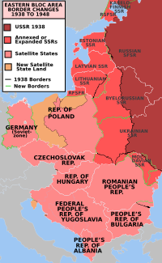
Beginnings of the conflict
Establishment of Eastern Bloc based on M-R Pact
States incorporated into Soviet Union
East European countries become satellites
Marshall Plan 1947
Revive Germany & economies
Rejected by USSR
Truman Doctrine 1947
Containment and deterrence
Notes:
Marshall Plan offered to ALL european countries including USSR
After the Marshall Plan, the introduction of a new currency to Western Germany to replace the debased Reichsmark and massive electoral losses for communist parties, in June 1948, the Soviet Union cut off surface road access to Berlin, initiating the Berlin Blockade, which cut off all non-Soviet food, water and other supplies for the citizens of the non-Soviet sectors of Berlin.^{[84]} Because Berlin was located within the Soviet-occupied zone of Germany, the only available methods of supplying the city were three limited air corridors.^{[85]}
By February 1948, because of massive post-war military cuts, the entire United States army had been reduced to 552,000 men.^{[86]} Military forces in non-Soviet Berlin sectors totaled only 8,973 Americans, 7,606 British and 6,100 French.^{[87]} Soviet military forces in the Soviet sector that surrounded Berlin totaled one and a half million men.^{[88]} The two United States regiments in Berlin would have provided little resistance against a Soviet attack.^{[89]} Therefore, a massive aerial supply campaign was initiated by the United States, Britain, France and other countries, the success of which caused the Soviets to lift their blockade in May 1949.
On July 20, 1948, President Truman issued the second peacetime military draft in U.S. history.
Truman delivered a speech that called for the allocation of $400 million to intervene in the war and unveiled the Truman Doctrine, which framed the conflict as a contest between free peoples and totalitarian regimes

Slide 64
The war of ideas
Radio Free Europe 1949
Radio Liberty 1951
Voice of America
BBC
Washington Times
CAUSA, VOC
Heritage Foundation
Notes:
RFE was developed out of a belief that the Cold War would eventually be fought by political rather than military means.^{[8]} American policymakers such as George Kennan and John Foster Dulles acknowledged that the Cold War was essentially a war of ideas. The United States, acting through the CIA, funded a long list of projects to counter the Communist appeal among intellectuals in Europe and the developing world.
On February 21, 1981, RFE/RL's headquarters in Munich was struck by a massive bomb, causing $2 million in damage. Several employees were injured, but there were no fatalities. Stasi files opened after 1989 indicated that the bombing was carried out by a group of international terrorists under the direction of Ilich Ramirez Sanchez, the arch-terrorist known by the alias Carlos the Jackal, and paid for by Nicolae Ceauşescu, president of Romania.^{[42]}
Funding for RFE/RL increased during the Reagan Administration. President Ronald Reagan, a fervent opponent of Communism, urged the radios to be more critical of the communist regimes. This presented a challenge to RFE/RL's broadcast strategy, which had been very cautious since the controversy over its alleged role in the Hungarian Revolution.^{[43]}
During the Mikhail Gorbachev era in the Soviet Union, the radios worked hand in hand with Glasnost and benefited significantly from the Soviet regime's new openness. Gorbachev stopped the practice of jamming the radios' broadcasts, and dissident politicians and officials could be freely interviewed by the radios for the first time without fearing persecution or imprisonment.^{[44]} By 1990 Radio Liberty had become the most listened-to Western radio station broadcasting to the Soviet Union.^{[45]} Its coverage of the 1991 August coup enriched sparse domestic coverage of the event and drew in a wide audience from throughout the region.^{[46]} The broadcasts allowed Gorbachev and Boris Yeltsin to stay in touch with the Russian people during this turbulent period. Boris Yeltsin later expressed his gratitude through a presidential decree allowing Radio Liberty to open a permanent bureau in Moscow.^{[47]}
With the arrival of the Reagan administration, the Heritage Foundation and other conservative foreign policy think tanks saw a political opportunity to significantly expand Carter's Afghanistan policy into a more global "doctrine," including U.S. support to anti-communist resistance movements in Soviet-allied nations in Africa, Asia and Latin America. According to the book Rollback, "it was the Heritage Foundation that translated theory into concrete policy. Heritage targeted nine nations for rollback: Afghanistan, Angola, Cambodia, Ethiopia, Iran, Laos, Libya, Nicaragua and Vietnam."^{[5]}
Along with the broadcasts of the British Broadcasting Corporation and the Voice of America to Eastern Europe,^{[99]} a major propaganda effort begun in 1949 was Radio Free Europe/Radio Liberty, dedicated to bringing about the peaceful demise of the Communist system in the Eastern Bloc.^{[100]} Radio Free Europe attempted to achieve these goals by serving as a surrogate home radio station, an alternative to the controlled and party-dominated domestic press.^{[100]} Radio Free Europe was a product of some of the most prominent architects of America's early Cold War strategy, especially those who believed that the Cold War would eventually be fought by political rather than military means, such as George F. Kennan.^{[101]}
American policymakers, including Kennan and John Foster Dulles, acknowledged that the Cold War was in its essence a war of ideas.^{[101]} The United States, acting through the CIA, funded a long list of projects to counter the Communist appeal among intellectuals in Europe and the developing world.

Slide 65
Communist expansion
Berlin blockade and airlift June ‘48- May ’49
Division of Germany
Establishment of NATO April 1949
12 countries North America and Western Europe
China becomes communist 1949
North Korea becomes communist 1945-49
South Korea holds elections
Korean War 1950-53
Notes:
The Berlin Blockade (24 June 1948 – 12 May 1949) was one of the first major international crises of the Cold War and the first resulting in casualties. During the multinational occupation of post-World War II Germany, the Soviet Union blocked the Western Allies' railway and road access to the sectors of Berlin under Allied control. Their aim was to force the western powers to allow the Soviet zone to start supplying Berlin with food and fuel, thereby giving the Soviets practical control over the entire city.
In response, the Western Allies organized the Berlin Airlift to carry supplies to the people in West Berlin. The United Kingdom's Royal Air Force and the recently formed United States Air Force, flew over 200,000 flights in one year that provided 13,000 tons of daily necessities such as fuel and food to the Berliners.^{[1]} By the spring of 1949, the effort was clearly succeeding, and by April, the airlift was delivering more cargo than had previously flowed into the city by rail.
The success of the Berlin Airlift brought humiliation to the Soviets who had refused to believe it could make a difference. The blockade was lifted in May 1949 and resulted in the creation of two separate German states
North Korea refused to participate in a United Nations–supervised election held in the south in 1948, which led to the creation of separate Korean governments for the two occupation zones.

Slide 66
Continuing conflict
Warsaw Pact established 1955
Start of Vietnam War 1955-75
Hungarian independence uprising 1956
Cuban Revolution 1959
Competition by proxy in Third World
Sino-Soviet split 1956
Berlin Crisis and Wall 1961
Cuban Missile Crisis 1962

Slide 67
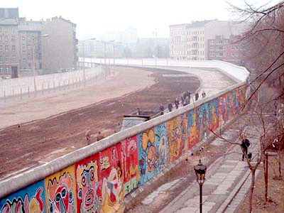
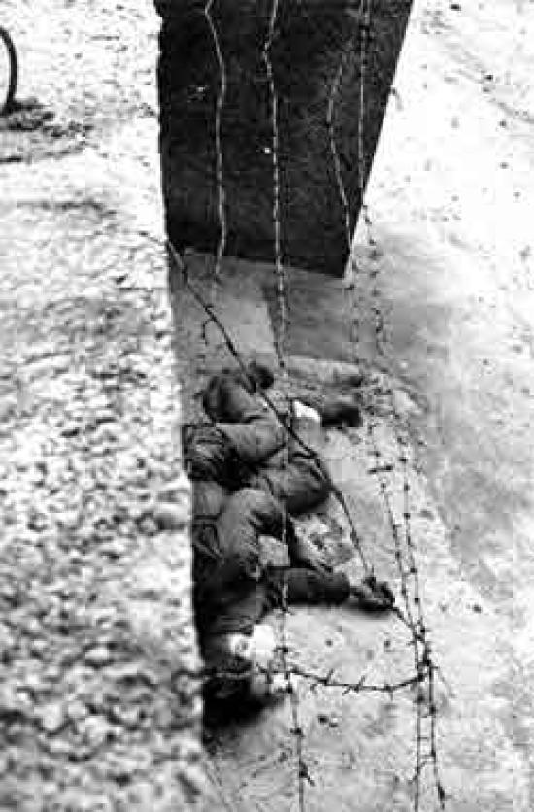
Berlin Wall scenes
Berlin Wall
Peter Fechter August 1962

Slide 68
Communist expansion
Prague Spring and Soviet invasion of Czechoslovakia 1968
Brezhnev Doctrine
Right to invade a socialist state to stop it adopting capitalism
Soviet support for Arab nations against Israel
Notes:
The Prague Spring (Czech: Pražské jaro, Slovak: Pražská jar) was a period of political liberalization in Czechoslovakia during the era of its domination by the Soviet Union after World War II. It began on 5 January 1968, when reformist Slovak Alexander Dubček came to power, and continued until 21 August when the Soviet Union and members of its Warsaw Pact allies (except Romania) invaded the country to halt the reforms.
The Brezhnev Doctrine was a Soviet Union foreign policy
"When forces that are hostile to socialism try to turn the development of some socialist country towards capitalism, it becomes not only a problem of the country concerned, but a common problem and concern of all socialist countries." This doctrine was announced to retroactively justify the Soviet invasion of Czechoslovakia in August 1968 that ended the Prague Spring, along with earlier Soviet military interventions, such as the invasion of Hungary in 1956. These interventions were meant to put an end to democratic liberalization efforts and uprisings that had the potential to compromise Soviet hegemony inside the Eastern bloc, which was considered by the Soviets to be an essential defensive and strategic buffer in case hostilities with NATO were to break out.

Slide 69
Détente and Peaceful Co-existence
Chinese – American relations
President Nixon visits China 1972
Sino-Soviet split deepens
Notes:
The US continued to spend heavily on supporting friendly Third World regimes in Asia. Conflicts in peripheral regions and client states—most prominently in Vietnam—continued.^{[165]} Johnson stationed 575,000 troops in Southeast Asia to defeat the National Front for the Liberation of South Vietnam (NLF) and their North Vietnamese allies in the Vietnam War, but his costly policy weakened the US economy and, by 1975, ultimately culminated in what most of the world saw as a humiliating defeat of the world's most powerful superpower at the hands of one of the world's poorest nations.^{[19]}

Slide 70
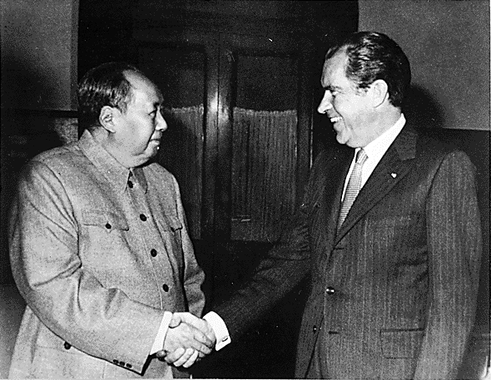
Mao Zedong and Richard Nixon 1972

Slide 71
Détente and Peaceful Co-existence
Chinese – American relations
President Nixon visits China 1972
Sino-Soviet split deepens
American – Soviet Relations
Nixon visits Moscow 1972
Anti-Ballistic Missile Treaty 1972
Strategic Arms Limitation Talks 1974
Helsinki Accords 1975
American defeated in Vietnam 1975
Notes:
The visit ushered in a new era of Sino-American relations.^{[67]} Fearing the possibility of a Sino-American alliance, the Soviet Union yielded to American pressure for détente.^{[155]}
The US continued to spend heavily on supporting friendly Third World regimes in Asia. Conflicts in peripheral regions and client states—most prominently in Vietnam—continued.^{[165]} Johnson stationed 575,000 troops in Southeast Asia to defeat the National Front for the Liberation of South Vietnam (NLF) and their North Vietnamese allies in the Vietnam War, but his costly policy weakened the US economy and, by 1975, ultimately culminated in what most of the world saw as a humiliating defeat of the world's most powerful superpower at the hands of one of the world's poorest nations.^{[19]}

Slide 72
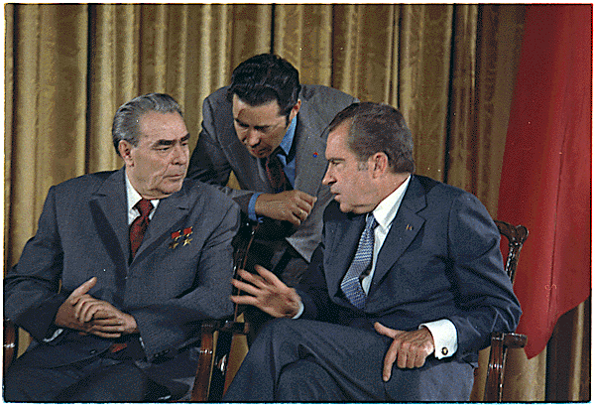
Leonid Brezhnev and Richard Nixon

Slide 73
Renewed conflict
Soviet invasion of Afghanistan 1979
Solidarity in Poland 1980-81
Thatcher (‘79) and Reagan (‘81) elected
Falklands conflict 1982
Arms build up by USA
‘Stars Wars’, B-1 bomber etc.
Invasion of Grenada 1983
Reagan Doctrine
Support for Contras in Nicaragua
Support for Mujihadeen in Afghanistan
Notes:
During December 1979, approximately 75,000 Soviet troops invaded Afghanistan in order to support the Marxist government formed by ex-Prime-minister Nur Muhammad Taraki, assassinated that September by one of his party rivals.^{[180]} As a result, US President Jimmy Carter withdrew the SALT II treaty from the Senate, imposed embargoes on grain and technology shipments to the USSR, demanded a significant increase in military spending, and further announced that the United States would boycott the 1980 Moscow Summer Olympics. He described the Soviet intervention in Afghanistan as "the most serious threat to the peace since the Second World War.
Grenada first time country went communist had been returned to democracy

Slide 74
The war against communism
“The Reagan Doctrine proclaimed that the truce with communism was over. The West would henceforth regard no area of the world as destined to forego its liberty simply because the Soviets claimed it to be within their sphere of influence. We would fight a battle of ideas against communism, and we would give material support to those who fought to recover their nations from tyranny.”
Margaret Thatcher, December 1997

Slide 75
Final years
Gorbachev elected 1985
Perestroika
Glasnost
Gorbachev – Reagan talks 1985-87
End of Cold War
Withdrawal from Afghanistan 1989
End of the Angolan conflict 1989
Fall of Berlin Wall and revolutions in East Europe 1989
End of Soviet Union 1991

Slide 76
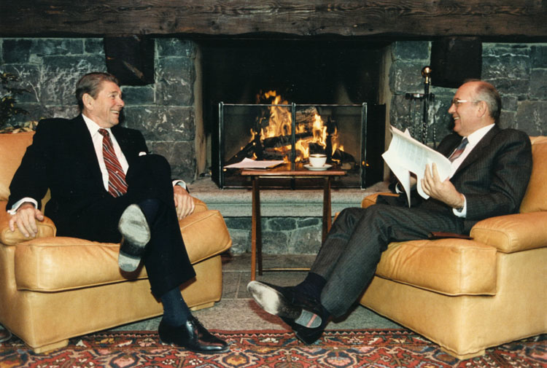
Reagan and Gorbachev

Slide 77
Third World War in the West over
USA
West Europe
Turkey
USSR
East Europe
Peace

Slide 78
What was the human cost of communism?
20-60 million in the Soviet Union 65 million in the People's Republic of China 1 million in Vietnam 2 million in North Korea 2 million in Cambodia 1 million in communist Eastern Europe 150,000 in Latin America 1.7 million in Africa 1.5 million in Afghanistan
Stéphane Courtois (ed) The Black Book of Communism: Crimes, Terror, Repression. Harvard University, 1999

Slide 79
Results of the end of the war
Peaceful restoration of Cain and Abel on the worldwide level
Restoration of the third blessing possible
Privatisation, free market
World wide expansion of democracy

Slide 80
How did we contribute to the fall of communism?
VOC
CAUSA
Washington Times
Star Wars
Rallies
CARP
PWPA

Slide 81
Third World War in the East
USA
Japan
S. Korea
USSR
China
N. Korea
Ideological War
‘Cold War’

Slide 82
God’s side and Satan’s side
Abel side
Cain side
Israel | First Israel | Iran, Syria, Hamas etc.
Christian world | Second Israel | China
South Korea | Third Israel | North Korea
Notes:
Cain and Abel relative. Which closest to God’s will and Abel-type view of life

Slide 83
God’s side and Satan’s side
Abel side
Cain side
Judaism | First Israel | Islamism
Christianity | Second Israel | Communism
Unificationism | Third Israel | Juche

Slide 84
Three religions, three nations
Judaism, is in an elder brother's position. Christianity, is in the position of the second brother. The Unification Church, is in the position of the youngest brother. Israel, the United States and Korea, the nations where these three religions are based must be brothers. Because these three nations have a common destiny representing God's side, the Communist bloc as Satan's representative is trying to isolate and destroy them at the U.N.
Sun Myung Moon, Washington Monument, 1976

Slide 85
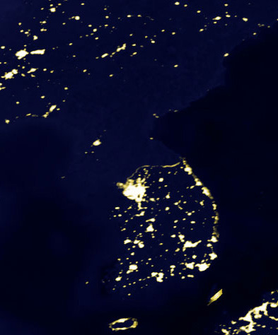
What is North Korea like?
Communist one party state
Planned economy
Most militarised nation in the world
Nuclear state
Worst human rights
Religious persecution
North
South
Korea at night
Notes:
Multiple international human rights organizations, including Amnesty International and Human Rights Watch, accuse North Korea of having one of the worst human rights records of any nation.^{[171]} North Koreans have been referred to as "some of the world's most brutalized people" by Human Rights Watch, due to the severe restrictions placed on their political and economic freedoms.^{[172]}
North Korean defectors have testified to the existence of prisons and concentration camps^{[173]} with an estimated 150,000 to 200,000 inmates (about 0.85% of the population), and have reported torture, starvation, rape, murder, medical experimentation, forced labour, and forced abortions.^{[174]} Convicted political prisoners and their families are sent to these camps, where they are prohibited from marrying, required to grow their own food, and cut off from external communication (which was previously allowed)

Slide 86
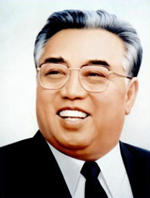
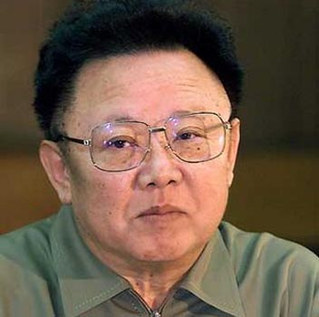
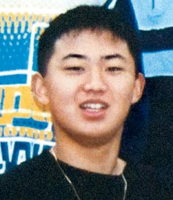
What is North Korea like?
Communist one party state
Hereditary dynasty
Kim Il Sung – “Great Leader” is the ‘Eternal President’
Kim Jong Il – “Dear Leader”
Kim Jong Un – “Brilliant Comrade”
Notes:
Kim Il Sung was raised in a Presbyterian family; his maternal grandfather was a Protestant minister, his father had gone to a missionary school and was an elder in the Presbyterian Church, and both his parents were reportedly very active in the religious community. Kim was an accomplished church organist

Slide 87
What is North Korea like?
Communist one party state
Hereditary dynasty
Personality cult
“Adore Kim Jong Il with all your heart”
Divine ruler
“Do not believe in God. Believe in the Great Man.”
Ruling ideology of Juche
Juche calendar began 1912
Notes:
The Juche Idea (Korean pronunciation: [tɕutɕʰe] approximately "joo-ch'he") is the official state ideology of North Korea (Democratic People's Republic of Korea). It teaches that "man is the master of everything and decides everything," and that the Korean people are the masters of Korea's revolution. Juche is a component of North Korea's political system.^{[citation needed]} Juche literally means "main body" or "subject"; it has also been translated in North Korean sources as "independent stand" and the "spirit of self-reliance".
In 1972, Juche replaced Marxism-Leninism in the revised North Korean constitution as the official state ideology, this being a response to the Sino-Soviet split. Juche was nonetheless defined as a creative application of Marxism-Leninism. Kim Il-sung also explained that Juche was not original to North Korea and that in formulating it he only laid stress on a programmatic orientation that is inherent to all Marxist-Leninist states.
"independence in politics" (chaju)
"self-sustenance in the economy" (charip)
"self-defense in national defense" (chawi).

Slide 88
Third World War
Nature of conflict depends on human responsibility
Military conflict
Cain – Abel struggle
Fail
Responsibility
Fulfil
Ideological conflict

Slide 89
How is God’s side doing?
USA and Europe separating from Israel
Revival of anti-Semitism
South Korea has economic interests in Arab world which mean it won’t support Israel
Christian and Unification Church super-sessionism

Slide 90
How is Satan’s side doing?
North Korea supplying missile technology to Iran, Hamas and Hezbollah
North Korea supplying nuclear technology to Syria
Iran sponsoring Hamas and Hezbollah
Islamist forces have a long term plan for jihad to conquer the West and make it Muslim
Notes:
http://metropolitician.blogs.com/scribblings_of_the_metrop/2007/02/korean_antisemi.html

Slide 91
What is to be done?
Critique and counter proposal to Juche
Critique and counter proposal to Islamism
Rallies to support Israel by Christian and Unification churches
Deterrence to guarantee Israel and South Korea
Support liberal and democratic forces in North Korea, China and Muslim countries

Slide 92
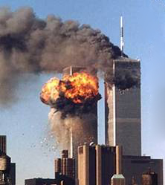
Al-Qaeda’s critique of the West
“What are we calling you to, and what do we want from you?”
We call you to stop your oppression, lies, immorality and the debauchery that has spread among you.
We call you to be a people of manners, principles, honour and purity; to reject the immoral acts of fornication, homosexuality, intoxication, gambling and trading with interest.”

Slide 93
Global clash of civilisations
Israel
Christian bloc
S. Korea
Palestine
Muslim bloc
N. Korea

