Slide 1

Course for Re-launching Providence
1st day of the 1st month of 2011
by the heavenly calendar in the 2nd year of Cheon-gi
Unification Church World Mission Headquarters
Director of Education
Rev. Jin Hun Yong
Notes:
섭리 재출발을 위한 노정

Slide 2

CONTENTS
I. Introduction
II. Pioneering Pyongyang
III. Ordeals at Hungnam Labor Camp
IV. From Hungnam to Busan and Freedom
V. Refugee Years in Busan
VI. Providence Leading to the Founding of Our Church
VII. Lessons To Be Learned
Notes:
목차
Ⅰ.서론
Ⅱ.평양개척전도
Ⅲ.흥남노무자수용소 수난
Ⅳ.흥남에서 부산까지 자유남하
Ⅴ.부산 피난시절
Ⅵ.협회창립직전의 섭리
Ⅶ.교훈

Slide 3
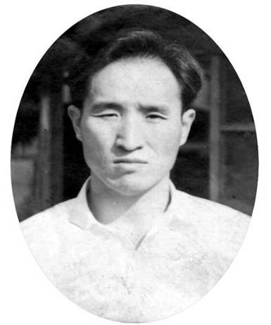
Course for Re-launching Providence
(June 6, 1946 - 1960. lunar 3.16)
Notes:
섭리재출발을 위한노정(1946.6.6-1960.음3.16)

Slide 4
I. Introduction
Seven-year course after the end of WWII
Beginning of the forty-year wilderness course
Prayed five times a day for forty years for the unity of seven nations
Father watched the movie “Papillon” seven times
The goal of the course of re-launching providence was in finding a family
Notes:
Ⅰ.서론
제2차 세계대전 후 7년 노정
40년 광야노정의 시작
40년 동안 7개국 하나 되도록 하루 5번 기도
D. 영화 ‘빠삐용’을 7번 보신 참아버님
E. 섭리 재출발 노정은 가정이 목표

Slide 5
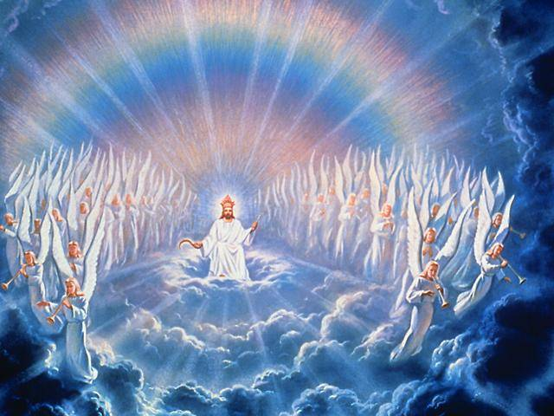
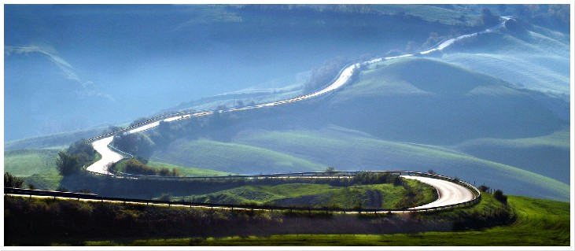
'Crossing the 38th parallel’
(May 27 - June 6, 1946)
In accordance with God’s decree
and His will
followed a rainbow path
covering 120 ris (47 km)
In search of one man and three women
Notes:
삼팔선을 넘어라‘
(1946.5.27-6.6)
하늘의 명령과
뜻만 따라
무지개 길
120리 인도

Slide 6
True Parents' Departure from North Korea
Jesus
John-the-Baptist’s betrayal after his testimony (Failed to appoint 12 disciples)
Left Jerusalem in order to find disciples
Made Peter and other fishermen, prostitutes, tax collectors one of his 12 disciples
Betrayal of Judas Iscariot
Court of Pilate
Pilate washes his hand, indicating Jesus’ innocence
Jews, Jesus’ crucifixion
Appeared spiritually to his 12 disciples forty days after his death
True Parents
Kim Baek-moons betrayal after his testimony (Failed to appoint 12 disciples)
Left North Korea
Kim In-ju, Kim Won-pil, Jeong Dal-ok, Cha Sang-soon, Ok Se-hyeon, Ji Seung-do
Anonymous letter from Christians (betrayal)
Daedong prison (Circumstances similar to that of Court of Pilate)
Acquitted and released after 90 days
Another anonymous letter leading to imprisonment at Hungnam and path of the cross
In prison found 12 disciples
Notes:
예수님 참부모님
세례요한증거후 배반 12제자 못세움 김백문 증거후 배반(12제자 못세움)
제자들 찾으러 예루살렘을 떠남 북한으로 떠남
어부 창녀세리등 베드로 등 12제자 김인주 김원필 정달옥 차상순 등
가롯유다의 배반 기독교인들의 투서(배반)
빌라도 법정 대동보안소 빌라도 법정과 같음
빌라도 손을 씻으며/무죄밝힘 90일만에 무죄로 풀려남
유대민족 예수님의 십자가 처형 재투서로 흥남감옥서 십자가노정
40일만에 영적으로 12제자 찾음 감옥에서 실체로 12제자 찾음

Slide 7
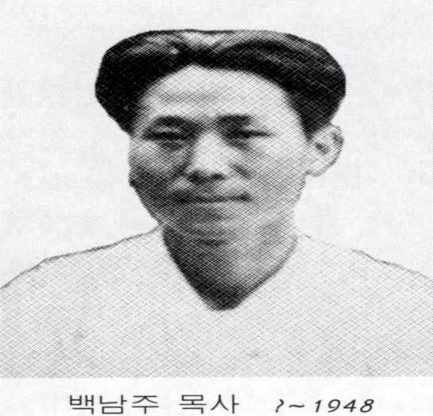
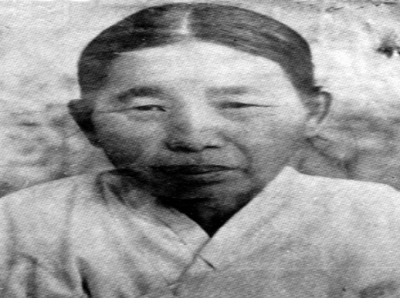
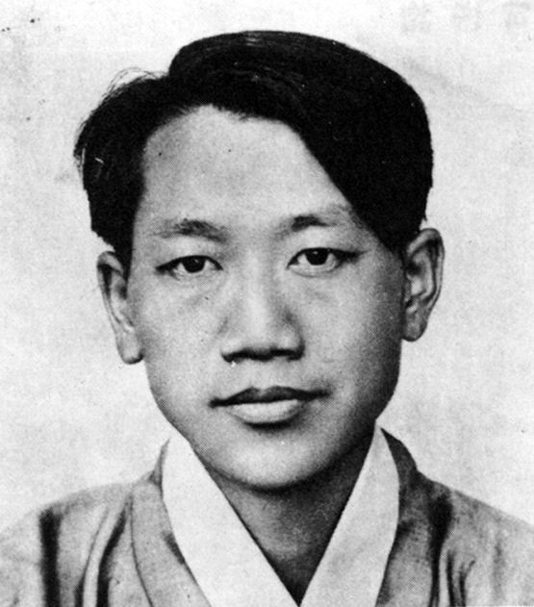
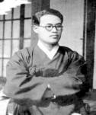
II. Pioneering Pyongyang (June 6, 1946 - February 22, 1948)
West (Women)
East (Men)
Adam
True Father
(Adam type) Paek Nam-joo
(Eve type) Kim Seong-do
Women
Spiritual groups
Cheolsan
Eve
Wonsan
(Mary type) Heo Ho-bin
(Ann type) Pak Eul-ryong
(Jesus type) Lee Yong-do
Defected groups
shrine worship
Men
Rebuilding
Cain
Abel
(John-the-Baptist type) Kim Baek-moon
Notes:
여성신령교단 중심, 남성교단 재건회, 변절교단 신사참배
서쪽 여성중심-동쪽 남성중심

Slide 8
II. Pioneering Pyongyang (June 6, 1946-February 22, 1948)
Arrival at Pyongyang, the Jerusalem of the East, and Pioneering Mission (June 6, 1946 -)
At Na Choi-seob’s house in Kyongchang-ri, Pyongyang and holding meetings at aunt’s house
Members who were spiritually led: Chung Deuk-eun, Kim Jong-hwa, Chung Myeong-seon, etc
Fifteen devout members of the five-hundred congregation at Jangdaehyeon Church were in attendance
Notes:
Ⅱ.평양개척전도 (1946.6.6-1948.2.22)
A. 동양의 예루살렘인 평양도착과 개척전도(1946.6.6-)
1.평양 경창리에서 나최섭의 집과 이모 집에서 집회
2.영적인 인도 찾아온 식구들: 정득은, 김종화, 정명선 등
3.장대현 교인 500 명 중에서 독실한 15명 출석

Slide 9

II. Pioneering Pyongyang (June 6, 1946-February 22, 1948)
Ordeal at Pyongyang Daedong Prison, and the Inside Belly Church (August 11 - November 21, 1946)
Kim Seong-do’s Holy Lord Church
The Fall was an illicit sexual relationship.
Jesus’ death was unjust.
Jesus will come again in the flesh.
Last words to her descendants: If you hear rumors about a promiscuous group, go visit that group.
Notes:
II. 평양 개척전도(1946.6.6-1948.2.22)
A. 평양 대동보안서 수난과 복중교(1946.8.11-11.21)
1.김성도의 성주교단
a.타락은 음란으로 되었다.
b.예수님은 억울하게 돌아 가셨다.
c.예수님은 육신 쓰고 재림하신다.
d. 음란집단으로 소문난 곳을 찾아가라고 후손에게 유언

Slide 10
II. Pioneering Pyongyang (June 6, 1946-February 22, 1948)
Ordeal at Pyongyang Daedong Prison, and the Inside Belly Church (August 11 - November 21, 1946)
Mrs. Heo Ho-bin's Inside Belly Church
Person in charge of Kim Seong-do’s Holy Lord Church branch in Pyongyang
Prepared clothes for Jesus to wear from his birth to the age of thirty-three for all four seasons of the year
Imprisoned at Daedong Prison for her belief that the Lord would be born through a woman’s womb
Received revelation that she would meet the Lord in prison.
Heo Ho-bin’s disciples took turns going to her prison to sing hymns
Notes:
II. 평양 개척전도(1946.6.6-1948.2.22)
A. 평양 대동보안서 수난과 복중교(1946.8.11-11.21)
2. 허호빈의 복중교
a. 김성도의 성주교단의 평양지부 책임자
b.예수님을 위해 33세까지 4계절 옷과 이불 준비
c.복중으로 재림한다는 교리 때문에 대동보안서에 수감
d. 감옥에서 재림주를 만난다는 계시 받음.
e. 허호빈의 제자들은 감옥을 돌면서 찬송가 부름.

Slide 11
II. Pioneering Pyongyang (June 6, 1946-February 22, 1948)
Ordeal at Pyongyang Daedong Prison, and the Inside Belly Church (August 11 - November 21, 1946)
Letter incident and extreme torture (September 18, 1946)
True Father was imprisoned at Daedong Prison on allegations of being an agent of Syngman Rhee and of causing “social disturbance” that was reported through an anonymous letter by a Christian.
He wrote a letter to Mrs. Heo Ho-bin.
In the letter, Father told her that he would take responsibility for everything; that she should state ignorance and be released.
Father conveyed the letter to Mrs. Heo through the person who delivered meals to prisoners.
Notes:
II. 평양 개척전도(1946.6.6-1948.2.22)
A. 평양 대동보안서 수난과 복중교(1946.8.11-11.21)
3. 대동보안서 편지사건과 모진 고문(1946.9.18)
a. 참아버님은 기독교인의 투서와‘사회 문란죄’
이승만의 스파이로 몰려 대동보안서에 수감되심.
b. 허호빈에게 편지 씀
c.‘모든 것은 내가 책임질 테니 무조건 모른다.’고
말하고 석방되라.
d. 밥을 배달하는 사람을 통해 허호빈에게 전달.

Slide 12
II. Pioneering Pyongyang (June 6, 1946-February 22, 1948)
Ordeal at Pyongyang Daedong Prison, and the Inside Belly Church (August 11 - November 21, 1946)
Letter incident and extreme torture (September 18, 1946)
Heo Ho-bin receives letter but it is discovered by prison guard
Father’s molar cracked during ensuing torture
Father went to the brink of death and survived; Heo Ho-bin died under torture
Three-months later acquitted: “Song of the Victors”
(Pontius Pilate washed his hands implying that Jesus was without fault)
Notes:
II. 평양 개척전도(1946.6.6-1948.2.22)
A. 평양 대동보안서 수난과 복중교(1946.8.11-11.21)
3. 대동보안서 편지사건과 모진 고문(1946.9.18)
e.허호빈이 받고 간수에게 발각
f. 당시의 고문으로 이빨에 금이 감.
g.죽음의 경지에서 가까스로 살아나심.
허호빈은 고문으로 숨짐.
h.3개월 무죄판결 '승리자의 새노래‘
(본디오 빌라도의 예수님 죄없음 손씻음

Slide 13
II. Pioneering Pyongyang (June 6, 1946-February 22, 1948)
B. Providence centered on Pak Wol-rye, Jehovah's wife
Spiritual leader on the completion-level centering on women
Father attended Pak (57 yrs old) and daughters for forty days
Won spiritual victory on each of the eight vertical stages
Reversed dominion and offered a full-bow (Testified that Father was God in the flesh)
Lived in the house next door and commuted to work for forty days
Notes:
II. 평양 개척전도(1946.6.6-1948.2.22)
B. 여호와의 부인 박월례를 중심한 섭리
1.여성 중심한 완성급의 영적인 지도자
2.57세 된 박 여인과 딸들을 40일 간 모심
3.종적인 8단계에서 단계별로 영적인 승리
4.주관성 전도와 경배(실체하나님이다 증거)
5.옆집에 기거하면서 40일 간 출퇴근

Slide 14
III. Ordeals at Hungnam Labor Camp
(February 22, 1948 - October 14, 1950)
A. Factors Leading to Ordeal at Hungnam Labor Camp
Identity Issues: Agent of Syngman Rhee
Doctrine Issues: Evangelizing in a different way from the established churches
Family Issues: Turn one’s back once he leaves the family
Church Finance Issues: Model devotee of the established churches
North Korean Policy Issues: To exterminate religion
Misunderstanding about Heaven’s Feast: Scheduled to happen on March 1, 1948
Imprisoned for disturbing society after 82 anonymous letters sent to the authorities
Notes:
III. 흥남노무자 수용소 수난(1948.2.22-1950.10.14)
A. 흥남감옥 수난의 원인
1. 신분상의 문제: 이승만의 스파이
2. 교리상의 문제: 기성교회와 다른 방식으로 포교
3. 가정상의 문제: 한번 나오면 가정을 등질 정도
4. 교회재정상의 문제: 기성교회의 모범신자
5. 이북의 정책상의 문제: 종교말살 정책
6. 하늘 잔치에 대한 오해: 1948.3.1 예정
7. 82통의 투서로 ‘사회문란 죄’ 수감

Slide 15
III. Ordeals at Hungnam Labor Camp
(February 22, 1948 - October 14, 1950)
Three-months in Pyongyang and Transfer to Hungnam (February 22 - May 20, 1948)
Investigation and detention (February 22, 1948)
Father’s hair was shaved off (February 25) and a court trial was held on the 40th day (April 7)
Incarceration at Pyongyang Prison (April 7 – May 20)
Transferred to Hungnam's Bon-goong Camp for Special Laborers (May 20, 1948)
Notes:
III. 흥남노무자 수용소 수난(1948.2.22-1950.10.14)
B. 평양체류 3개월 수난과 흥남 이송(1948.2.22-5.20)
1.사전 조사와 구금 (1948.2.22)
2.삭발(2.25)과 40일째 법정공판(4.7)
3.평양형무소 수감 (4.7-5.20)
4.흥남 본궁 특별노무자 수용소로 이동 (1948.5.20

Slide 16
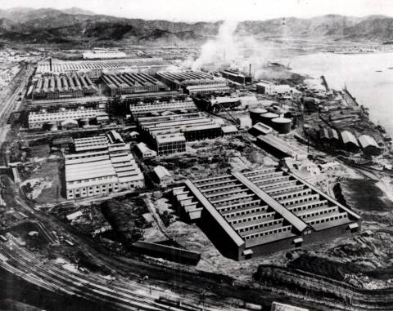
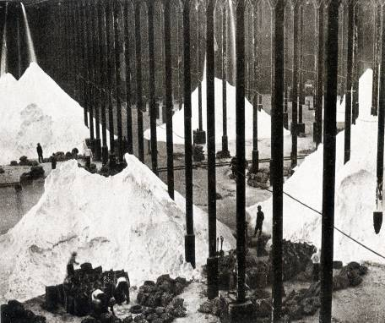
III. Ordeals at Hungnam Labor Camp
(February 22, 1948 - October 14, 1950)
Three-months in Pyongyang and Transfer to Hungnam
To reform people – to work people to death
April 7 Hearing: Sent off by members
(On the cross: Mary Magdalene, mother of Jacob and Joseph, or the mother of the sons of Zebedee)
Transferred to Hungnam's Bon-goong Camp for Special Laborers (3 pm, May 20 ~ June 21)
Father asked to be hand-cuffed to a murderer (Symbolizes death, Simon of Cyrene)
Piles of ammonia sulfite at the Hungnam fertilizer plant
View of Nitrogen Fertilizer Company’s Hungnam plant
Notes:
III. 흥남노무자 수용소 수난(1948.2.22-1950.10.14)
B. 평양체류 3개월 수난과 흥남 이송
5.교화시키는 곳 - 죽일사람을 노동시키는 곳
6.4.7,공판 - 식구들의 전송
(십자가 선상: 막달라 마리아, 야고보와 요셉의 어머니
또 세베대의 아들들의 어머니)
7. 흥남 본궁특별노무자수용소 이송(5.20,15:00경~6.21)
살인수와 수갑차기 자원(죽음상징,구레네 사람 시몬)

Slide 17
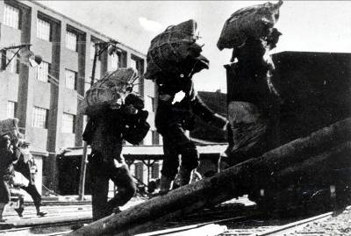
III. Ordeals at Hungnam Labor Camp
(February 22, 1948 - October 14, 1950)
Imprisoned at Hungnam Deok-ri Special Labor Camp
(June 21, 1948 - October 14, 1950)
Appalling forced labor at Hungnam fertilizer plant
Each team of ten people responsible to bag one thousand three hundred bags; dozens of inmates died every day
Total investment in the work; volunteered for the most difficult tasks (Took on labor work without succumbing to disease or death)
Gave away half of his rations for three weeks; ate buckwheat rice balls (December 14 – 28, 1949) Honored as a model prisoner (official recognition from Satan)
Notes:
III. 흥남노무자 수용소 수난(1948.2.22-1950.10.14)
C. 흥남 덕리 특별노무자 수용소 수감(1948.6.21-1950.10.14)
1. 흥남 비료공장의 처참한 강제노동
2. 10명 1개조 1300가마니 암모니아비료 퍼담기
하루에도 몇 십명씩 죽어감
3. 전심전력 투입, 가장 어려운 일 자청
(죽음의 병마앞에서도 굴하지않고 노동감래)
4. 3주간 절반식사,모밀 주먹밥 (49.12.14-28)
감옥 안에서의 모범상 수상(사탄앞에 공인)

Slide 18
III. Ordeals at Hungnam Labor Camp
(February 22, 1948 - October 14, 1950)
C. Imprisoned at Hungnam Deok-ri Special Labor Camp
5. Choong-mo nim's visits / Ok Se-hyeon’s visits – hair
(Distributing to other inmates what Choong-mo nim had brought in her presence)
* Jesus – To Mary, his mother (John 2:4)
“Dear woman, why do you involve me?”
* True Father – To Choong-mo nim
Father was more concerned of God: ”Do not cry for me as your son. When I shed tears amidst death in prison, the Father in heaven is shedding tears of blood for this pitiable child.”
(Father severed the bond of affection of his physical parents and instead resolved to focus on God)
Notes:
III. 흥남노무자 수용소 수난(1948.2.22-1950.10.14)
C. 흥남 덕리 특별노무자 수용소 수감
5. 김경계충모님 방문 / 옥세현방문-머리카락
(충모님 보는 앞에서 옷 지어준 것을 다른 죄수에게)
* 예수님 – 어머니 마리아에게:요2:4
여자여, 당신과 내가 무슨 상관이 있습니까?
* 참아버님 - 충모님에게
“나를 당신의 아들로 취급하고 울지 마소, 내가
감옥에서 죽음가운데서 눈물흘릴 때, 하늘에 계신
내 아버지는 이 못난 자식을 위해 피눈물을 흘리십
니다.” 하고 오히려 하늘이 걱정하실까봐 염려하셨
다고 한다.
(인간적인 부모의 정도 끊고 하늘염려와 결의)

Slide 19
III. Ordeals at Hungnam Labor Camp
(February 22, 1948 - October 14, 1950)
Imprisoned at Hungnam Deok-ri Special Labor Camp
(June 21, 1948 - October 14, 1950)
6. How Father survived Hungnam
On the restored foundation built on forty years of indemnity by the Korean people
Course to separate Satan similar to the offering of the pigeon and Isaac (June 25)
Paying indemnity for the betrayal of the government and John-the-Baptist figures
Finding disciples in prison
Found disciples through the works of the spirit world; had a core of 12 – 24 disciples
Notes:
III. 흥남노무자 수용소 수난(1948.2.22-1950.10.14)
C. 흥남 덕리 특별노무자 수용소 수감(1948.6.21-1950.10.14)
6. 흥남에서 살아나신 배경
● 민족적 40년 탕감복귀터전
● 비둘기와 이삭번죄처럼 사탄분립노정(6.25)
● 정권과 세례요한격 책임자들의 불신 몸소 탕감
● 옥중 제자 전도
영계역사로 제자전도, 12명-24명 결속

Slide 20
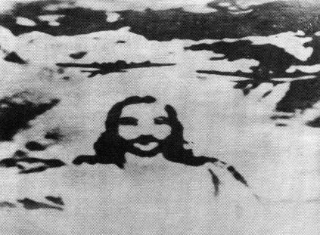
III. Ordeals at Hungnam Labor Camp
(February 22, 1948 - October 14, 1950)
June 25 was a Holy War for the purpose of rescuing the messiah. (UN bombing began at 2 am October 14, 1950, United nations Peace Forces of the Korean War Memorial Federation (December 13, 2004)
Symbolizing Jesus’ resurrection three days after his death and the resurrection of the Second Advent
  Photo of Jesus’ image caught in the airs of North Korea by a US fighter pilot
  (Published on “PARIS MATCH”)
Notes:
III. 흥남노무자 수용소 수난(1948.2.22-1950.10.14)
D. 6.25는 메시아 구출을 위한 성전이었다.
(유엔폭격 50.10.14.02:00, 유엔성전추모연합회 (2004.12.13)
미군전투기 조종사가 우연히 찍은 북한 상공에 현현한 예수
(“PARIS MATCH”지 게재)

Slide 21
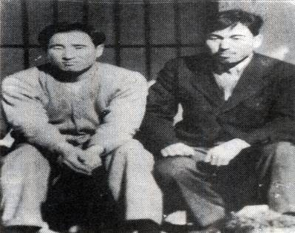
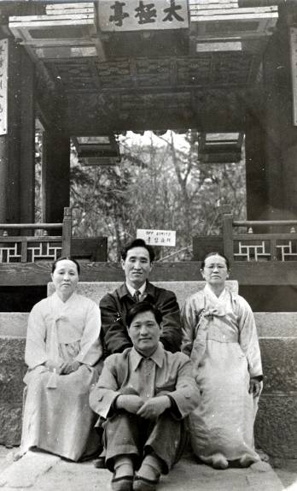
IV. From Hungnam to Busan and Freedom
(October 14, 1950 - January 27, 1951)
From Hungnam to Pyongyang and 40 days in Pyongyang
Arrived after ten days with only prison clothes and powder made of mixed grains.
Looking for members in Pyongyang for forty days.
Went south with Park Chung-hwa and Kim Won-pil.
Notes:
IV. 흥남에서 부산까지 자유남하(1950.10.14-1951.1.27)
A. 흥남에서 평양귀환과 평양체류 40일
1.수의와 미숫가루를 가지고 걸어서 10일 만에 도착
2.40일 동안 평양에서 전도한 모든 식구 찾음.
3.박정화를 대동하고 김원필과 함께 남하.

Slide 22
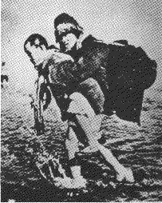
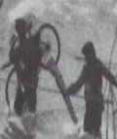
IV. From Hungnam to Busan and Freedom
(October 14, 1950 - January 27, 1951)
From Pyongyang to Seoul (December 4 - 27, 1950)
Result of course in North Korea:
One man and three women
2. Traveling to Yongmae Islands
Father carried Park Chung-hwa on his back and walked 4km to Yongmae Islands under dire circumstances and then back again
Only relatives of soldiers were permitted on the boats
From Pyongyang to Seoul (December 4 – 27): Warm reception prepared after receiving a revelation
Notes:
IV. 흥남에서 부산까지 자유남하 (1950.10.14-1951.1.27)
B. 평양에서 서울까지(1950.12.4-12.27)
1. 이북 노정의 결과: 한 남자와 세 여자
2. 용매도 왕복 일화
a. 4Km의 거리인 용매도까지 박정화를 업고
왕복걷기, 한번빠지면 나오기 어려운 조건
b. 군인 가족이 아니라서 뱃길로 남하 포기
c. 평양-서울(12월 4일~27일) 몽시로 환대

Slide 23
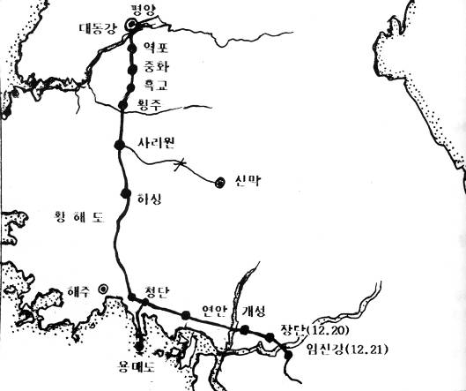
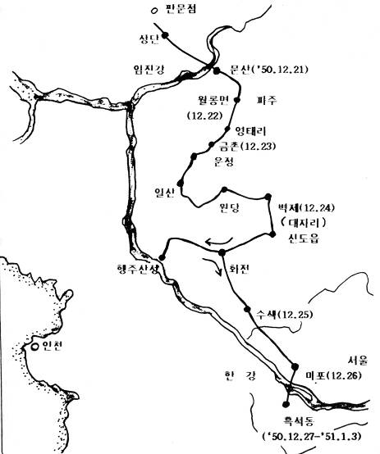
From Imjin River to Heukseok-dong
(December 21 - 27, 1950)
From Pyongyang to Imjin River (December 4 - 21, 1950)

Slide 24
IV. From Hungnam to Busan and Freedom
(October 14, 1950 - January 27, 1951)
C. One week in Seoul (December 27, 1950 - January 3, 1951)
Stayed at Kwak No-pil’s house in Heukseok-dong for one week.
Called up for military service and physical examination: Class C (December 31, 1950)
Certificate of refugee status issued by Yoo Hong, head of peace-keeping forces.
Found letter at Kwak No-pil house
On the path of refugee headed for Kwak No-pil’s house in Busan.
Notes:
IV. 흥남에서 부산까지 자유남하(1950.10.14-1951.1.27)
C. 서울에서 1주간 체류(1950.12.27-1951.1.3)
1. 흑석동 곽노필 집에서 1주간 머무심.
2. 국민방위군 병역소집을 위한 신검에서 병종(1950.12.31)
3. ‘유홍’(柳鴻) 치안대장에게서 피난민 증명서를 발급.
4. 곽노필 집에서 편지 발견
5. 부산의 곽노필 집을 목적지로 피난길에 오르심.

Slide 25
IV. From Hungnam to Busan and Freedom
(October 14, 1950 - January 27, 1951)
D. From Seoul to Busan (January 4 - 27, 1951)
Departed with Class C certificate and refugee certificate.
Took the Joongang line instead of Gyeongbu line.
Separated from Park Chung-hwa at Gyeongju.
Getting a free ride in a freight car to Busan arriving at Choryang Station.
Notes:
IV. 흥남에서 부산까지 자유남하 (1950.10.14-1951.1.27)
D.서울에서 부산으로(1951.1.4-1.27)
1. 병종확인서와 피난민 증명서 지참하고 떠남.
2. 경부선이 아니라 중앙선을 따라서 감
3. 경주에서 박정화와 헤어짐.
4. 부산까지는 화차로 이동하여 초량역에 도착.

Slide 26
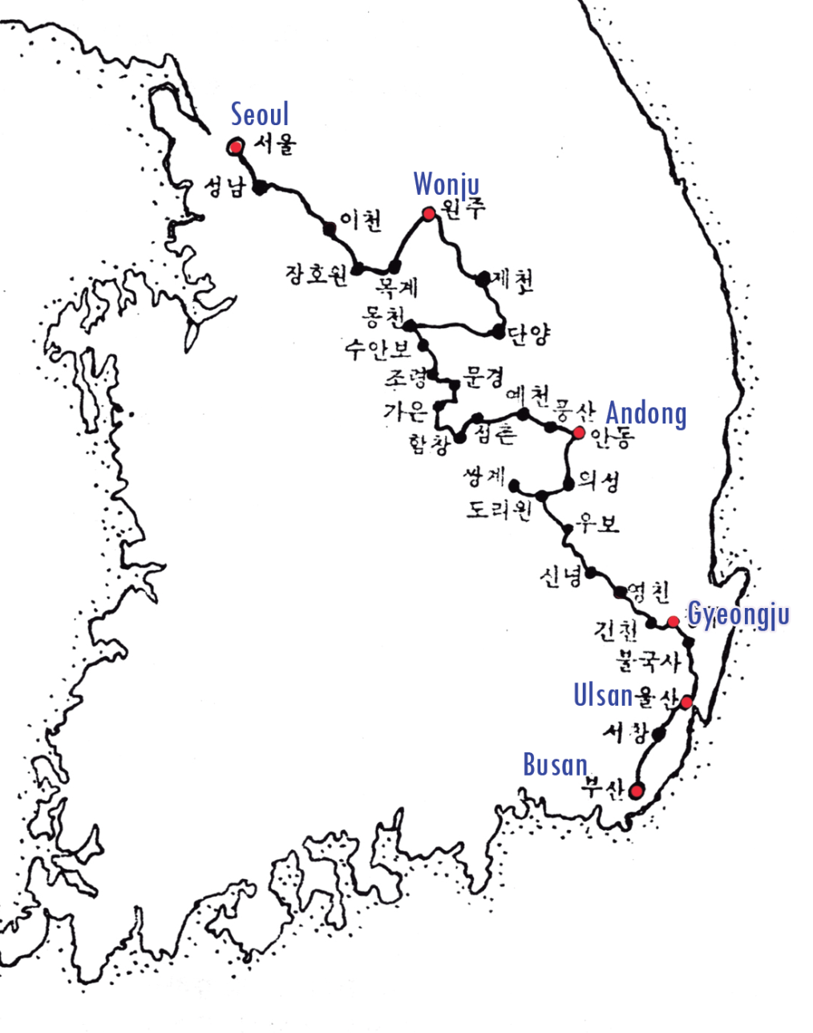
From Seoul to Busan (January 3 - 27, 1951)

Slide 27
V. Refugee Years in Busan
(January 27, 1951 September 7, 1953)
A. Refugee’s joys and sorrows (January 27 – August 1951)
Father’s appearance when he arrived at Busan
Stayed for three days at the home of newly-wed Kwak No-pil
Meeting Eom Deok-moon
Hunger during refugee life
Beginning to write the first Divine Principle (May 11, 1951)
Busan laborers' camp
Luke 9:58, "Foxes have holes and birds of the air have nests, but the Son of Man has no place to lay his head.”
Notes:
V. 부산 피난 시절 (1951.1.27-1953.9.7)
A. 애환이 서린 미 정착 피난민 생활(1951.1.27-8월)
1. 부산 도착시의 형체
2. 곽노필 신혼 집에서 3일간 기거
3. 엄덕문씨와 만남
4. 배고픈 피난민 시절
5. 원리원본 집필시작 (1951.5.11)부산노무자 수용소
눅9:58, 여우도 굴이 있고 공중의 새도 집이
있으되 인자는 머리 둘 곳이 없도다.

Slide 28
V. Refugee Years in Busan
(January 27, 1951 September 7, 1953)
B. Preparing new beginning at cardboard hut at Beomnetgol
Built cardboard hut at 1513 Beomil 4 district, Dong-gu, Busan City (August 1951)
Painting portraits and contacting members who were in North Korea
Yearning for God, humankind and creation
Completion of the first Principle text (May 11, 1951 - May 10, 1952)
Kang Hyun-shil (May 10, 1952) and Rev. Lee Yo-han (December 1, 1952)
Notes:
V. 부산 피난 시절(1951.1.27-1953.9.7)
B. 범냇골 토담집에서 재출발 준비
1. 토담집 건축, 부산시 동구 범일4동 1513번지(1951.8)
2. 초상화 부업과 이북식구를 찾은 후 집으로 연락
3. 하나님, 인간, 만물을 그리워함.
4. 원리원본 집필과 탈고 (1951.5.11-1952.5.10)
5. 강현실 전도사(52.5.10)와 이요한 목사(52.12.1)입교

Slide 29
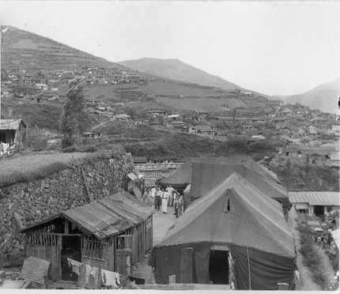
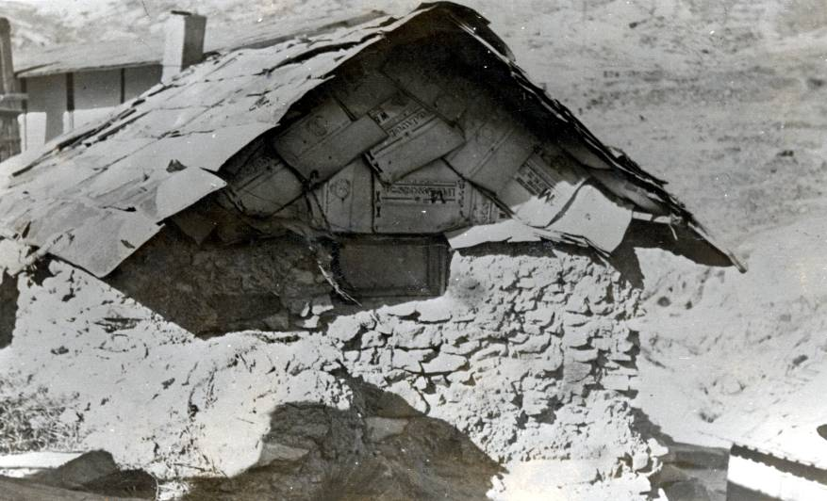
Cardboard hut at Beomnetgol

Slide 30
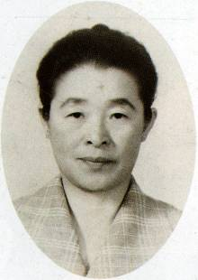
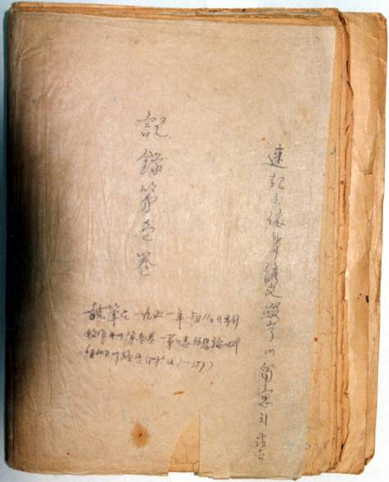
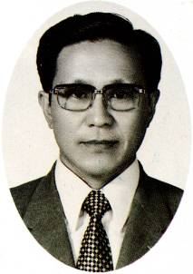
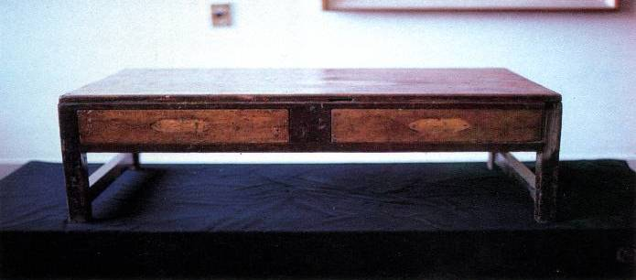
Ms. Kang Hyun-shil
First volume of the first Principle text
Rev. Lee Yo-han
Desk used in writing the first Principle text

Slide 31
V. Refugee Years in Busan
(January 27, 1951 September 7, 1953)
Ordeals at Soojeong district and spread of witnessing (January - September 17, 1953)
Elder Lee Bong-woon and six family members join (April 14, 1953)
Pioneer mission in Daegu and sending missionaries Kang Hyun-shil (July 20, 1953); Lee Yo-han (Mid-August 1953)
Armistice Agreement ending the Korean War (July 23, 1953)
Holy Grounds at Beomnetgol, Busan
Notes:
V. 부산 피난 시절(1951.1.27-1953.9.7)
C.수정동 수난과 전도 확산(1953.1-9.17)
1. 이봉운 장로의 6가족 입교 (1953.4.14)
2. 대구 개척과 최초의 선교사 파송
강현실(1953.7.20); 이요한(1953.8. 중순)
3. 한국전쟁 휴전: 1953.7.23
4.부산 범냇골 성지소개

Slide 32
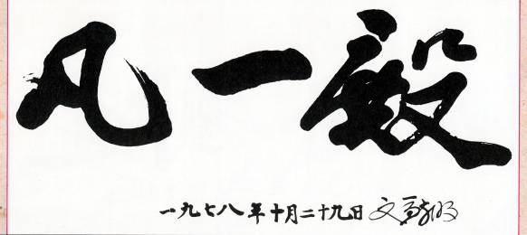
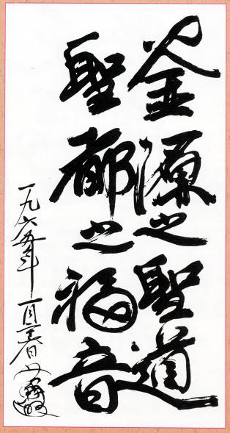
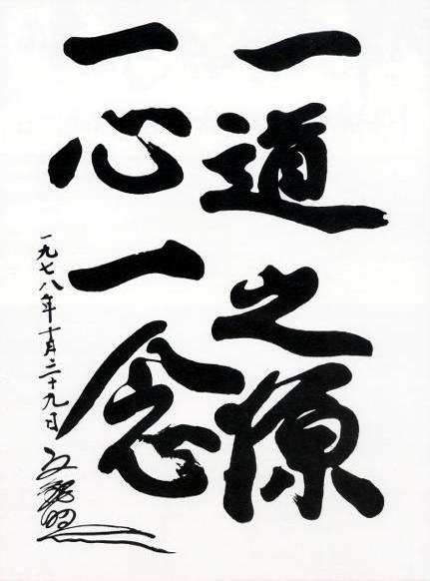
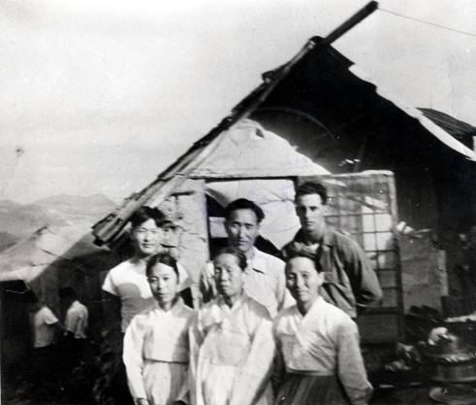
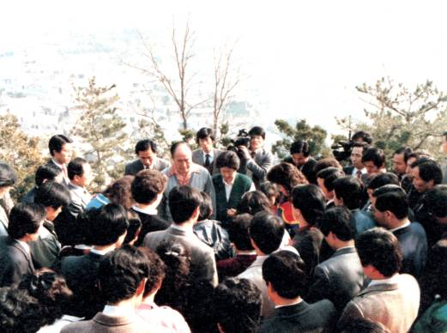
V. Refugee Years in Busan
(January 27, 1951 September 7, 1953)
부 원 지 성 도 성 도 지 복 음
일 도 지 원 일 심 일 념
Summer of ‘52

Slide 33
VI. Providence Leading to the Founding of Our Church
(September 17, 1953 – May 1, 1954)
A. Foundation centered on Busan, Daegu and Seoul.
B. Severe persecution in Daegu / spiritual phenomena
C. Eu Hyo-won joins in Busan
D. Visit with disciples to and rejection by Na Woon-mong Elder in Yongmoon Mountain
Notes:
VI. 협회창립 직전의 섭리(1953.9.17-1954.5.1)
A.부산,대구,서울 중심한 기반
B.핍박이 심한 대구/영적인 현상
C.부산에서 유효원 전도
D. 제자들과 용문산의 나운몽 장로방문과 거절

Slide 34
XII. Lessons To Be Learned
Despite the foundation of victory in WWII, US and Korean leaders did not fulfill their responsibility.
Satan invaded the forty year condition of separation; a fratricidal war was fought for three years in order to separate from Satan, similar to the offering of Isaac.
John-the-Baptist figures who were prepared failed to fulfill their responsibility. (Testified about Father but failed to follow him.)
Messiah’s first mission was to survive.
Bitter resentment of six thousand years of the messiah having to overcome tribulations with devotion
Notes:
XII.교 훈
1. 2차대전 승리터전에도 미국과 민족적 책임자들의 책임 못함.
2. 40년 탕감복귀 성별 조건은 다시 사탄의 침범, 이삭번죄처럼 3년의
분 립을 위한 민족전쟁을 치루어야 했음.
3. 준비된 세례요한 격 사명자들의 책임절감.
(증거하고 같이 따르지 못함의 반복)
4. 메시아의 제1차 사명은 생존
5. 메시아로서 정성과 고난을 넘어서야하는 6000년 의 한

Slide 35
The End

